Slide 1
Hybrid-Brain: A Test-Driven Spiking Cognitive Architecture
• Integrating reward learning, affect, personality and language
• 63 commits | 17 tagged milestones | 111 tests | 21 architecture decision records
• Every number in this deck regenerates from a command
Notes:
Open with the methodology: test-driven, every acceptance criterion measured, 21 ADRs. The claims are computational, not phenomenal - stated up front.

Slide 2
The integration gap
• Spiking simulators (Brian2, NEST): rigorous neural dynamics,
• but no cognition, affect or behavior loop
• Cognitive agents (ACT-R, Generative Agents): rich cognition,
• but no neural substrate and no reward learning
• Hybrid-Brain: connects spiking cortex -> affect -> personality
• -> behavior in ONE loop, every module traced to literature
Notes:
Name the two families and position between them. The mapping table (next slide) is the evidence of the trace.

Slide 3
Every module traced to cognitive neuroscience
• Dopaminergic RPE -> Schultz, Dayan & Montague (1997) Science
• Place cells -> O'Keefe & Nadel (1978) Cognitive Map
• Somatic markers -> Damasio (1996) Phil Trans R Soc B
• Selective attention -> Posner & Petersen (1990) Annu Rev
• Habit vs goal -> Balleine & Dickinson (1998) Neuropharm
• Full table: docs/neuroscience_mapping.md (20+ modules)
Notes:
Point to the repo file live if needed. Supporting refs marked honestly in the table.

Slide 4
Methods honesty: measurement over derivation
• LIF neurons + E/I synapses, validated against Brian2
• f-I threshold: computed 0.93 (theory) vs measured 10-20
• The measurement superseded the derivation - recorded as a
• methodological rule: data over derivation
• Amplifies to every module: acceptance by number, not claim
Notes:
This slide pre-empts the 'is it rigorous' question. The calibration test that settled a two-theory dispute is in tests/ and git history.

Slide 5
Implemented brain regions
• Thalamus: deterministic sensory relay
• Hippocampus: place cells (2D Gaussian fields)
• Amygdala: threat conditioning, dopamine-gated 3-factor rule
• Cortex6: six layers, homeostatic row-sum feedforward
• Basal ganglia: Go/No-Go channels, cross-inhibition
• PFC: recurrent working memory with delay persistence
Notes:
Each region passed sweep or acceptance tests; cortex6 was tuned via a 16-combo sweep (tune_cortex.py).

Slide 6
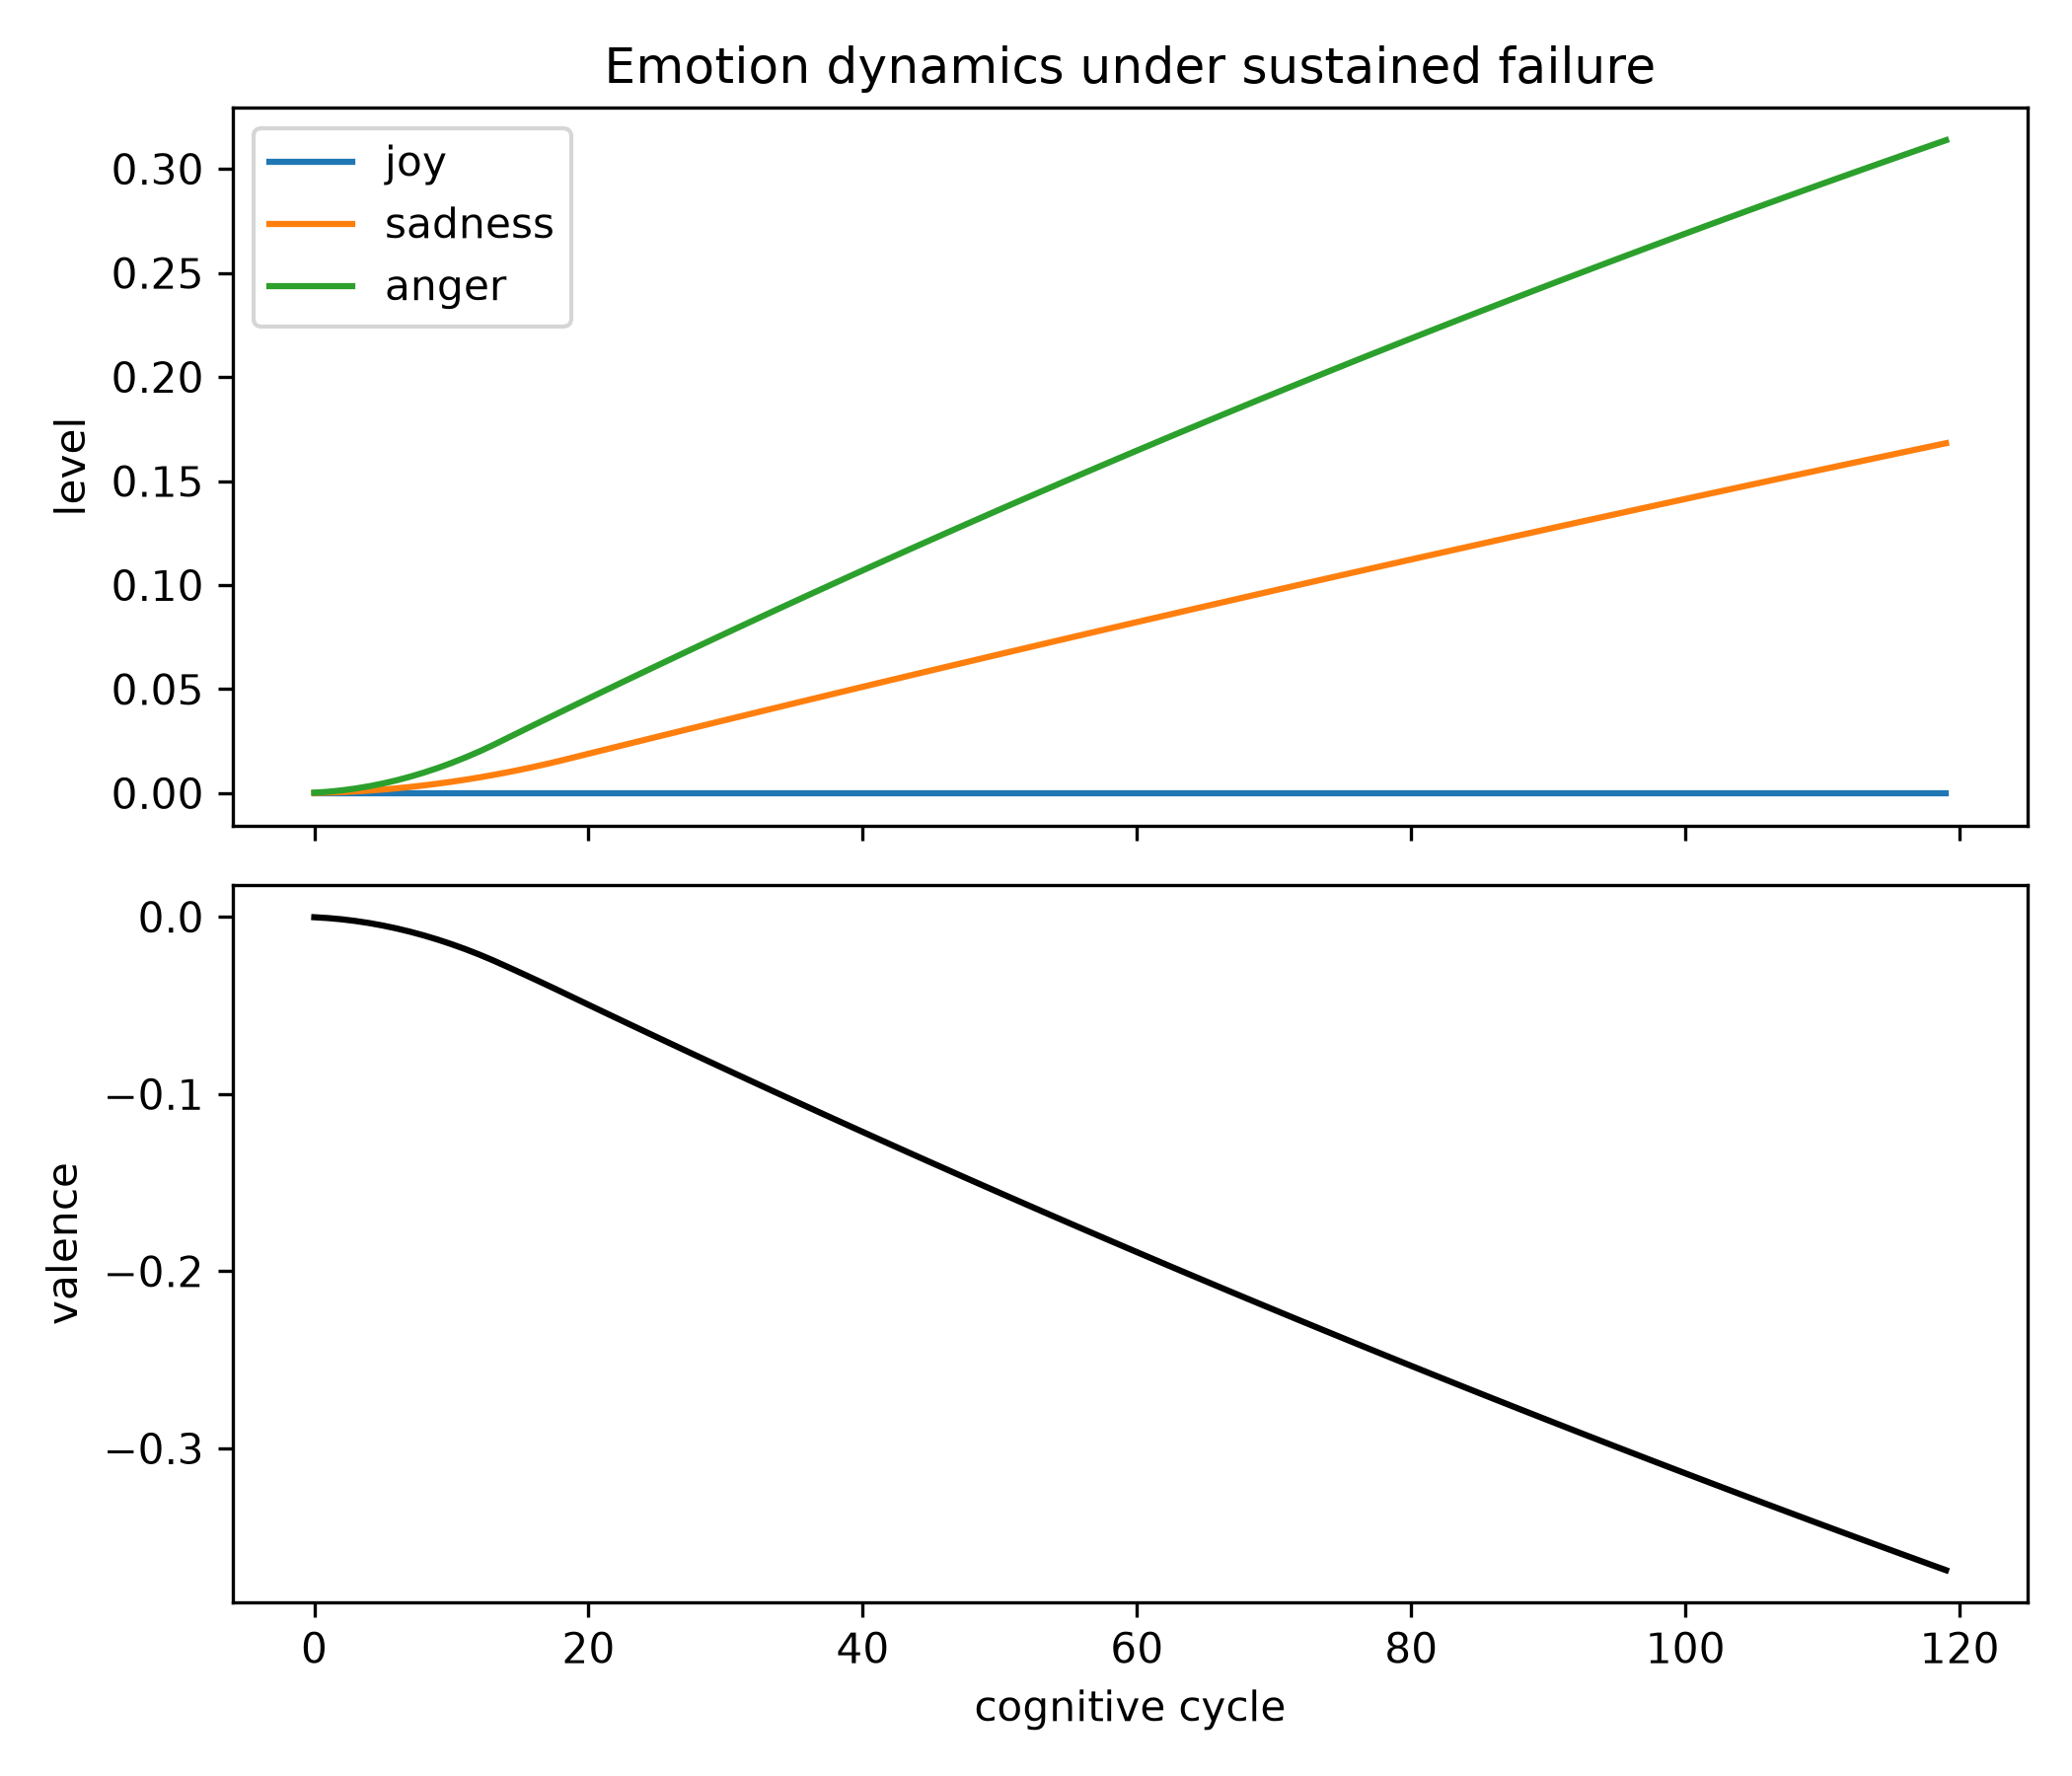
Emotion dynamics under sustained failure
• Six Ekman emotions with timescale hierarchy:
• dopamine ~100ms | emotions 2-30s | moods ~hours (ADR-012)
• sadness (tau 30s) rises slowly and persists; anger faster
• (blocked-escape profile) - matches figure
Notes:
The hierarchy is TESTABLE (test_timescale_hierarchy) and was the tripwire that caught a real regression.

Slide 7
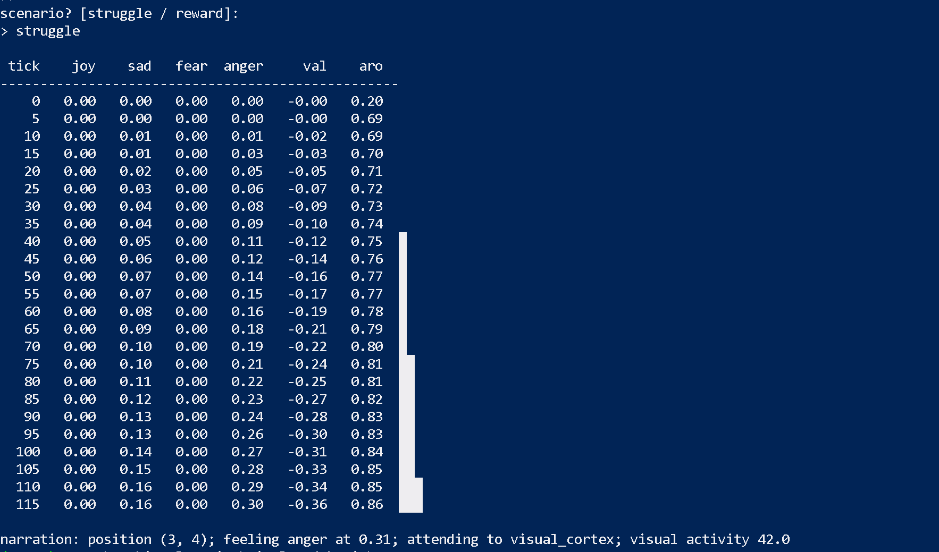
Live affect monitor + narration
• struggle scenario: sadness 0->0.16, anger 0->0.30
• valence -0.36, arousal 0.86 (measured run)
• Narration reflects the dominant emotion - telemetry in
• language, per ADR-018
Notes:
The screenshot is a real run. If asked: the emotion levels feed somatic markers which bias action values.

Slide 8
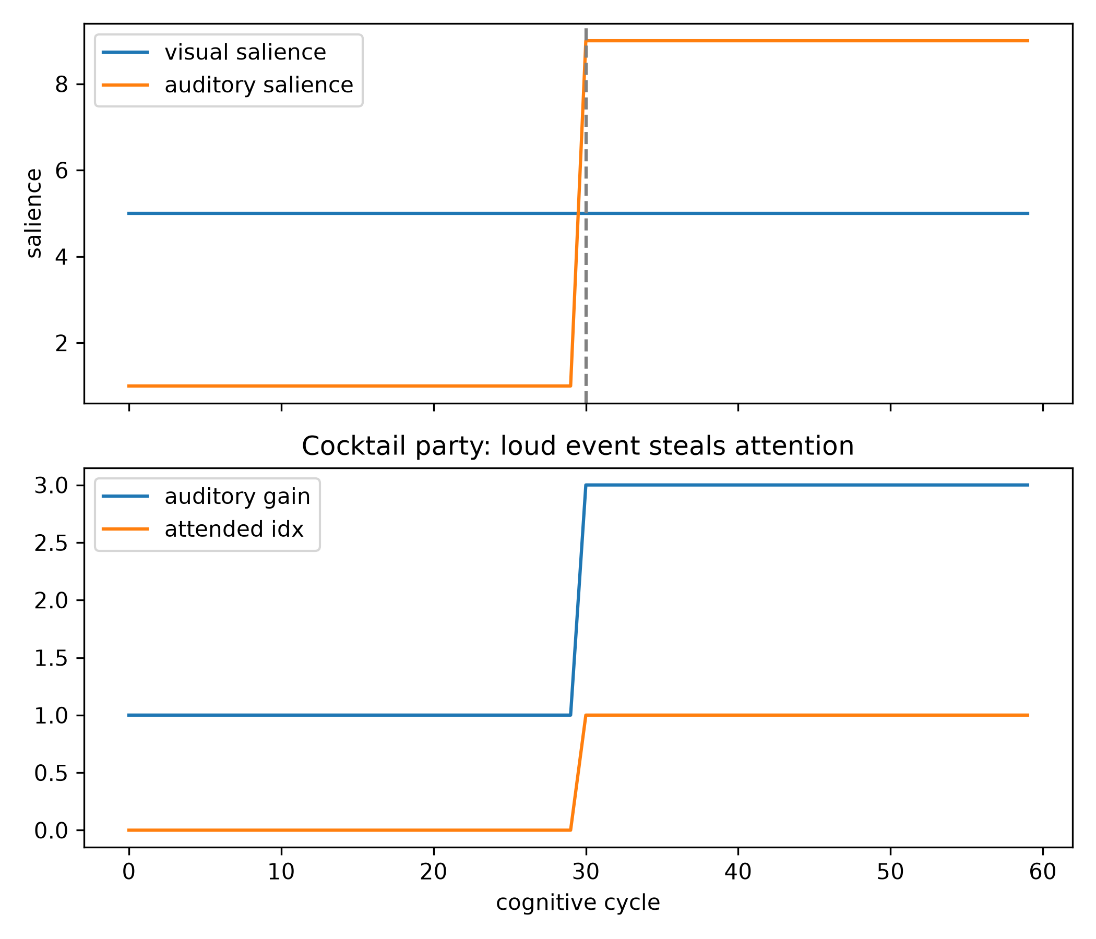
Selective attention with two real streams
• Visual cortex vs auditory stream, genuinely competing
• Attended stream gets 3x gain; dwell prevents flicker
• Loud auditory event STEALS attention after dwell
• Posner & Petersen (1990) networks, implemented
Notes:
The steal is deterministic and test-verified (test_loud_event_steals_attention).

Slide 9
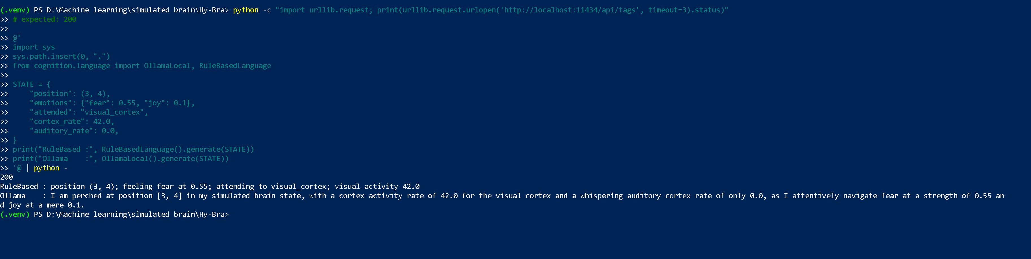
Language narrates, never decides (ADR-018)
• An LLM that acts = an untrained foreign brain: outside RPE,
• plasticity, consolidation - nothing teaches it
• Language = READ-ONLY telemetry: consumes GlobalWorkspace,
• emotions, attention; emits first-person narration
• First spoken sentence from real brain state
Notes:
This boundary protects the attribution chain - the 'why this action' question stays answerable.

Slide 10
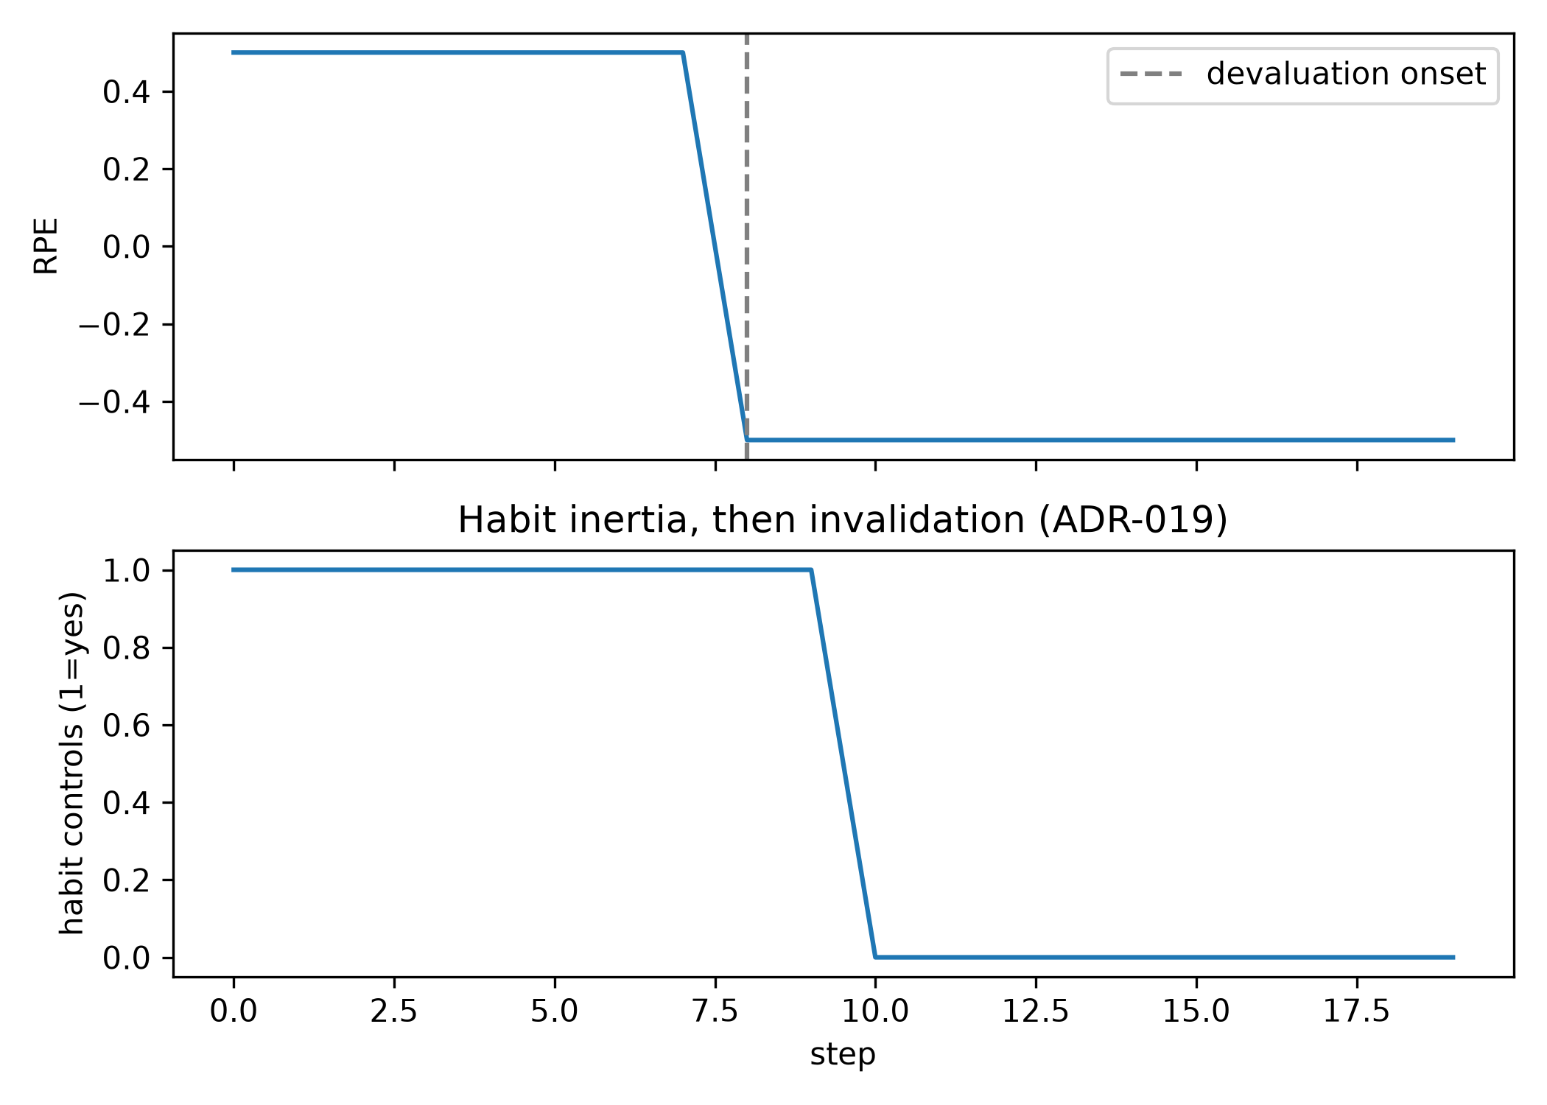
Habit vs goal-directed dissociation (ADR-019)
• Habits form only on LOW RPE-variance (stable values)
• Ballistic execution: no value lookup, no BG call
• Under reward devaluation: inertia persists, then an
• accumulated-error detector invalidates the cache
• Balleine & Dickinson (1998); Yin & Knowlton (2006)
Notes:
The dissociation is the point: two control regimes, measurably different. Dossier Q7 extends this.

Slide 11
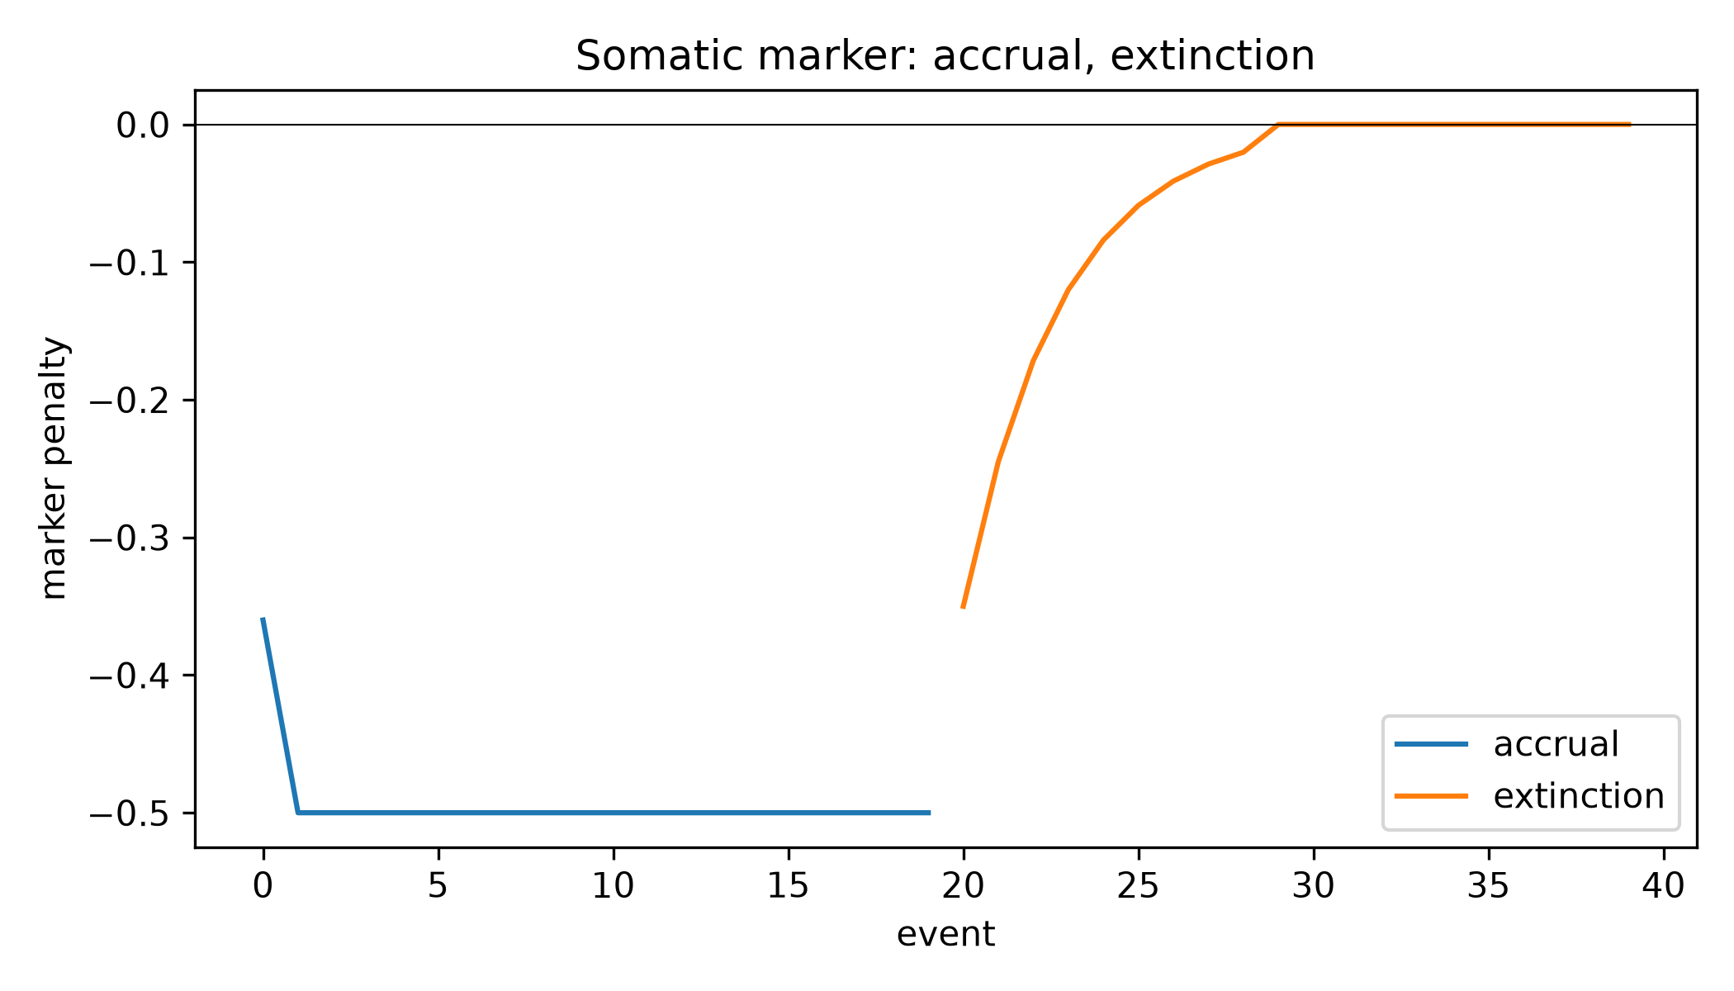
Somatic markers bias decisions (Damasio 1996)
• Punishment + arousal accrue a bounded position penalty
• Read-time bias on action utilities - never written into
• the value table (extinction snaps to zero past threshold)
• Ablation-tested: avoidance with ZERO navigation cost
Notes:
Week 18 acceptance: ON-arm 0/10 vs OFF-arm 10/10 visits to the punished region, eval goals 10/10 both arms.

Slide 12
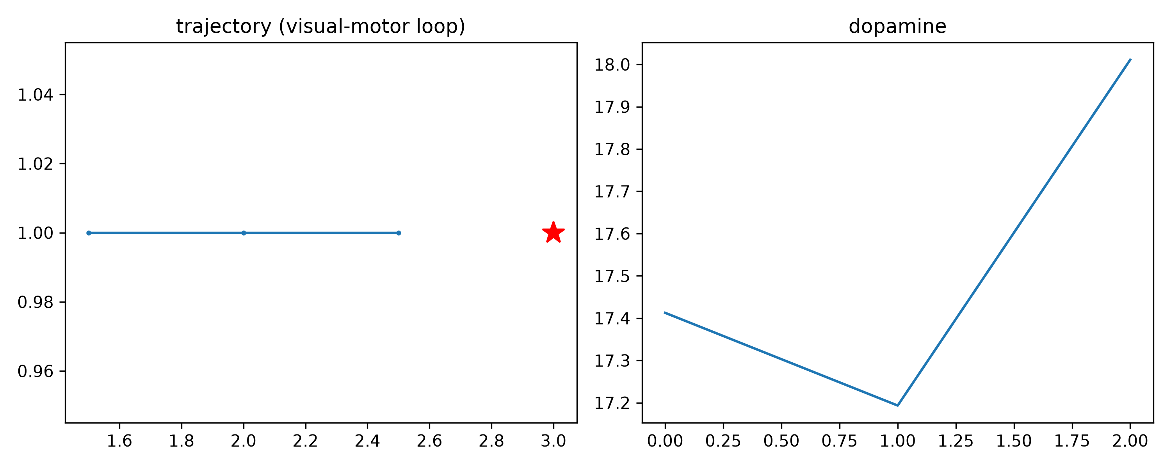
Visual-motor closed loop
• VisualWorld render -> MobileNet features -> six-layer cortex
• -> attention -> Q(cell, action) -> MotorActuator -> reward
• Best evaluation trajectory: distance 1.50 -> 0.50
• Honest scope: decision via proven Q-table; neural readout
• live in-loop and logged
Notes:
The scope note is deliberate - attribution clarity over claim inflation. Full neural readout is future work.

Slide 13
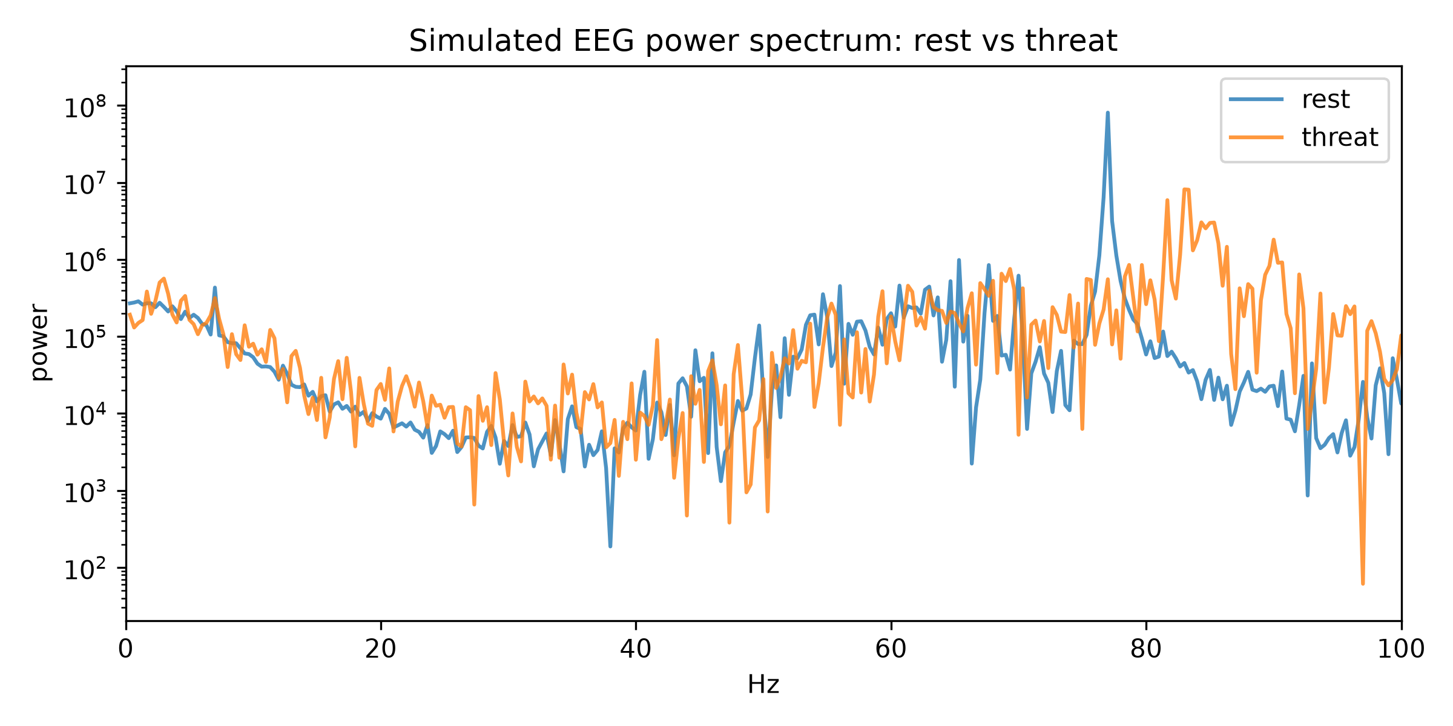
Simulated EEG: rest vs threat
• Region activity -> 10-20 montage channels -> FFT band power
• Threat shifts BETA power x1.94 (stress-EEG consistent)
• LIMITATION stated: rest gamma inflated by constant 75Hz
• drive; simulated EEG proxy, not a scalp forward model
Notes:
State the limitation BEFORE being asked. The gamma refinement (rhythmic rest drive) is future work.

Slide 14
Honest limitations
• Affect is COMPUTATIONAL, not phenomenal - no qualia claim
• Rat-scale abstractions: grid world, tone events
• Single-seed measurements; test-retest pending
• EEG is a simulated proxy; gamma baseline limitation
• Scope decisions recorded: ADR-006, ADR-020, ADR-021
• (superhuman features deferred, not silently cut)
Notes:
This slide builds credibility with academics - the limitation list is as important as the claims.

Slide 15
Reproducibility
• 63 commits, 17 tags, 111 tests, 21 ADRs
• Seed registry: every RNG seed scanned and documented
• Figure regeneration: one command each (make_figures,
• eeg_simulator, demo_month6)
• Repository: github.com/esmaeilireza/Hybrid-Brain
Notes:
Close: every number shown today regenerates from a command. Invite the committee to run the suite.

