Slide 1
Conducting Multivariate Meta-Analysis in R with metavcov
Min Lu
Research Assistant Professor of Biostatistics University of Miami Miller School of Medicine
ESMARCONF2023

Slide 2












Univariate vs Multivariate Meta-Analysis
Univariate Meta-Analysis
Multivariate Meta-analysis (MMA)
Study 1
Study 1
Study 2
…
Study n
$${\hat{α}}_{1},{SE}_{1}$$
Outcome 1
Study 2
$${\hat{α}}_{2},{SE}_{2}$$
$${\hat{α}}_{meta},{SE}_{meta},P_{meta}$$
…
$${ ({\hat{α}}_{1},{\hat{β}}_{1})}^{T},⅀_{1}$$
$${ ({\hat{α}}_{2},{\hat{β}}_{2})}^{T},⅀_{2}$$
$${ ({\hat{α}}_{n},{\hat{β}}_{n})}^{T},⅀_{n}$$
Study n
$${\hat{α}}_{n},{SE}_{n}$$
Study 1
$${\hat{β}}_{1},{SE}_{1}$$
$$({\hat{α}}_{meta},{\hat{β}}_{meta}),⅀_{meta},P_{meta}$$
Outcome 2
We need
covariances between outcomes
Study 2
$${\hat{β}}_{2},{SE}_{2}$$
$${\hat{β}}_{meta},{SE}_{meta},P_{meta}$$
…
Study n
$${\hat{β}}_{n},{SE}_{n}$$

Slide 3
Why MMA?
Combining different outcomes (effect sizes) across studies to:
Estimate the overall effects simultaneously
Explore relationships among outcomes
Improve power

Slide 4
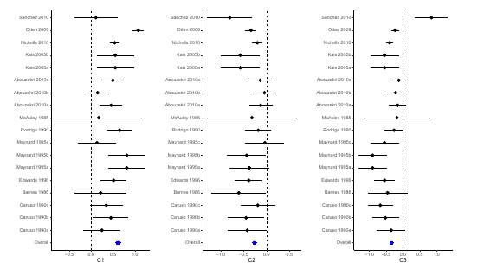
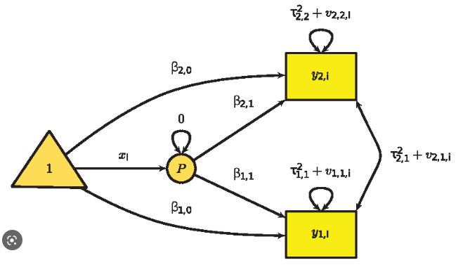
Different tools in R for MMA
Step1: Model preparation with metavcov
Computing Within-Study Covariances Missing Data Solutions
Multivariate Meta-analysis (MMA)
Study 1
Study 2
…
Study n
$${ ({\hat{α}}_{1},{\hat{β}}_{1})}^{T},⅀_{1}$$
$${ ({\hat{α}}_{2},{\hat{β}}_{2})}^{T},⅀_{2}$$
$${ ({\hat{α}}_{n},{\hat{β}}_{n})}^{T},⅀_{n}$$
Step 2: Model fitting with mixmeta or metaSEM
$$({\hat{α}}_{meta},{\hat{β}}_{meta}),⅀_{meta},P_{meta}$$
Step 3: Visualization with metavcov or metaSEM

Slide 5
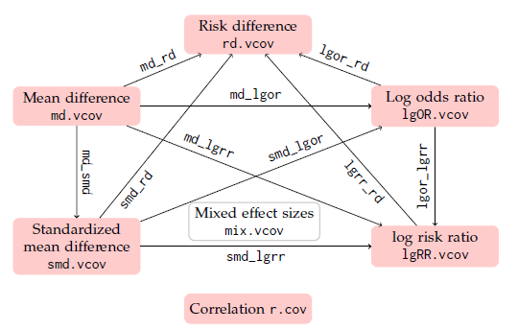

Different tools in R for MMA
Model preparation with metavcov
Different solutions for different types of effect sizes to computing within-study covariances
Model fitting with mixmeta or metaSEM
Same solutions for different types of effect sizes
$$({\hat{α}}_{meta},{\hat{β}}_{meta}),⅀_{meta},P_{meta}$$
Visulization with metavcov or metaSEM
Same solutions for different types of effect sizes
Extra bonus for correlation effect size

Slide 6
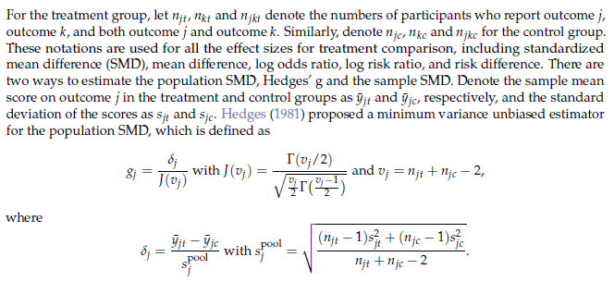
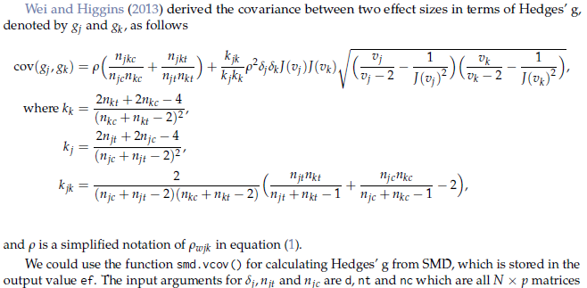
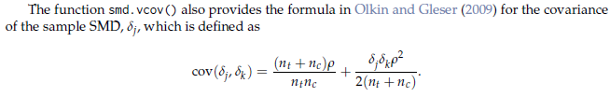
Examples in R --- Standardized mean difference (SMD)
Y. Wei and J. P. Higgins. Estimating within-study covariances in multivariate meta-analysis with multiple outcomes. Statistics in Medicine, 32(7):1191–1205, 2013.
I. Olkin and L. Gleser. Stochastically dependent effect sizes. The handbook of research synthesis and meta-analysis, pages 357–376, 2009.

Slide 7
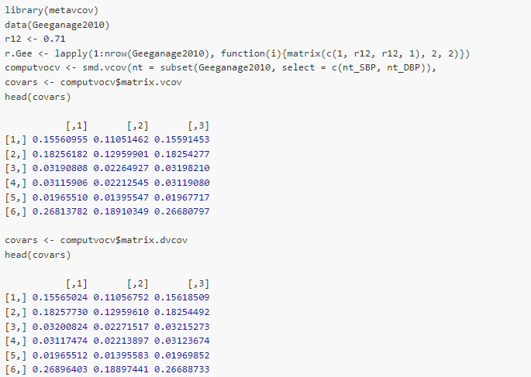
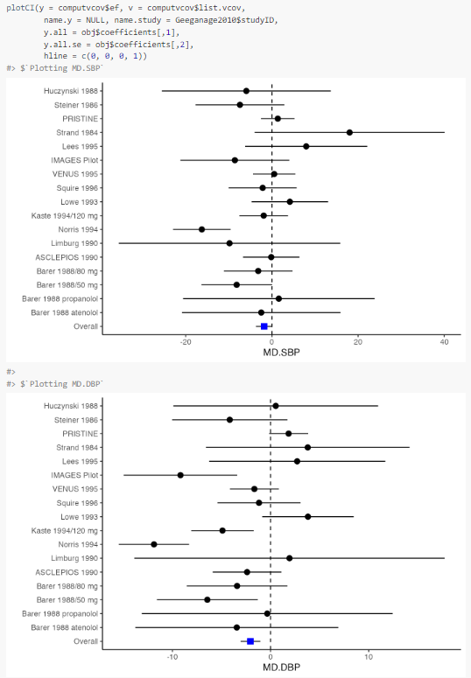
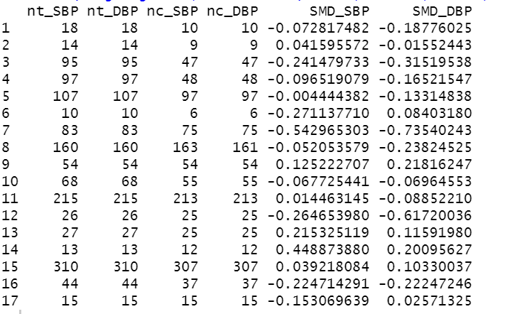
Examples in R --- Standardized mean difference (SMD)
In a meta-analysis, Geeganage and Bath (2010) studied whether blood pressure should be actively altered during the acute phase of stroke, and assessed the effect of multiple vasoactive drugs on BP in acute stroke nt: sample size of the treatment group nc: sample size of the control group SBP: systolic blood pressure in mHg
DBP: diastolic blood pressure in mHg

Slide 8
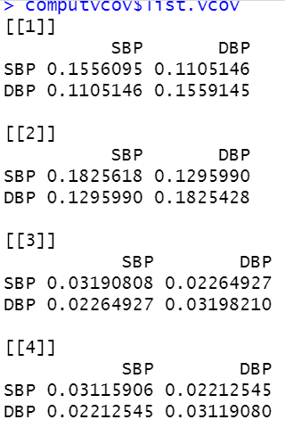
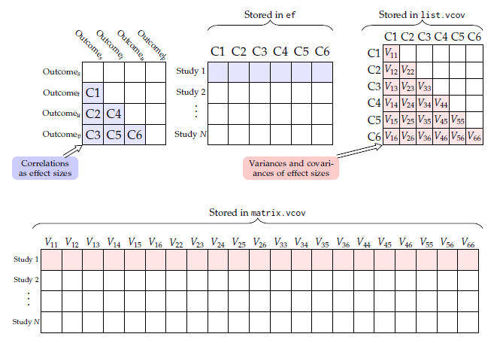
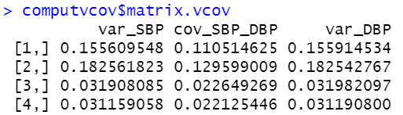
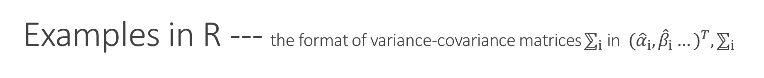
Examples in R --- the format of variance-covariance matrices $⅀_{i}$ in ${ ({\hat{α}}_{i},{\hat{β}}_{i}…)}^{T}, ⅀_{i}$
Some package needs a list of N matrices for N studies
Suppose we have 6 outcomes/effect sizes:
Some package needs matrix with k rows of “flattened” variance-covariances for k studies

Slide 9
Model Fitting Types – Fixed Effect vs Random Effect
Fixed Effect
Each study has a “true effect size” shared by all studies
The observed effect sizes in different studies will be distributed around the “true effect size” with a variance that depends on the precision of the different cohorts
Random Effect
The true effect size varies between studies
The studies included in the meta-analysis are assumed to be a random sample reflecting the distribution of true effects

Slide 10
Model Fitting Types – Fixed Effect vs Random Effect
Null hypothesis is that the means of all effect sizes are 0
Fixed effect has higher power than random effect

Slide 11
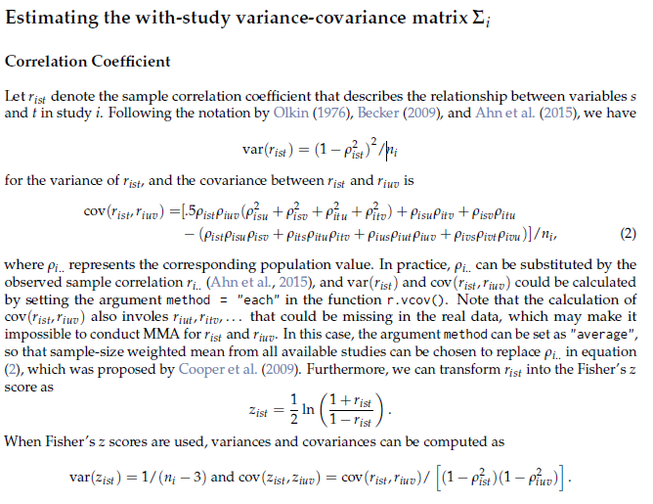
Examples in R --- Correlation coefficients (r)
I. Olkin. Asymptotic distribution of functions of a correlation matrix. chapter 11, pages 235–251. Shinko Tsusho, 1976.
B. J. Becker. Model-based meta-analysis. In H. Cooper, L. V. Hedges, and J. C. Valentine, editors, The handbook of research synthesis and meta-analysis, chapter 20, pages 377–395. Russell Sage Foundation, 2009.

Slide 12
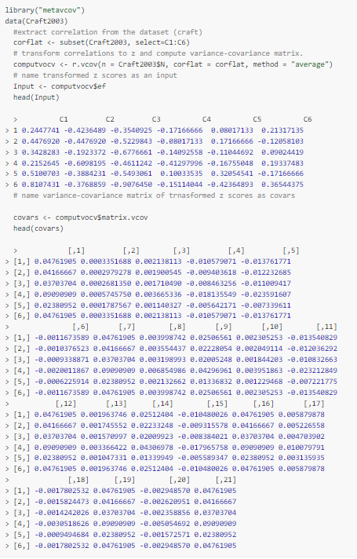
Examples in R --- Correlation coefficients (r)
The primary purpose of Craft et. al.’s (2003) meta-analysis was to examine the interrelationships between athletic performance and three subscales, cognitive anxiety, somatic anxiety, and self-concept, of the Competitive State Anxiety Inventory C1: Correlation coefficient between cognitive anxiety and somatic anxiety
C2: Correlation coefficient between cognitive anxiety and self concept
C3: Correlation coefficient between cognitive anxiety and athletic performance
C4: Correlation coefficient between somatic anxiety and self concept
C5: Correlation coefficient between somatic anxiety and athletic performance
C6: Correlation coefficient between self concept and athletic performance

Slide 13
Examples in R --- metavcov for different types of effect sizes
Function names:
dot --- effect sizes are the same type
--- works with multiple studies
underscore --- two effect sizes of different types
--- works with one study

Slide 14
References
Lu M. (2021). metavcov: Variance-Covariance Matrix for Multivariate Meta-Analysis, R package version 2.1. <m.lu6@umiami.edu>
Gasparrini A. (2019). mixmeta: An Extended Mixed-Effects Framework for Meta-Analysis, R package version 1.2. <antonio.gasparrini@lshtm.ac.uk>
Cheung M. (2015). metaSEM: Meta-Analysis using Structural Equation Modeling. R package version 1.3. <mikewlcheung@nus.edu.sg>
Ahn, S., Lu, M., Lefevor, G.T., Fedewa, A. & Celimli, S. (2016). Application of meta-analysis in sport and exercise science. In N. Ntoumanis, & N. Myers (Eds.), An Introduction to Intermediate and Advanced Statistical Analyses for Sport and Exercise Scientists (pp.233-253). Hoboken, NJ: John Wiley and Sons, Ltd.
Sera F., Armstrong B, Blangiardo M, Gasparrini A. (2019). An extended mixed-effects framework for meta-analysis. Statistics in Medicine. 38(29):5429-5444.
Cheung, M. W.-L. (2015). metaSEM: An R package for meta-analysis using structural equation modeling. Frontiers in Psychology, 5 (1521).
Geeganage, C., & Bath, P. M. (2010). Vasoactive drugs for acute stroke. Cochrane Database of Systematic Reviews 2010(7).
Craft, L. L., Magyar, T. M., Becker, B. J., & Feltz, D. L. (2003). The relationship between the competitive state anxiety inventory-2 and sport performance: a meta-analysis. Journal of Sport and Exercise Psychology, 25(1), 44-65.

Slide 15
Thank you very much!

