Slide 1
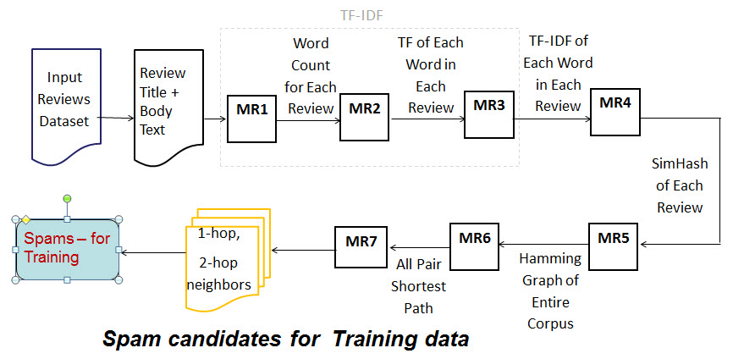
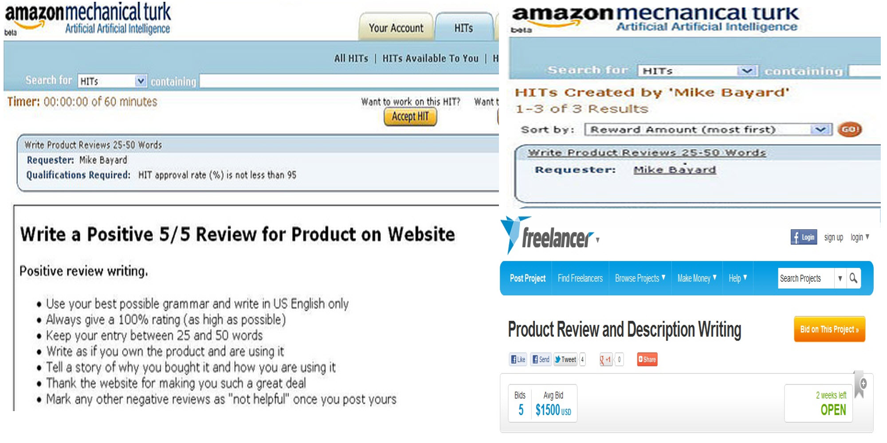
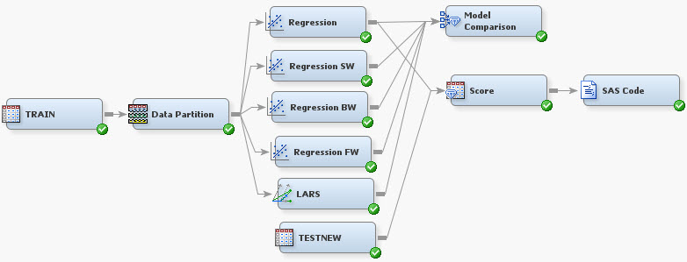
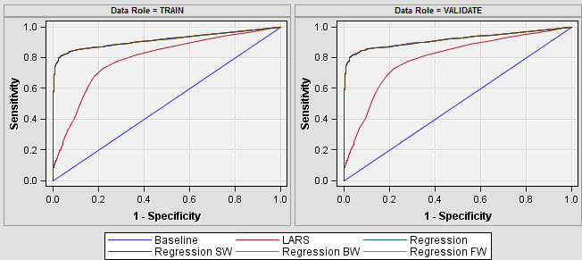
Analyzing Spam in Product Reviews
Abhinav Rai Ramani Madireddy
Motivation
Finding Text Similarity
Feature Extraction
Increasing effect of Reviews on sales
User-added Content:
unmoderated, no quality-control
Feature | Computation
Helpful Feedbacks | Ratio of feedbacks associated with a review
Rating | Rating given by the reviewer
Deviation from Average Reviewer Rating | Average reviewer rating – given rating
Deviation from Average Product Rating | Average product rating – given rating
Poorly written reviews | Reviews with capital letters, numbers
Number of Words | Length of the review
Positive and negative affinity of the review | Number of positive and negative words in a review
Classification - Results & Analysis
Limitations & Assumptions
Limited Feature Availability:
We missed on including some features
- Sales Rank of the product
- Position of the review on product web-page
- Identifying Brand-specific review
- text-similarity with product description
Evaluation of the classification results :
Misclassification rates for model : 0.04500
Input dataset
Normalize features that needed to be
weighted down.
Logistic regression is selected for model building
because of low misclassification rates.
Probability scores ranging from 0-1 given to each
review indicating the likelihood of being a spam.
Reviews with a score
inclined to 0 aren’t spam
and 1 otherwise.
Product reviews from Amazon
5.8 Mil Reviews ,1.2 Mil Products, 2.1 Mil Reviewers
Review: <member id> <product id> <date> <number of helpful
feedbacks> <number of feedbacks> <rating> <title> <body>
Product: <product id> <product name> <product type> <Brand>
<sales price> <list price> <short product description>
Freq | Probability
67.5613 | <0.5
32.487 | >0.5
Training Set Selection
Spam Candidates :
Intuition: Reviews Copied
from each other are Spam.
Find Reviews with similar
text . Naïve algorithm
requires N² comparisons
Non-Spam Candidates:
Top Reviews with > 10 feedbacks and high % of positive Feedbacks
Conclusion
We gave fractional scores to reviews between 0 and 1 indicating the probability of a review being a spam or not.
Used near-duplicate reviews as positive candidates, reviews with most helpful feedbacks as negative candidates for training.
Future work can include more product features, reviewer background (location, history etc.)
References
Opinion Spam and Analysis, Jindal , Liu. WSDM '08
SimHops: A Progressive Near-Duplicate Detection Mechanism using Hamming Distance

