Slide 1
Find the professor, not just the programme.
Seed round 2026
Notes:
Cover layout. Keep the kicker to a few words (round and year, or event and date). The title is one promise in the serif; italicise only the word that turns the sentence. Logo, lens rings and gold needle are part of the layout.

Slide 2
The problem
Applicants email dozens of professors. Most never reply, because most emails could be to anyone.
Notes:
Statement layout. One sentence in the serif: the claim in ink, the consequence in the muted second clause. No bullets, no images.

Slide 3
Fit, measured
91%
of a top match's recent papers share the applicant's first research interest.
Sample figure for this template. Replace it with a sourced number and name the source here.
Notes:
Metric layout. One number, its unit at about 60% size in grey, one line of meaning, and the source. The gold needle is the slide's single gold mark; do not add other gold.

Slide 4
How Graduator works
02
Notes:
Section layout. Two-digit section number in gold, the section name in under six words. Use at most three navy slides in a deck, cover and closing included.

Slide 5
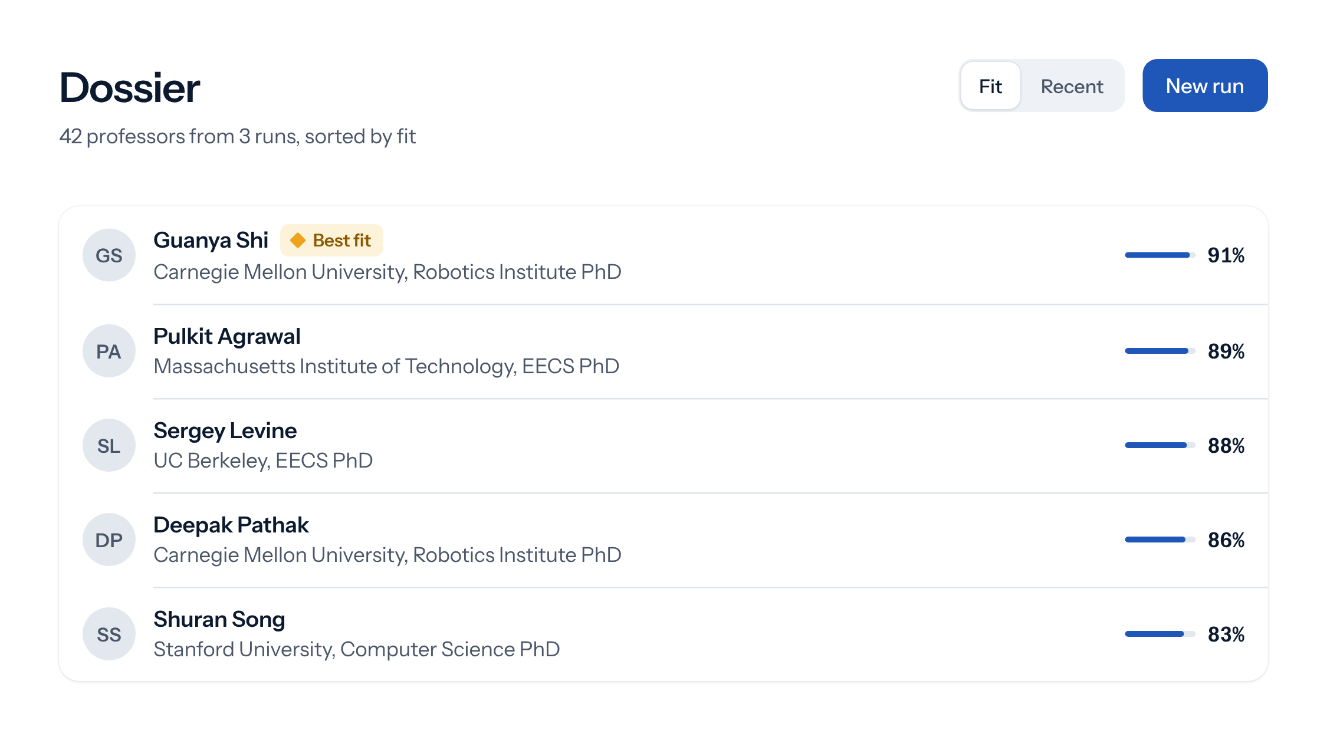
Every professor, ranked by what they publish
Dossier
Scores from the papers
Embeddings compare each professor's publications with the applicant's interests.
One best fit
The strongest match is marked, so the first email goes to the right person.
Evidence on tap
Open any row to see the papers that earned the score.
Notes:
Title-only layout, used for product slides. Show the real interface, not an illustration of it, with up to three short points beside it. Screenshots come from the design system's components on the canvas colour, so they sit on the slide without a frame.

Slide 6
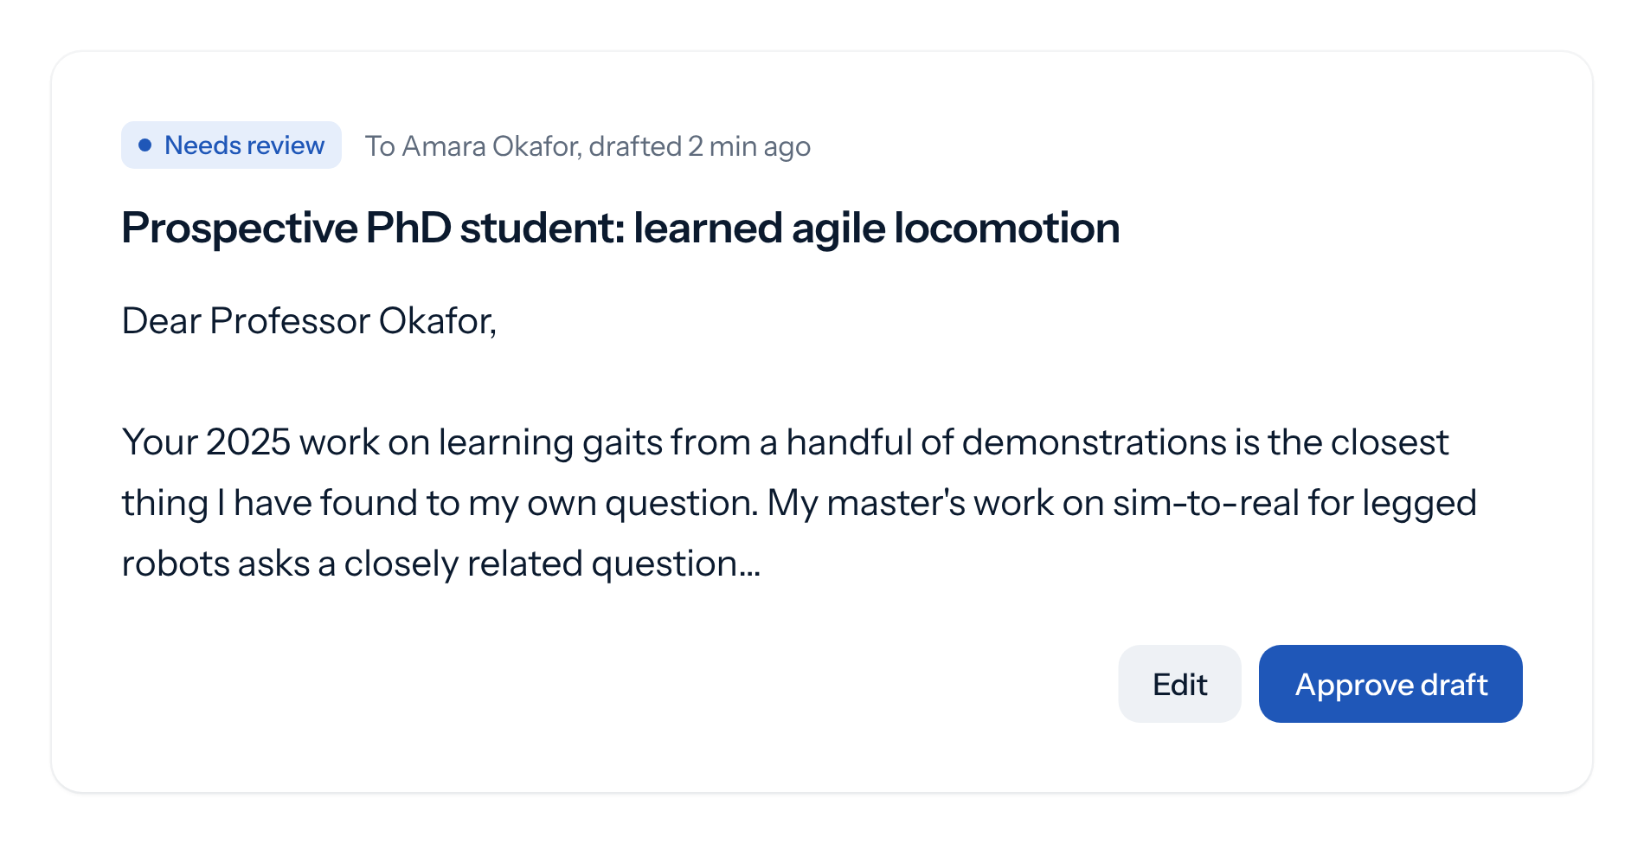
Nothing is ever sent for you
Outbox
Every draft waits for the applicant's approval.
Edit it, copy it, send it yourself. Graduator never emails a professor on anyone's behalf.
Notes:
Split layout: title and two or three sentences on the left, a screenshot or chart on the right. Use the picture placeholder, or place an image in the same area.

Slide 7
From interests to inbox in four steps
How it works
01
02
03
04
Describe your interests
Agents find the faculty
Every paper is read
You approve the email
Or let Gradis pull them from your CV.
Programmes first, then the people inside them.
Each professor is scored against your interests.
A personal draft waits in your Outbox.
Notes:
Steps on the title-only layout: a hairline, a gold two-digit number, a verb-phrase title and one line each. Four steps at most; no icons.

Slide 8
Runs started each month
Traction
Sample data for this template.
Replace the series with real figures and say the one thing they show, such as growth month over month.
Notes:
Chart layout. Native PowerPoint chart in the tint blue, values labelled on the bars, no gridlines or legend. Put the takeaway on the right in a sentence. The numbers on this sample are placeholders.

Slide 9
Free to start, Pro for a full search
Business model
Free
Pro
$0
$12
per month
per month, placeholder until launch
3 research runs a month
30 professors scored per run
Gradis, CV studio and export
30 research runs a month
100 professors scored per run
Interest suggestions from your CV
Notes:
Plans from docs/plans.md. Prices are set at launch; the $12 Pro price is the placeholder in api/billing/plans.py. The featured plan gets the 2px tint outline.

Slide 10
The people building Graduator
Team
AB
CD
EF
Founder name
Founder name
Advisor name
Role, and one line on why they are the person to build this.
Role, and one line of relevant experience.
Role, and the one thing they bring.
Notes:
Team on the title-only layout. Replace each grey circle with a square photo cropped to a circle (Format Picture > Crop to Shape > Oval). Names and roles here are placeholders.

Slide 11

Start with the professors who fit
hello@graduator.example
graduator.example
Notes:
Closing layout. The ask or the closing line, then contact details. Gradis appears here and nowhere else in the deck. The contact line is a placeholder.

