Slide 1
Core API
REST Server
Request Specification
Reservation Specification
Plumbing Specification
Reservation Workflow Control
Path Computation Engine
Topology Resource Manager
Pruning Service
Path Setup Service
B/W Resources
VLAN Resources
Reservation Database

Slide 2
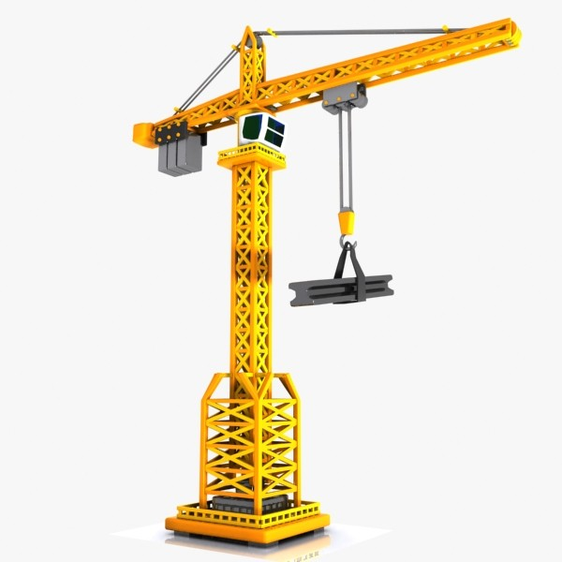

Page under construction. Check back soon!
ESnet
t
S
n
e

Slide 3
Fixture
Pipe
Junction
Requested
Fixture: Ingress Port
Fixture: Egress Port
Ethernet Port
MPLS Port
Physical Path
Switch
Router
Router
Router
Switch
Reserved
Reserved Pipe
Reserved Junction
Reserved Fixture

Slide 4
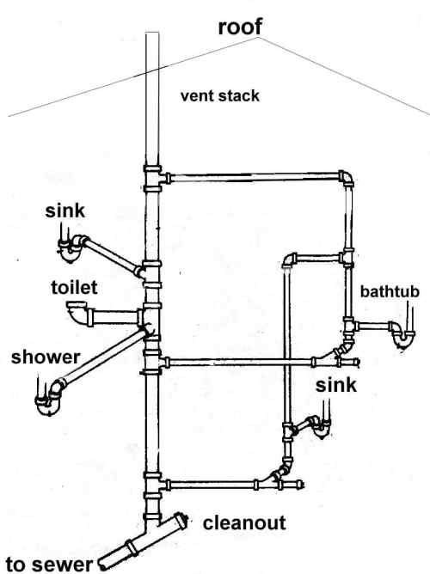

Slide 9
A
1
B
2
C
Switch A
Router
Switch B
Switch C
1
2

Slide 10
Request & Topology
Support Services
Request-Specific
PCE Modules
Pathfinding Algorithms

Slide 11
Request
Top
Service-Specific
Translation
Reservation

Slide 12
Basic
Non-Palindromic
Top
Translation
ERO-Specific
Survivability

Slide 13
Topology Service
Pruning Service
Bandwidth Service
VLAN Service
Top
Service-Specific
Translation
Dijkstra
Bellman-Ford
Bhandari

Slide 14
Ports
End-point
Ethernet Switch
Network Link (Bidirectional)
MPLS Router

Slide 18
B
5
10
Weight: (C,B) + (B,A) = 15
Weight: (A,D) + (D,C) = 2
A
C
1
1
D

Slide 19
B
5
10
A
E
C
5
5
10
5
D

Slide 20
B
Primary Weight: (C,E) + (E,A) = 10
Secondary Weight: (C,B) + (B,A) = 15
Service-Layer Weight: 10
5
10
A
E
C
5
5
10
5
D

Slide 21
B
Primary Weight: (C,E) + (E,A) = 10
Secondary Weight: (C,B) + (B,A) = 15
Service-Layer Weight: 10
5
10
A
E
C
5
5
Primary Weight: (A,E) + (E,C) = 10
Secondary Weight: (A,D) + (D,C) = 15
Service-Layer Weight: 10
10
5
D

Slide 23
Request:
ERO: Complete {A, M, M_{N}, N_{M}, N, N_{P}, P_{N}, P, P_{R}, R_{P}, R, R_{Q}, Q_{R}, Q, Q_{O}, O_{Q}, O, Z}
N
A
M
O
Z
P
R
Q

Slide 24
Request:
ERO: Complete { A, M, M_{N}, N_{M}, N, N_{P}, P_{N}, P, P_{R}, R_{P}, R, R_{Q}, Q_{R}, Q, Q_{O}, O_{Q}, O, Z }
Reservation:
N
A
M
O
Z
P
R
Q

Slide 25
Request:
ERO: Complete { A, M, M_{N}, N_{M}, N, N_{P}, P_{N}, P, P_{R}, R_{P}, R, R_{Q}, Q_{R}, Q, Q_{O}, O_{Q}, O, Z }
Reservation:
Link Pruned!
N
A
M
O
Z
P
R
Q

Slide 26
Request:
ERO: Complete { A, M, M_{N}, N_{M}, N, N_{P}, P_{N}, P, P_{R}, R_{P}, R, R_{Q}, Q_{R}, Q, Q_{O}, O_{Q}, O, Z }
Reservation: FAILURE
N
A
M
O
Z
P
R
Q

Slide 27
Request:
ERO A-Z: Complete { A, M, M_{N}, N_{M}, N, N_{P}, P_{N}, P, P_{R}, R_{P}, R, R_{Q}, Q_{R}, Q, Q_{O}, O_{Q}, O, Z }
ERO Z-A: Complete { Z, O, O_{Q}, Q_{O}, Q, Q_{N}, N_{Q}, N N_{M}, M_{N}, M, A }
N
A
M
O
Z
P
R
Q

Slide 28
Request:
ERO: Partial { A, P, N, Q, Z }
N
A
M
O
Z
P
R
Q

Slide 29
Request:
ERO: Partial { A, P, N, Q, Z }
N
A
M
O
Z
P
R
Q

Slide 30
Request:
ERO: Partial { A, P, N, Q, Z }
N
A
M
O
Z
P
R
Q

Slide 31
Request:
ERO: Partial { A, P, N, Q, Z }
N
A
M
O
Z
P
R
Q

Slide 32
Request:
ERO: Partial { A, P, N, Q, Z }
N
A
M
O
Z
P
R
Q

Slide 33
Request:
ERO: Blacklist { N_{M}, N_{P}, Q_{O} }
Reservation:
N
A
M
O
Z
P
R
Q

Slide 34
Request:
ERO: Blacklist { N_{M}, N_{P}, Q_{O} }
Reservation:
N
A
M
O
Z
P
R
Q

Slide 35
Request:
ERO: Blacklist { N_{M}, N_{P}, Q_{O} }
Reservation:
N
A
M
O
Z
P
R
Q

Slide 36
Request:
ERO: Blacklist { N_{M}, N_{P}, Q_{O} }
Reservation:
Route: {A, M, M_{P}, P_{M}, P, P_{R}, R_{P}, R, R_{Q}, Q_{R}, Q, Q_{N}, N_{Q}, N, N_{O}, O_{N}, O, Z}
N
A
M
O
Z
P
R
Q

Slide 37
Primary
N
A
M
O
Z
P
Q
Backup

Slide 38
N
A
M
O
Z
P
Q

Slide 39
Primary
N
A
M
O
Z
P
Q
Backup

Slide 40
Service-Layer Route
N
A
M
O
Z
P
Q

Slide 41
B
A
E
C
A
Z
D

Slide 42
Requested VLAN: 6
Already Reserved: 6
Request: [1, 5]
Assigned VLAN: 6
Assigned: 3
Assigned: 3

