Slide 1
How Does MS Work? Ehsan Zangene 5th session Time: 10-12 Place: Biomedicum 1, kok.3

Slide 2
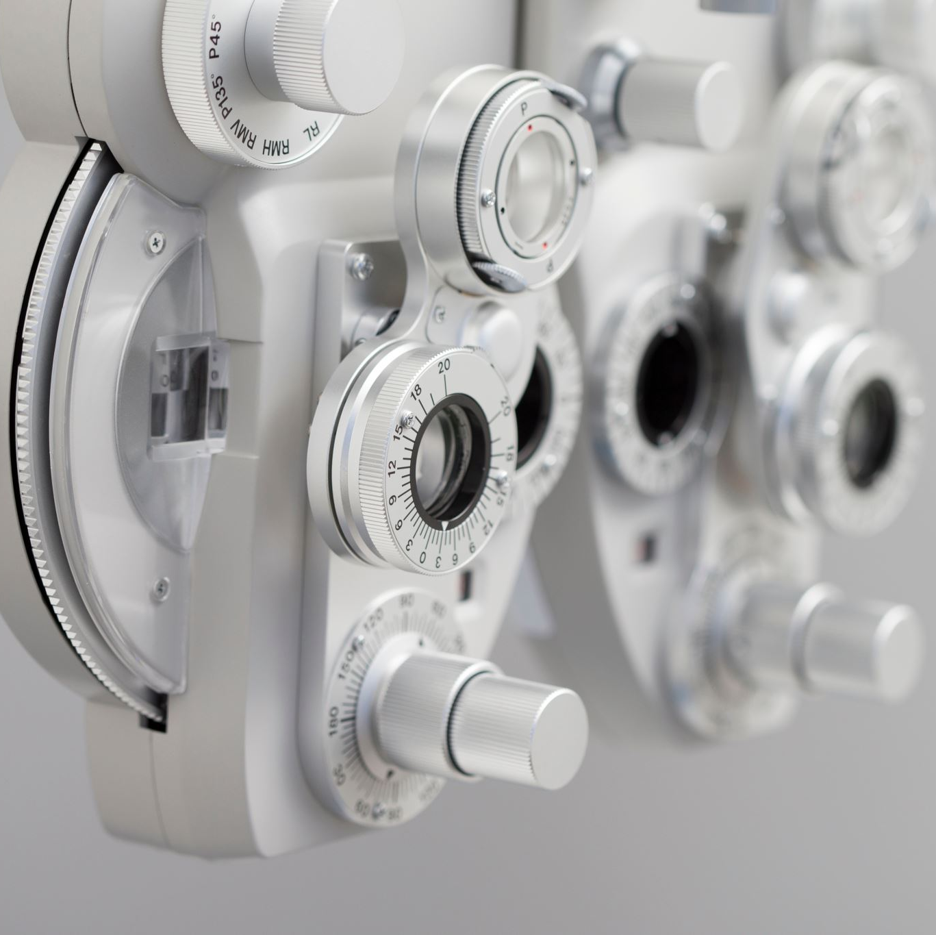
At the end of this session you should know:
Principles of mass spectrometry
Components of MS instruments
Tandem MS
Data acquisition techniques
DDA/DIA
TMT labelling

Slide 3

Individual assignment 15 min

Slide 4
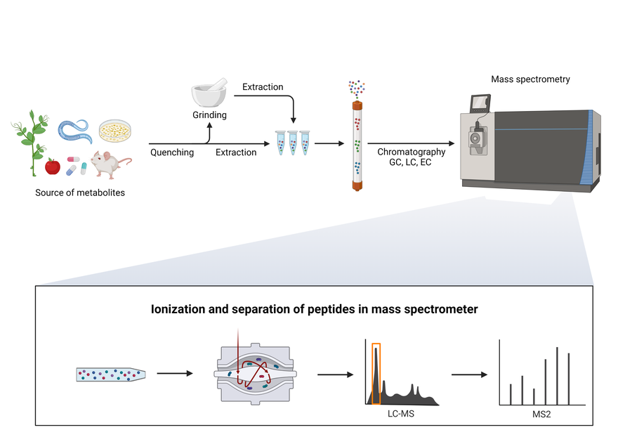
workflow
https://pel.caltech.edu/approach

