Slide 1
How Does MS Work? Ehsan Zangene 5th session Time: 10-12 Place: Biomedicum 1, kok.3

Slide 2
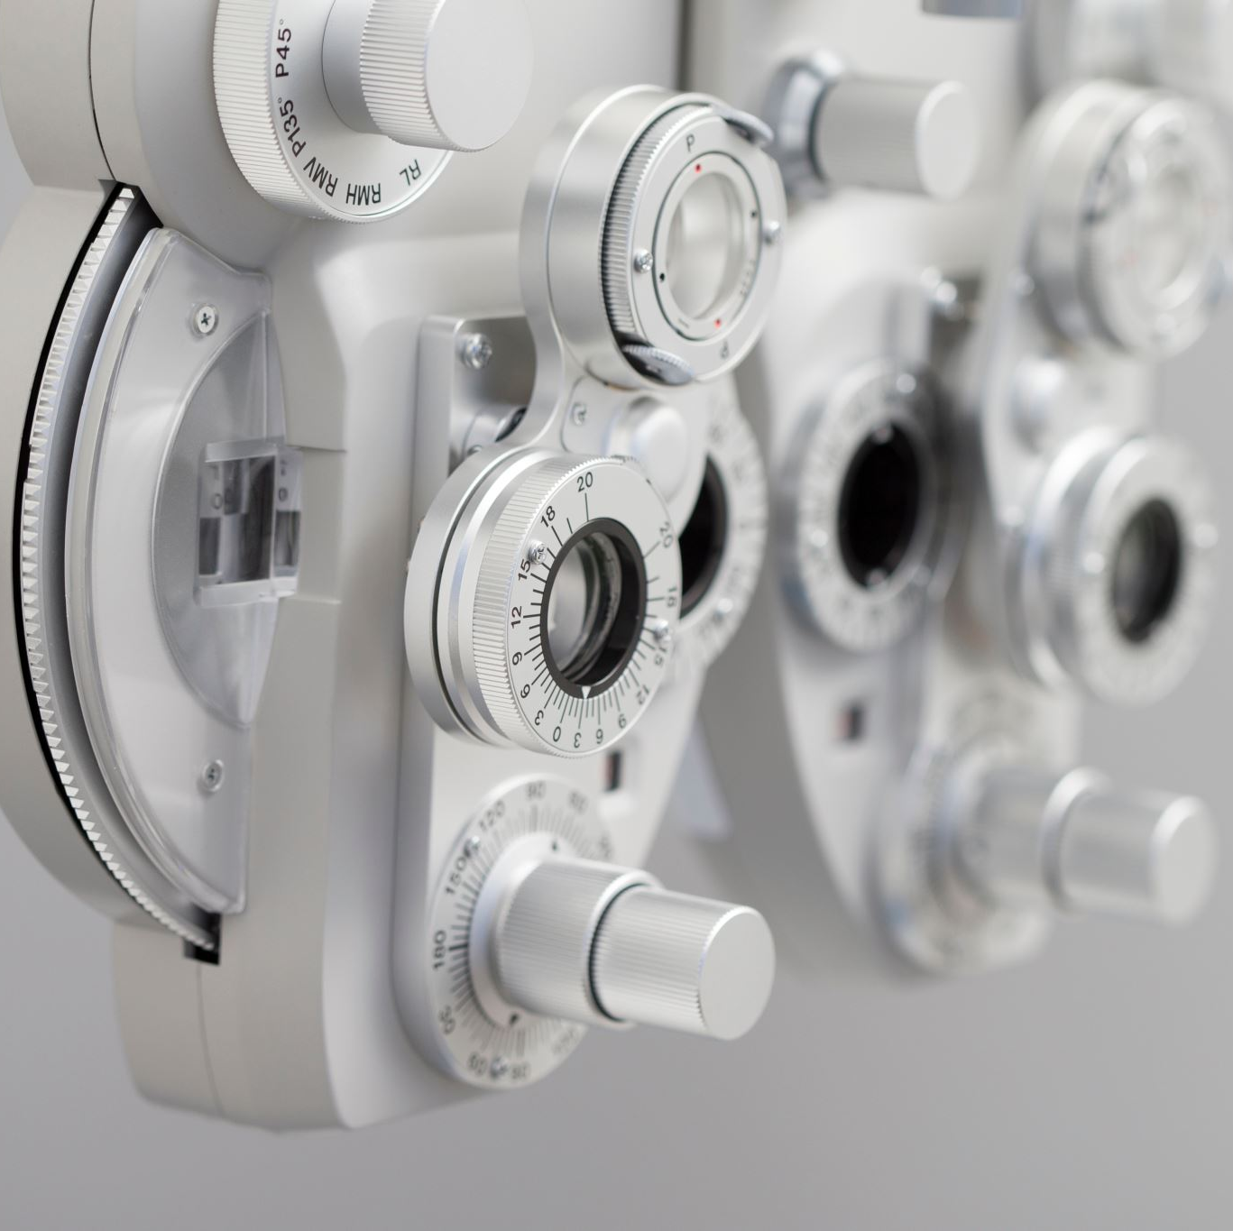
At the end of this session you should know:
Principles of mass spectrometry
Components of MS instruments
Tandem MS
Data acquisition techniques
DDA/DIA
TMT labelling

Slide 3

Individual assignment 15 min

Slide 4
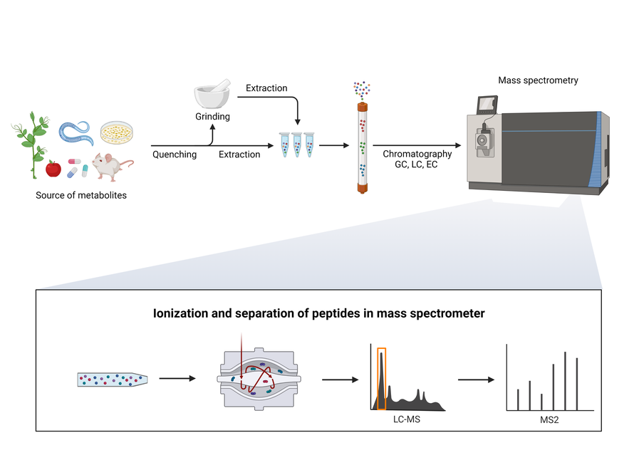
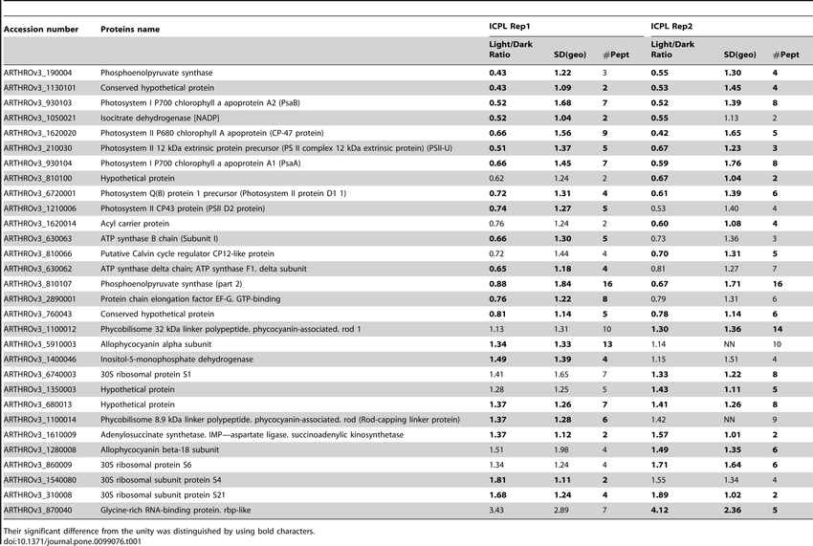
workflow
https://pel.caltech.edu/approach

Slide 5
workflow
https://pel.caltech.edu/approach

Slide 6
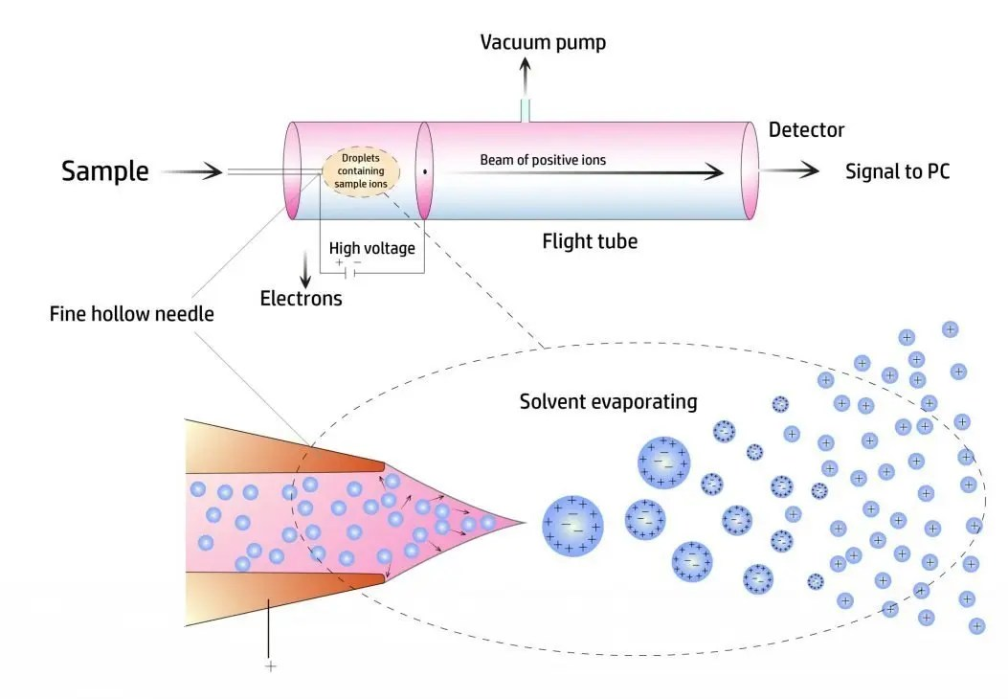
Principles of mass spectrometry
mass spectrometers do not measure mass
generating charged particles (ions) to generate ion beam
ion beam manipulated under high vacuum
measure ions mass to charge ratio
Parent ions
daughter ions (fragmented)

Slide 7
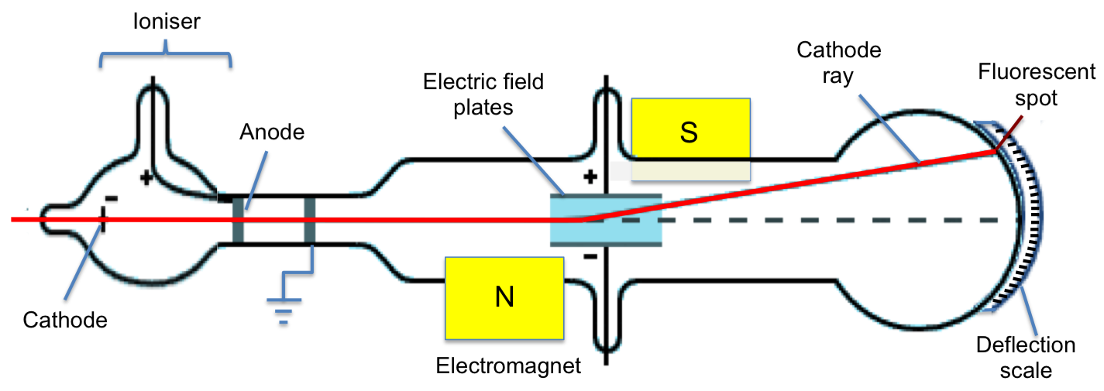
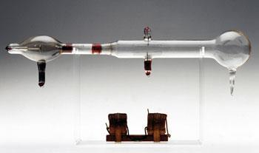
invented by jj thompson in 1913
Cathode with voltage applied to it
(ion Source)
beam
bent
Collimated beam
slits
evacuated tube filled with gas
Two mass filters
- magnetic coils -> magnetic field
- electrical diffraction plates -> electrical field
detector -> fluorescent coating
it will fluoresce when charged particle beam hits
He was able to separate different Neon isotope
https://monomole.com/mass-spectrometry-thomson-cathode-ray/

Slide 8
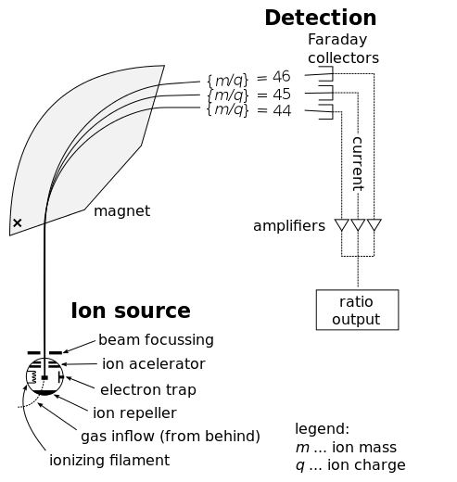
Mass filter
https://thornsandthistleshomestead.wordpress.com/2014/12/04/essential-oil-testing-deeper-dive-mass-spec/

Slide 9
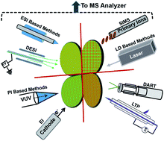
Ionization sources
Electrospray
MALDI
Other methods
https://pubs.rsc.org/en/content/articlelanding/2014/np/c3np70094a

Slide 11
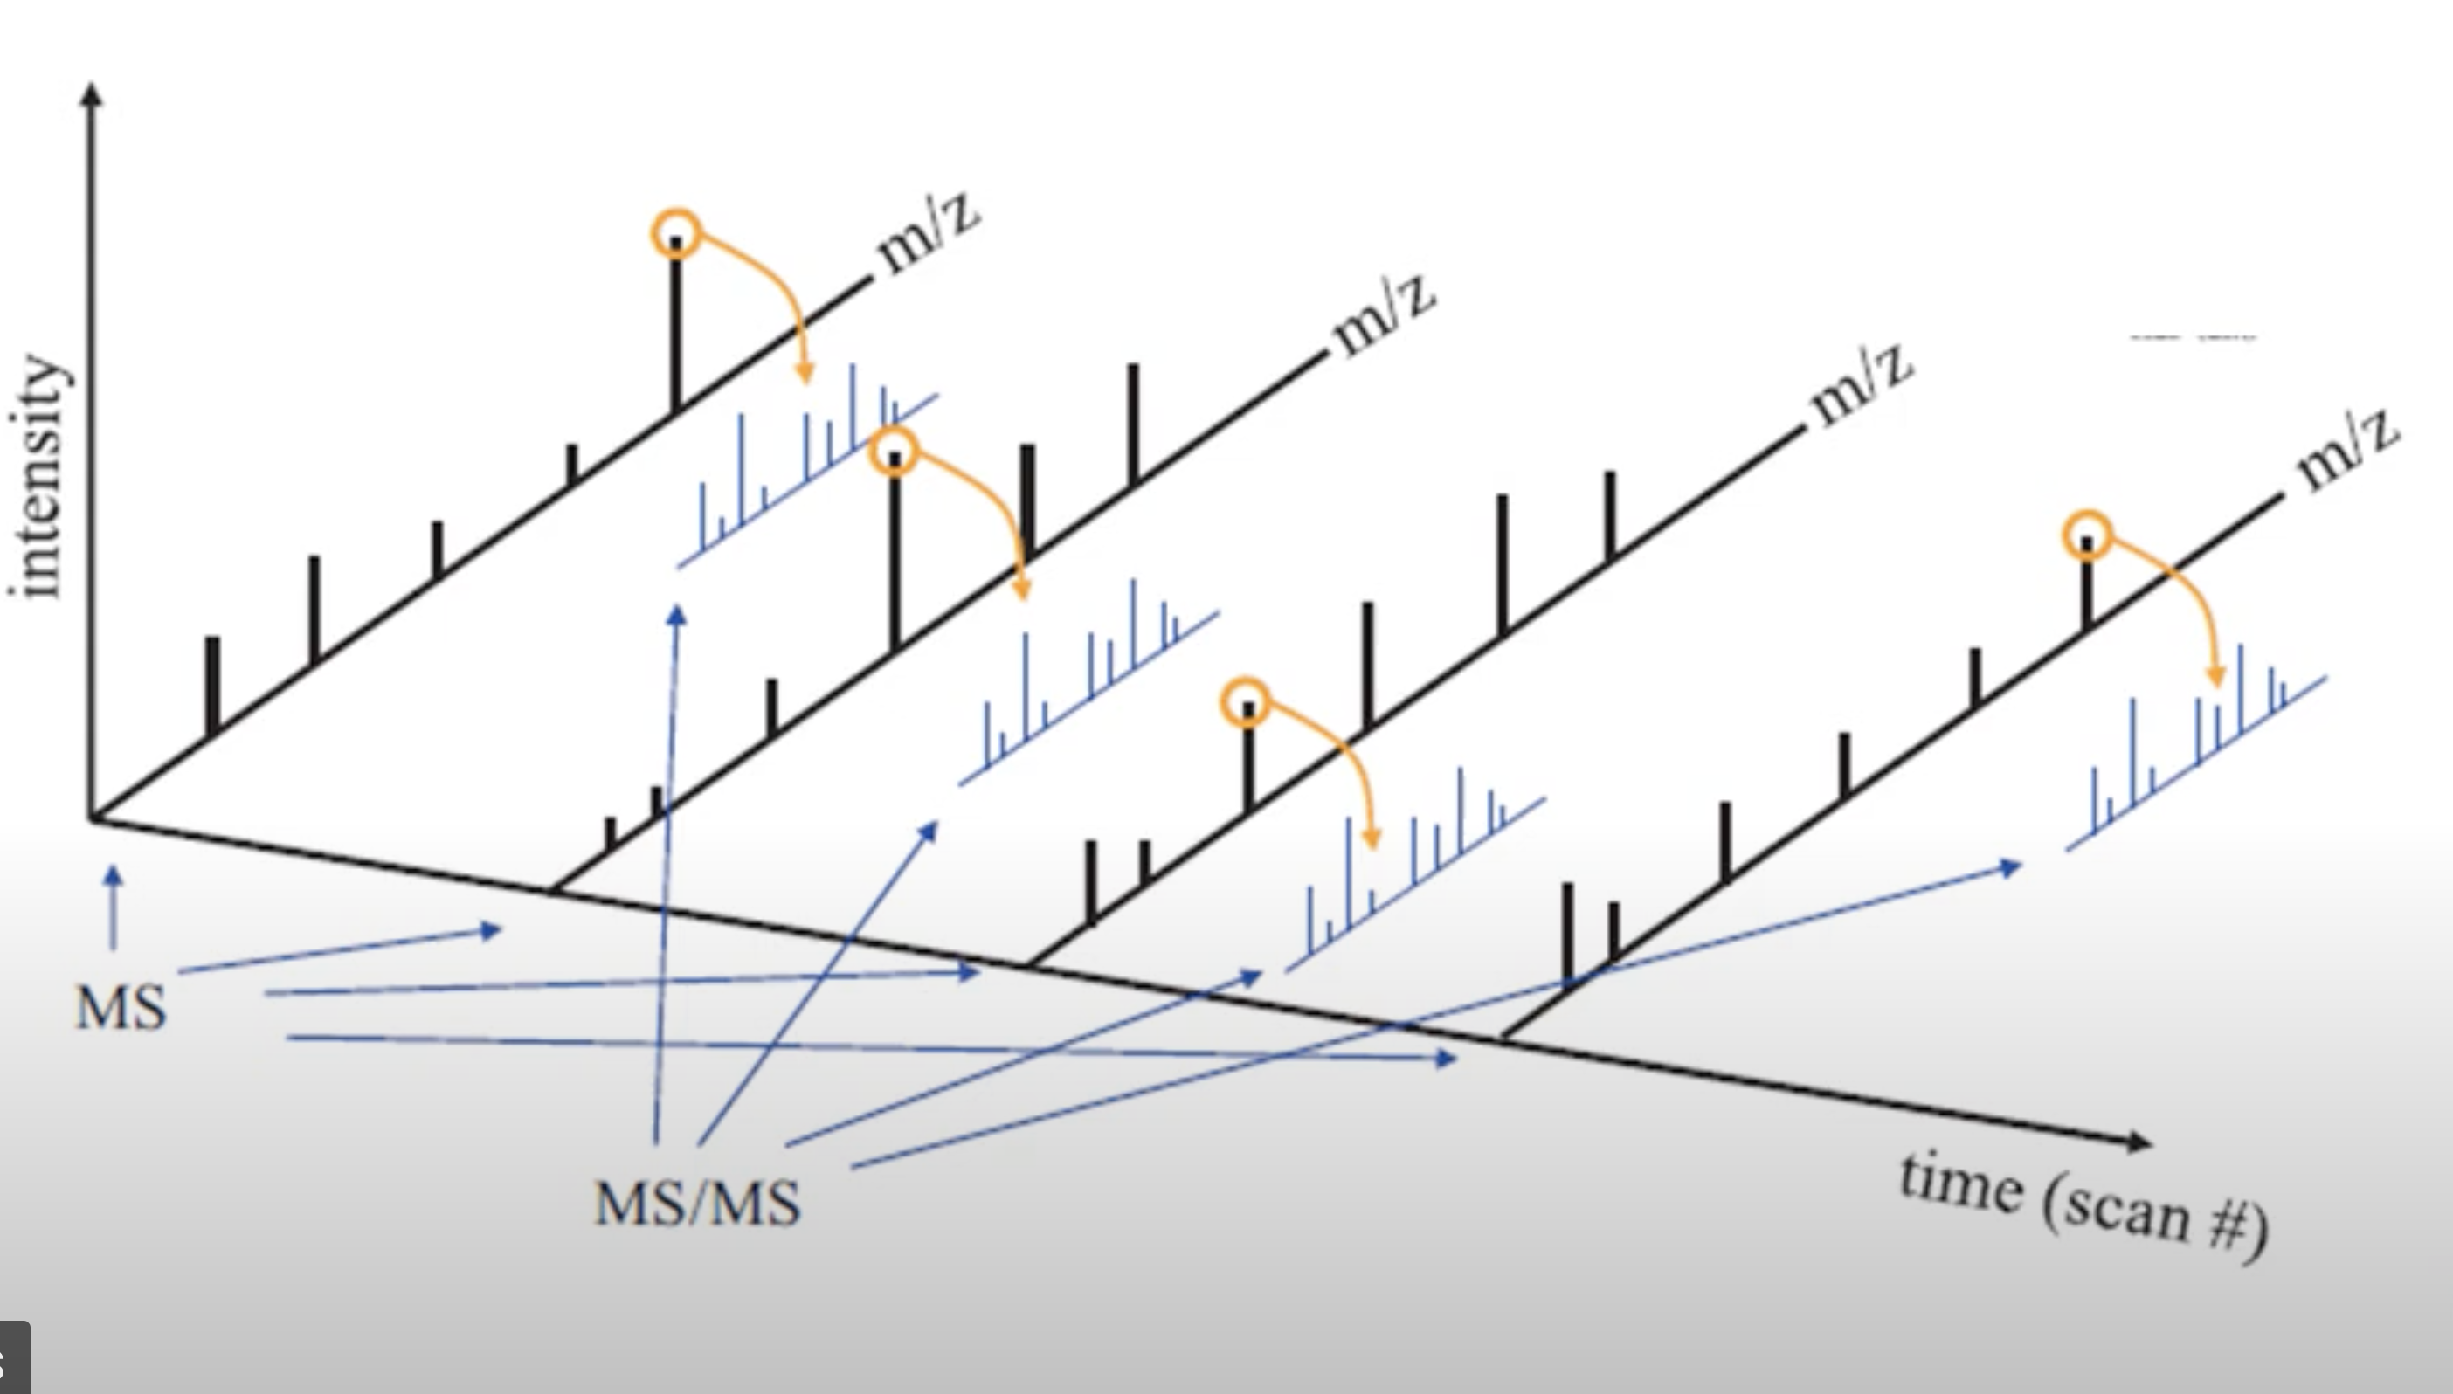

Slide 12


