Slide 1

NJ Transit & Amtrak rail
Uncovering Train Delay Patterns Using Unsupervised Learning
By Esona Fomuso

Slide 2
Introduction
A comprehensive study on Uncovering Train Delay Patterns using Unsupervised Learning
Modern transportation optimization demands comprehensive insights into transit system performance.
Rail services by NJ Transit and Amtrak are vital for efficient mobility but face challenges like delays and efficiency.
Research Focus:
Applying unsupervised learning techniques to NJ Transit and Amtrak rail performance data.
Aims to dissect complexities, identify patterns, and improve operational strategies.

Slide 3

Research Objective
Derived insights can influence decision-making, resource allocation, and service improvements.
Enhancing rail operations for both passengers and operators.

Slide 4
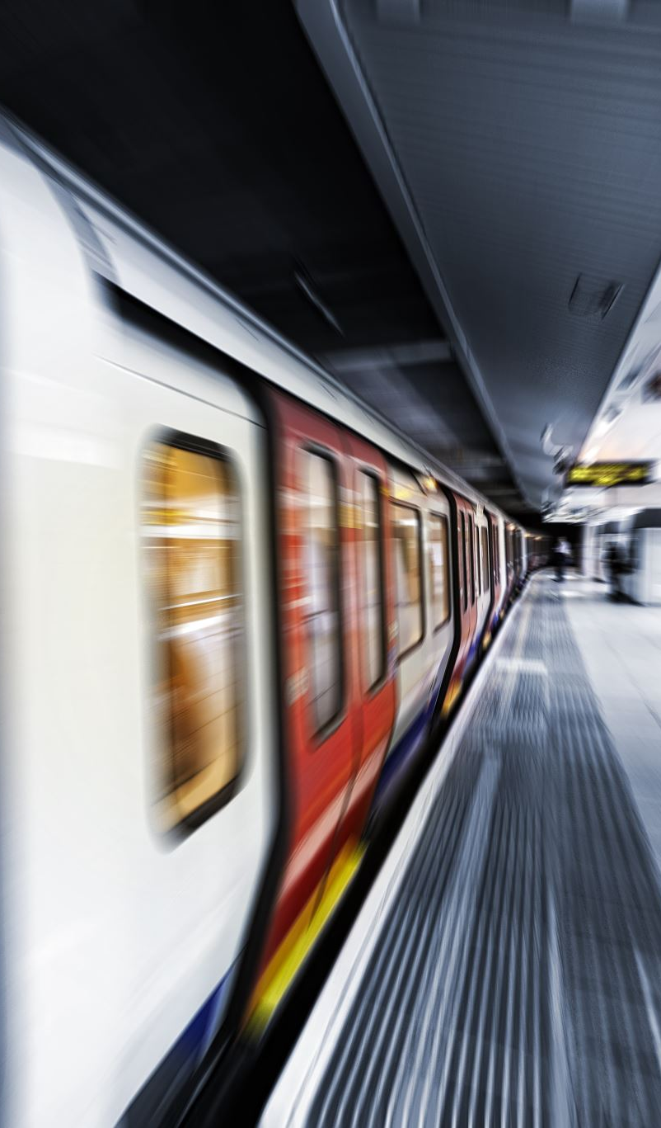
Research question & Sub questions
Research question: how can clustering techniques be employed to uncover patterns in NJ Transit and Amtrak rail performance data, focusing on train delays and station-related factors?
Sub question 1: Which cluster contains the most train delays on Friday?
Sub question 2: Which cluster contains the most train delays for the rush hour on weekdays?

Slide 5
Data
Dataset informationsource: kaggle - ”All_NJ_Transit2020_data.csv," then used a subset of the data.
Highlights:
Total records: 965568
Variables/columns: 13
Subset dataset
Total records: 98698
Variables/columns: 13key attributes:
Key attributes
Delay_minutes
Stop_sequence
Hour
Day

Slide 6
Methodology
Data collection & processing
Upload CSV from kaggle
Separate the subset data to use
Data exploration
Initial exploration of dataset structure, variables, and missing values
Examining columns, data types, and summary statistics
Feature selection
Identifying variables of interest for analysis
Apply unsupervised learning methods
Principal component analysis (PCA) with k-means to cluster & visualize
T-distributed stochastic neighbor embedding (t-sne) with gaussian mixture model (GMM) to cluster & visualize
Try different cluster sizes to select the best cluster size between 4 & 10
Use silhouette scores to justify choice
Statistical analysis & comparison
Use the visualization to answer the sub-questions

Slide 7

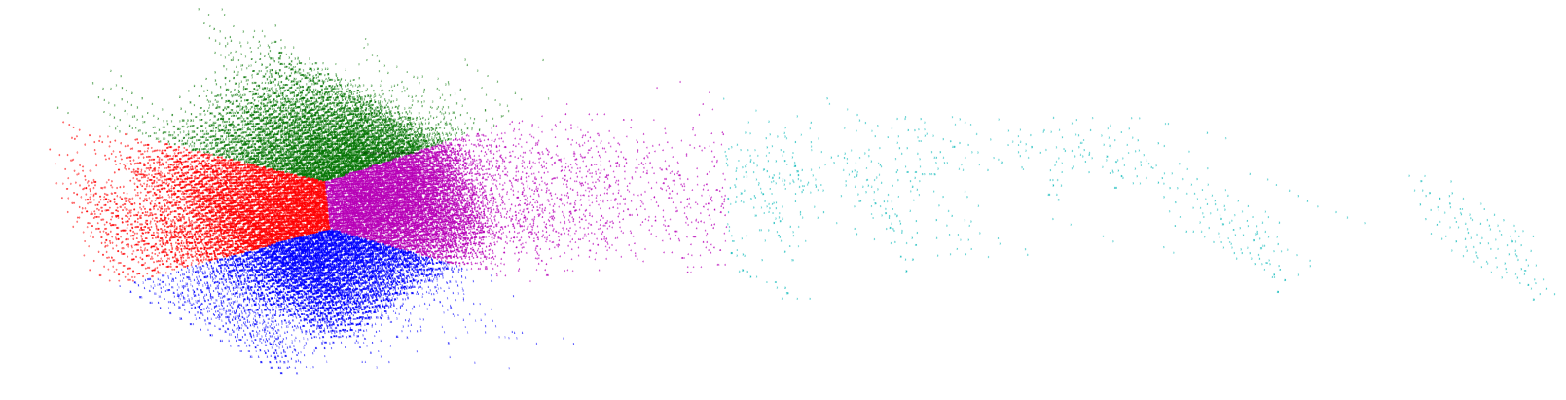
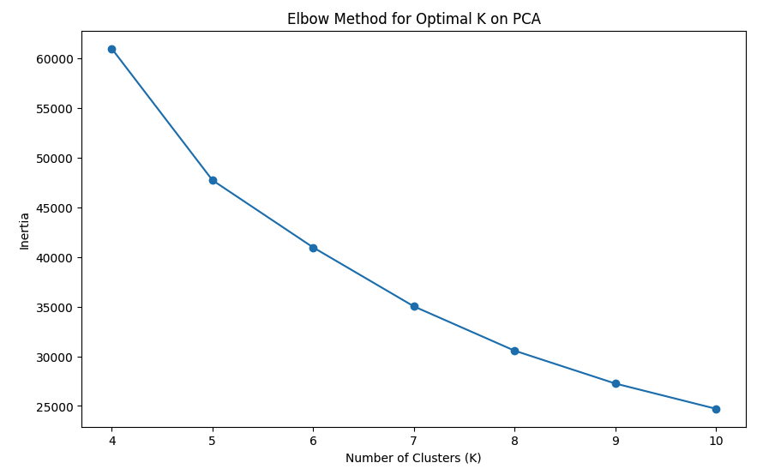
Findings: PCA/K-means
Using K-means Visualization
Using k-means clustering to visualize the data
Used silhouette score to get the best K = 8 with silhouette = 0.28
The plot shows little or no separation; the labels mostly sit on each other. Labels 5 and 3 do seem a little separated, but they are not clustered together. It looks like a lot of outliers exist.
PCA to reduce dimensionality, then k-means
With PCA-reduced data, K = 5 & improved silhouette = 0.36
The elbow method indicated the same best K as was determined after PCA was applied
The clusters 0, 1, 2, and 4 are nicely clustered together, while cluster 3 is very scattered and spread out, though not much gap separating the clusters from each other.
PCA Reduction with K-means Visualization

Slide 8
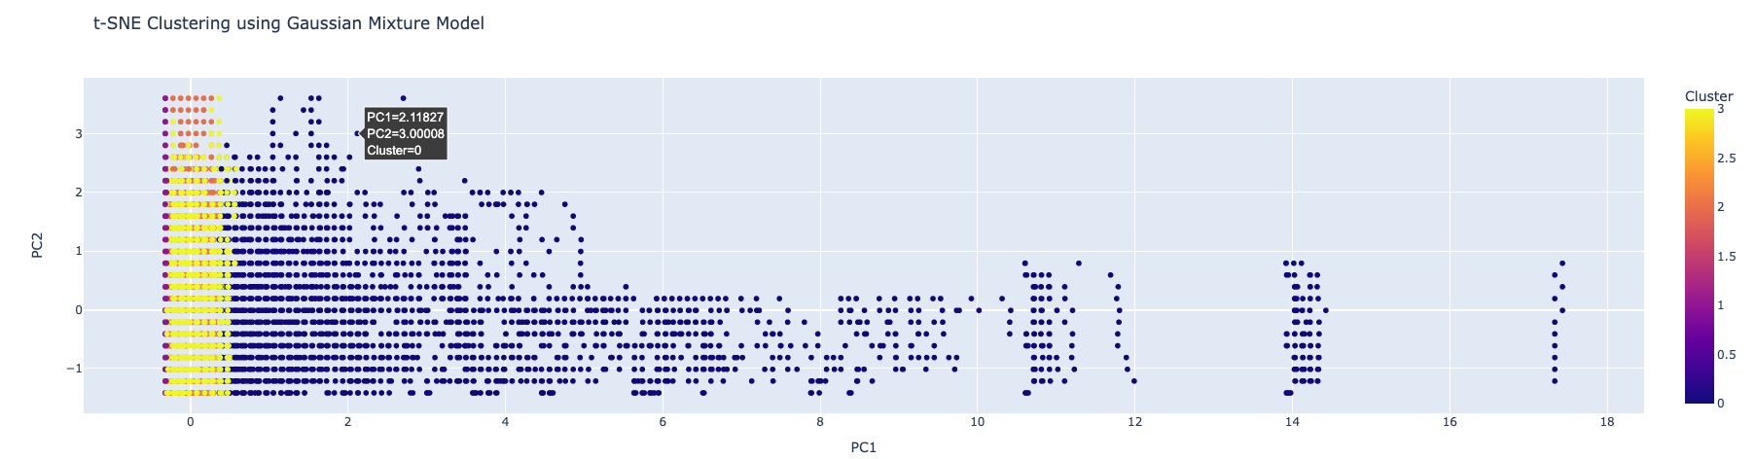
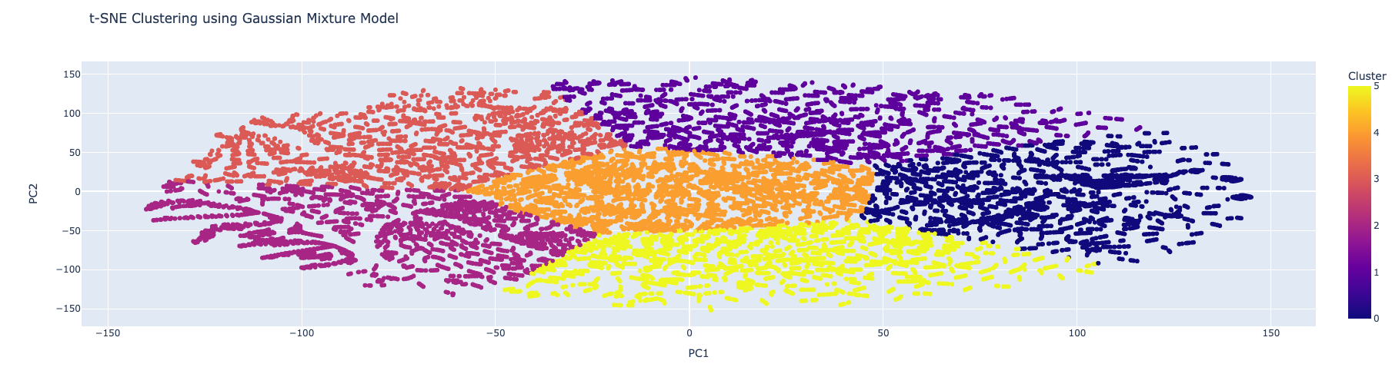
Findings: t-sne/gmm
Using GMM clustering to visualize the data
Used silhouette score to get the best number of components/clusters = 4 with silhouette = 0.053
The plot shows little or no separation, the clusters mostly sit on each other. cluster 0 does seem a little separated but the rest is not clustered together looks like a lot of outliers exist.
t-SNE to reduce dimensionality, then GMM clustering
With t-SNE-reduced data, the best number of components for GMM =6 and the corresponding improved silhouette score = 0.358
The t-SNE/GMM plot looks nicely separated with none of the 6 clusters sitting on the other.
Using Gaussian Mixture Model Visualization
T-SNE Reduction with Gaussian Mixture Model Visualization

Slide 9
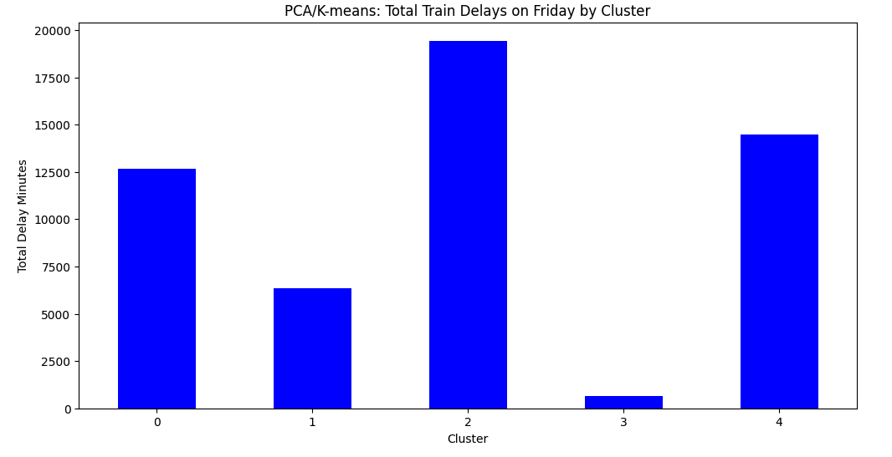
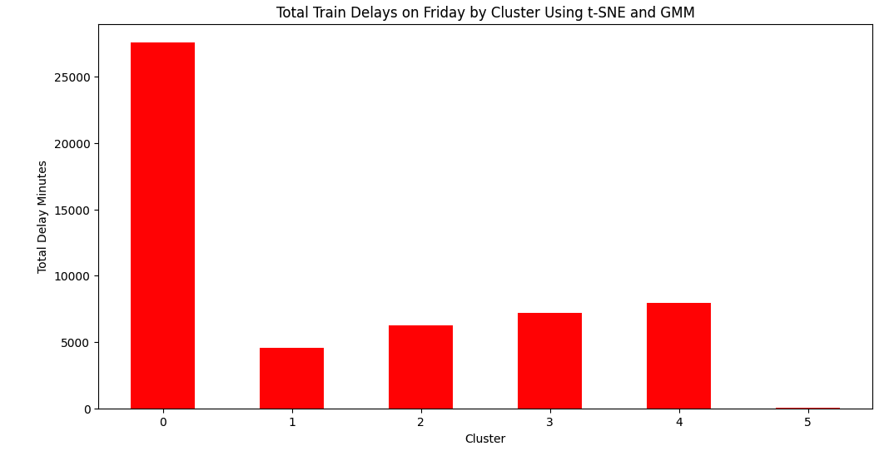
Which cluster contains the most train delays on Friday?
PCA/K-means
Cluster 2 has the most train delay on Friday with a total delay of 19438.90 minutes.
t-SNE/GMM
The cluster with the most train delays on Friday was 0, with a delay of 27609.72 minutes.

Slide 10
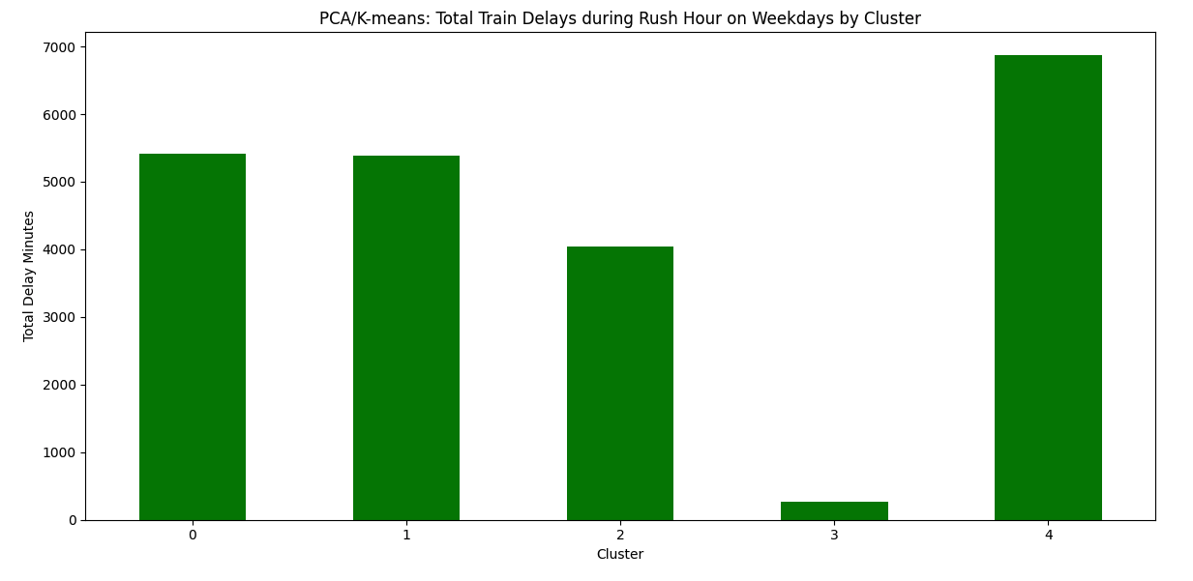
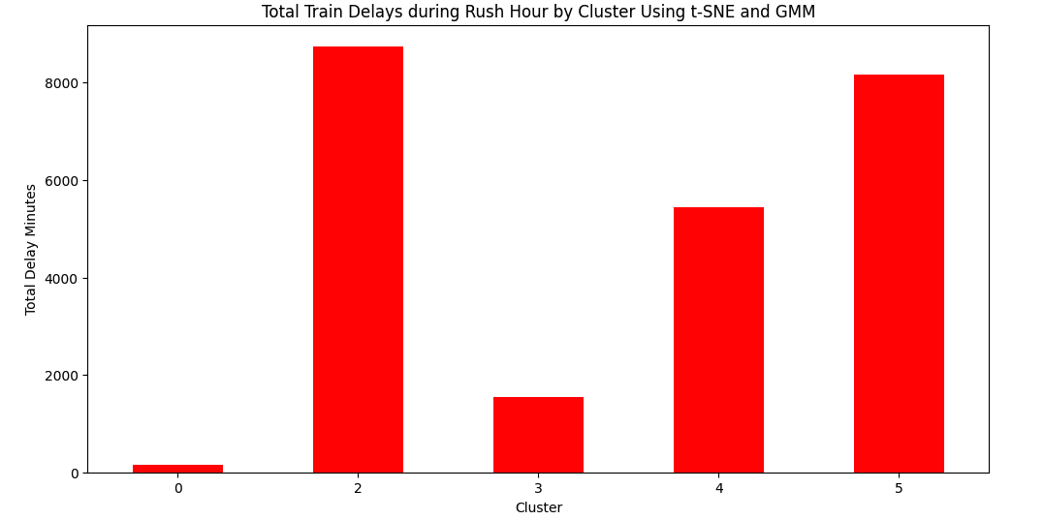
Sub Question 2: Which cluster contains the most train delays for the rush hour on weekdays?
PCA/K-means
Cluster 4 has the most train delays during rush hour on weekdays, with a total of 6867.083333333333 delays.
t-SNE/GMM
Cluster with the most train delays during rush hour on weekdays: 2 with a delay of 8748.67 minutes.

Slide 11
Comparison
Aspect | PCA/K-means Approach | t-SNE/GMM Approach
Optimal K Value (Silhouette / Elbow) | K=8 (Silhouette), K=5 (Elbow) | Best components: 4 (Silhouette)
Silhouette Score (Best K) | 0.270 (K=8) | 0.053 (Best components=4)
Improved Silhouette after dimension reduction (PCA/t-SNE) | Yes | Yes
Optimal cluster count (K Value/n_components) after Reduction (Silhouette) | K=5 (Silhouette=0.362) | Best Components = 6 (Silhouette=0.358)
Cluster Separation & Distribution | Clusters somewhat distinct | Varying silhouette scores; clusters less distinct
Train Delay on Friday (Cluster) | Cluster 2: 19438.90 minutes | Cluster 0: 27609.72 minutes
Train Delays during Rush Hour (Cluster) | Cluster 4: 6867.08 minutes | Cluster 2: 8748.67 minutes
Additional Consideration | Some improvement in the Silhouette value from 0.27 to 0.362 | Significant improvement in silhouette score (0.05 to 0.36); clusters are distinct, but separation can improve

Slide 12
Comparison Cont.
PCA/k-means approach:
advantages:
Dimensionality reduction: PCA effectively reduces the dimensionality of the data, making it easier to work with and visualize.
Interpretability
Improved silhouette score
Ease of interpretation
Considerations:
Clusters might not be distinct
t-SNE/GMM approach:
advantages:
Intricate patterns: t-SNE is effective at capturing complex and nonlinear relationships between data points, making it suitable for revealing intricate patterns.
Significant silhouette score improvement
Hidden patterns
Considerations:
High computational cost
Interpretation challenges
Notes:
PCA/K-means Approach: Advantages:
Dimensionality Reduction: PCA effectively reduces the dimensionality of the data, making it easier to work with and visualize.
Interpretability: PCA provides principal components that have meaningful interpretations and can help identify the most influential features.
Improved Silhouette Score: In your analysis, PCA improved the silhouette score, indicating better cluster separation after dimension reduction.
Ease of Interpretation: K-means clustering provides clear cluster assignments and is relatively straightforward to interpret.
Considerations:
Clusters Might Not Be Distinct: While PCA improved silhouette scores, the clusters might still overlap to some extent, potentially impacting the interpretability of the clusters.
t-SNE/GMM Approach: Advantages:
Intricate Patterns: t-SNE is effective at capturing complex and nonlinear relationships between data points, making it suitable for revealing intricate patterns.
Significant Silhouette Score Improvement: In your analysis, the t-SNE/GMM approach showed a significant improvement in silhouette score, indicating distinct and meaningful clusters.
Hidden Patterns: GMM can capture hidden patterns in the data and model different covariance structures within clusters.
Considerations:
High Computational Cost: t-SNE can be computationally intensive, especially for large datasets, which might limit its scalability.
Interpretation Challenges: t-SNE can result in clusters that are visually distinct but harder to interpret and label.

Slide 13
DATA limitations
Sensitivity to feature selection and dimensionality reduction techniques.
Sensitivity to the initial conditions in K-means and GMM algorithms.
Potential overfitting of clusters if not validated rigorously.

Slide 14
recommendations
Enhancing Feature Selection:
Refine feature selection by exploring additional relevant variables.
Improving Visualization:
Experiment with other clustering algorithms to identify the best-fit approach.
Visualize the various clustering not to relying on Silhouette score alone
Continuous Monitoring and Feedback:
Validate results using data from different time periods for consistency.

Slide 15
conclusion
Unveiling Rail Performance Patterns
Enhanced Insights: PCA/K-means approach offers improved silhouette scores, revealing distinct clusters within rail performance data.
Interpretability: Simplified cluster interpretation empowers stakeholders to comprehend patterns and implications effectively.
Operational Impact: Unveiled insights on train delays and rush hour performance lay foundations for operational optimization.
Strategic Decision-Making: By utilizing PCA/K-means, we bridge data complexities to actionable strategies, enhancing passenger experience and operational efficiency.
Notes:
Conclusion: PCA/K-means Approach
In the pursuit of unraveling the intricate complexities of NJ Transit and Amtrak rail performance data, the PCA/K-means approach emerges as the recommended choice. This selection is grounded in a comprehensive assessment of the analysis outcomes, highlighting key advantages that align with our research objectives.
Enhanced Silhouette Scores: Through Principal Component Analysis (PCA), we successfully reduced the dimensionality of the data, resulting in an improved silhouette score. This signifies clearer separation between clusters and enhances the interpretability of our findings.
Simpler Cluster Interpretation: The K-means clustering technique employed with PCA offers clusters that are relatively straightforward to interpret. This empowers stakeholders to grasp the underlying patterns and implications of rail performance more intuitively.
By embracing the PCA/K-means approach, we address the essential considerations of improved silhouette scores and cluster interpretability. Our findings shed light on critical aspects such as train delays on Fridays and during rush hours, providing valuable insights for operational optimization.
In conclusion, the PCA/K-means approach not only aligns with the research objectives but also offers a pathway to actionable insights that can influence rail operations, resource allocation, and service enhancements. This journey exemplifies the potential of advanced data analysis techniques in transforming raw rail performance data into strategic decision-making tools, ultimately contributing to the advancement of efficient and passenger-centric transportation systems.

Slide 16

References
www.kaggle.com/pranavbadami/nj-transit-amtrak-nec-performance

Slide 17
Questions?

