Slide 1

Natural Language Processing Comp237

Slide 2
Members
Liangyu Wang
Wing Yan Lau
Sze Man Tang

Slide 3

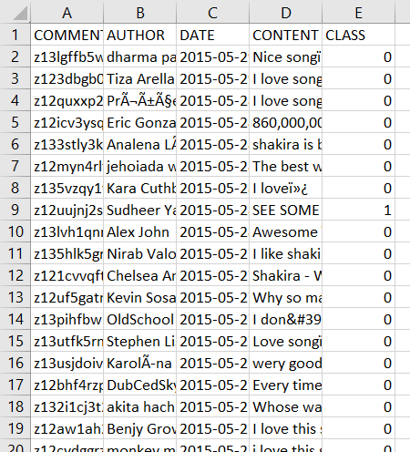
Youtube05-Shakira.csv
We load “Youtube05-Shakira.csv” file into a Pandas data frame.

Slide 4
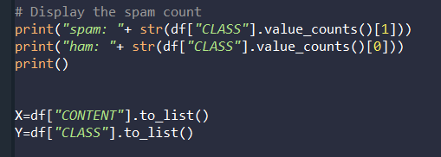
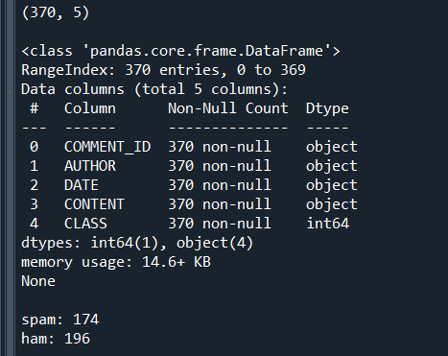
Basic Data Exploration
For this project we use only the “CONTENT” and “CLASS” columns.

Slide 5
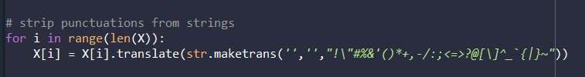
Preprocessing
For pre-processing, we strip all the punctuation marks from the comments in CONTENT column

Slide 6
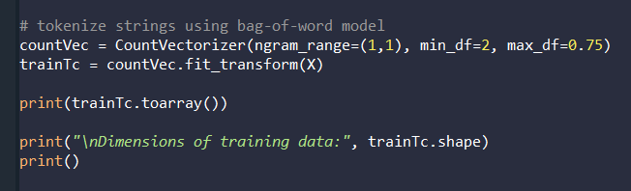
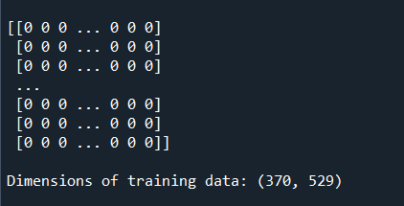
Vectorization
We then use count_vectorizer to tokenize and vectorize all the comments using the bag of words model. We use min_df=2 to ignore words that are in less than 20% of comments, and use max_df=0.75 to ignore words that are in more than 75% of comments. We use CountVectorizer’s default list of stop words. The dimension of our vectorized comments data is (370, 529), meaning our bag of word model contains 529 features.

Slide 7
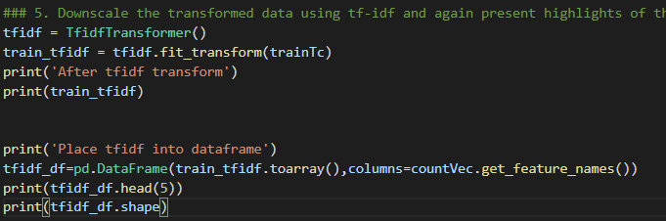
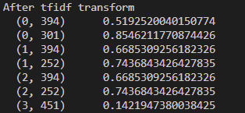
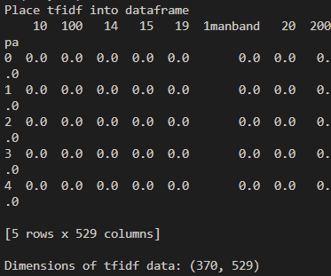
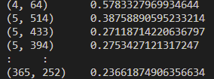

Tf-idf Transformer
Downscale the transformed data using tf-idf
Place data into dataframe for shuffle and split

Slide 8
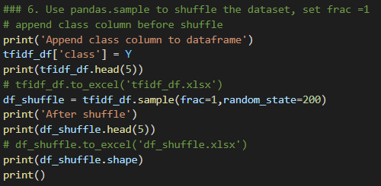
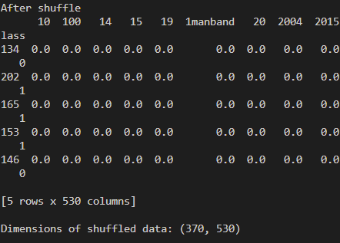
Shuffle the data
Append the class back to the data
Shuffle using pandas.DataFrame.sample with frac=1

Slide 9
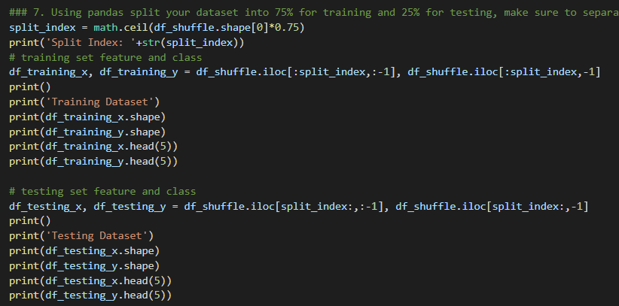
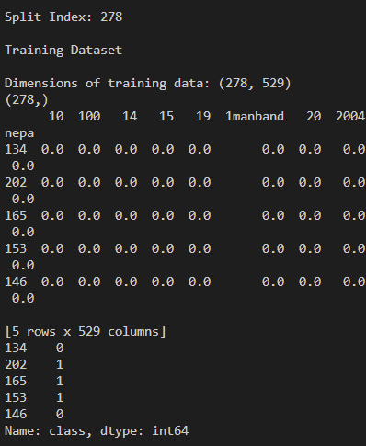
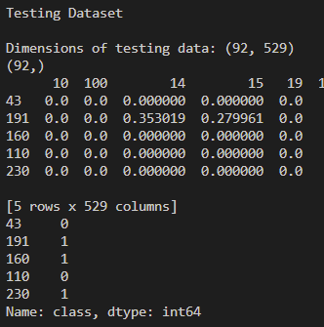
Test training split
Split the data into 75% training data and 25% of testing data
Total # of data = 370
# of training data = 370*0.75 = 278
# of testing data = 370-278 = 92
Split using pandas.DataFrame.iloc

Slide 10
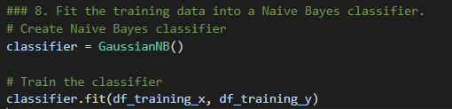
Naive Bayes classifier
Create Naïve Bayes Classifier
Train the classifier using the 75% training data

