Slide 1
Machine Learning for Precision Psychiatry : Opportunities and Challenge

Slide 2
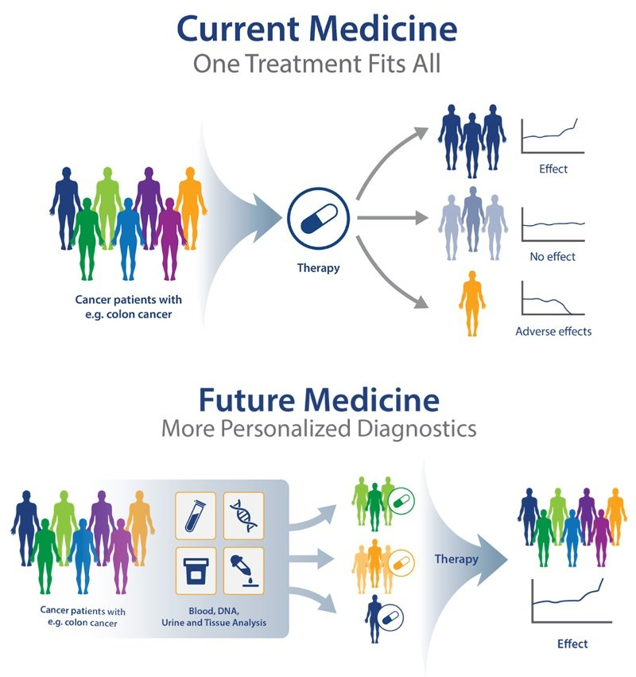
What is precision psychiatry?
Patients
Notes:
Precision psychiatry is a branch of medicine that uses precision medicine to tailor mental health treatments to the individual. This approach takes into account the person's genetic makeup, lifestyle, and environment to tailor treatments that are most likely to be effective for that individual.
In the future, precision psychiatry may be used to develop personalized mental health treatments, based on an individual's specific genetic makeup and brain structure. This approach has the potential to greatly improve the effectiveness of mental health treatments and reduce the side effects of medications.

Slide 3
What is precision psychiatry?
Patients
Notes:
Precision psychiatry is a branch of medicine that uses precision medicine to tailor mental health treatments to the individual. This approach takes into account the person's genetic makeup, lifestyle, and environment to tailor treatments that are most likely to be effective for that individual.
In the future, precision psychiatry may be used to develop personalized mental health treatments, based on an individual's specific genetic makeup and brain structure. This approach has the potential to greatly improve the effectiveness of mental health treatments and reduce the side effects of medications.

Slide 4

A fuzzy diagnostic problem
Current diagnostic procedures rely on clinical observation and symptoms reported by patients and caregivers
Notes:
### How are psychiatric patients diagnosed using the DSM?
The DSM is a classification system for mental disorders that is used by mental health professionals to diagnose and treat patients. The DSM is divided into different categories, or "axes," that each contain a different set of disorders. The five axes are:
1. Clinical Disorders
2. Personality Disorders
3. Substance-Related Disorders
4. Intellectual Disability
5. Medical Conditions
To diagnose a patient, a mental health professional will assess the patient's symptoms and compare them to the criteria for each disorder in the DSM. If the patient meets the criteria for a specific disorder, they will be given a diagnosis.

Slide 5
What about Pathophysiology?
Definition. Pathophysiology (consisting of the Greek origin words “pathos” = suffering; “physis” = nature, origin; and “logos” = “the study of”) refers to the study of abnormal changes in body functions that are the causes, consequences, or concomitants of disease processes.

Slide 6
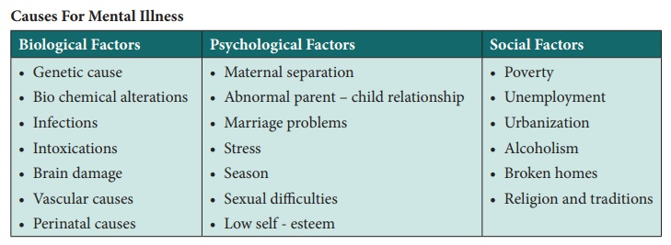
Pathophysiology

Slide 7
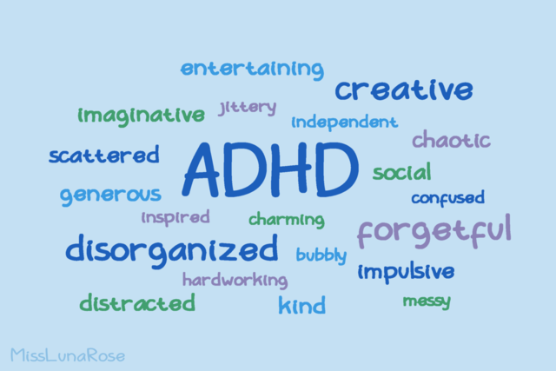

Slide 8
What is Attention deficit hyperactivity disorder (ADHD)?
ADHD is a disorder characterized by impulsivity, hyperactivity, and difficulty paying attention.

Slide 9
How is ADHD diagnosed?
A licensed clinician interviews the parent or caregiver and/or patient to document the criteria for the disorder.
It cannot be diagnosed by rating scales alone,
neuropsychological tests,
Or neuroimaging.

Slide 10
The main features of the diagnosis of ADHD
The presence of developmentally inappropriate levels of hyperactive-impulsive and/or inattentive symptoms for at least 6 months;
Symptoms occurring in different settings (e.g., home and school);
Symptoms that cause impairments in living
Some of the symptoms and impairments first occurred in early to mid-childhood; and
No other disorder better explains the symptoms

Slide 11
Importantly
Many weak genetic or environmental risk factors
Several cognitive paradigms in which people with ADHD show impaired performance
Small differences in the structure and functioning of the brain between people with and without ADHD.
Known effective pharmacological treatment
Notes:
- ADHD is rarely caused by a single genetic or environmental risk factor but most cases of ADHD are caused by the combined effects of many genetic and environmental risks each having a very small effect.
- People with ADHD often show impaired performance on psychological tests of brain functioning, but these tests cannot be used to diagnose ADHD.
- Neuroimaging studies find small differences in the structure and functioning of the brain between people with and without ADHD. These differences cannot be used to diagnose ADHD.
- Regulatory agencies around the world have determined that several medications are safe and effective for reducing the symptoms of ADHD as shown by randomized controlled clinical trials.

Slide 12
What are the different common measures?
MRI
EEG
Questionnaires/rating scales
Neuropsychological tests
Motion data (i.e. accelerometer)
Pupillometry
Genetics
Microbiome
Notes:
MRI the disorder has been associated with abnormalities in several brain regions, including the prefrontal cortex, anterior cingulate cortex, and basal ganglia.
EEG Reduced alpha (attention and focus) and increased theta and beta (impulsivity and hyperactivity) power
Questionnaires/rating scales- CAARS (social impact of ADHD), DIVA (DSM structured interview) and more…

Slide 13
Multiple weak markers
None of these measures are sufficent on their own
The idea is to accumelate enough weak observational evidence to pass the bar to classify a person as suffering from ADHD

Slide 14
Targets
Early detection
Diagnosis
and Prognosis
Notes:
- Early detection in precision psychiatry refers to the identification of risk factors or early signs of mental illness in order to intervene early and prevent the development of more serious symptoms.
- Diagnosis in precision psychiatry is the use of specific and sensitive tests to identify the presence of a mental illness.
- Prognosis in precision psychiatry is the use of predictive modelling to identify the likely course and outcome of a mental illness.

Slide 15
Early detection
improves our understanding of the disease
enables the development of preventive treatments
Change lifestyle to reduce the effect of disease modifying risk factors
It provides a larger treatment window

Slide 16
Early detection potential benefits
1. Earlier diagnosis
2. Earlier treatment
3. Improved treatment response
4. Fewer hospitalizations
5. Improved quality of life

Slide 17
What is sensitivity and specificity?
 | CP | CN
PP | TP | FP | Positive Precision TP/PP
PN | FN | TN | Negative Precision TP/PP
 | Sensitivity TP/CP | Specificity TN/CN
Condition
Support
A test is sensitive if it correctly identify those with the disease (i.e. More TP less FN)
A test is specific when it correctly identifies those without the disease (More TN less FP)
A test that is insensitive will miss-classify people as healthy when they are not (More FN less TP)
A test that is non-specific will miss-classify people as having the disease when they are healthy (More FP less TN)
Prediction
Accuracy
Notes:
The importance of sensitivity and specificity can be seen when we consider the consequences of a false positive or false negative result. A false positive result (test says you have the disease when you don't) can lead to unnecessary anxiety and further testing. A false negative result (test says you don't have the disease when you do) can delay treatment and lead to worsening of symptoms.

Slide 18
Interventions and Treatments
Interventions are typically proactive and aim to prevent or reduce the occurrence of psychiatric symptoms or disorders.
Treatment, on the other hand, is typically reactive and focuses on alleviating existing symptoms or disorders.

Slide 19
Examples of interventions
Psychoeducational,
Cognitive behavioural therapy,
Community support programs.
Notes:
- psychoeducational,
Psychoeducational interventions are designed to educate and support people with mental health conditions, and their families. These interventions can help people to understand their condition, to manage their symptoms, and to cope with the challenges of living with a mental health condition. Psychoeducational interventions can take many different forms, but all share the goal of providing education and support to people with mental health conditions.
- cognitive behavioural therapy,
Cognitive behavioural therapy (CBT) is a type of psychotherapy that focuses on changing negative thoughts, emotions, and behaviors. CBT is considered an intervention because it is a short-term, goal-oriented approach that can be used to treat a variety of mental health conditions. CBT has been shown to be effective in treating conditions such as anxiety, depression, eating disorders, and substance abuse.
- community support programs.
Community support programs provide a range of services and supports to people with mental illness. These programs can include case management, housing assistance, job training and placement, and other support services. While community support programs are not considered a treatment for mental illness, they can be an important part of a person’s overall care plan.

Slide 20
Examples of Treatments
Medication
Therapy
Lifestyle changes
Notes:
Treatment for psychiatric disorders can vary depending on the specific disorder and its severity. In general, however, treatment may involve a combination of medication, therapy, and lifestyle changes.
- Medication: Medication can be used to help stabilize mood, manage symptoms, and reduce the risk of relapse. Commonly prescribed medications for psychiatric disorders include antidepressants, anti-anxiety medications, and antipsychotics.
- Therapy: Therapy can provide support, guidance, and coping strategies for dealing with mental illness. It can be conducted individually, in groups, or in family sessions. Common types of therapy used to treat psychiatric disorders include cognitive-behavioural therapy (CBT), interpersonal therapy (IPT), and psychodynamic therapy.
- Lifestyle changes: Making positive lifestyle changes can help improve overall mental health and well-being. This may include getting regular exercise, eating a balanced diet, getting enough sleep, and avoiding substance abuse.

Slide 21
ML and precision Psychiatry
Explainability
Recommender systems
Adaptive Questionnaires
Longitudinal symptom monitoring
Multi-morbidity effects on prognosis
Better disease categorization
Effective treatment
Dosage control
Better prognosis
Notes:
A recommender system is a type of artificial intelligence that is used to predict what a user might want to buy or watch. It is commonly used in online stores and streaming services to recommend items to users based on their past behaviour.
In psychiatric treatments, recommender systems can be used to suggest different types of therapy or medication for patients based on their symptoms and past response to treatment. For example, a recommender system could suggest cognitive behavioural therapy for a patient with depression who has not responded well to medication in the past.

Slide 22
Challenges
Reproducibility problems in evidence based psychiatric disorders
The need for more data from multiple heterogenous sites
The need for better research building blocks

Slide 23
Research domain criteria matrix - Constructs
Negative Valence Systems : Fear, anxiety etc.
Positive Valence Systems : Reward response , Learning and Valuation
Cognitive Systems : Attention, Perception, Memory, Language and control
Social Processes : Attachment, Communication, Self and Others Perception
Arousal and Regulatory Systems : Arousal, Sleep-Wakefulness, Circadian Rhythms
Sensorimotor Systems : Motor Actions, Agency, Habit and Innate Motor Patterns

Slide 24
Research domain criteria matrix - Units of Analysis
Circuits
Physiology
Behaviors
Self-Reports
Molecules
Paradigms
Electronic health records (EHR)
Electronic social records (ESR)
Digital foot print
Language
Activities of daily living ADL
Notes:
##### Circuits Refers to measurements of particular circuits as studied by neuroimaging techniques, and/or other measures validated by animal models or functional neuroimaging (e.g., emotion-modulated startle, event-related potentials with established source localization)
##### Physiology Refers to measures that are well-established indices of certain constructs, but that do necessarily not tap circuits directly (e.g., heart rate, cortisol).
##### Behaviors Refers to behavioural tasks (e.g., a working memory task) or to systematic behavioural observations (e.g., a toddler behavioural assessment).
##### Self-Reports Refers to interview-based scales, self-report questionnaires, or other instruments that may encompass normal-range and/or abnormal aspects of the dimension of interest.
##### Molecules
Refers to specific neurotransmitters or neuromodulators and their expected patterns associated to a disease .
##### Paradigms
A paradigm is a model or framework that is used to guide research and understanding in a particular field. In mental health research, paradigms are used to help explain and predict patterns of behaviors, thoughts, and emotions. They can also be used to develop new treatments and interventions.
For example, actigraphy is a tool used to study mental problems associated with disruptions in circadian rhythms. This method uses a wearable device to track an individual's movement and sleep patterns.

Slide 25
Data Availability, Management and Quality
The size of today’s datasets.
The limited units of analysis being collected
The limited longitudinal information in most datasets
Noisy collection process
Inability to retrospectively evaluate fuzzy constructs
The need for automated curation and ingestion protocols
Transparency selection and exclusion criteria
Scalability

Slide 26
Translational psychiatric predictive models
Unbiased
Robust
Sensor agnostic
Multi-model
Explainable
Interpretable
Notes:
Translational psychiatric predictive models
- Unbiased models : The need for the model to be validated in different populations,
- Robust models : The need for the model to be generalizable to different settings,
- Sensor agnostic : The need for the model to be independent from a measuring device
- Multi-model : The need for the prediction to be internally corroborated on multiple information sources
- Explainable : The degree of to which a model can be explained by its creators
- Interpretable : The degree to which a model can be interpreted by its users.

