Slide 1
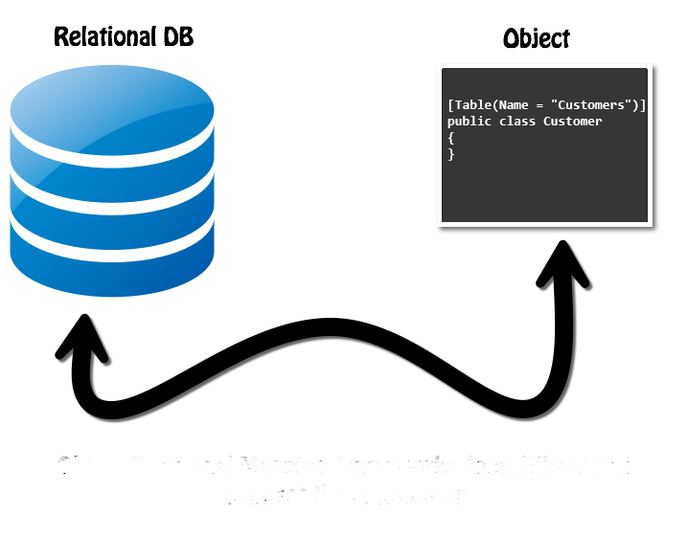

ORM Fundamentals
ADO.NET and ORM Frameworks
SoftUni Team
Technical Trainers
Software University
https://about.softuni.bg/

Slide 2
Questions
sli.do #csharp-db

Slide 3
Table of Contents
Traditional Data Access
ORM Technologies
Basic Concepts
Advantages and Disadvantages
ORM Features
Retrieving Entities from Database
Mapping Navigation Properties
Change Tracking
Generating SQL
3

Slide 4
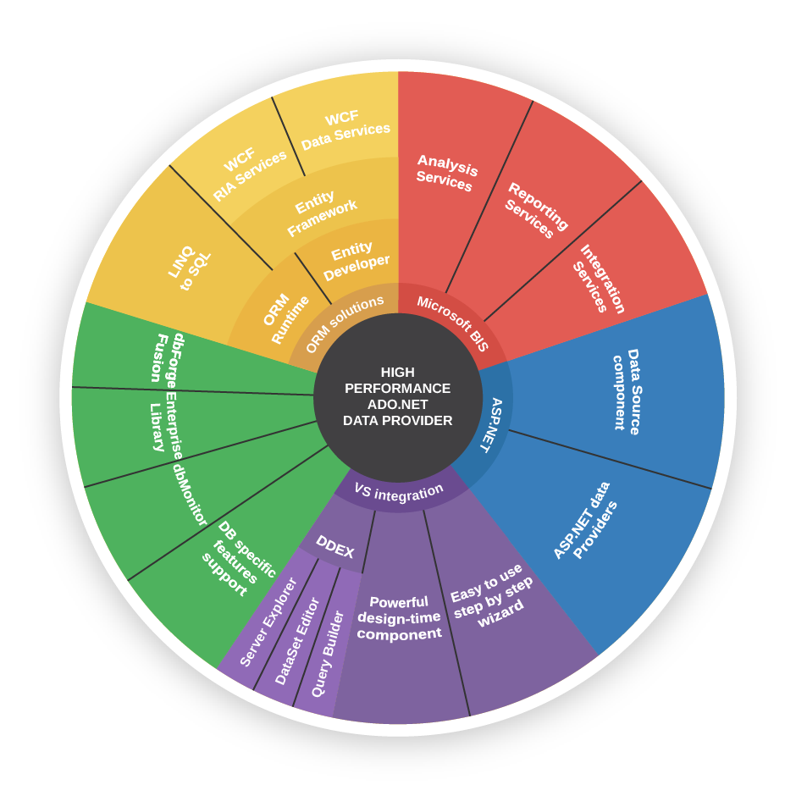
ADO.NET

Slide 5
What is ADO.NET?
ADO.NET is a standard .NET class library for accessing databases, processing data and XML
NuGet package for SQL Server: Microsoft.Data.SqlClient
https://github.com/dotnet/SqlClient
Supports connected, disconnected and ORM data access models
Excellent integration with LINQ
Allows executing SQL in RDBMS systems
Allows accessing data in the ORM approach

Slide 6
Data Providers in ADO.NET
Data Providers are collections of classes that provide access to various databases
For different RDBMS systems different Data Providers are available
Several common objects are defined
Connection – to connect to the database
Command – to run an SQL command
DataReader – to retrieve data

Slide 7
Data Providers in ADO.NET
Several standard ADO.NET Data Providers come as part of .NET Framework
SqlClient – accessing SQL Server
OleDB – accessing standard OLE DB data sources
Odbc – accessing standard ODBC data sources
Oracle – accessing Oracle databases
Third party Data Providers are available for:
MySQL, PostgreSQL, Interbase, DB2, SQLite
Other RDBMS systems and data sources
SQL Azure, Salesforce CRM, Amazon SimpleDB, …

Slide 8
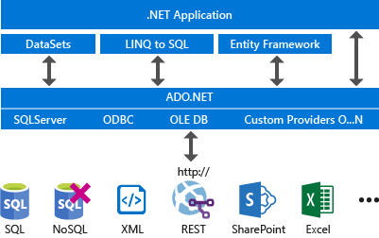
.NET, EF, ADO.NET and Data Providers

Slide 9

SqlClient and ADO.NET Connected Model
Retrieving data in connected model
Open a connection (SqlConnection)
Execute command (SqlCommand)
Process the result set of the query by using a reader (SqlDataReader)
Close the reader
Close the connection
SqlDataReader
SqlParameter
SqlParameter
SqlCommand
SqlParameter
SqlConnection
Database

Slide 10
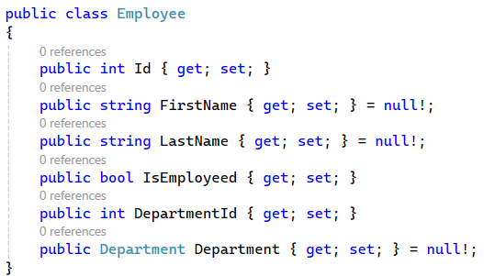
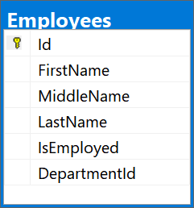
ORM (Object-Relational Mapping)
ORM data access model (Entity Framework Core)
Maps database tables to classes and objects
Objects can be automatically persisted in the database
Can operate in both connected and disconnected modes
OO
Programming
Language
ORM
Framework
Database

Slide 11
ORM – Benefits and Problems
ORM benefits
Less code
Use objects with associations instead of tables and SQL
Integrated object query mechanism
ORM drawbacks
Less flexibility
SQL is automatically generated
Performance issues (sometimes)

Slide 12
ADO.NET: Entity Framework Core
Entity Framework Core is a generic ORM framework
Create entity data model mapping the database
Open an object context
Retrieve data with LINQ / modify the tables in the object context
Persist the object context changes into the DB
Connection is automatically managed

Slide 13
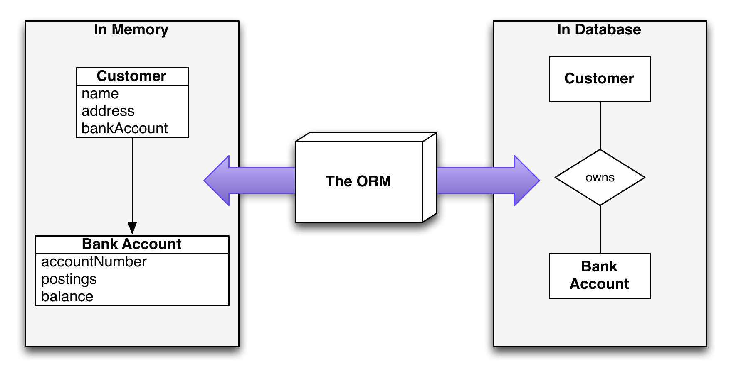
Introduction to ORM
Object-Relational Mapping

Slide 14
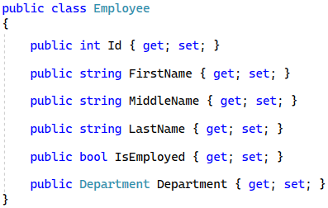
What is ORM?
Object-Relational Mapping (ORM) allows manipulating databases using common classes and objects
Database Tables ➔ C#/Java/etc. classes
14

Slide 15
ORM Frameworks: Features
ORM frameworks typically provide the following functionality
Automatically generate SQL to perform data operations
Create object model from database schema (DB First model)
Create database schema from object model (Code First model)
Query data by object-oriented API (e.g., LINQ queries)
database.Employees.Add(new Employee
{
FirstName = "George",
LastName = "Peterson",
IsEmployed = true });
INSERT INTO Employees
(FirstName, LastName, IsEmployed)
VALUES
('George ', 'Peterson', 1)

Slide 16
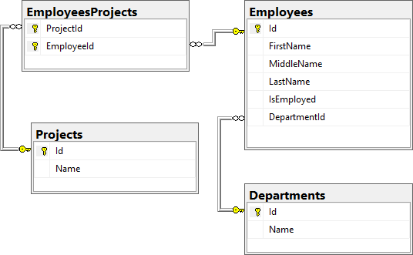
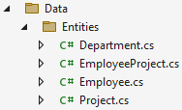
Database First Model
Database First model - models the entity classes after the database

Slide 17
Code-First Model
Code-first model - begins with classes that describe the model and then the ORM generates a database

Slide 18
ORM Advantages and Disadvantages
Advantages
Developer productivity – writing less code
Abstract from differences between object and relational world
Manageability of the CRUD operations for complex relationships
Easier maintainability
Disadvantages
Reduced performance (due to overhead or autogenerated SQL)
Reduces flexibility (some operations are hard to implement)

Slide 19

Entity Classes
Data Holders

Slide 20
Entity Classes
Entity classes are regular C# classes
Used for storing the data from the DB in-memory
20

Slide 21
Entity Classes: Navigation Properties
Reference type properties
Point to relevant object, connected by foreign key
Set by the framework
Example: Employee's Department
public class Employee
{
public int Id { get; set; }
...
public int DepartmentId { get; set; }
public Department Department { get; set; }
}

Slide 22
Entity Classes: Navigation Properties
Navigation Properties can also be collections
Usually of type ICollection<T>
Hold all of the objects whose foreign keys are the same as the entity's primary key
Set by the ORM framework
public class Department
{
public int Id { get; set; }
...
public ICollection<Employee> Employees { get; set; }
}

Slide 23

DbSet<T>
Specialized Collections

Slide 24
DbSet<T> Class
Generic collection with additional features
Each DbSet<T> corresponds to a single database table
Inherits from ICollection<T>
foreach-able
Supports LINQ operations
Usually several DbSets are a part of a DbContext
24

Slide 25
DbSet<T> Features
Each DbSet tracks its own entities through a change tracker
Has every other feature of an ICollection<T>
Accessing the elements (LINQ)
Adding / Updating elements
Removing an entity/a range of entities
Checking for element existence
Accessing the count of elements

Slide 26

DbContext

Slide 27
DbContext Class
Holds several DbSet<T>
Responsible for populating the DbSets
Users create a DbContext, which inherits from DbContext
Using one DbSet per database table
public class SoftUniDbContext : DbContext
{
public DbSet<Employee> Employees { get; set; }
public DbSet<Department> Departments { get; set; }
public DbSet<Project> Projects { get; set; }
}

Slide 28

Reading Data
Querying the DB Using ORM

Slide 29
Using DbContext Class
First create instance of the DbContext
In the constructor, you can pass a database connection string
DbContext properties
All entity classes (tables) are listed as properties
e.g., DbSet<Employee> Employees { get; }
var context = new SoftUniDbContext();

Slide 30
Reading Data with LINQ Query
Executing LINQ-to-Entities query over entity
Employees property in the DbContext
var context = new SoftUniDbContext()
var employees = context.Employees
.Where(e => e.JobTitle == "Design Engineer")
.ToList();
public class SoftUniDbContext : DbContext
{
public DbSet<Employee> Employees { get; }
public DbSet<Project> Projects { get; }
public DbSet<Department> Departments { get; }
}

Slide 31
Reading Data with LINQ Query
We can also use extension methods for constructing the query
Find element by ID
var context = new SoftUniDbContext()
var employees = context.Employees
.Where(c => c.JobTitle == "Design Engineering")
.Select(c => c.FirstName)
.ToList();
var context = new SoftUniEntities()
var project = context.Projects .FirstOrDefault(p => p.Id == 2);
Console.WriteLine(project.Name);

Slide 32
Change Tracking

Slide 33
Change Tracking
Each DbContext instance tracks changes made to entities
These tracked entities in turn drive the changes to the database when SaveChanges is called
Entity instances become tracked when they are
Returned from a query, executed against the database
Explicitly attached to the DbContext by Add, Attach, Update or similar methods
Detected as new entities connected to existing tracked entities
33

Slide 34
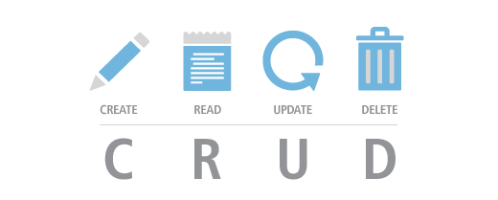
CRUD Operations

Slide 35
Creating New Entities
To create a new table row use the method Add(…) of the corresponding DbSet
Create a new Project object
var project = new Project()
{
Name = "Judge System"
};
context.Projects.Add(project);
context.SaveChanges();
Add the object to the DbSet
Execute SQL statements
35

Slide 36
Updating Existing Entities
DbContext allows modifying entity properties and persisting them in the database
Just load an entity, modify it and call SaveChanges()
The DbContext automatically tracks all changes made on its entity objects
SELECT the first employee
var employee =
context.Employees.FirstOrDefault();
employees.FirstName = "Alex";
context.SaveChanges();
Execute an SQL UPDATE

Slide 37
Deleting Existing Data
Delete is done by Remove() on the specified entity collection
SaveChanges() method performs the delete action in the database
Mark the entity for deleting at the next save
var employee =
context.Employees.First();
context.Employees.Remove(employee);
context.SaveChanges();
Execute the SQL DELETE command

Slide 38

Summary
ADO.NET - Primary Data Access
ORM frameworks map database schema to objects in a programming language
LINQ can be used to query the DB through the DB Context
Change Tracking
CRUD
…
…
…

Slide 39
Trainings @ Software University (SoftUni)
Software University – High-Quality Education, Profession and Job for Software Developers
softuni.bg, about.softuni.bg
Software University Foundation
softuni.foundation
Software University @ Facebook
facebook.com/SoftwareUniversity
39
Notes:
39

Slide 40

License
This course (slides, examples, demos, exercises, homework, documents, videos and other assets) is copyrighted content
Unauthorized copy, reproduction or use is illegal
© SoftUni – https://about.softuni.bg
© Software University – https://softuni.bg
Notes:
40

