Slide 1
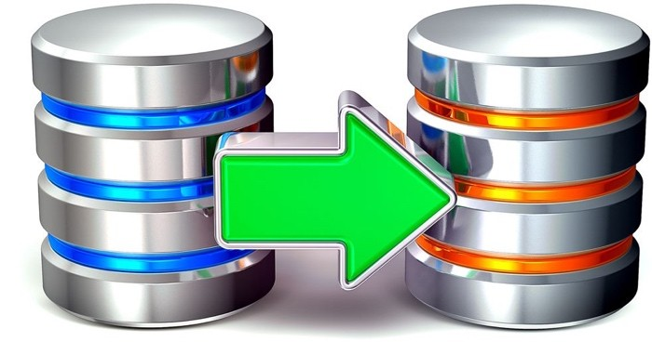
EF Core Migrations
Sync Db Schemas and Applications
SoftUni Team
Technical Trainers
Software University
https://about.softuni.bg/

Slide 2
Have a Question?
sli.do
#csharp-db

Slide 3
Table of Contents
Migrations Overview
Applying Migrations
Understanding the Connection String
Managing Migrations
Customize Migration Code
EF Core Migration Commands
Multiple Providers
Error Handling
3

Slide 4
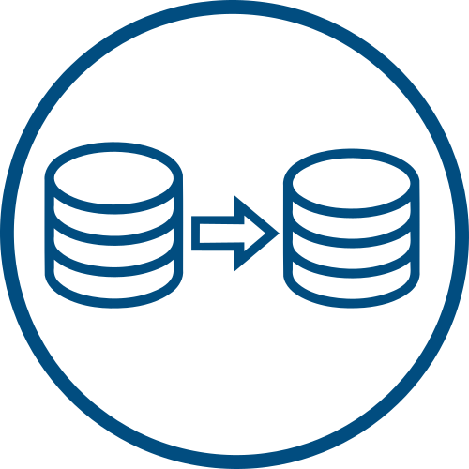
Migrations Overview
First Steps with Migrations

Slide 5
Migrations in EF Core
Data models change as features get implemented
Add new entities or properties
Remove entities, properties
Migrations feature in EF Core:
Allows to update the db schema
Keeps the db schema in sync with the data model
Protects the existing data in the database

Slide 6
How do Migrations Function
Change Introduced
Edited Model
EF Core Tools
Data Model
Compares Edited Model & Snapshot
Model Snapshot
Model Snapshot

Slide 7
How do Migrations Function
Migrations Source Files
Can be tracked in the project's source control like any other source file
Once a Migration has been generated, it can be applied to a database in various ways
EF Core records all applied migrations in a history table
Differences Determined
Migration Source Files

Slide 8

EntityFrameworkCore.Tools
Manage NuGet Packages EntityFrameworkCore.Tools
Create a conceptual model from an existing database
Then graphically visualize and edit your conceptual model
Graphically create a conceptual model first
Then generate a database that supports your model

Slide 9
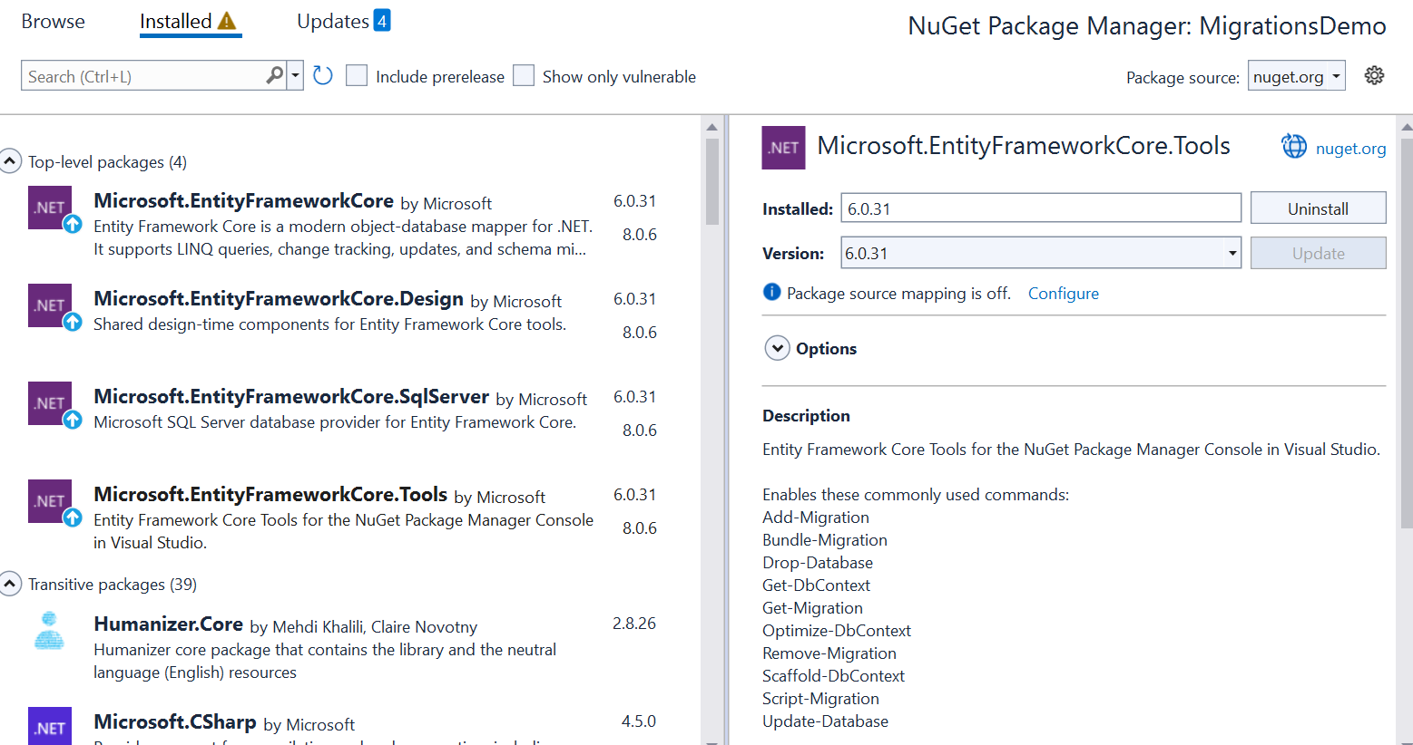
Create Migration – NuGet Packages
Start the MigrationsDemo project in Visual Studio
EFCore.Tools is added to your MigrationsDemo project

Slide 10
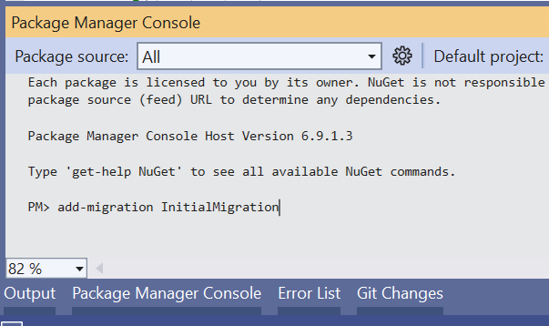
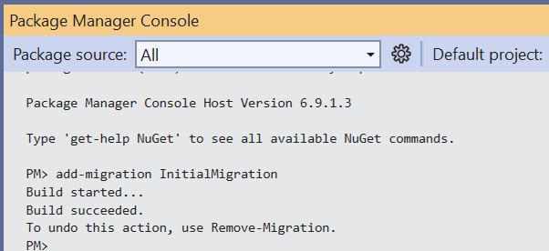
Create Migration – Package Manager Console
Add a migration to the project
Run the command shown
A migration will be created and applied

Slide 11
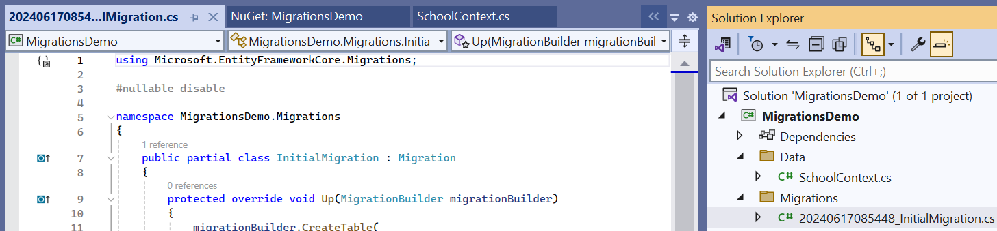
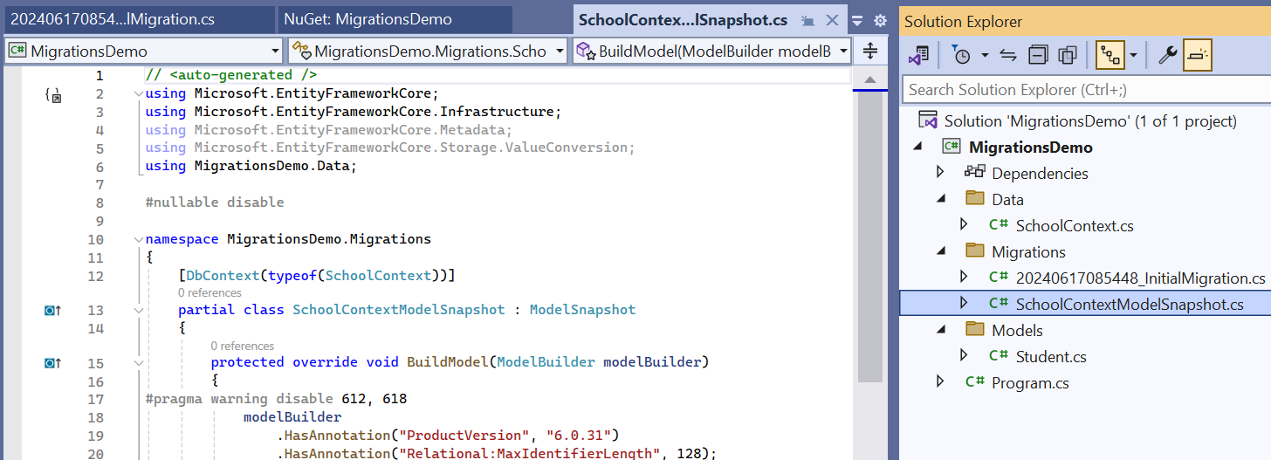
Create Migration – Migration Source Files
Each Migration typically generates two main files:
Migration Class File
Model Snapshot

Slide 12

Applying Migrations
Database Update

Slide 13
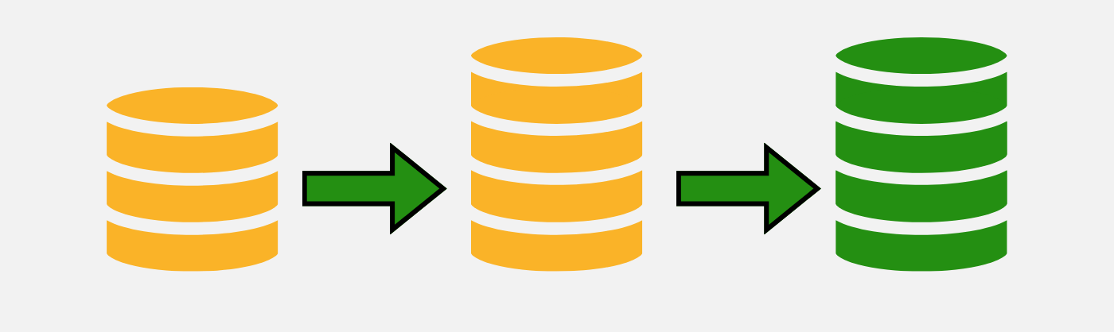
Database Update
What is 'update-database' ?
The 'update-database' command in Entity Framework Core applies any pending migrations to the database
It ensures that the database schema matches the current state of the EF Core model

Slide 14
How It Works?
Checks Migration History
Compares the applied migrations (recorded in '__EFMigrationsHistory' table) with available migrations
Generates SQL
Creates SQL scripts based on the 'Up' methods in pending migrations
Executes SQL
Runs the SQL scripts to update the database schema
Updates History
Records the applied migrations in the '__EFMigrationsHistory' table to avoid reapplying them

Slide 15
Understanding the Connection String
A Connection String is a string that specifies information about a data source and the means of connecting to it
It includes details such as the database server, database name, authentication credentials, and other configuration settings…
Db Server
Db Name
Credentials

Slide 16
Connection String Components
Server
The name or network address of the SQL Server instance (e.g., (localhost)\\mssqllocaldb)
Database
The name of the database to connect to (e.g., School)
Authentication Details
Specify the use of Authentication
Other settings to communicate with the db server

Slide 17
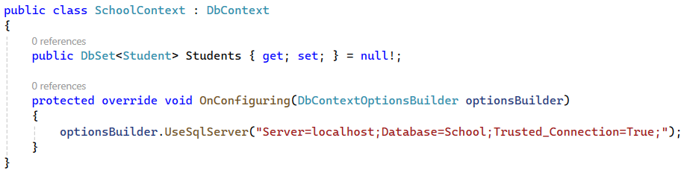
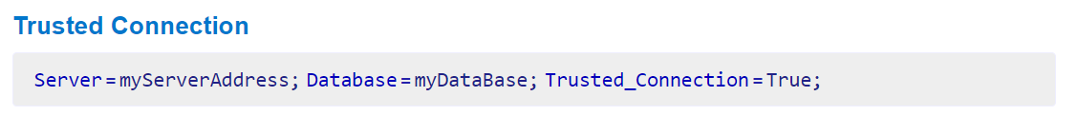
Configuring the Connection String
The Connection String could be defined in the 'OnConfiguring' method of the DbContext class
Example:

Slide 18
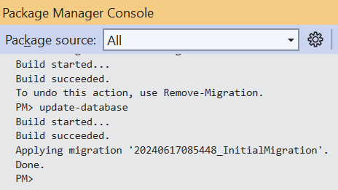
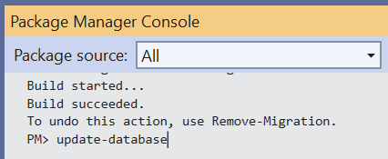
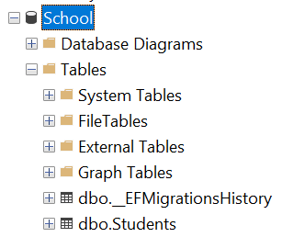
Running the 'Update-Database' Command
Type the 'update-database' command (case insensitive)
Press 'Enter'
This will apply any pending migrations to the database

Slide 19

Managing Migrations
Evolving the Models

Slide 20
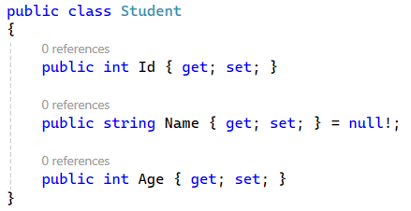
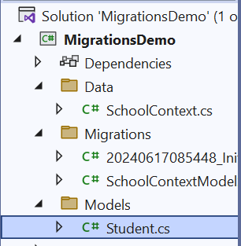
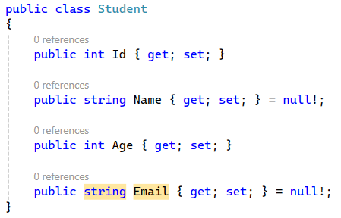
Evolving the Model
Evolve the Student model by adding a new property:
Open the Student class file
Add a new property Email

Slide 21
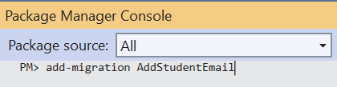
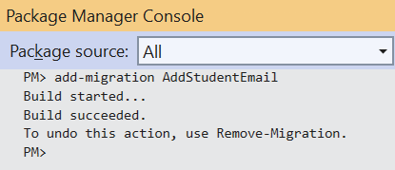
Creating a New Migration
Open the Package Manager Console in Visual Studio
Run the command to create a new migration

Slide 22
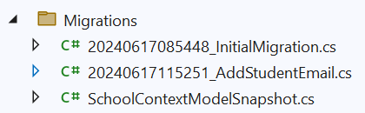
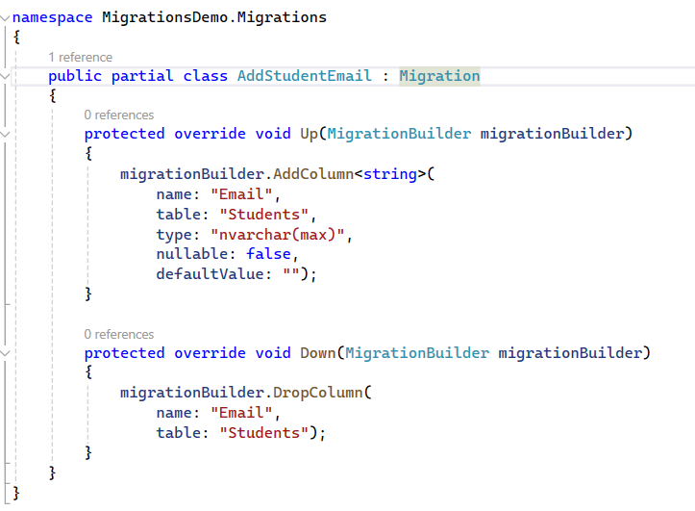
Migration File
EF Core generates a new migration file in the 'Migrations' folder
Up Method
Adds the Email column to the 'Students' table
Down Method
Removes the Email column if the migration is rolled back

Slide 23
Remove a Migration Before Applying It
How to remove a migration before applying it to the database
Open the Package Manager Console
Run the 'remove-migration' command
Why Remove a Migration?
Realized there's an error in the migration
Need to make additional changes to the model
Created a migration accidentally

Slide 24
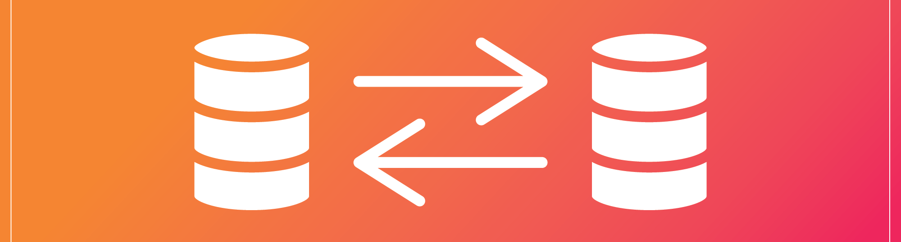

Remove-Migration
The command removes the last migration that has not been applied to the database
It deletes the migration file from the 'Migrations' folder
No Database Changes
Since the migration has not been applied yet, there are no changes made to the database

Slide 25
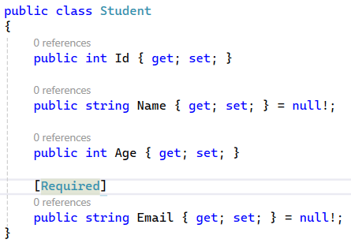
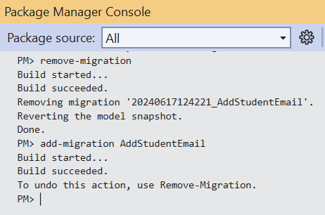
Practical Example
After creating the 'AddStudentEmail' migration, you realize you forgot to set the 'Email' property as required
Instead of applying the migration, you remove it, update the model, and create a new migration

Slide 26
Applying the Migration
Updating the database
Run the 'update-database' command
Verifying the changes
Using SQL Server Management Studio (SSMS)
Open SSMS and connect to the SQL Server instance
Navigate to the 'School' database and refresh the tables
Verify that the 'Students' table now includes the updated 'Email' column

Slide 27
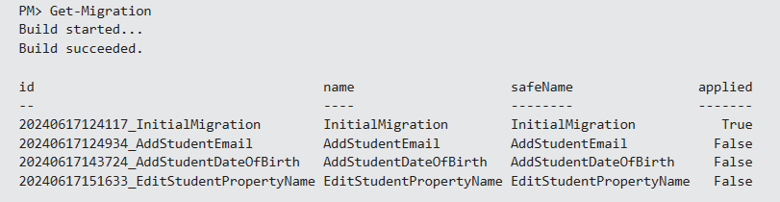
Listing All Migrations
All existing Migrations could be listed by executing 'Get-Migration' command

Slide 28
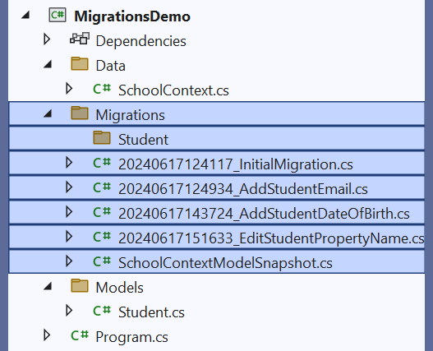
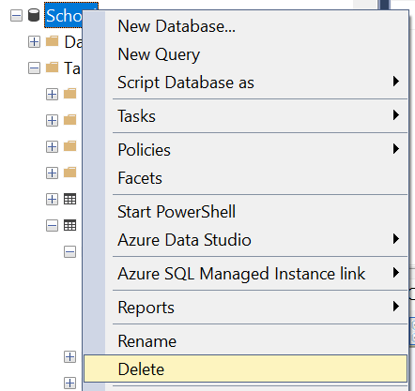
Resetting All Migrations
In some extreme cases, it may be necessary to remove all migrations and start over
This can be easily done by deleting your 'Migrations' folder and dropping your database
At that point you can create a new initial migration, which will contain your entire current schema

Slide 29

Customize Migration Code
Review Migration Files

Slide 30
Why Customize Migrations
Real-World Requirements
Default migration code may not always meet specific business or technical requirements
Customizing migrations allows for more precise control over the database schema changes
Complex Operations
Perform complex data transformations or ensure data integrity during schema changes

Slide 31
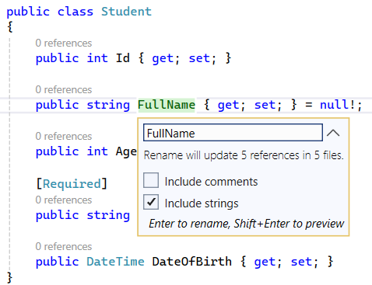
How to Customize Migrations
After creating a migration, EF Core generates code in the Up and Down methods
You can modify this code to suit your specific needs
One example where customizing migrations is required is when renaming a property

Slide 32
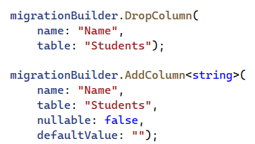

Create Custom Migration
EF Core is unable to know when the intention is to drop a column and create a new one, and when a column should be renamed
If the above migration is applied as-is, all your student names will be lost
To rename a column, replace the above generated migration with the following

Slide 33
Tip
The migration scaffolding process warns when an operation might result in data loss (like dropping a column)
If you see that warning, be especially sure to review the migrations code for accuracy

Slide 34
What Else Could Be Customized?
Adding / Altering Indexes
Custom SQL commands
Adding / Altering Constraints
Adding a Unique Constraint
Adding a Foreign Key Constraint
Data Seeding
Advanced Column Types and Computed Columns

Slide 35

Multiple Providers
Does Db Matter?

Slide 36
Multiple Db Providers
The EF Core Tools only scaffold migrations for the active provider
It is possible to maintain multiple sets of migrations
One for each provider
Adding a migration to each, for every model change
Using multiple context types
Using one context type

Slide 37
Reasons to Work With Multiple Providers
Maybe you are building an application distributed as a Software-as-a-Service (SaaS) product
And a standalone product your customers can install in their data center
SaaS may use PostgreSQL
Customers may have standardized on Microsoft SQL Server
Some customers prefer to use Windows Server and SQL Server database and others prefer to use Linux and MySQL

Slide 38

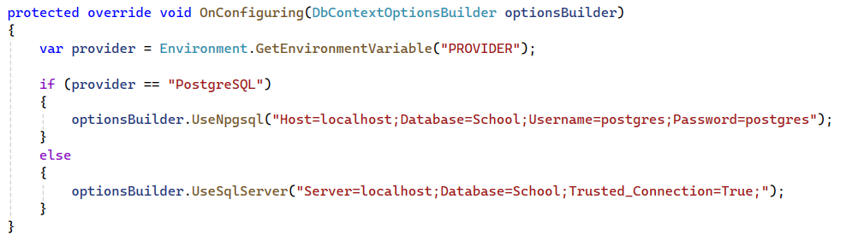
PostgreSQL in EF Core
Add the PotgreSQL provider to your project
Updating the DbContext

Slide 39
Creating Migrations
Create subfolders
In your project, create a 'Migrations' folder if it doesn’t already exist
Within the 'Migrations' folder, create subfolders for each provider, for example:
'SqlServerMigrations'
'PostgreSqlMigrations'

Slide 40
Setting Up Environment Variables
Environment variables store configuration settings outside the codebase
Setting Environment Variables:
For SQL Server
$env:PROVIDER="SqlServer"
For PostgreSQL
$env:PROVIDER="PostgreSQL"

Slide 41

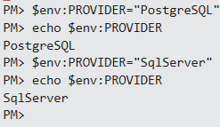
Setting Up Environment Variables
Environment Variable can be easily checked through the Package Manager Console:
echo $env:PROVIDER
The Environment Variable value can be switched through the PM Console:

Slide 42

Creating a Migration for PostgreSQL
Set the correct Environment Variable value
$env:PROVIDER="PostgreSQL"
Create the migration and specify the output directory:
add-migration InitialCreate -o Migrations/PostgreSqlMigrations

Slide 43
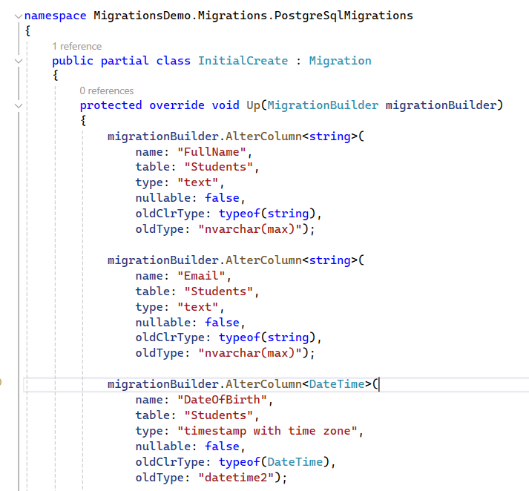
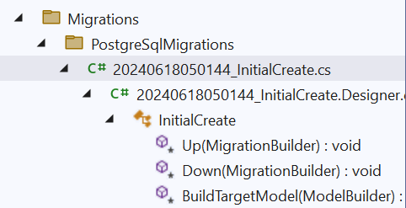
PostgreSQL Migration File
The migration files are located in the specified subfolder

Slide 44

Error Handling
Common Errors and Good Practices

Slide 45

Model and Database Schema Mismatch
Occurs when the model and the database are out of sync
System.InvalidOperationException: The model backing the 'DbContext' context has changed since the database was created.
Ensure all migrations are applied using 'Update-Database'

Slide 46
Migration Conflicts
Conflicts between migrations created by different team members
Migration conflicts can also happen locally
This can occur if you make multiple changes to your model and generate migrations without applying them in sequence
System.Data.SqlClient.SqlException: There is already an object named 'TableName' in the database.

Slide 47
Migration Conflicts
Solutions:
Apply migrations in sequence to keep the local database schema in sync with the model
Communicate and coordinate migration creation within the team
Merge conflicting migrations manually if necessary

Slide 48
SQL Syntax Errors
Errors in the SQL commands generated by EF Core
System.Data.SqlClient.SqlException: Incorrect syntax near 'keyword’.
Solution:
Review and customize the migration code to correct SQL syntax
Use 'migrationBuilder.Sql' to execute raw SQL if needed

Slide 49
Data Loss Issues
Risk of data loss when dropping or renaming columns incorrectly
No specific error, but data may be lost
Solution:
Use 'RenameColumn' instead of dropping and adding columns
Backup data before applying risky migrations

Slide 50

Summary
…
…
…
Purpose and benefits of migrations in EF Core
Essential commands
Creating and applying migrations
Customizing migration code
Configuring and managing connection strings
Organizing migrations and applying them in sequence
Error Handling

Slide 51
Trainings @ Software University (SoftUni)
Software University – High-Quality Education, Profession and Job for Software Developers
softuni.bg, about.softuni.bg
Software University Foundation
softuni.foundation
Software University @ Facebook
facebook.com/SoftwareUniversity
51
Notes:
51

Slide 52

License
This course (slides, examples, demos, exercises, homework, documents, videos and other assets) is copyrighted content
Unauthorized copy, reproduction or use is illegal
© SoftUni – https://about.softuni.bg
© Software University – https://softuni.bg
Notes:
52

