Slide 1

EF Core Essentials
Key Optimizing Strategies for Better Performance
SoftUni Team
Technical Trainers
Software University
https://about.softuni.bg/

Slide 2
Have a Question?
sli.do
#csharp-db

Slide 3
Table of Contents
EF Core Features Overview
Generic Repository Design Pattern
Inversion of Control
Dependency Injection
3

Slide 4

Features in EF Core
Overview

Slide 5
Recap of EF Core Basics
Entity Framework Core is a lightweight, extensible, cross-platform
ORM (Object Relational Mapping) framework for .NET applications
Provides a high-level abstraction for managing relational databases with minimal code
Supports many database engines

Slide 6
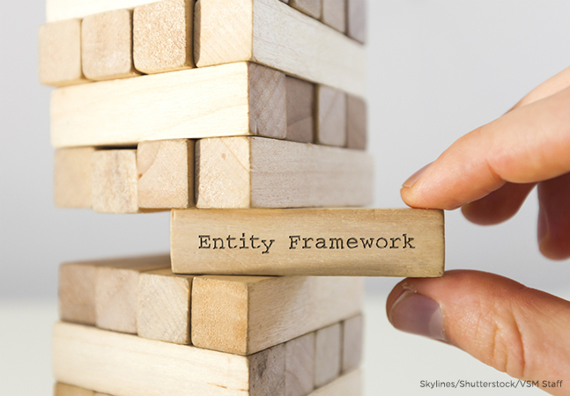
The Model
With EF Core, data access is performed using a model
A model is made up of entity classes and a context object that represents a session with the database
The context object allows querying and saving data

Slide 7
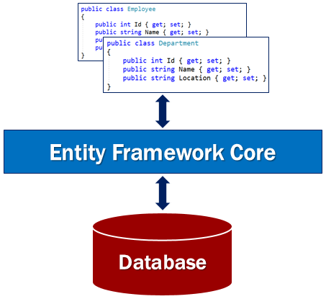
Model Development Approaches
Generate a model from an existing database
Hand code a model to match the database
Once a model is created, use EF Migrations to create a database from the model
Migrations allow evolving the database as the model changes

Slide 8

Querying
Instances of entity classes are retrieved from the database using Language Integrated Query (LINQ)
LINQ allows you to use C# to write strongly typed queries
It uses your derived context and entity classes to reference database objects

Slide 9
Querying
EF Core passes a representation of the LINQ query to the database provider
Database providers in turn translate it to database-specific query language
Queries are always executed against the database even if the entities returned in the result already exist in the context
Querying allows you to read data from the database

Slide 10

Saving Data
Data is created, deleted, and modified in the database using instances of your entity classes
Saving data means adding new entities to the database, removing entities, or modifying the properties of existing entities in some way

Slide 11
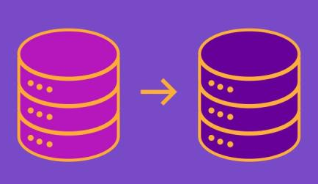
Saving Data Approaches
Entity Framework Core (EF Core) supports two fundamental approaches for saving data to the database:
Change tracking and SaveChanges
ExecuteUpdate and ExecuteDelete ("bulk update")

Slide 12

Local Generic Repository
Repository Pattern

Slide 13
Repository Pattern
Without Repository direct access to DbContext
The Repository Pattern is a fundamental design pattern in software development
Provides an abstraction layer between the application's data access logic and the underlying data source
It promotes separation of concerns and enhances code maintainability, testability, and scalability

Slide 14

Generic Repository Pattern
The Generic Repository pattern in C# is a design pattern that abstracts the application's data layer, making it easier to manage data access logic across different data sources
It aims to reduce redundancy by implementing common data operations in a single, generic repository rather than having separate repositories for each entity type

Slide 15
Key Concepts
Generic Interface
A generic repository typically starts with a generic interface defining common operations like Add, Delete, Find, and Update
These operations are defined in a generic way, applicable to any entity type
Implementation
The generic interface is then implemented in a concrete class
This class handles the data source interactions, such as querying a database using an ORM (like Entity Framework)
Entity Framework Context
The implementation will often utilize an Entity Framework context to interact with the database

Slide 16
Why Do We Need Generic Repository DP
In a Basic Repository or Non-Generic Repository, we need to create separate repositories for every entity in our application
For example, if we have three entities:
Employee, Product, and Customer
We need to create three repositories: EmployeeRepository, ProductRepository, and CustomerRepository

Slide 17
DRY Principle
Creating separate repositories is boring and repetitive work
Especially if all the repositories will do the same kind of work
Typically database CRUD operations
This is against the DRY (Don’t Repeat Yourself) principle
To solve the above problem, the Generic Repository Design Pattern comes into the picture

Slide 18
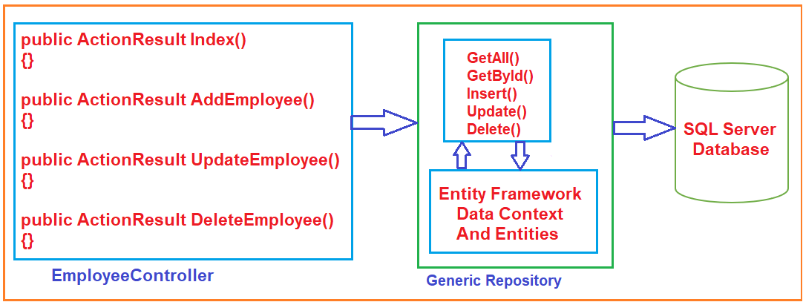
Example

Slide 19
Inversion of Control Design Principle
The IoC Design Principle suggests the inversion of various types of controls in object-oriented design to achieve loose coupling between the application classes
The Main class should NOT have a concrete implementation of an aggregated class
It should depend on the abstraction of that class
Here, control means any extra responsibilities a class has other than its main or fundamental responsibility

Slide 20
What is Dependency Injection?
IoC can be done using Dependency Injection (DI)
How to inject concrete implementation into a class using abstraction (an interface inside)
The main idea of dependency injection is to reduce the coupling between classes and move the binding of abstraction and concrete implementation out of the dependent class
DI is how one object knows about another abstracted dependent object

Slide 21
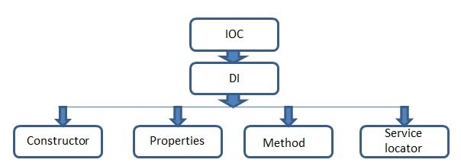
Ways to Achieve DI
Injection via Constructor
Injection via Property
Injection via Method
Injection via Service Locator

Slide 22

Live Demo
Cinema Web Application
Notes:
22

Slide 23

Summary
EF Core main features Overview
Generic Repository Design Pattern
IoC and DI
…
…
…

Slide 24
Trainings @ Software University (SoftUni)
Software University – High-Quality Education, Profession and Job for Software Developers
softuni.bg, about.softuni.bg
Software University Foundation
softuni.foundation
Software University @ Facebook
facebook.com/SoftwareUniversity
24
Notes:
24

Slide 25

License
This course (slides, examples, demos, exercises, homework, documents, videos and other assets) is copyrighted content
Unauthorized copy, reproduction or use is illegal
© SoftUni – https://about.softuni.bg
© Software University – https://softuni.bg
Notes:
25

