Slide 1
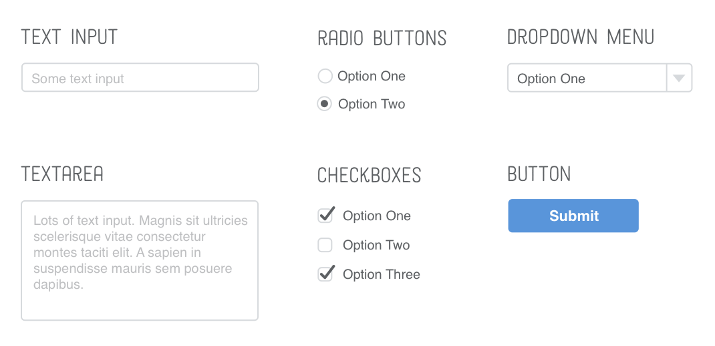
Working with Forms
SoftUni Team
Technical Trainers
Software University
https://softuni.bg

Slide 2
Table of Contents
What are Forms?
How do we Use Them?
Styling a Form
Responsive Forms with Flexbox
Advanced Styling

Slide 3

HTML Forms

Slide 4
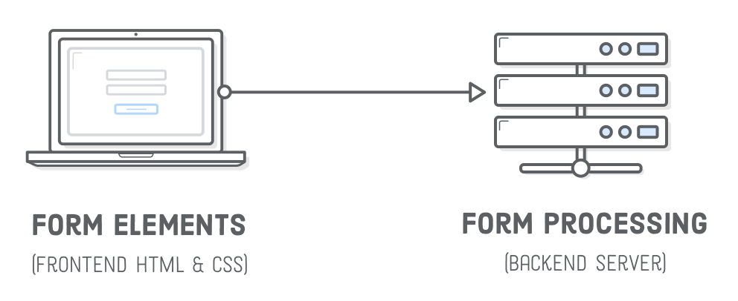
HTML Forms
The HTML form element represents a document section that contains interactive controls for submitting information to a web server

Slide 5
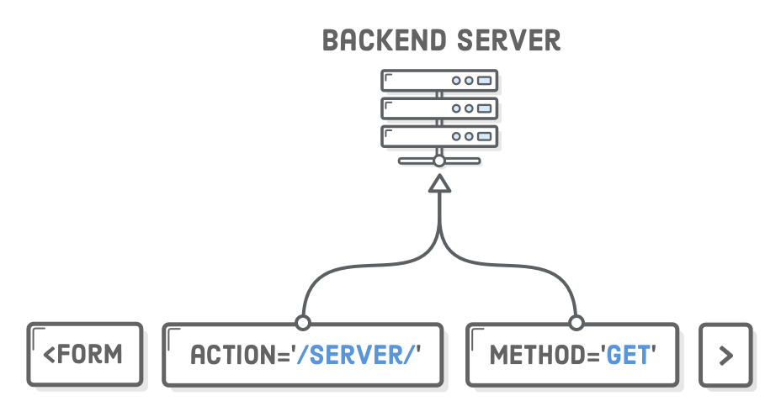
HTML Forms
Attributes - Method
The HTTP method that the browser uses to submit the form

Slide 6
HTML Forms
Attributes – Method – Post
Corresponds to the HTTP POST method
Form data are included in the body of the form and sent to the server

Slide 7
HTML Forms
Attributes – Method – Get
get - Corresponds to the HTTP GET method
Form data are appended to the action attribute URI with a '?' as separator, and the resulting URI is sent to the server
Use this method when the form has no side-effects and contains only ASCII characters

Slide 8
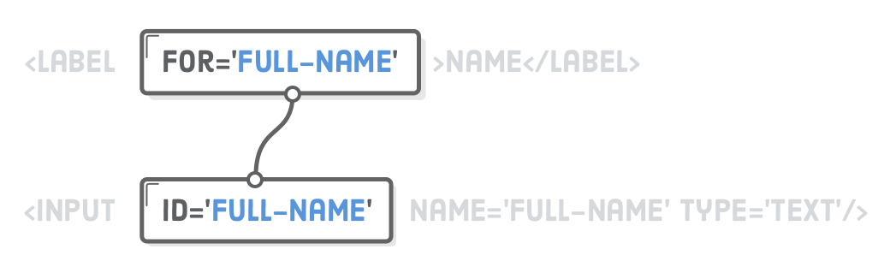
HTML Form – HTML Tags
Label
The HTML label element represents a caption for an item in a user interface

Slide 9
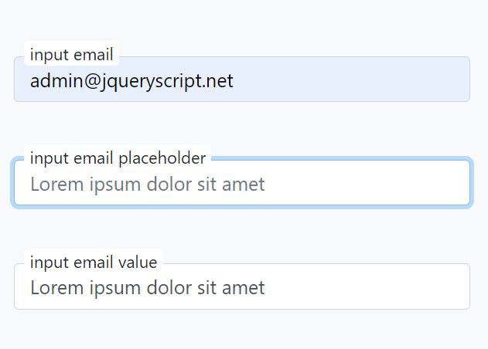
HTML Form – HTML Tags
Label
The label text is not only visually associated with its corresponding text input
It is programmatically associated with it too
You can click the associated label to focus/activate the input, as well as the input itself
This increased hit area provides an advantage to anyone trying to activate the input, including those using a touch-screen device

Slide 10
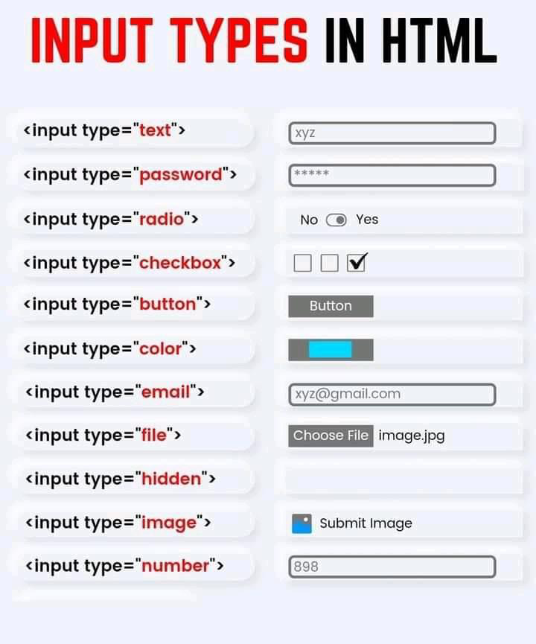
HTML Form – HTML Tags
Input
Used to create interactive controls for web-based forms in order to accept data from the user
A wide variety of types of input data and control widgets are available, depending on the device and user agent
The <input> element is one of the most powerful and complex in all of HTML due to the sheer number of combinations of input types and attributes

Slide 11
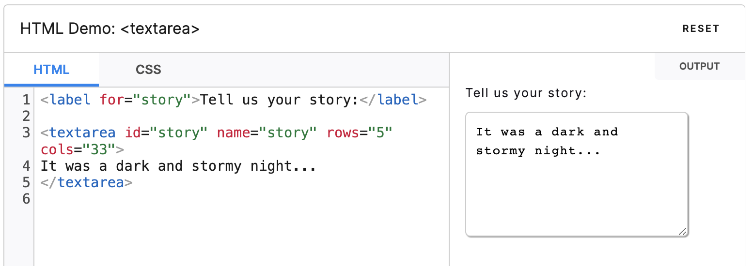
HTML Form – HTML Tags
Textarea
Represents a multi-line plain-text editing control, useful when you want to allow users to enter a sizeable amount of free-form text, for example a comment on a review or feedback form

Slide 12
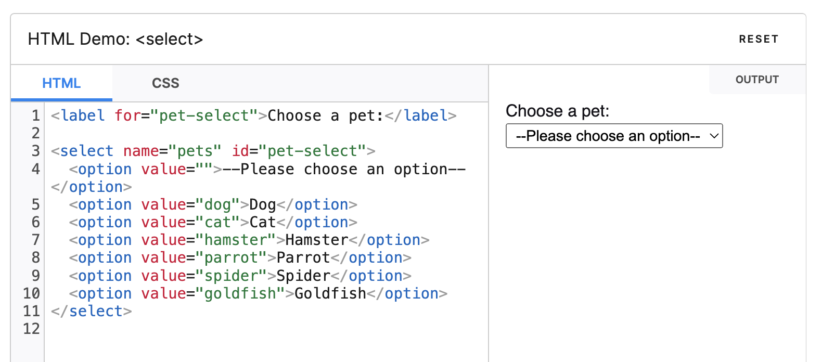
HTML Form – HTML Tags
Select & Option
The <select> HTML element represents a control that provides a menu of options
The <option> HTML element is used to define an item contained in a <select>, an <optgroup>, or a <datalist> element. As such, <option> can represent menu items in popups and other lists of items in an HTML document

Slide 13
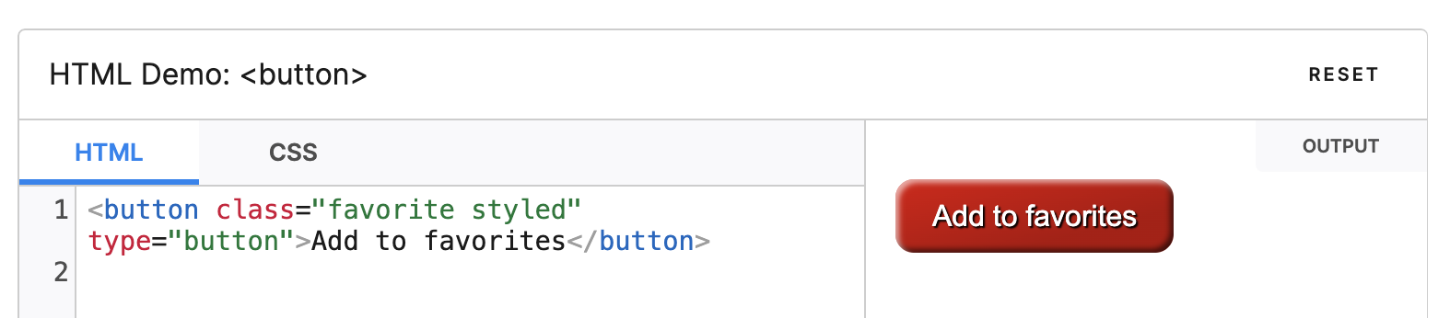
HTML Form – HTML Tags
Button
Interactive element activated by a user with a mouse, keyboard, finger, voice command, or other assistive technology. Once activated, it then performs an action, such as submitting a form or opening a dialog

Slide 14
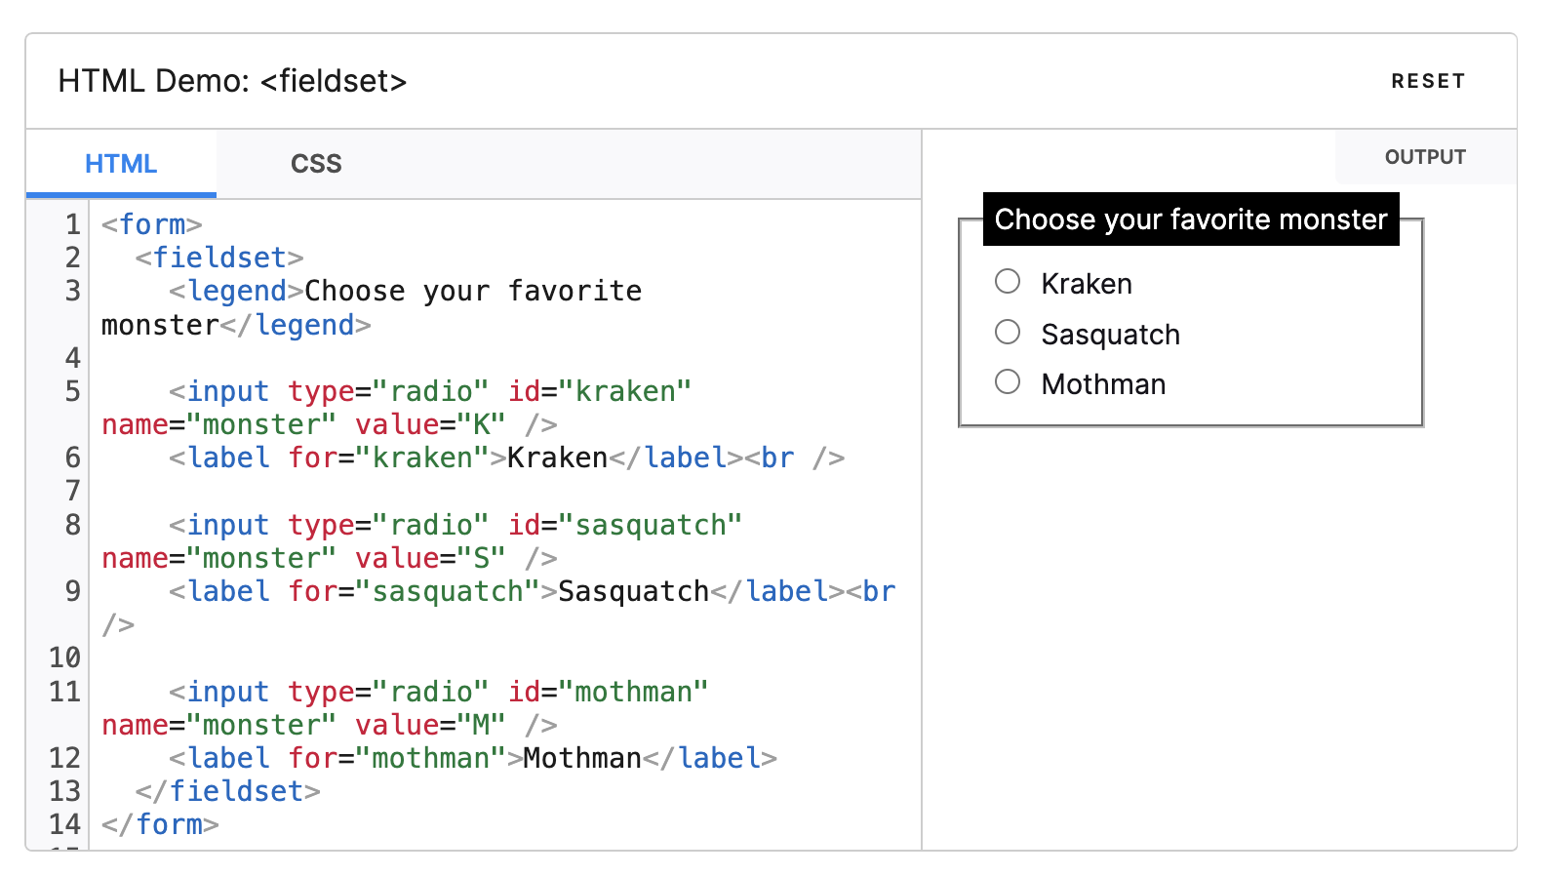
HTML Form – HTML Tags
Fieldset & Legend
The HTML fieldset element is used to group several controls as well as labels within a web form

Slide 15
Resources
https://developer.mozilla.org/en-US/docs/Web/HTML/Element/form
https://developer.mozilla.org/en-US/docs/Learn/HTML/Forms/How_to_structure_an_HTML_form
https://developer.mozilla.org/en-US/docs/Learn/HTML/Forms/Your_first_HTML_form
https://developer.mozilla.org/en-US/docs/Learn/HTML/Forms/Styling_HTML_forms
https://css-tricks.com/tips-for-creating-great-web-forms
https://css-tricks.com/options-for-web-forms

Slide 16
Resources
Floating label
https://codepen.io/callmenick/pen/OxpKNZ
https://codepen.io/tonystar/pen/LRdpYZ
https://codepen.io/elujambio/pen/yjwzGP

Slide 17

Summary
…
…
…
What are Forms?
How do we Use Them?
Styling a Form
Responsive Forms with Flexbox
Advanced Styling

Slide 18
Trainings @ Software University (SoftUni)
Software University – High-Quality Education, Profession and Job for Software Developers
softuni.bg, about.softuni.bg
Software University Foundation
softuni.foundation
Software University @ Facebook
facebook.com/SoftwareUniversity
18
Notes:
18

Slide 19

License
This course (slides, examples, demos, exercises, homework, documents, videos and other assets) is copyrighted content
Unauthorized copy, reproduction or use is illegal
© SoftUni – https://about.softuni.bg/
© Software University – https://softuni.bg
Notes:
19

