Slide 1
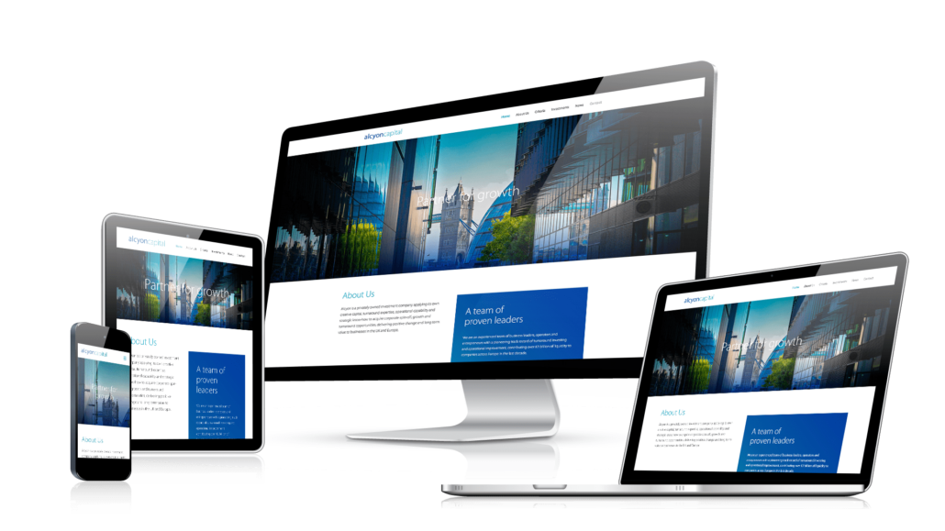
Responsive Web Design
SoftUni Team
Technical Trainers
Software University
https://softuni.bg

Slide 2
Table of Contents
What is Responsive Web Design?
Why is it Important?
Media Queries

Slide 3

Responsive Web Design

Slide 4
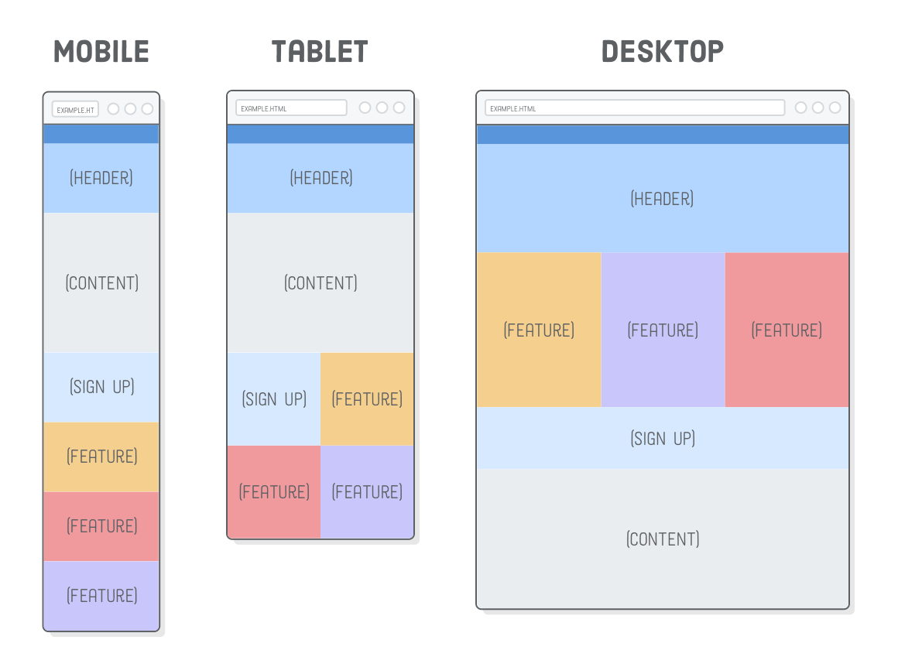
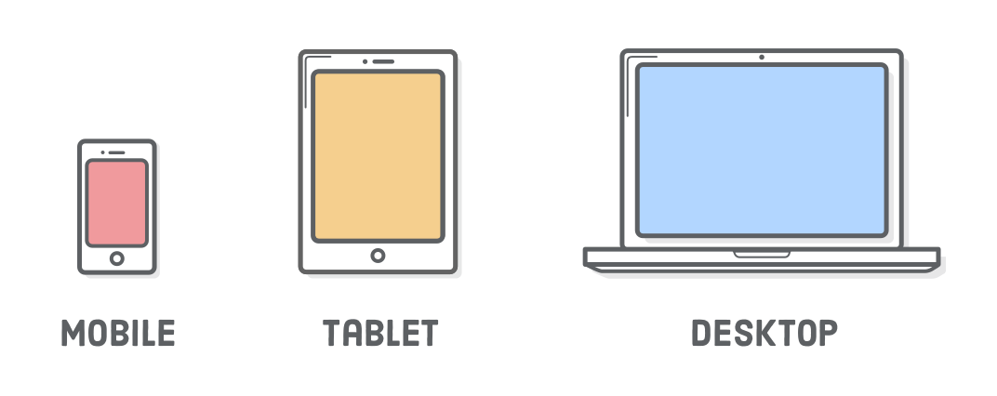
What is Responsive Web Design?
It is an approach to make web pages render well on all screen sizes and resolutions while ensuring good usability
It is the way to design for a multi-device web

Slide 5
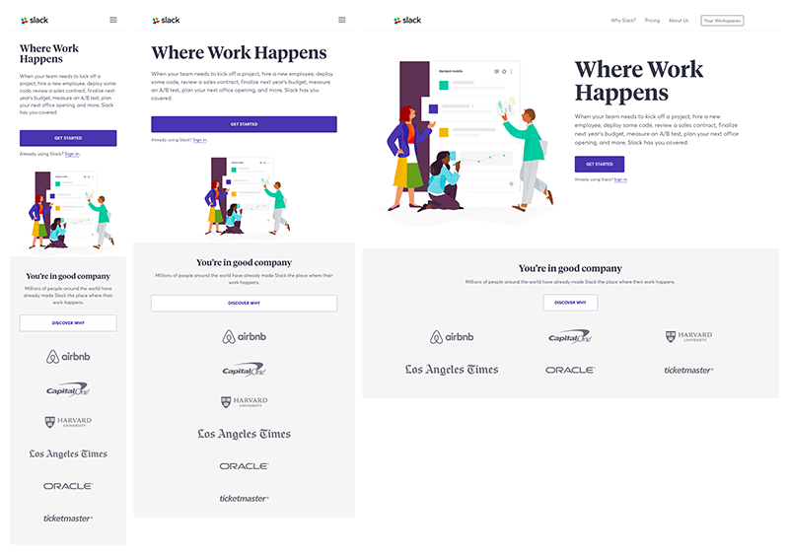
What is Responsive Web Design?
Ethan Marcotte wrote an introductory article about the approach, Responsive Web Design, for A List Apart
https://developer.mozilla.org/en-US/docs/Learn/CSS/CSS_layout/Responsive_Design

Slide 6
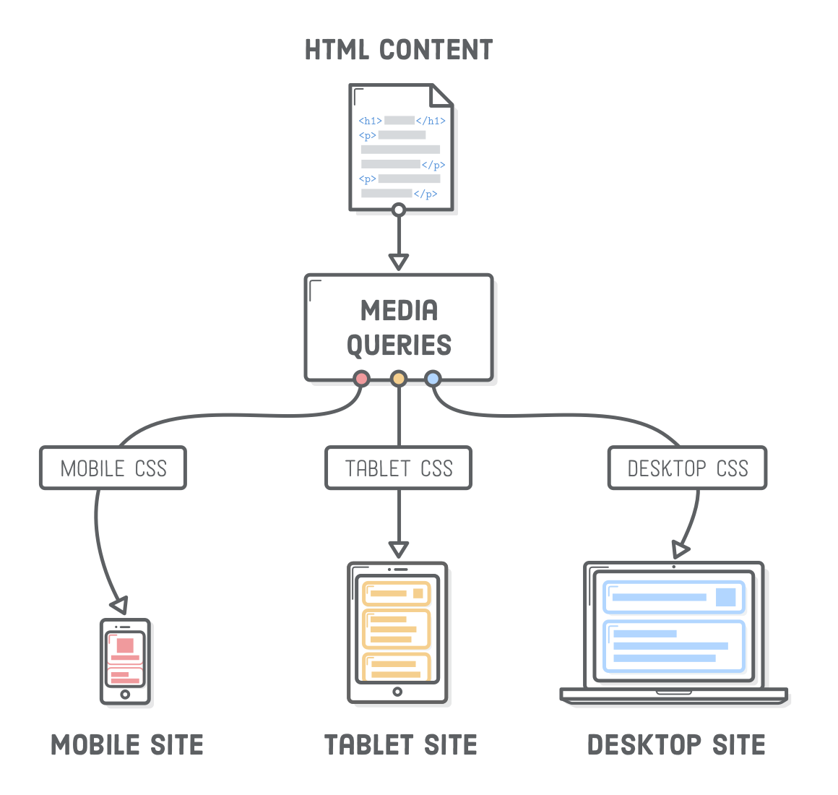
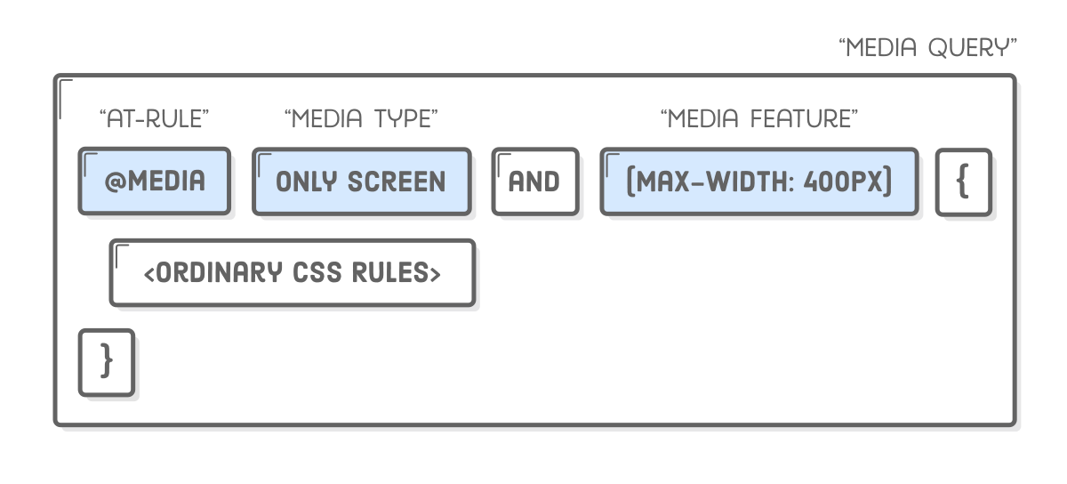
Responsive Web Design – How?
Media Queries - Allow us to run a series of tests (e.g., whether the user's screen is greater than a certain width, or a certain resolution) and apply CSS selectively to style the page appropriately for the user's needs

Slide 7
Media Queries
In HTML
Media Queries can be applied to various elements:
In the link element's media attribute, they define the media to which a linked resource (typically CSS) should be applied
In the source element's media attribute, they define the media to which that source should be applied (This is only valid inside picture elements)
In the style element's media attribute, they define the media to which the style should be applied

Slide 8
Media Queries
Media Types
Media types describe the general category of a given device
Although, websites are commonly designed with screens in mind, you may want to create styles that target special devices such as printers or audio-based screen readers
@media print { ... } @media screen, print { ... }

Slide 9
Media Queries
@import
The @import CSS at-rule is used to import style rules from other style sheets
These rules must precede all other types of rules, except @charset rules
As it is not a nested statement, @import cannot be used inside conditional group at-rules
@import url('styles.css') screen;

Slide 10

Media Queries
Media Features
Media features describe a specific characteristic of the user agent, output device, or environment:
@media screen and (min-width: 600px) {
…
}

Slide 11
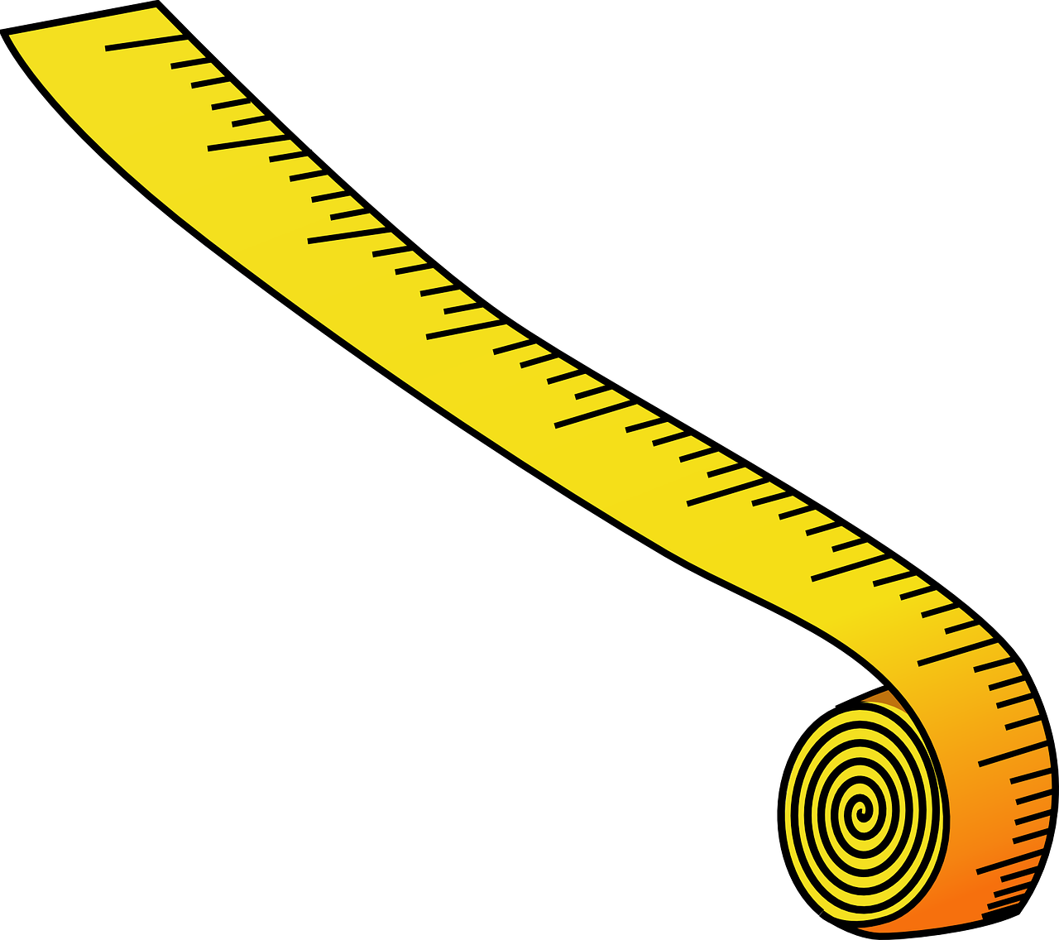
Media Queries
Media Features – min-width
Specifies a minimal width for the viewport in order to apply the rules included
@media screen and (min-width: 600px) {
…
}

Slide 12
Media Queries
Media Features – max-width
Specifies a maximum width for the viewport up to which it will apply the rules included
@media screen and (max-width: 600px) {
…
}

Slide 13
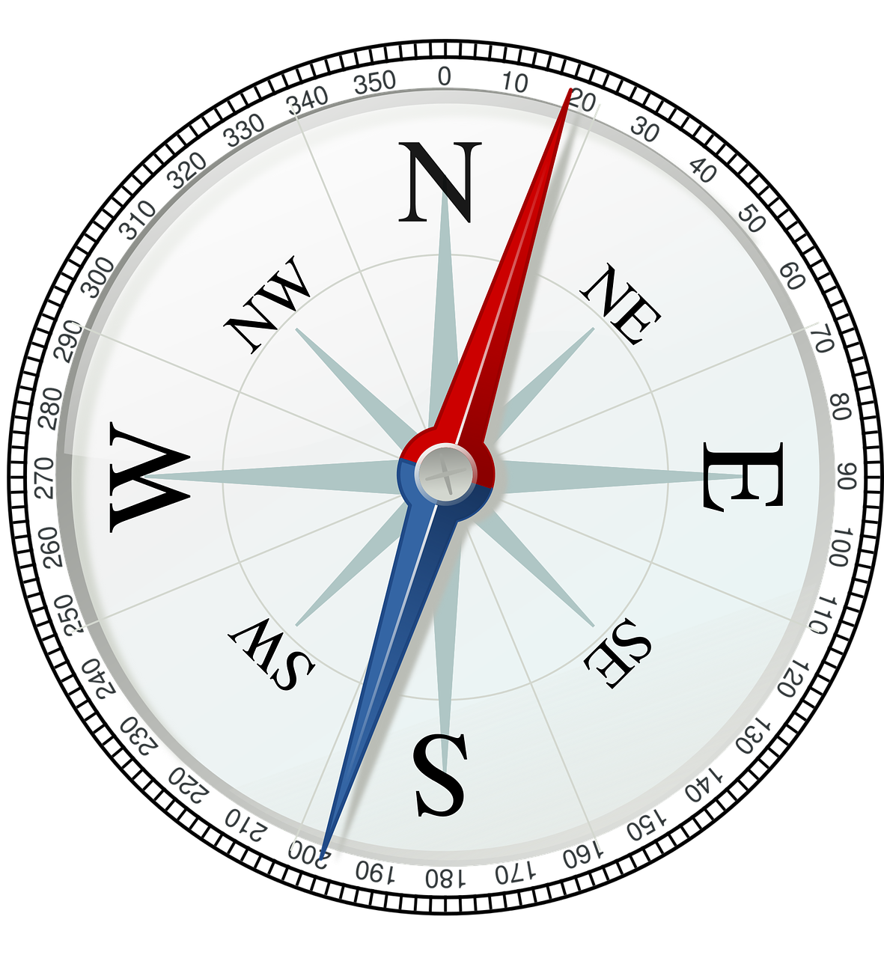
Media Queries
Media Features – orientation
Specifies a device orientation for which it will apply the rules included
@media screen and (orientation: landscape) {
…
}

Slide 14

Media Queries
Media Features – hover
Checks for a device ability for which it will apply the rules included
@media screen and (hover: hover) {
…
}

Slide 15
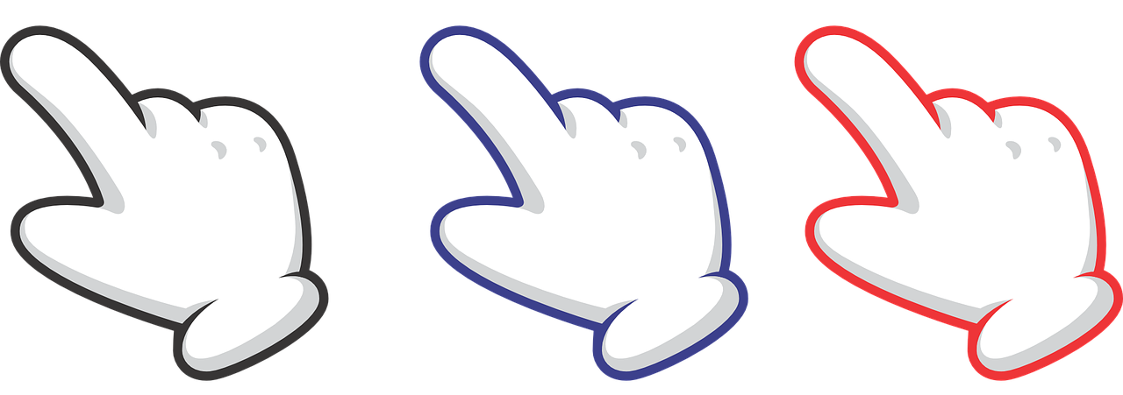
Media Queries
Media Features – pointer
Checks for a device ability for which it will apply the rules included
@media screen and (pointer: fine) {
…
}

Slide 16

Media Queries
Logical operators
The logical operators only can be used to compose a complex media query
You can also combine multiple media queries into a single rule by separating them with commas
@media screen and (pointer: fine) {
…
}

Slide 17
Media Queries
Logical operators – and
The and operator is used for combining multiple media features together into a single media query, requiring each chained feature to return true in order for the query to be true
It is also used for joining media features with media types
@media screen and (pointer: fine) {
…
}

Slide 18
Media Queries
Logical operators – not
The not operator is used to negate a media query, returning true if the query would otherwise return false
If present in a comma-separated list of queries, it will only negate the specific query to which it is applied
If you use the not operator, you must also specify a media type
@media screen not (pointer: fine) {
…
}

Slide 19
Media Queries
Logical operators – only
The only operator is used to apply a style only if an entire query matches and is useful for preventing older browsers from applying selected styles
If you use the only operator, you must also specify a media type
@media only screen and (pointer: fine) {
…
}

Slide 20
Media Queries
Logical operators – , (comma)
Commas are used to combine multiple media queries into a single rule
Each query in a comma-separated list is treated separately from the others
Thus, if any of the queries in a list is true, the entire media statement returns true. In other words, lists behave like a logical or operator
@media (min-height: 680px), only screen and (orientation: portrait) {
...
}

Slide 21
Resources
https://developer.mozilla.org/en-US/docs/Web/CSS/Media_Queries
https://developer.mozilla.org/en-US/docs/Web/CSS/@import
https://developer.mozilla.org/en-US/docs/Web/CSS/Media_Queries/Testing_media_queries
https://developer.mozilla.org/en-US/docs/Web/CSS/Media_Queries/Using_media_queries#Media_features
https://caniuse.com/#feat=css-mediaqueries
https://css-tricks.com/snippets/css/media-queries-for-standard-devices/
https://responsivedesign.is/articles/why-you-dont-need-device-specific-breakpoints/
https://davidwalsh.name/animate-media-queries
https://mediaqueri.es/
https://responsivedesign.is/

Slide 22

Summary
…
…
…
What is Responsive web design?
Why is it important?
Media Queries

Slide 23
Trainings @ Software University (SoftUni)
Software University – High-Quality Education, Profession and Job for Software Developers
softuni.bg, about.softuni.bg
Software University Foundation
softuni.foundation
Software University @ Facebook
facebook.com/SoftwareUniversity
23
Notes:
23

Slide 24

License
This course (slides, examples, demos, exercises, homework, documents, videos and other assets) is copyrighted content
Unauthorized copy, reproduction or use is illegal
© SoftUni – https://about.softuni.bg/
© Software University – https://softuni.bg
Notes:
24

