Slide 1
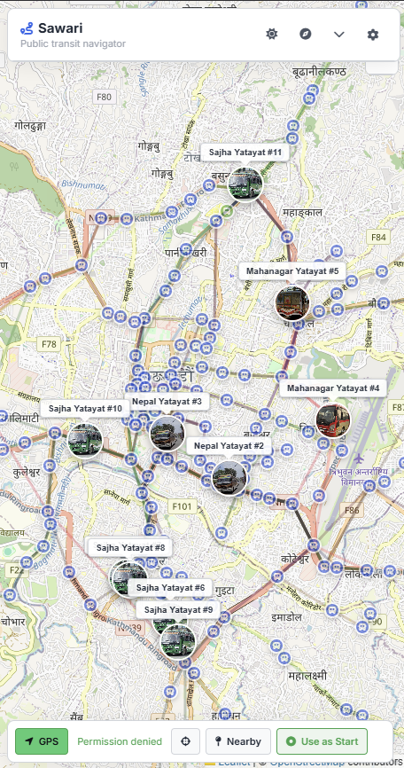
AI HACKATHON 2026 · TEAM SPARK
Sawari
App screenshot
(map + route result)
सवारी
Smart public transit navigation
for Kathmandu Valley.
Sakshyam Bastakoti
Sakshyam Upadhaya
Zenith Kandel

Slide 2
01 / THE PROBLEM
I'm new to Kathmandu.
How do I get around?
Ride Sharing
Private Vehicle
Public Bus
Pathao · InDrive · Yango
Own bike or car
Cheap · Efficient · Reliable
Easy to use, but expensive — and high carbon emissions. Not sustainable for daily commuting.
Fast and flexible, but most newcomers don't arrive with their own vehicle.
The obvious choice — but where do you start? Which bus? When? How much?
Expensive & polluting
Not accessible
कहाँ? कुन? कहिले? कसरी? कति?
The public bus is the right answer — but no one knows how to use it.

Slide 3
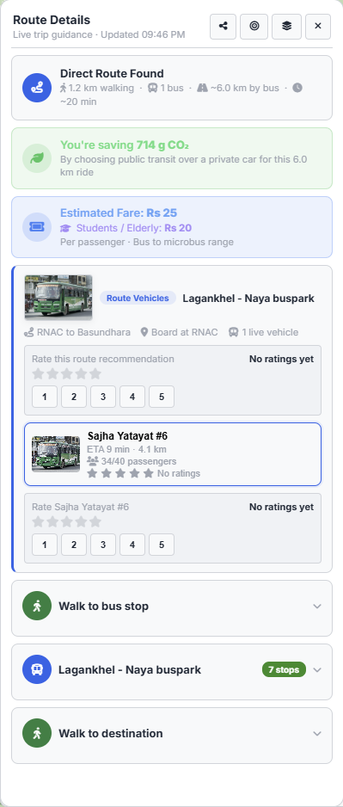
02 / THE SOLUTION
Sawari answers
all five questions.
कहाँ?
WHERE?
Shows you the nearest bus stop on a live map
कुन?
WHICH?
Finds the right bus — direct or with transfers
कहिले?
WHEN?
Live vehicle tracking with real-time ETA
कसरी?
HOW?
Step-by-step walking + boarding + alighting guide
कति?
HOW MUCH?
Official DoTM fares with student & elderly discounts
🌱 Reduces CO₂ vs ride-sharing 💰 5–10× cheaper than Pathao or InDrive

Slide 4
03 / KEY FEATURES
Built for real commuters.
—
AI Natural Language Input
—
Live Bus Tracking
Type or speak naturally in Nepali or English — no stop names needed
Positions update every 3 seconds with smooth animated movement on map
—
Fare Calculator
—
Transfer Routing
DoTM-based tariff: bus, microbus, with student & elderly discounts
Multi-leg routes when no direct bus runs between two points
—
Carbon Savings
—
GPS + Nearby Stops
Every trip shows CO₂ saved vs private car — a gentle green nudge
Real-time location, compass, and one-tap start from your position
No login required · No app download · Works on any browser

Slide 5
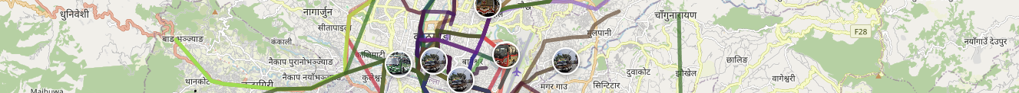
04 / HOW IT WORKS
From question to journey
in seconds.
01
02
03
04
Enter your destination
AI plans your route
Track your bus live
Board and save money
Type, tap the map, or say it in plain Nepali or English
Sawari finds the best bus — with transfers if needed
See it on the map with ETA and current passenger count
Know your exact fare before boarding. Help the planet too.

Slide 6
SAWARI · AI HACKATHON 2026 · TEAM SPARK
Thank you.
Smarter, greener, cheaper commuting for Kathmandu.
कहाँ?
कुन?
कहिले?
कसरी?
कति?
All answered.
Team Spark

