Slide 1
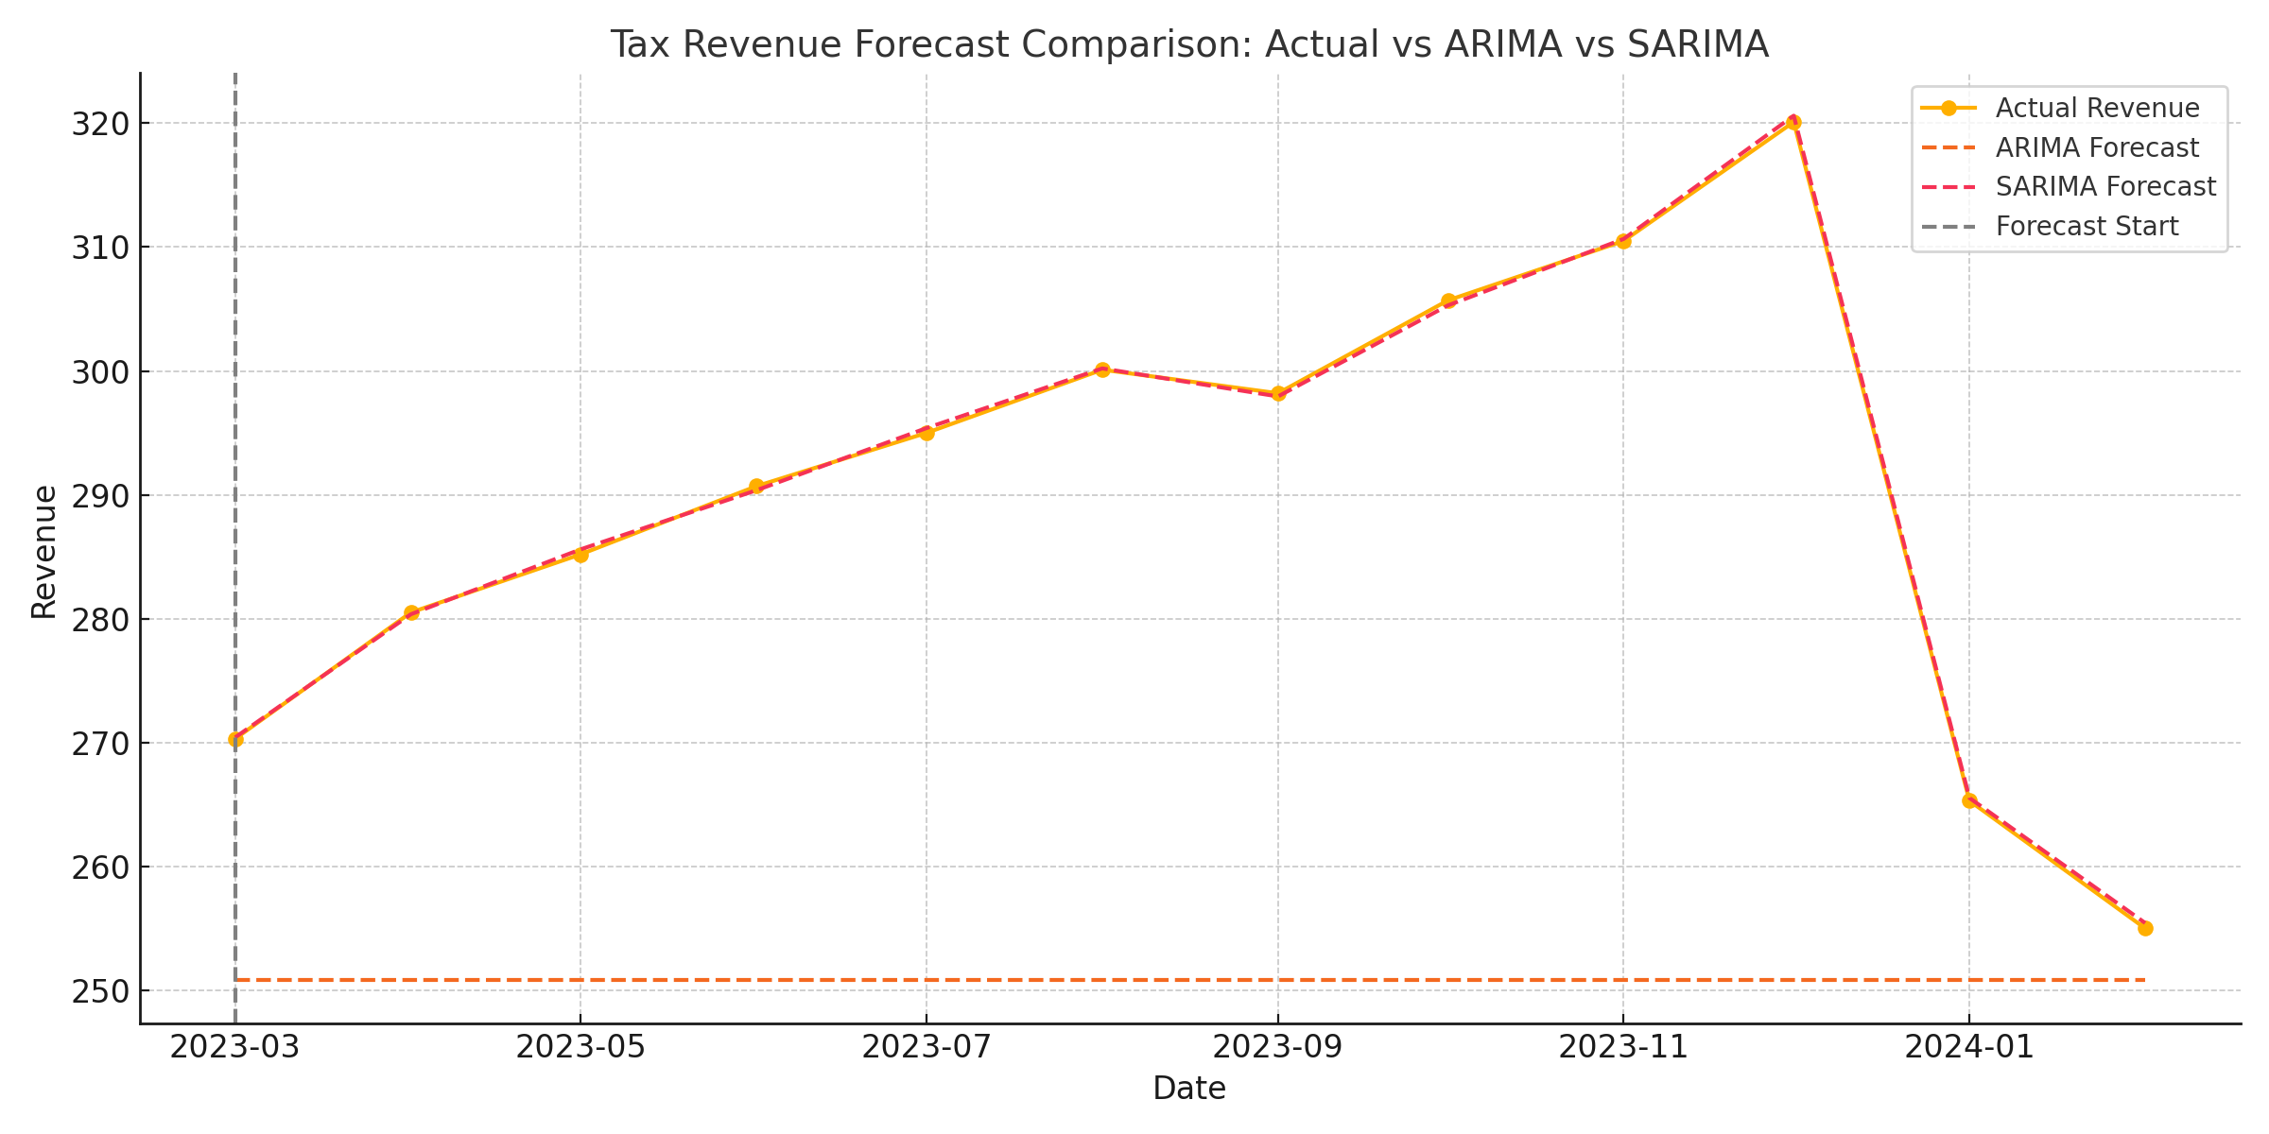
Tax Revenue Forecast: ARIMA vs SARIMA

