Slide 1
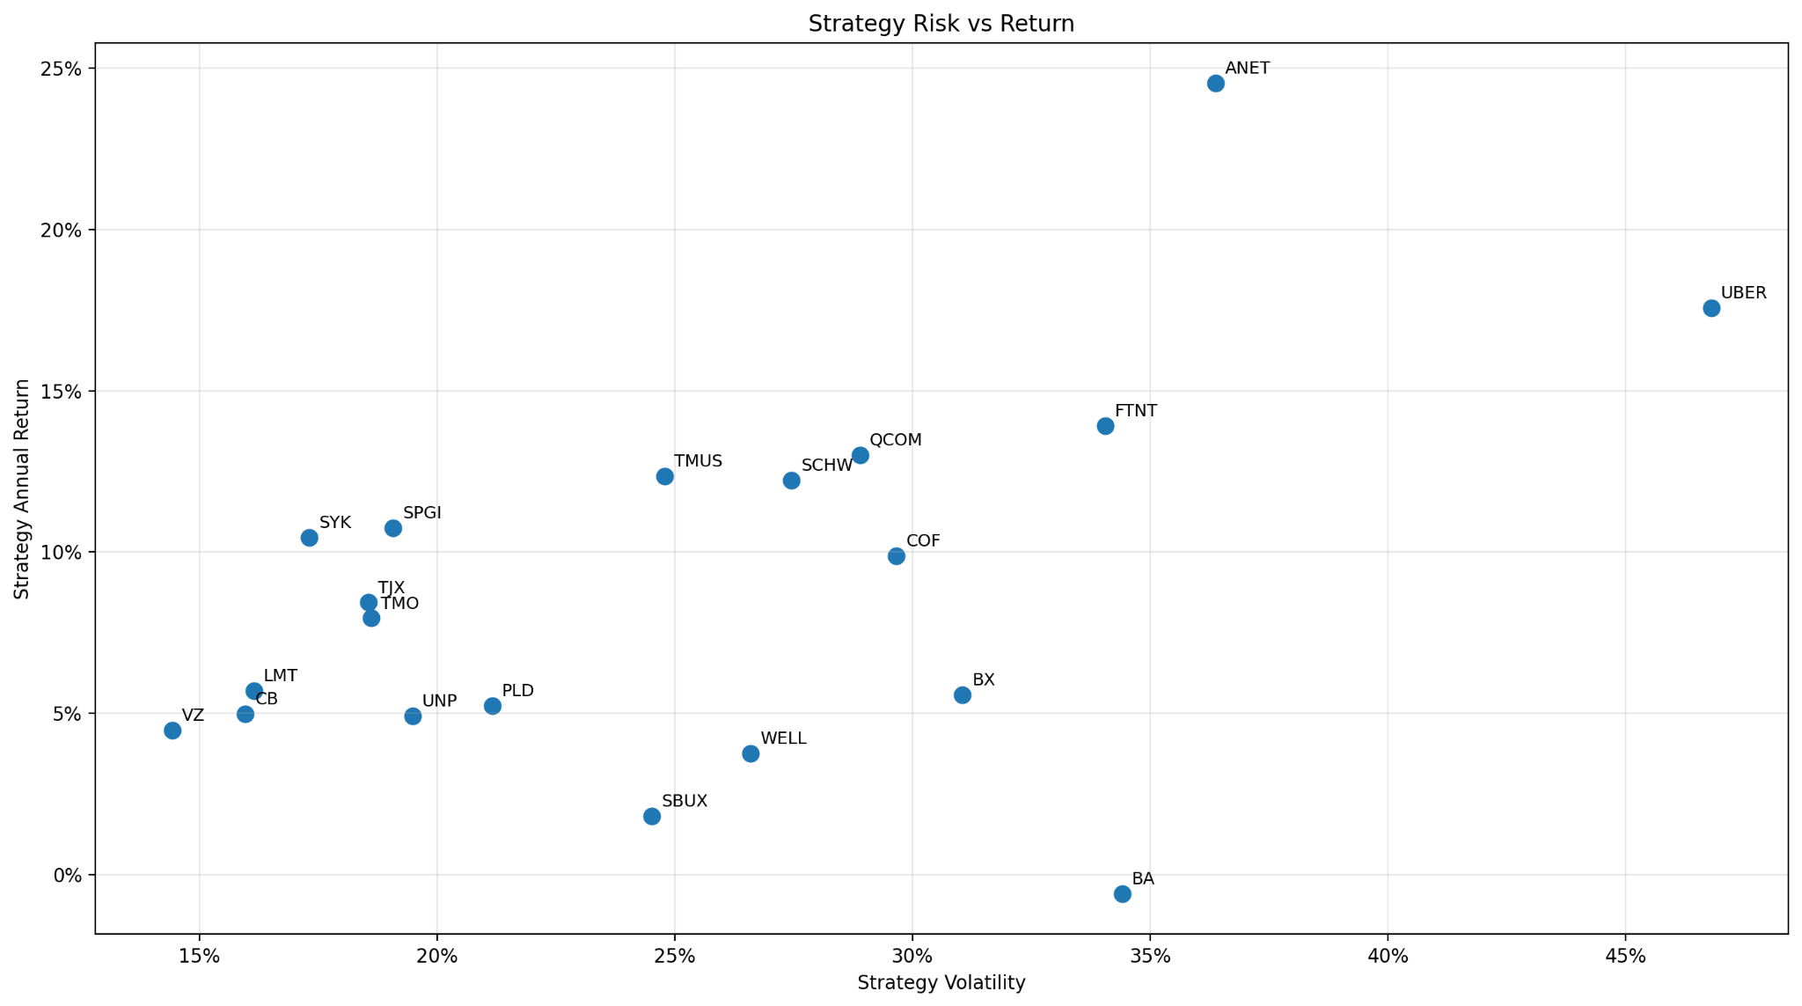
Backtesting a 5-Day Drop Strategy
20 S&P 500 stocks, 2012 to 2025
Buy after a 5% five-day drop. Sell after a 3% rebound from entry.
Risk vs return summary
Elias Powell

Slide 2
Strategy design
Rules-based backtest with next-day execution to reduce look-ahead bias
5%
3%
$100K
20
Drop threshold over the prior five trading days
Profit target from the entry price
Initial capital per ticker backtest
Random S&P 500 stocks tested
Entry logic: calculate the five-day return using close prices, create the buy signal after the close, then execute the trade on the next trading day using Open when available.
Exit logic: hold until the position gains at least 3% from entry. If the target is not hit before the final date, close the position on the last trading day.
Educational backtest only, not investment advice
2

Slide 3
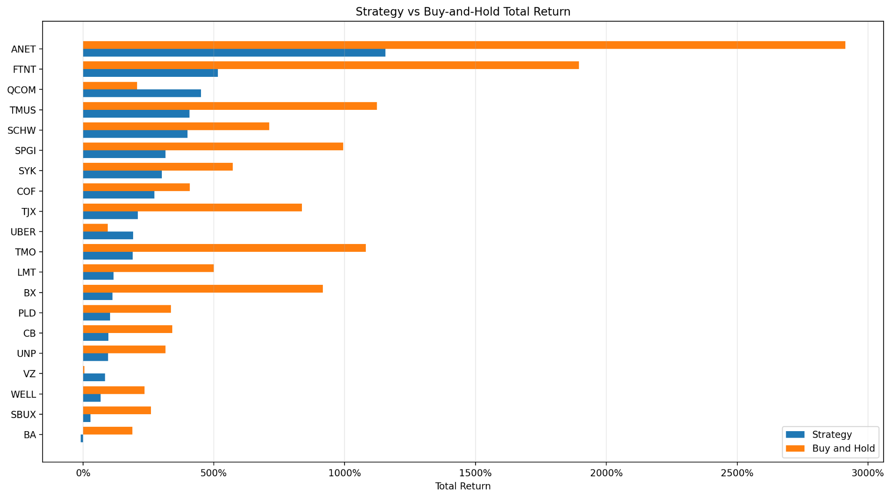
Return comparison
Strategy returns were positive for many names, but buy-and-hold often captured more compounding
Educational backtest only, not investment advice
3

Slide 4
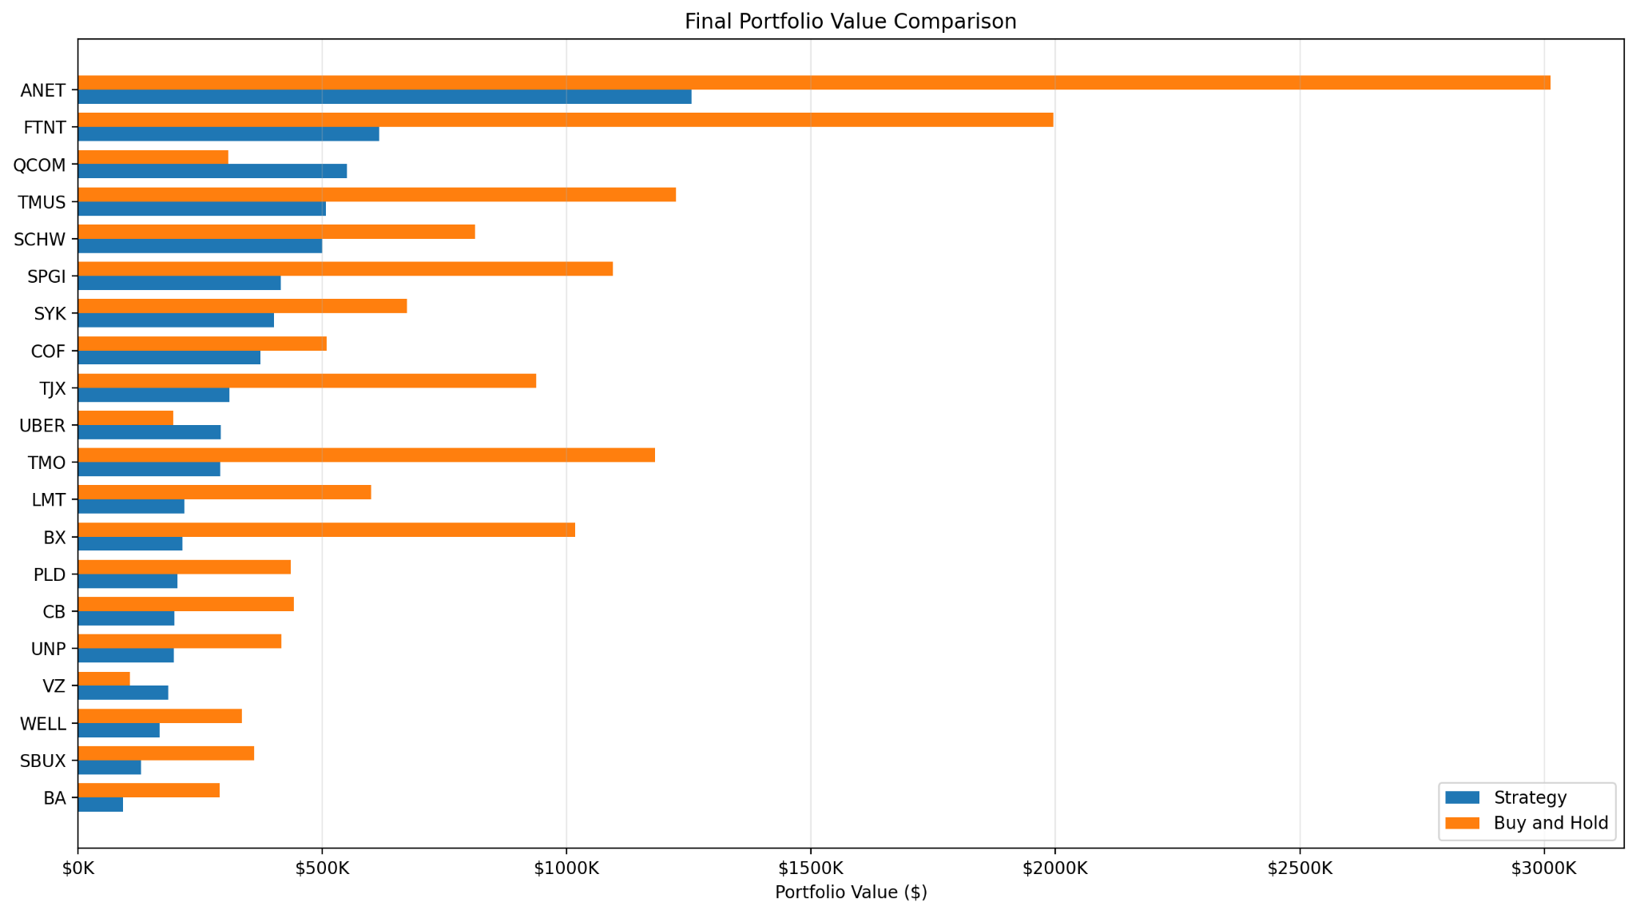
Final portfolio value
Ending values show the opportunity cost of being out of the market during long rallies
Educational backtest only, not investment advice
4

Slide 5
Risk vs return
Higher annual return usually came with higher strategy volatility
Educational backtest only, not investment advice
5

Slide 6
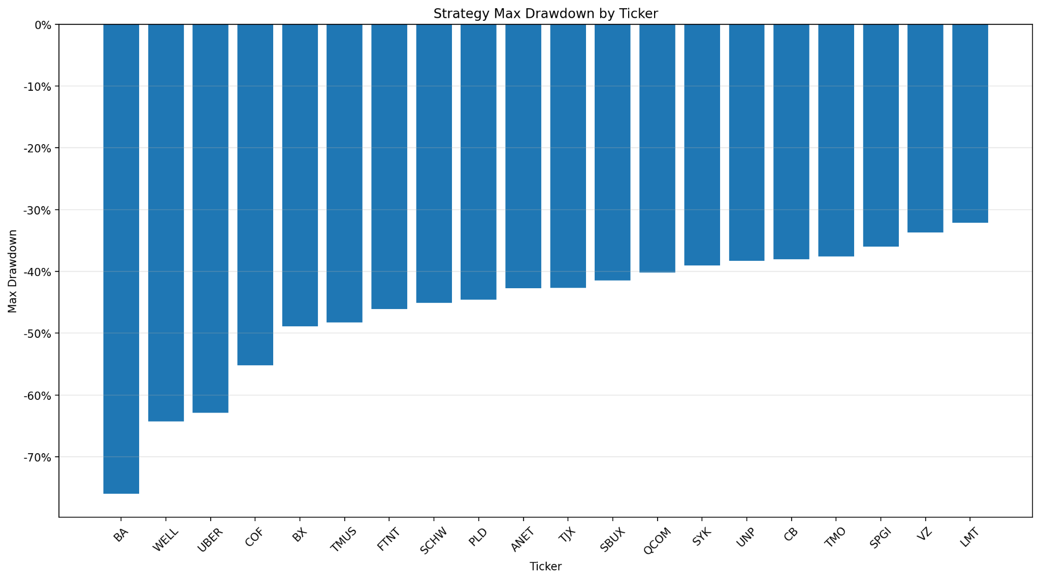
Drawdown matters
Even with high win rates, several stocks still had large peak-to-trough declines
Educational backtest only, not investment advice
6

Slide 7
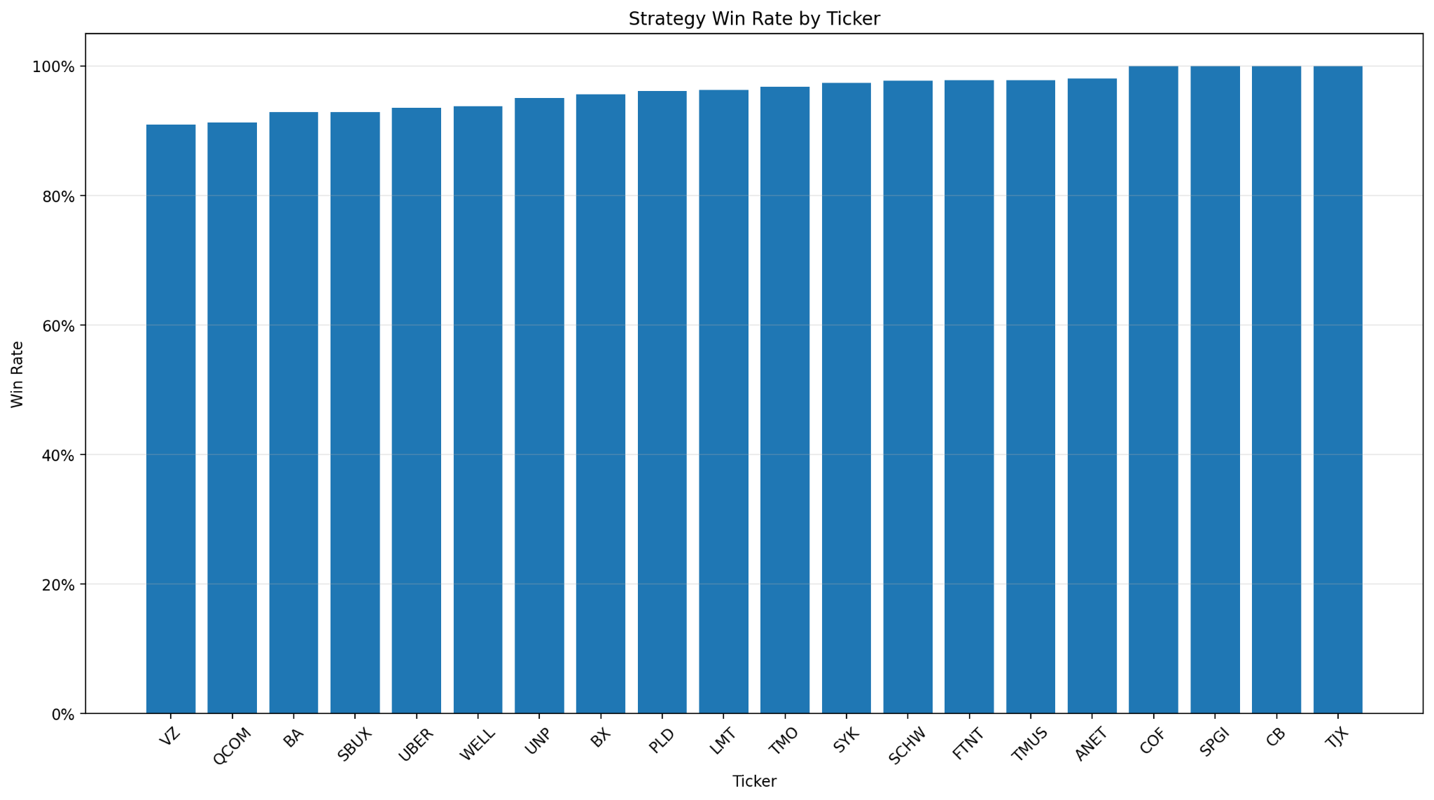
Win rate by ticker
The strategy produced high win rates, but win rate alone did not guarantee outperformance
Educational backtest only, not investment advice
7

Slide 8
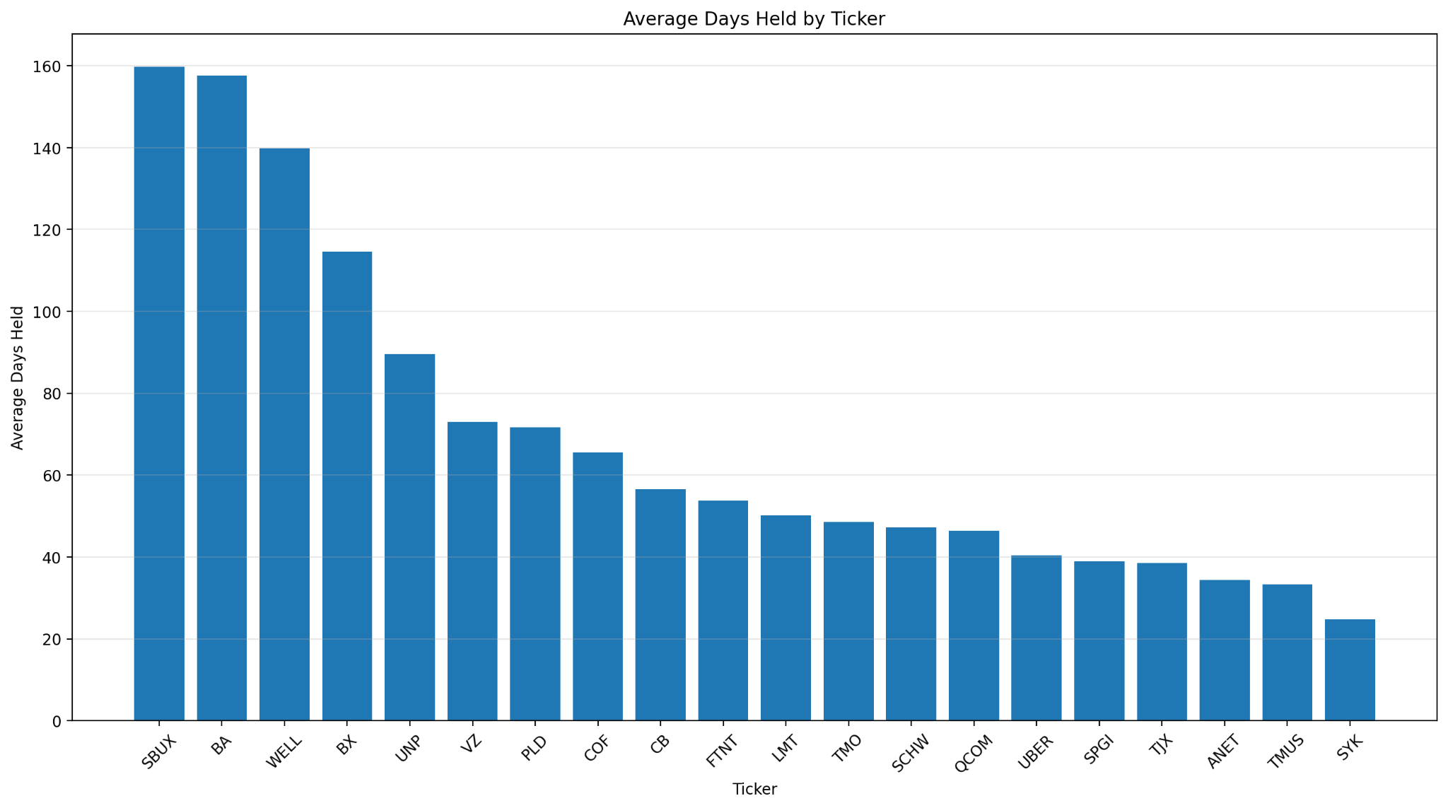
Average days held
The 3% recovery target could still keep capital tied up for long periods
Educational backtest only, not investment advice
8

Slide 9
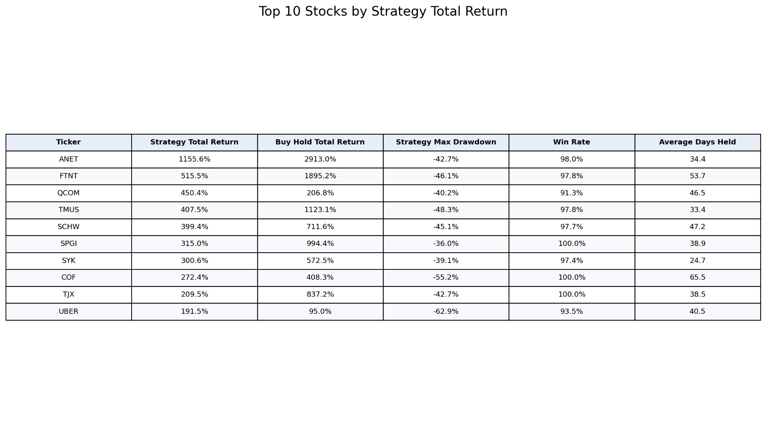
Top performers and takeaway
Best strategy returns came from names like ANET, FTNT, QCOM, TMUS, and SCHW
Takeaway
A simple dip-buying strategy can generate strong individual results, but market exposure, drawdown, and time in position matter just as much as win rate.
Educational backtest only, not investment advice
9

