Slide 1
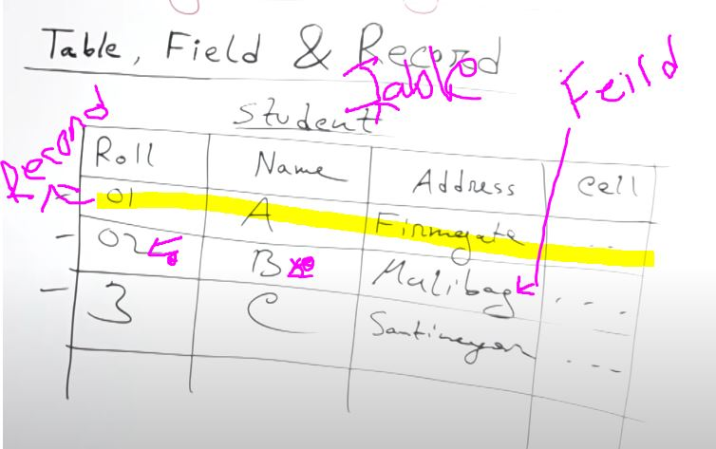
Database is a collection of related Data

Slide 2
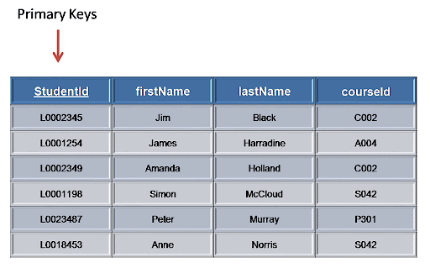
KEY
KEY
3 Type of key:
Primary Key
Composite Primary Key
Foreign key
Primary Key:
Primary keys must contain UNIQUE values, and cannot contain NULL values.
A table can have only ONE primary key; and in the table, this primary key can consist of single or
multiple columns (fields).

Slide 3
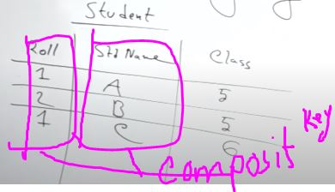
Composite Primary Key
Composite Primary Key:
A composite key is a combination of two or more columns in a table that can be used to uniquely identify each row in the table.
Here, Roll and Name from student of
Different classes are used as a composit key,
As roll can be repeated.

Slide 4
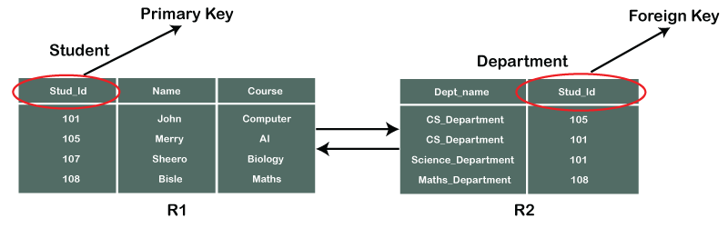
Foreign key
Foreign Key:
A foreign key is a column or group of columns in a relational database table that provides a link between data in two tables. It acts as a cross-reference between tables because it references the primary key of another table, thereby establishing a link between them.
Example:
CREATE TABLE Orders ( OrderID int NOT NULL, OrderNumber int NOT NULL, PersonID int, PRIMARY KEY (OrderID), FOREIGN KEY (PersonID) REFERENCES Persons(PersonID) );

Slide 5
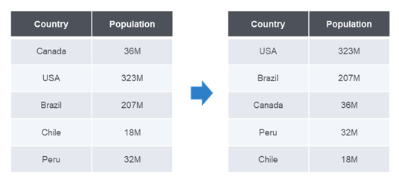
Sorting
Sorting:
The SQL ORDER BY clause is used to sort the data in ascending or descending order, based on
one or more columns. Some databases sort the query results in an ascending order by default.

Slide 6
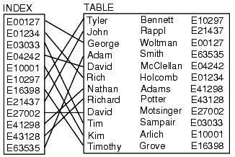

Indexing
Indexing:
Indexing is a way to optimize the performance of a database by minimizing the number of disk
accesses required when a query is processed. It is a data structure technique which is used to
quickly locate and access the data in a database.
Sorting based on age:

Slide 7
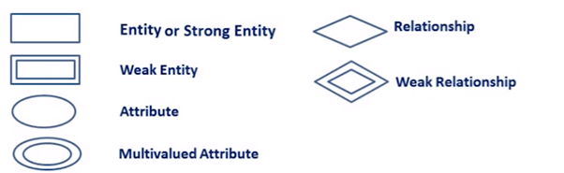
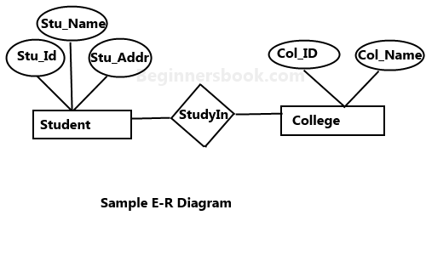
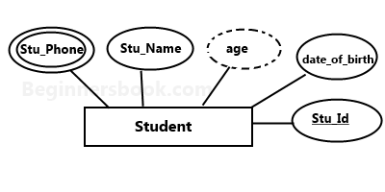
Entity Relationship Diagram
Entity Relationship:
In terms of DBMS, an entity is a table or attribute of a table in database, so by showing
relationship among tables and their attributes, ER diagram shows the complete logical structure
of a database.
Age is derived attribute (From date of bith)
Stu_phone can have multiple nuber

Slide 8

Degree of Relationship
Degree of Relationship:
the number of an entity type that is connected to a relationship is the degree of that relationship.
There is 3 degree of relationship:
Uniary
Binary
Ternary
Unary Relationship:
A unary relationship exists when both the participating entity
type are the same.
Ex: A student has friendship relationship with another student.

Slide 9
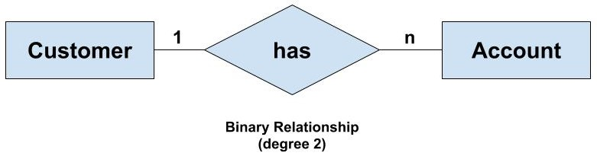
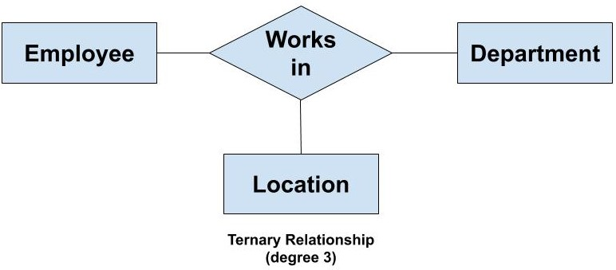
Binary Relationship:
A binary relationship exists when exactly two entity type participates.
For example, We have two entity type ‘Customer’ and ‘Account’ where each ‘Customer’ has an ‘Account’ which stores the account details of the ‘Customer’. Since we have two entity types participating we call it a binary relationship. Also, one ‘Customer’ can have many ‘Account’ but each ‘Account’ should belong to only one ‘Customer’. We can say that it is a one-to many binary relationship
Ternary Relationship:
A ternary relationship exists when exactly three entity type participates.
For example, We have three entity type ‘Employee’, ‘Department’ and ‘Location’. The relationship between these entities are
defined as an employee works in a department, an employee works at a particular location. So, we can see we have three entities
participating in a relationship so it is a ternary relationship. The degree of this relation is 3.

Slide 10
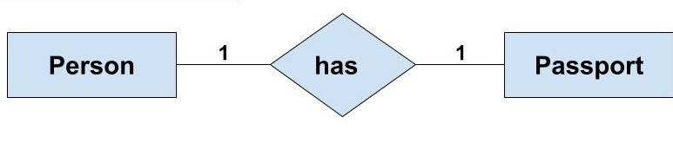
Classification of Relationship
Degree of Relationship:
the number of an entity type that is connected to a relationship is the degree of that relationship.
There is 3 degree of relationship:
One-to-One Relationship
One-to-Many or Many-to-One Relationship
Many-to-Many Relationship
One-to-One Relationship:
Such a relationship exists when each record of one table is related to only one record of the other
table.
For example, If there are two entities ‘Person’ (Id, Name, Age, Address)and ‘Passport’(Passport_id, Passport_no).
So, each person can have only one passport and each passport belongs to only one person.

Slide 11
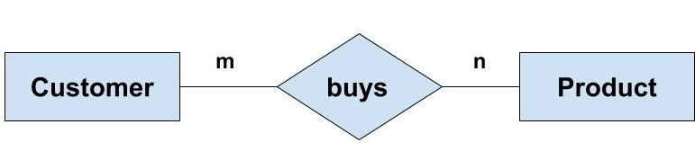
One-to-Many or Many-to-One Relationship:
Such a relationship exists when each record of one table can be related to one or more than one record of the other table.
For example, We have two entity type ‘Customer’ and ‘Account’ where each ‘Customer’ has an ‘Account’ which stores the account details of the ‘Customer’. Since we have two entity types participating we call it a binary relationship. Also, one ‘Customer’ can have many ‘Account’ but each ‘Account’ should belong to only one ‘Customer’. We can say that it is a one-to many binary relationship
Many-to-Many Relationship:
Such a relationship exists when each record of the first table can be related to one or more than one record of the second table
and a single record of the second table can be related to one or more than one record of the first table
Example: If there are two entity type ‘Customer’ and ‘Product’ then each customer can buy more than one product and a product
can be bought by many different customers.

