Slide 1
SOA and Cloud Computing
A Simple Client to SOAP Web Services

Slide 2
Building a SOAP based Web Multiplication Calculator
Technologies Used:
Python (Instead of Java)
Fast API (Instead of Servlets)
SOAP Web-Service (http://www.dneonline.com/calculator.asmx)
WSDL file: http://www.dneonline.com/calculator.asmx?wsdl

Slide 3
Task Overview:
User input 2 numbers (Num1, Num 2).
Format a XML based SOAP request using the numbers.
Create a POST request to SOAP service EndPoint.
Receive and Return the result response.

Slide 4
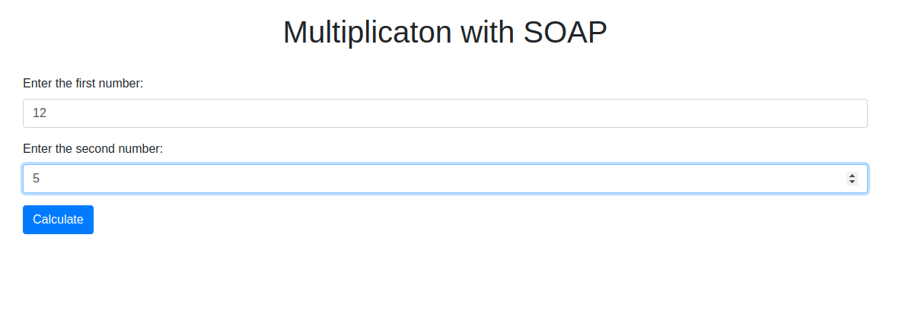
Screenshots of the Project
Landing page: Take input of numbers.

Slide 5
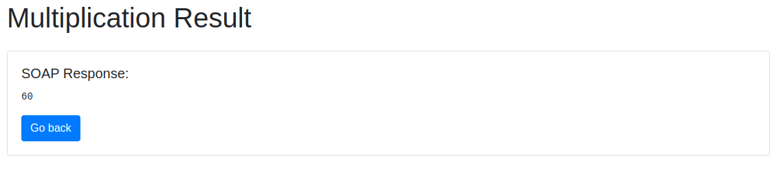
Screenshots of the Project
Result page: Show the result of the multiplication.

Slide 6
How to run the Project
Clone repo/ Download and unzip the folder.
Install Anaconda/ Miniconda.
Install Dependencies.
Go to the project folder via terminal.
Run this command in the terminal: uvicorn main:app --reload
It should give output like this: Uvicorn running on http://***.*.*:****
Go to this url and you should see the web application.

Slide 7
References:
Basic idea: https://www.youtube.com/watch?v=MfbwXUXFeJs&ab_channel=Pycornerspy
More details: https://www.geeksforgeeks.org/making-soap-api-calls-using-python/
Used CHATGPT to integrate bootstrap to the web pages, some debugging and explanation.

