Slide 1
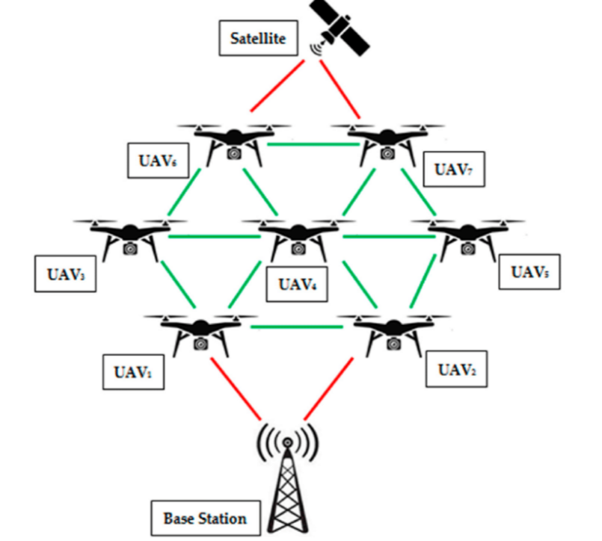
AD hoc network
Cluster-Based Routing Protocols for Flying Ad Hoc Networks (FANETs)

Slide 2

WHY USE FANET?
Provide low-cost, adaptable, and simple-to implement flying nodes
Complicated task more quickly and collectively

Slide 3
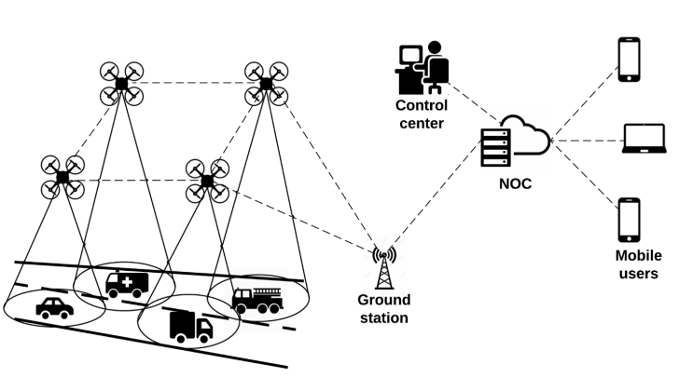
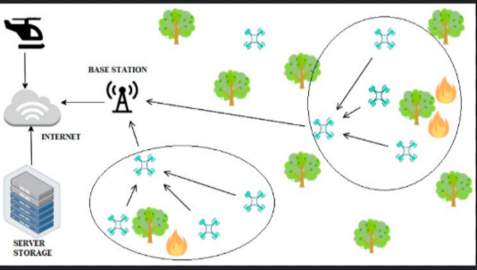
Applications of fanet
Transport monitoring
Prevention and control of forest fires

Slide 4
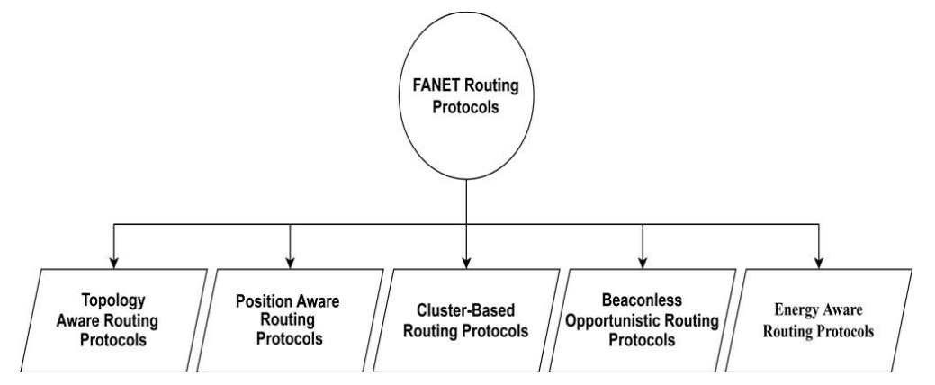
Routing protocols for uavs

Slide 5
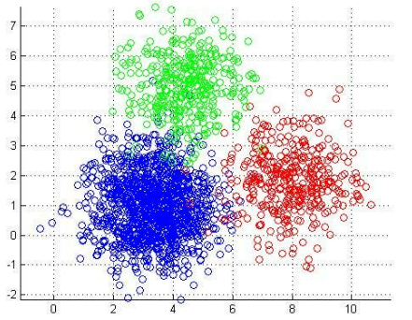
pUrpOse of the paper
FANET challenges:
Challenge 1: High mobility of nodes (drones).
Challenge 2: Highly dynamic topology.
HIERARCHICAL routing technique known as clustering is necessary to offer
Scalability
Survivability
Distribute payload among UAV to maintain the performance
A survey of the cluster-based routing protocols (CBRPs) in terms of strength, weakness, specific application, method, number of nodes.etc
21 protocols are studied.

Slide 6
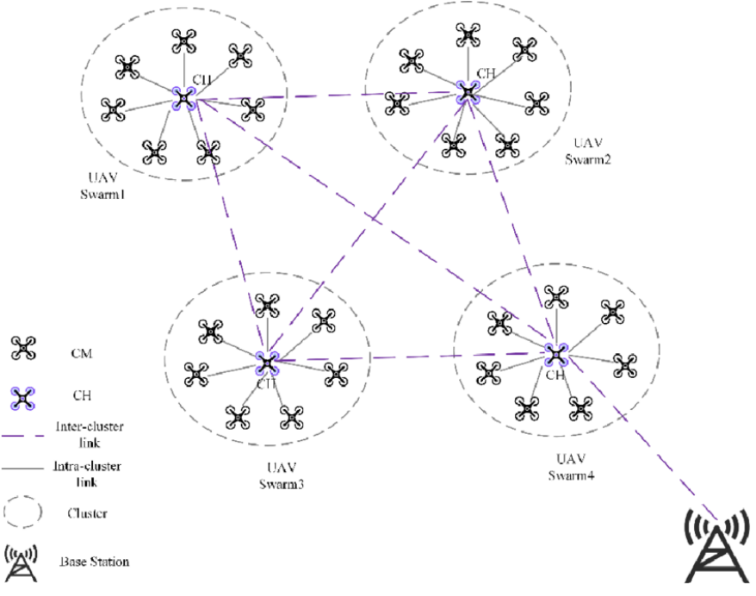
Cluster based network

Slide 7
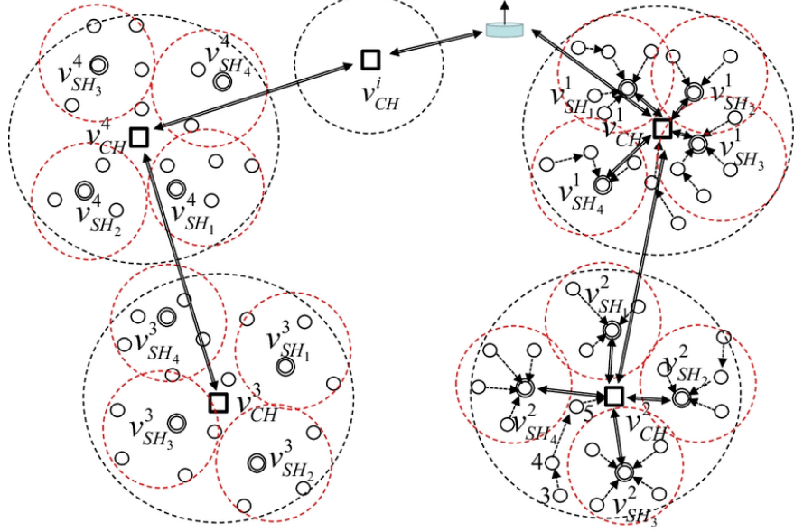
clusters/
sub clusters
Each CH, is considered as a temporary BS

Slide 8
types of cbrps
CH
probabilistics
alg
CH
Energy, Tx power,etc
Probabilistics Clustering
Deterministic Clustering
Dynamic
Bio-Inspired
Hybrid
Weight Based
Fuzzy Based
Heuristic Based
Compound
Notes:
Dynamic: CH selection is actively managed (distances, energy. etc) Weight :Energy, Tx powe, adn severak neighbour nodes
Bio-inspired : Info from natur and combines with other technikes Fuzzed: similar UAV in the same clusters
Hybrid: combiens both Heuristic: Based on the centroid estimate approach in centroid learning
Compound: mobility and connectivity of the net

Slide 9
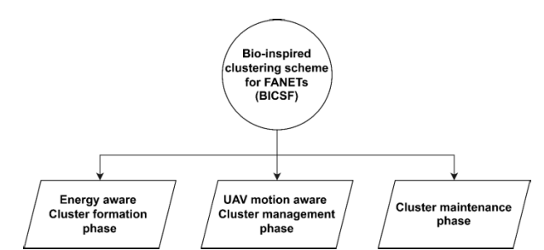
Bio-inspired

Slide 10



socs
Self Organization Based Clustering Scheme
Determines CH, based on its “Luciferin”, energy and connectivity to GCS
glowworm swarm
Notes:
m

Slide 11
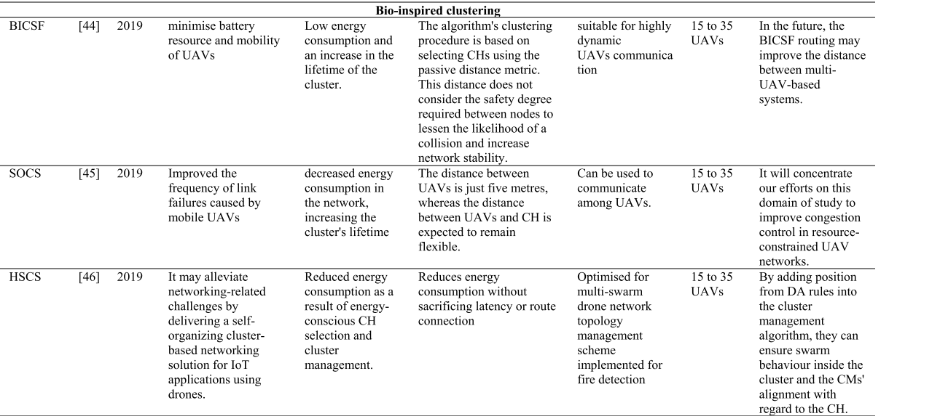

Slide 12



ealc
Energy-Aware Link-based
(Deterministic clustering / weight based)
CH selection relies in Fitness maximization and power consumption
“The transmission power of UAVs was modified based on predicted operational requirements”
Notes:
deal_degree: This is a target or optimal number of connections (or neighbors) that a UAV

Slide 13
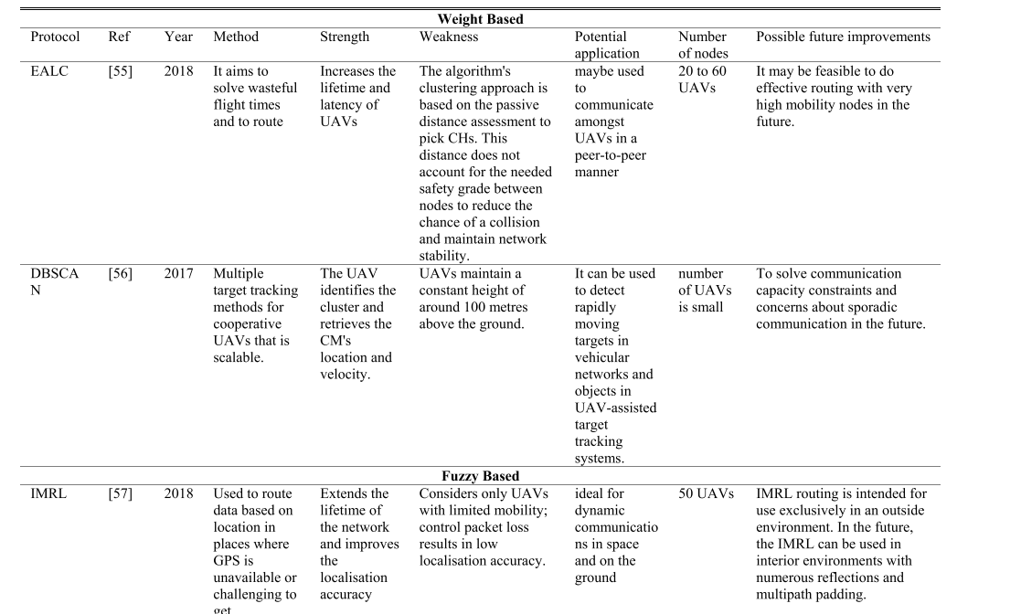

Slide 14
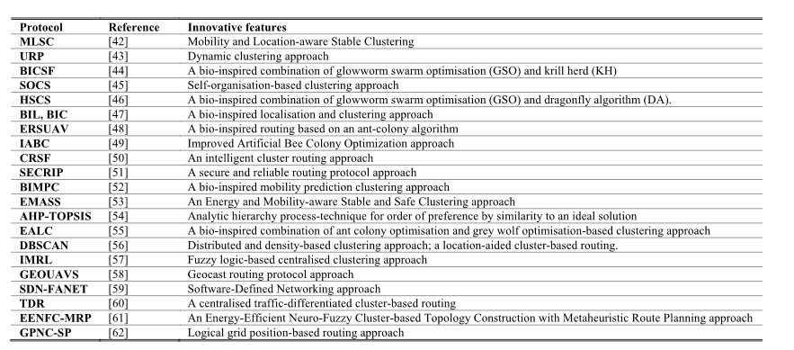
COmparison of cluster-based routing

Slide 15
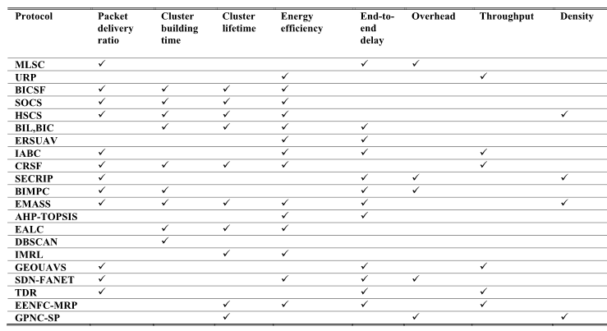
“In terms of highly dynamic, energy-restricted and communication and cooperation for UAV net. bio-inspired and hybrid outperformed the other”.
“A weight-based clustering strategy is critical for cluster-based routing”.

Slide 16
future challenges
Main Problems:
Problem 1: Frequent connectivity failures.
Problem 2: Cluster building time
Problem 3: Cluster lifetime
Problem 4: Packet loss
Problem 5: Limited bandwidth
Problem 6: Throughput limitations
etc.
Promising Directions
Dynamic Topology Control
Energy constraint
Multimedia Communication Routing
Efficient path planning
UAV’s Communication
Security Issues
Ensuring QOS
Node Location

Slide 17
Conclusions
Routing in FANETs seeks to improve route stability, survivability, distribute payload amos UAVS, network coverage cooperation, and collaboration to maintain the ability of the system in handling a higher number of UAVs while tracking high dynamism, cost-prohibitive , and residual energy.
There are eight promising directions: dynamic topology, control energy constraint, multimedia communication routing, efficient path planning, UAVs communication, security issues, ensuring QoS, and node location.

Slide 18
code

Slide 19
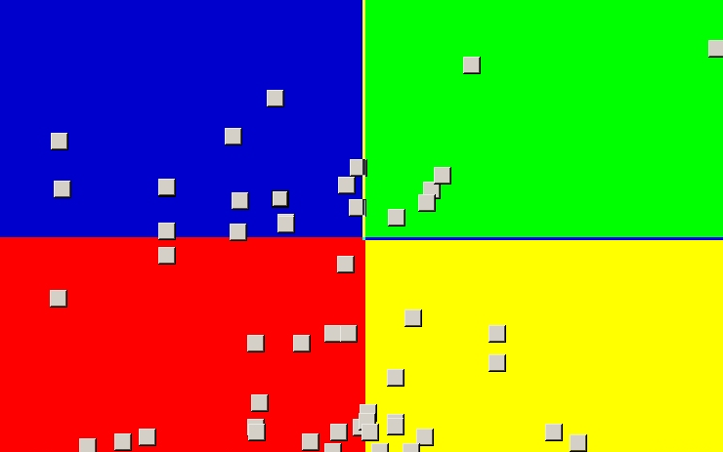
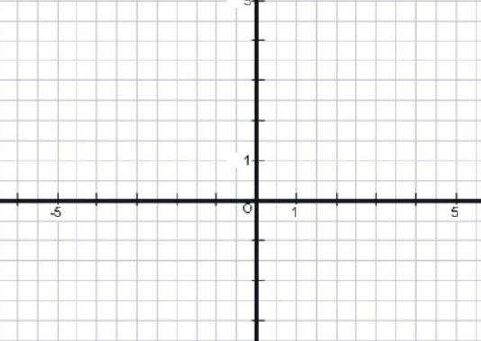
Cluster zones

Slide 20
head cluster
Less distances to the center of the cluster zone.
Most “aligned” direction with the cluster average. (moving to the same direction.)

