Slide 1
Swedish Hypersonics
from Hermes on
J.Oppelstrup, KTH ( em.)
Focal areas
Aerothermodynamics: Shock layers, TPS
Propulsion: PDE and Scramjets
(Materials) ..
26-08-29
Hyperstructures26

Slide 2





Players
FOI: Swedish Defence Research Agency
  --2000: Mainly experimental
  Hypersonic tunnels HYPxxx
  2000 – Computation / test´
SAAB:
  CFD
KTH:
  Real gas CFD
  Materials
LTH:
  Combustion
GKN Aerospace:
  Rocket nozzles
Küchemann book – DynaSoar, wave riders
26-08-29
Hyperstructures26

Slide 3
Swedish hypersonics
1. Hermes era -- 1992
  Shock‑vortex interaction on blunt deltas
  TPS heating
  Equilibrium real‑gas CFD.
2. The quiet period 1992 -- 2010
  FOI missile aerodynamics
  Shock‑layer modelling
  PDE model and experiments
3. Modern FOI & LTH hypersonics
  Shock‑layer/vortex coupling on gliders
  High‑enthalpy modelling
  Scramjet inlet physics.
  LES/DNS shock–turbulence interaction
  reacting flows
4. HYPER‑X initiative 2026 --
  Modern tools, unified collaborative agenda.
26-08-29
Hyperstructures26

Slide 4
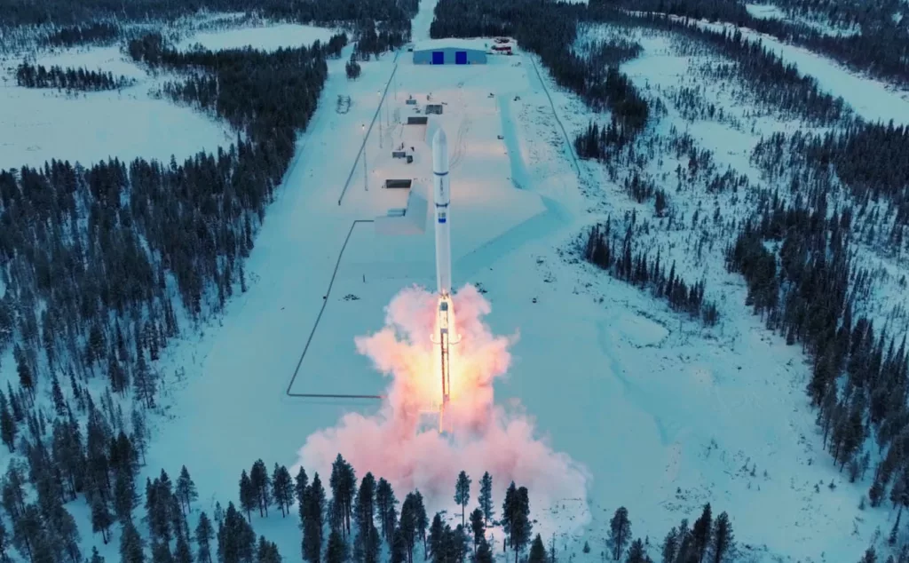
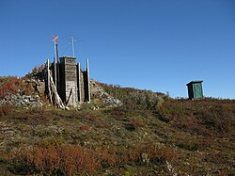
Sweden in Space:
Esrange Space Center
“Once the rockets are up, who cares how [where] they come down,...” (Tom Lehrer)
  Small payloads to orbit
  Satellite Comm.(68 º N)
  Rocket testbed
Esrange shelters:
56,000 km² Sami country
26-08-29
Hyperstructures26

Slide 5
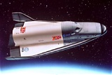
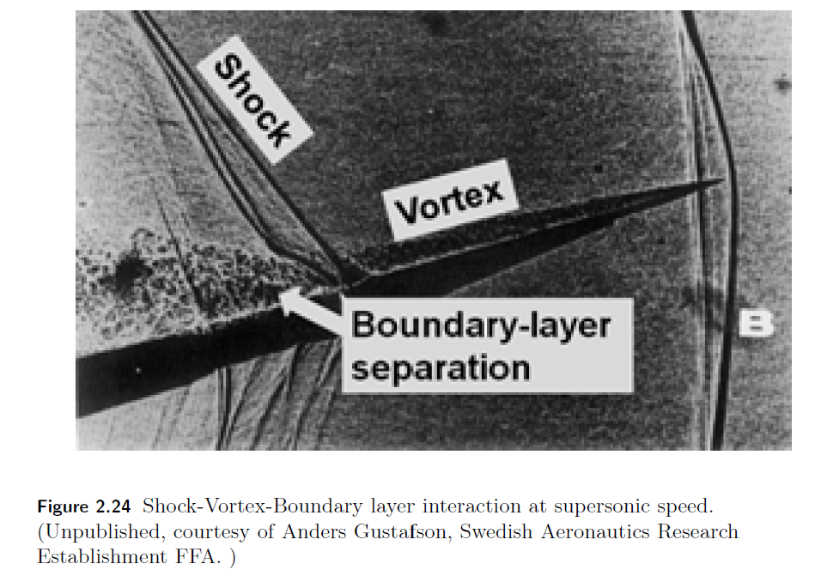
Hermes
Blunt Delta Wing M <= 7 WT tests
Equilibrium real gas in Saab CFD
Jan Vos, then EPFL
Academic work on numerics
γ - gas
Shock capture
Boundary layer BC
Focus on delta wing
Shock-Vortex-BL interaction
--- dual purpose ---
Saab 39
VFE
26-08-28
Hyperstructures26

Slide 6
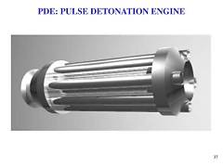

FOI
FOI-R--0135--SE (2001)
Multi cycle experiments on a pulse detonation engine
Tegner,J., Olsson,S.
FOI‑R–4991–SE (2020)
Aerodynamic Modelling of Hypersonic Glide Vehicles
Nordin,J., Hedlund,H., Karlsson, M
FOI‑R–5143–SE (2022)
High-Speed Aerothermodynamics for Advanced Flight Vehicles
Karlsson,M., Hedlund,H.
CATLA Clean Air High Temperature Laboratory
(2023)
Experimental facility, scramjet
1700 K clean, dry air at ~25 km altitude conditions
26-08-28
Hyperstructures26

Slide 7
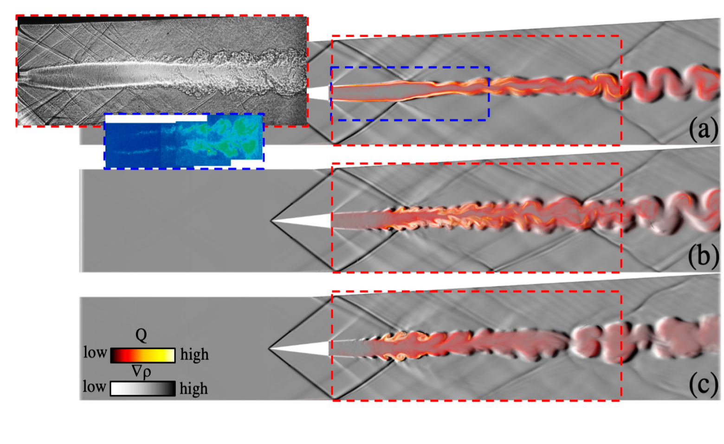
LTH
Fureby,C.,Sahut,G.,Ercole,A.,Nilsson,T.
Large Eddy Simulation of Combustion for High-Speed
Airbreathing Engines. Aerospace 2022, 9, 785. https://doi.org/10.3390/
Density gradient, ∇𝜌, combined with the heatrelease,𝑄, for the
D7, (b) J20, and (c) Z22 reaction mechanisms using the
LDKM subgrid flow model
26-08-28
Hyperstructures26

Slide 8
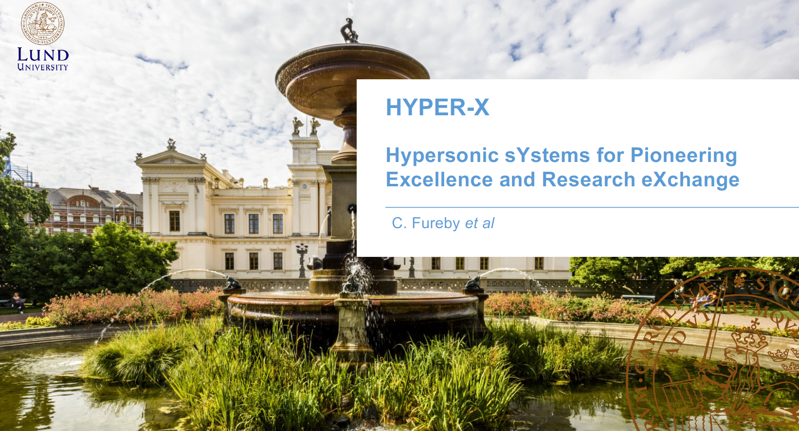
26-08-28
Hyperstructures26

Slide 9
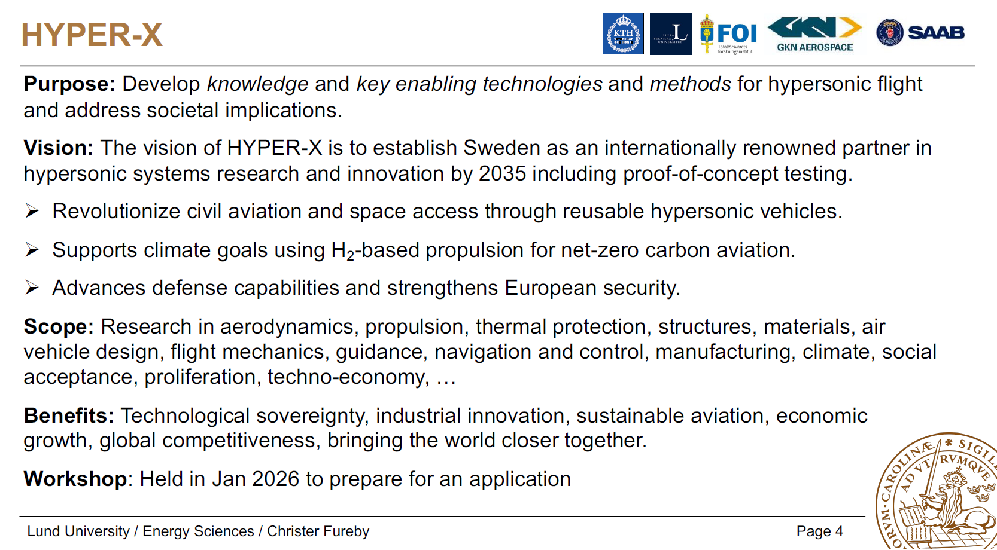
26-08-28
Hyperstructures26

Slide 10
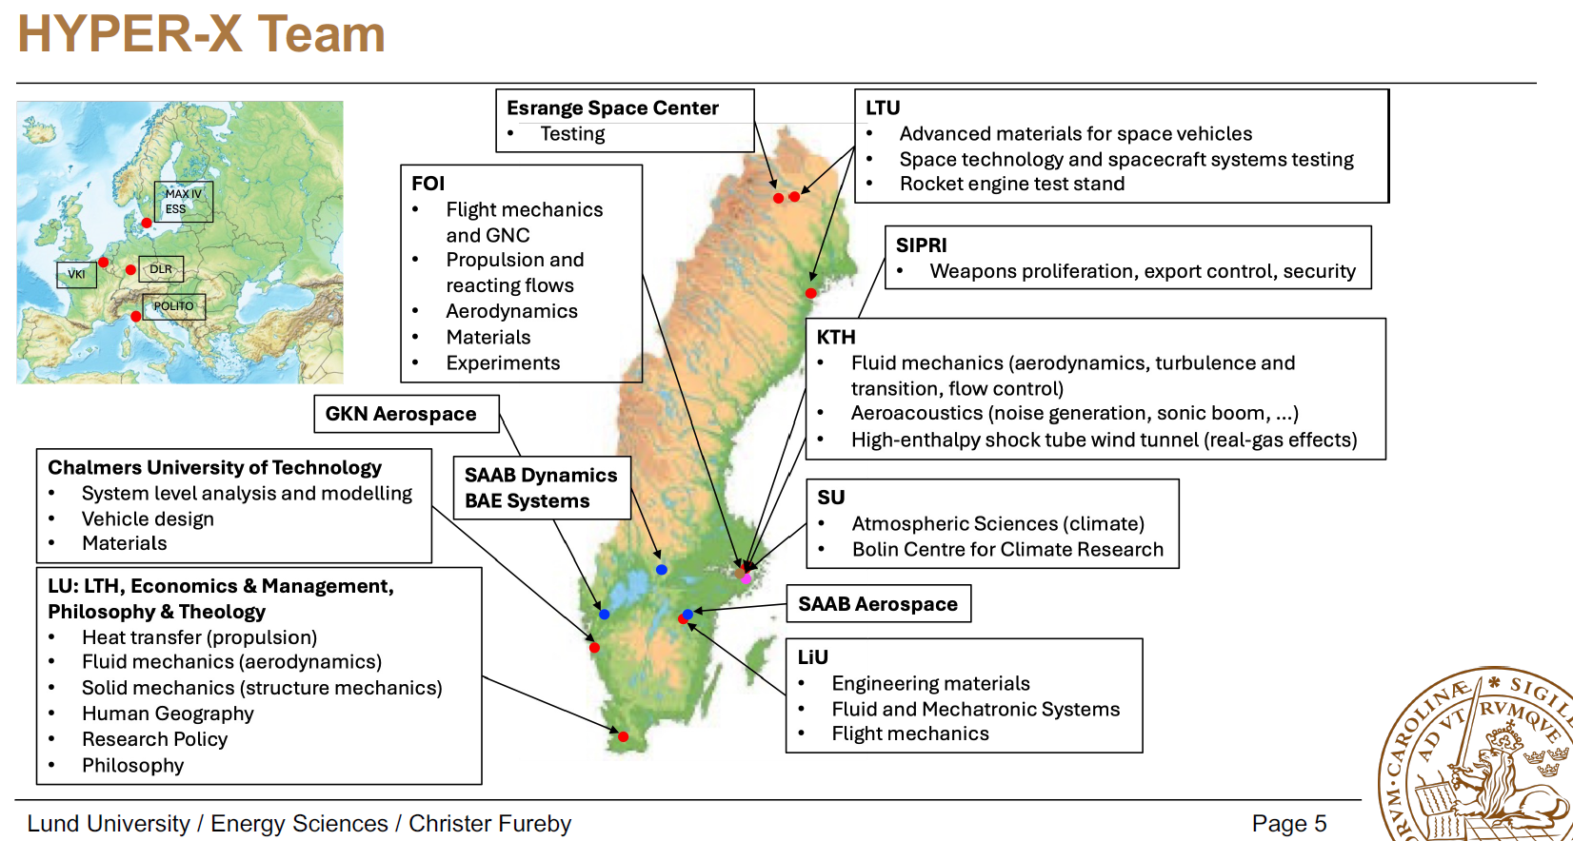
26-08-28
Hyperstructures26

Slide 11
Summary
After a lengthy period of work-up exercises
following the demise of Hermes:
The HYPER-X project can become
a competent trusted partner in
collaborative projects
26-08-28
Hyperstructures26

