Slide 1

A Case Study Tested Framework For Multivariate Analyses Of Microbiomes:
Software For Microbial Community Comparisons
By
Eric Marcus Spaulding

Slide 2
Research Relevance
Notes:
Bacteria -> Good vs. Bad
Microbiome – Community composition of microbial organisms (bacteria) in some area
Learn which bacteria support healthy body function
Identify some possible factors in obesity
Learn about the physical condition of a wild animal from a noninvasive sample
Consider the environmental impact of thawing permafrost
Compare DNA extraction methods against each other
Because this research is done with microbial communities, let’s talk about how we classify a microbe.
- Leave slide at (4 min)

Slide 3
Phylogenetic Lineage
Kingdom, Phylum, Class, Order, Family, Genus, Species
Animalia, Chordata, Mammalia, Primate, Hominidae, Homo, Homo Sapiens
Animalia, Chordata, Mammalia, Carnivora, Felidae, Felis Linnaeus, Felis catus Linnaeus
3 domains of life: based on Ribosomal RNA
Eukaryota : includes animals, plants, fungi, etc.
Archaea
Bacteria
Notes:
Lineage – Breakdown of life classifications from very vague to more specific
Transition: Using this method of phylogenetic resolution we reconstruct the microbial community from nothing but DNA fragments
- Leave slide at (5:30)

Slide 4
Goals Of The Framework
Demonstrate that communities of bacteria are consistently distinct at different sample locations
Visualize composition and differences of bacterial communities in multiple ways.
Notes:
-Transition: Now that I’ve given you an idea what this research is all about, let’s talk about how it’s done.
Leave slide at (6 min)

Slide 5
Methods
Data Analysis Using Perl and R
Notes:
Leave slide at (6:30)

Slide 6
Getting Data From QIIME
QIIME (pronounced chime)
Stands for Quantitative Insights Into Microbial Ecology
Notes:
What is QIIME? A Software Pipeline
Uses other software projects as swappable modules
Take sample from an environment
Recovery DNA (QiaGen DNA extraction kit)
Process DNA into FASTA files
QIIME classifies DNA sequences
QIIME organizes information into an OTU matrix
OTUs – Metagenomic data that has been matched against a curated database and organized into taxonomic categories
Taxa – Plural for Taxon, which is a single OTU
Leave slide at (10 min)

Slide 7
Data Acquisition & Formatting
Written in Perl
Format incoming data as needed
Can handle data from multiple sources
Notes:
Leave slide at (12 min)

Slide 8
Finding Discriminatory Bacteria
Notes:
Why do we need to find discriminatory bacteria? (Feature Selection)
Noise, Redundant Information
Feature Selection – the act of choosing an ideal sub-set of features from some data.
Discriminatory means that a classifier can use to recognize communities it’s seen before -> (Supervised Learning)
In order to make sure the classifier isn’t just memorizing the data
Cross-Validation – Systematically testing models built by supervised learning algorithms in order to test the performance of a classifier on a dataset.
Statistics database
Built from Feature Selection inside of Cross-Validation
- Leave slide at (17 min)

Slide 9
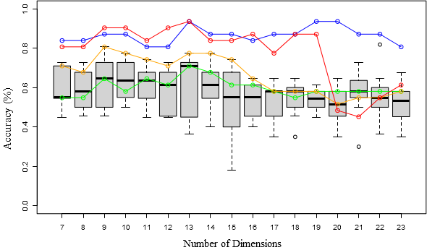
Visualized Statistics Database
Notes:
Each box represents a different number of features
The green line shows the accuracy found when using the base dataset
The orange line shows the accuracy found when using the P16% dataset
The blue line shows the accuracy found when bacteria found with basic feature selection are checked with cross-validation
The red line shows the accuracy found when discriminatory bacteria are checked with cross-validation
Leave slide at (21 min)

Slide 10
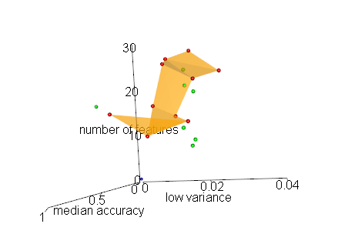
Visualized 3D-Pareto Frontier
Notes:
The green points represent boxes that are dominated
The red points represent boxes that are dominated by no other box, showing equally optimal solutions
The orange border is a series of triangles drawn when the red points are sorted by median accuracy and sets of 3 points are taken using a sliding window to draw n - 2 triangles.
The blue point in the background represents the origin (0,0,0) as a frame of reference.
Pareto Frontier – The boundary defined by the set of equally optimal solutions when optimizing for multiple objectives
- Leave slide at (24 min)

Slide 11
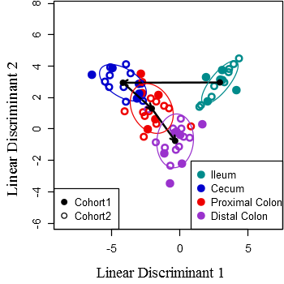
LDA visualization discriminating between four intestinal microbiomes.
Notes:
Strain B – 14 genera
Filled circles and open circles represent cohorts 1 and 2, respectively.
Black dots represent the centroid for each cluster and ellipses indicate 1 standard deviation.
The arrows show the flow of digesta between chambers.
The accuracies were 78.79% (62.12%)
Dimensional Reduction – projecting multi-dimensional data into a 2 or 3 dimensional vector space - Leave slide at (28 min)

Slide 12
Core Microbiome
Identify taxa present in every sample of a microbiome
For core taxa
Find median, min, and max presence across the samples
Pie chart using the median presence
Notes:
- Leave slide at (29 min)

Slide 13
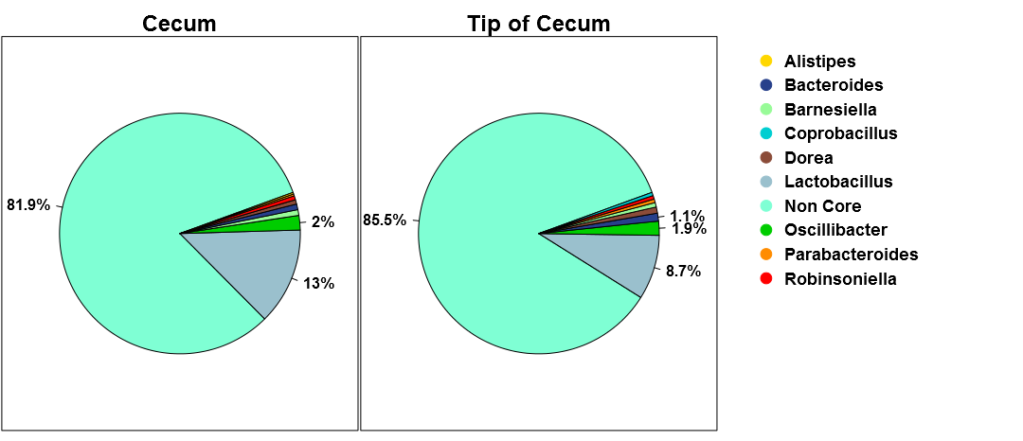
Core microbiomes found in the longitudinal study of the mouse intestine.
Notes:
- Leave slide at (29:30 min)

Slide 14
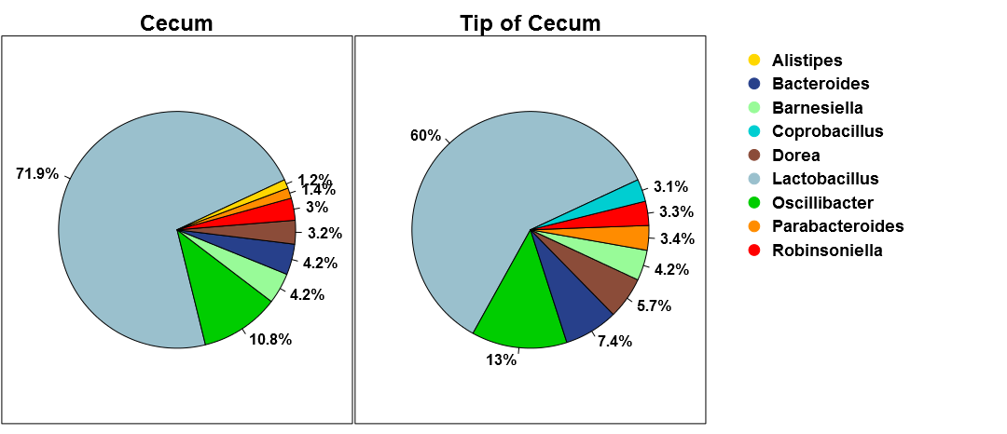
Core microbiomes found in the longitudinal study of the mouse intestine.
Notes:
-Transition: There is, of course, more than one way to group data. Current study is grouping by intestinal location, but what about other studies?
- Leave slide at (30 min)

Slide 15
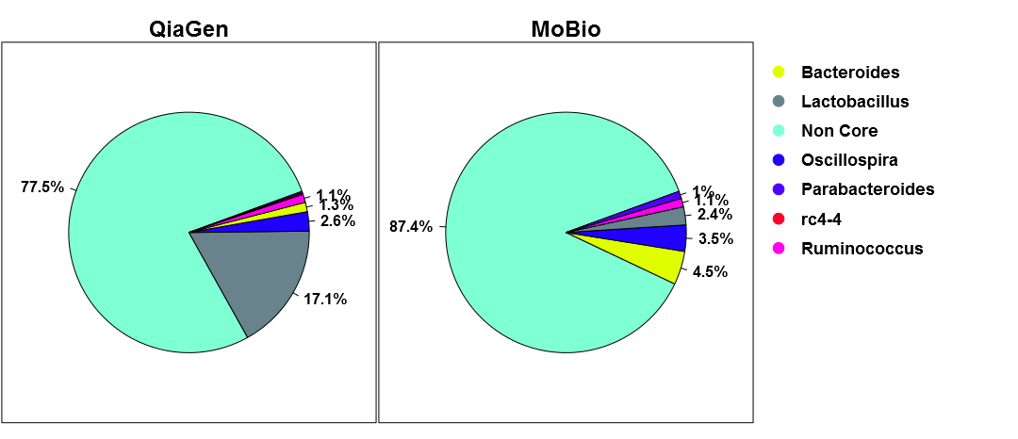
Core microbiomes found by QiaGen vs. MoBio DNA recovery methods.
Notes:
These bacteria were identified to the genus level.
The noncore bacteria make up most of each microbiome.
QiaGen finds a lot more Lactobacillus
MoBio finds more Bacteroides and Parabacteroides.
- Leave slide at (31:30 min)

Slide 16
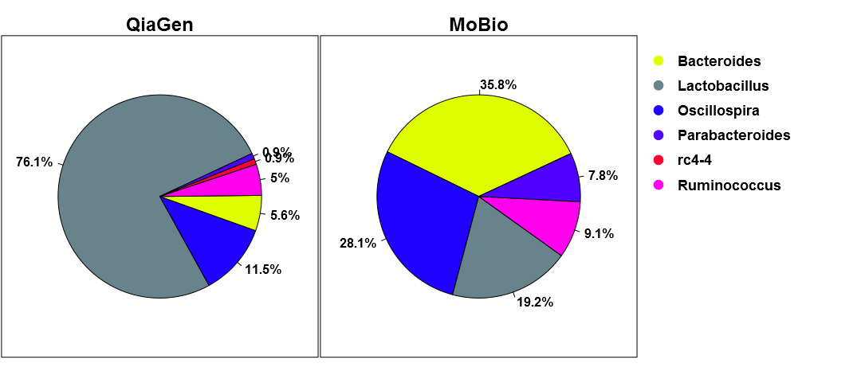
Core microbiomes found by QiaGen vs. MoBio DNA recovery methods.
Notes:
These bacteria were identified to the genus level.
QiaGen finds a lot more Lactobacillus
MoBio finds more Bacteroides and Parabacteroides.
- Leave slide at (32 min)

Slide 17
Side-by-side Microbiomes
Visualize whole microbiomes side-by-side
Multiple levels of phylogenetic resolution
Visualize differences between microbiomes
Notes:
- Leave slide at (32:30 min)

Slide 18
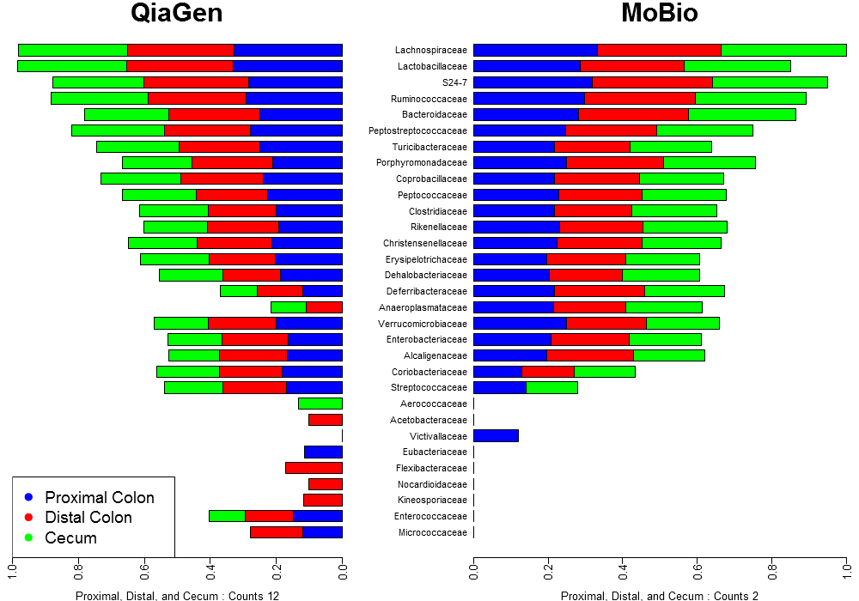
Side-by-side microbiomes found by QiaGen vs. MoBio DNA recovery methods.
Notes:
These bacteria were identified to the family level.
- Leave slide at (33:30 min)

Slide 19
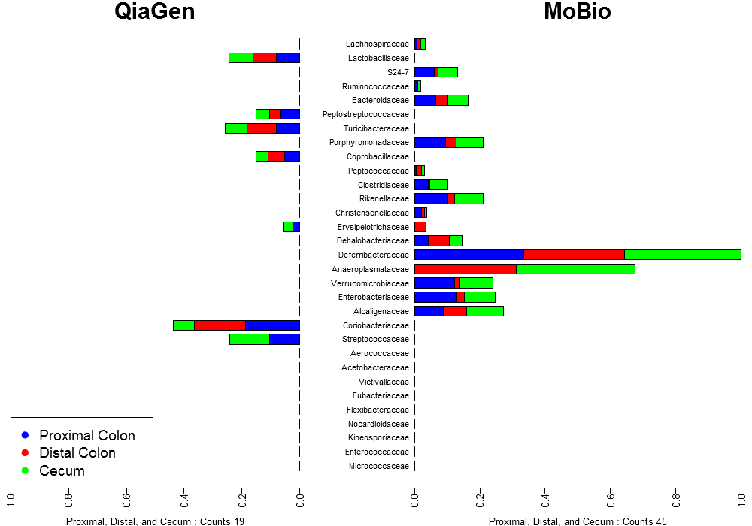
Side-by-side microbiomes found by QiaGen vs. MoBio DNA recovery methods.
Notes:
These bacteria were identified to the genus level.
The noncore bacteria make up most of each microbiome.
- Leave slide at (34 min)

Slide 20
Summary
Notes:
-This framework I have developed is capable of extracting information about the composition of bacterial communities from a popular framework and reformatting it for deeper analysis.
-ID set of discriminatory bacteria – LDA cross-validation gives the framework’s confidence
Visualize differences between microbiomes – LDA for dimensional reduction
Identify and visualize the core bacteria in a microbiome
Visualize two whole microbiomes side-by-side
Then visualize same thing but only the differences
-Challenges
- Leave at 38 min

Slide 21
Future Work
Notes:
Build a web based graphical user interface
Improve framework to be more efficient for computational bottlenecks
Add testing modules for regression and unit testing
Do more research into lower levels of phylogenetic resolution
i.e. would a family or order level analysis have given better classifier results?
39 min (presentation over)

Slide 22
Acknowledgements
Montgomery GI Bill
Research Assistant opportunities
My family for supporting me
Everyone at the Holben Lab
Specifically: Sam Pannoni, Ellen Lark, Frances Gilman, and Bill Holben
All the UM CS Department Faculty & Staff
Especially: Mike Rosulek, Robyn Berg, Michael Cassens
Alden Wright and Douglas Raiford
Notes:
- Leave slide at (40 min)

Slide 23
Questions?

Slide 24
Biological Impacts – Case Studies
Intestinal and fecal microbiomes give insight into host health
Soil microbiomes vary greatly by season and temperature
Invasive microorganisms don’t just replace existing community members
Notes:
- Leave slide at (36 min)

Slide 25
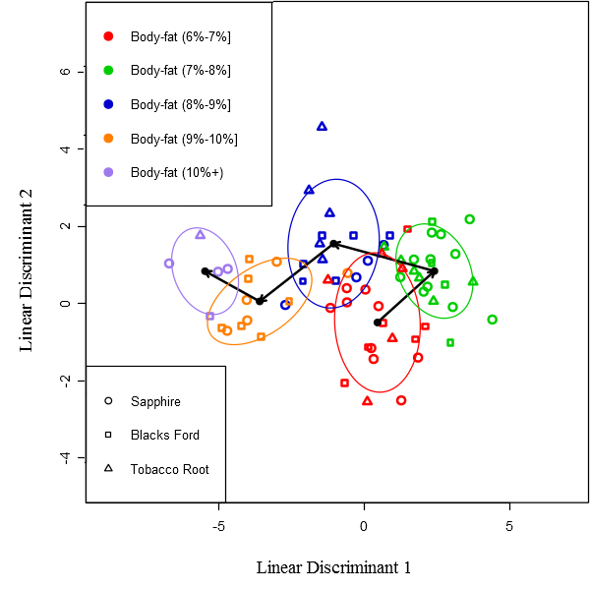
Elk Case Study
Notes:
Study looked at fecal microbiomes
21 genera
The arrows show progression from less to more body fat.
The accuracies were 55.56% (29.17%).

Slide 26
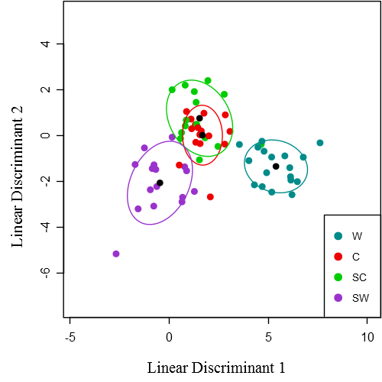
Permafrost Soil Case Study
Notes:
23 genera
Groups: Control, Snow-side Control, Warmed, and Snow-side Warmed.
Black dots represent the centroid for each cluster and ellipses indicate 1 standard deviation.
The accuracies were 58.21% (29.85%).

Slide 27
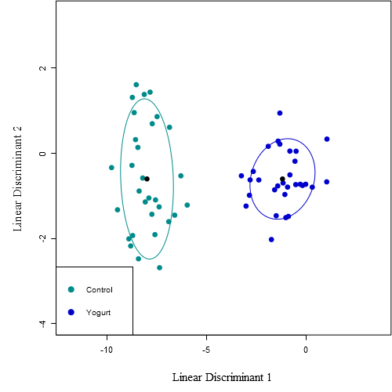
Yogurt Fed Mice Case Study
Notes:
Looked at intestinal microbiome
Considered the effects of probiotics
12 genera
96.67% (83.33%)

