Slide 1
Ravendb – An introduction
.NET Utvikling
Faggruppemøte
Espen Ekvang
12/02/14

Slide 2
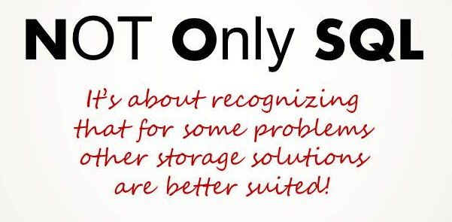
Notes:
Hva er NoSQL og hvorfor er det i vinden?
Hvem benytter det og hvorfor benyttes det i stedet for vanlig relasjonsdatabase?
Er det slik at vi alltid velger relasjonsdatabase fordi det er det vi er vandt til?

Slide 3

stored schema-less as JSON documents
query using LINQ from .NET code, or
using provided RESTful API
Notes:
Transaksjonell og open-kildekode dokumentdatabase skrevet i .NET
Bygd for skalering – replikering og sharding (horisontal replikering) ut-av-boksen

Slide 4

Notes:
Klient-server arkitektur
Serveren er ansvarlig for lagringen og utførelsen av spørringene
Klienten er det som konsumenten bruker for å kunne kommunisere med serveren

Slide 5
Getting started
Create Empty MVC project
Add Raven Client from Nuget (Install-package RavenDB.Client)
Add Raven Server from Nuget (Install-package RavenDB.Server)
Start Raven server from: packages/Raven Server <version>/tools/Raven.Server.exe
Notes:
Raven server can run in 4 modes:
Standalone windows service
In IIS
Embedded
From command line (usefull for development) can also run in RAM

Slide 6
documentstore
Expensive to create, perform only once (typically in global.asax)
Use documentstore to open session
Make sure to call SaveChanges() on session to persist changes
using (var store = new DocumentStore {ConnectionStringName = "RavenDB"})
{
store.Initialize();
using (var session = store.OpenSession())
{
var blogEntry = new BlogEntry {Title = "The title", Content = "The content"};
session.Store(blogEntry);
session.SaveChanges();
}
}
Notes:
Tip #1: create store in global asax
Tip #2: Create an abstract controller with ability to handle session creations and teardown.
Tip #3: Objects should have an Id property

Slide 7
Query data
Querying done using LINQ
RavenDB generates dynamic index (first-hit penalty)
using (var store = new DocumentStore {ConnectionStringName = "RavenDB"})
{
store.Initialize();
using (var session = store.OpenSession())
{
var allEntries = _session.Query<BlogEntry>();
var entriesWithTitle = _session.Query<BlogEntry>()
.Where(entry => entry.Title == “thetitle" );
}
}

Slide 8
Create Index
Map-Reduce in RavenDB Management studio
Define index in code
Make use of the index

Slide 9
Inline index
DocumentStore.DatabaseCommands.PutIndex("Employees/ByDepartmentName",
new IndexDefinitionBuilder<Employee, EmployeesByDepartment>
{
Map = <map function goes here using LINQ>,
Reduce = <reduce function goes here using LINQ>
});

Slide 10
Separate class index
public class Employees_ByDepartmentName : AbstractIndexCreationTask<Employee, Employees_ByDepartmentName.ReduceResult>
{
public class ReduceResult
{
}
public Department()
{
Map = <insert map function here>,
Reduce = <insert reduce function here>
}
}
//add the index
IndexCreation.CreateIndexes(typeof(Employees_ByDepartmentName).Assembly, null);

Slide 11
Use INdex
var result = session.Query<EmployeesByDepartment>("Employees/ByDepartmentName")
.FirstOrDefault(x => x.Department="SomeDepartment")

Slide 12
exercise
Use RavenDB to provide storage functionality for the very simple EmployeeOverview.
The application should have the following abilities:
Add new employee
List all employees for different departments
Delete an existing employee
Clone repository found here:
https://github.com/espenekvang/Intro2Raven
See branch possible-solution for a simple solution to the exercise

Slide 13
thanks
Espen Ekvang

