Slide 1
Hydrogen Production in ERCOT

Slide 2
Hydrogen from Electrolysis
Centralized PEM Electrolysis
Detailed financial analysis by NREL over a 40 year investment period
Feedstock costs are the main cost driver when producing hydrogen using electrolysis
77 % of cost for centralized plant
57 % of cost for decentralized plant
The feedstock cost is the cost of electricity and water to the electrolysis
Electricity totally dominates
Distributed PEM Electrolysis

Slide 3
Hydrogen from Natural Gas
NREL has calculated the cost of centralized production of hydrogen from natural gas with carbon capture.
Case study example of a plant producing hydrogen at 340 ton/day
The process produce 9.26 CO2 kg/kg H2, whereof 8.33 kg CO2/kg H2 is captured and 0.93 kg CO2/ kg H2 is emitted
Amounts to a capture rate at 90 % of produced CO2
Capital Costs
H2A Total Direct Capital Cost | $202 246 784
H2A Carbon Sequestration Total Direct Capital Cost | $137 971 172
Indirect Depreciable Capital Costs | $142 891 542
Total Capital Costs | $484 210 222

Slide 4
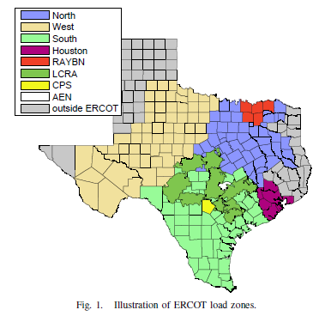
ERCOT Load Zones
ERCOT is divided into 8 load zones where we have historical prices
Both prices from the Day-ahead (DAM) and Real-time (RTM) markets are available
The mean prices are the same but RTM is more fluctuating: STD(RTM) = 3xSTD(DAM) for 2017
Load zone | DAM - MEAN | DAM - STD | RTM - MEAN | RTM - STD
AEN | 24.69 | 10.15 | 24.84 | 33.59
CPS | 25.62 | 10.96 | 26.04 | 51.05
HOUSTON | 29.02 | 16.56 | 29.17 | 69.01
LCRA | 24.97 | 10.66 | 25.02 | 35.25
NORTH | 23.89 | 9.65 | 23.73 | 25.54
RAYBN | 23.66 | 9.02 | 23.52 | 24.83
SOUTH | 28.91 | 14.77 | 28.04 | 45.69
WEST | 23.72 | 10.60 | 23.57 | 29.35

Slide 5
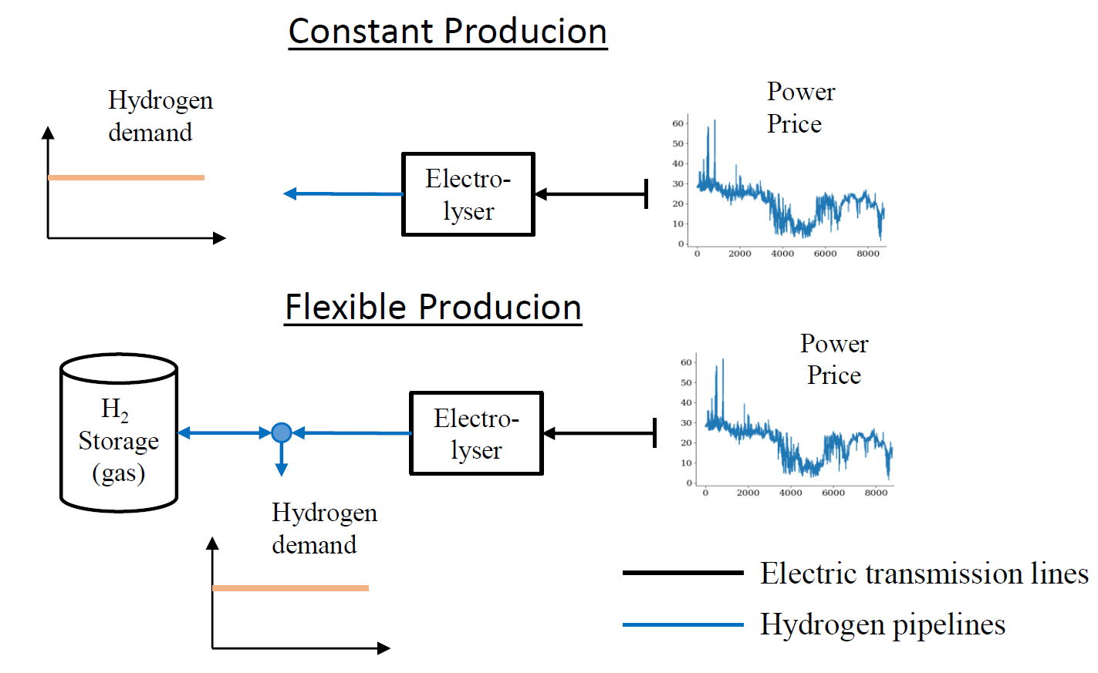
Hydrogen Production from Electrolysis
Current cost of producing hydrogen from electricity in ERCOT
Place a 50 ton per day electrolysis plant in respective load zones
Assume it does not affect the electricity price
What is the optimal configuration of a flexible plant?
Results:
 | Day-ahead Market |  | Real-time Market
Load zone | Electrolyzer [MW] | Storage [Nm³] | Electrolyzer [MW] | Storage [Nm³]
AEN | 123.4176 | 69521.69 | 116.5914 | 121611.7
CPS | 124.1889 | 76473.86 | 117.3808 | 150126.5
HOUSTON | 133.7024 | 115869.5 | 119.3578 | 139043.4
LCRA | 123.6034 | 72034.52 | 116.7803 | 126378.6
NORTH | 120.3827 | 69521.69 | 116.9896 | 108144.9
RAYBN | 118.7894 | 69521.69 | 115.3533 | 101122.5
SOUTH | 131.9882 | 115869.5 | 121.7034 | 155596.2
WEST | 121.8031 | 86228.45 | 120.2367 | 141193.5
MEAN | 124.73 | 84380.11 | 118.05 | 130402.15

Slide 6
Hydrogen Cost from Electrolysis - ERCOT
As the mean electricity price is the same in both markets. procuring hydrogen at a constant level gives the same costs
When hydrogen is produced flexibly. the RTM market gives lower costs as it has periods with very low costs where we can produce hydrogen cheaper.
However. using perfect foresight for the RTM market is not realistic as the low prices arise from uncertainties in renewable energy production
A flexible system can react to these uncertainties and take advantage of the low prices
But storage strategies are too good when we have perfect foresight and would not be achievable in practice
RTM – Real-time market
DAM – Day-ahead market
Flex – with storage
Const – without storage
PS: grid tariffs are not included here, network zones don’t directly overlap with load zones

Slide 7
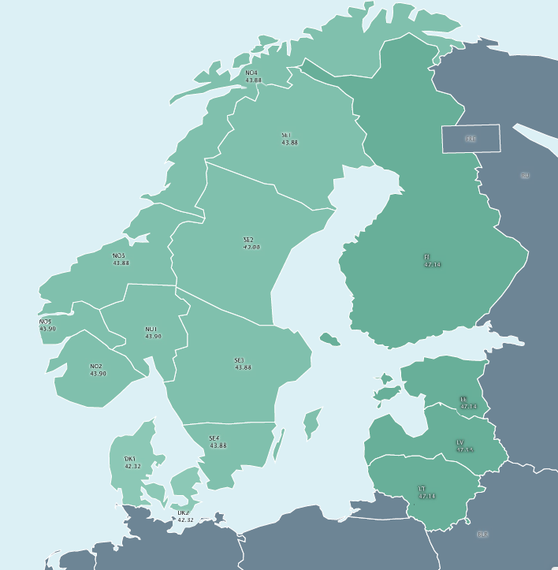
Nordpool
 | MEAN | STD
SYS | 29,40757 | 5,175868
SE1 | 30,84111 | 7,158612
SE2 | 30,84111 | 7,158612
SE3 | 31,23813 | 7,968093
SE4 | 32,18019 | 8,946456
FI | 33,19174 | 9,61076
DK1 | 30,08477 | 10,67856
DK2 | 31,96569 | 10,98284
Oslo | 29,03505 | 4,878746
Kr.sand | 28,83175 | 4,625652
Bergen | 28,83855 | 4,536337
Molde | 29,52928 | 5,540113
Tr.heim | 29,52928 | 5,540113
Tromsø | 25,72827 | 5,238795
EE | 33,20384 | 9,543607
LV | 34,67895 | 10,35208
LT | 35,13181 | 10,80792
AVG | 30,84 | 7,57
TEXAS | 23,72 | 10,60
Higher prices and lower price variation than Texas

Slide 8
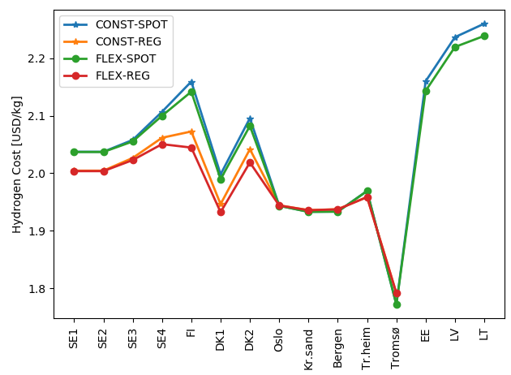
Hydrogen Cost from Electrolysis - Nordpool
Producing hydrogen in the regulating market is cheaper than from the spot market in Sweden, Finland and Denmark but not in Norway
Flexible production don’t have significantly impact on the costs of hydrogen production due to low price variations
Generally more expensive than Texas due to higher electricity prices, hydrogen production in Northern Norway (Tromsø) is the only one that is competitive with Texas

Slide 9
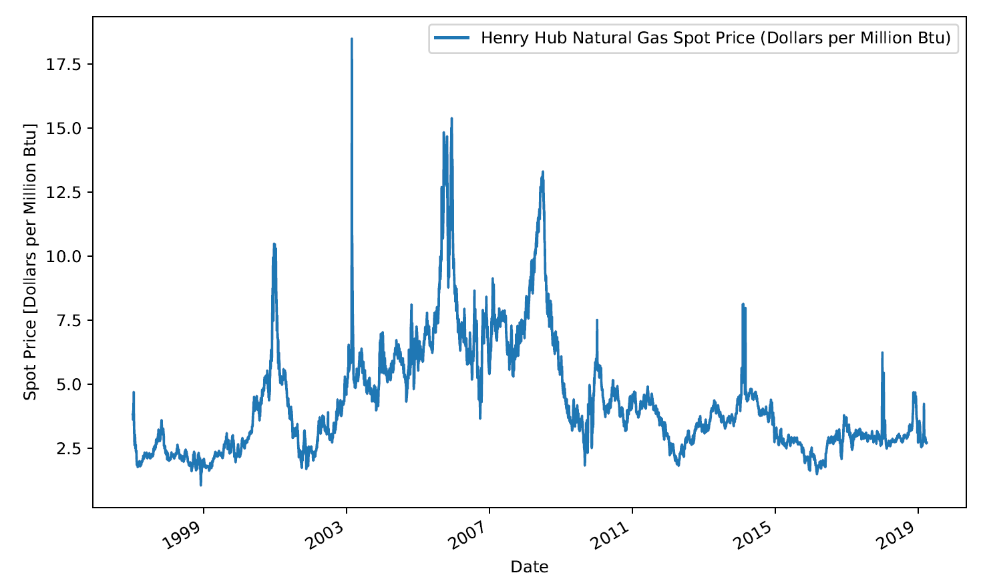
Natural Gas Henry Hub

Slide 10
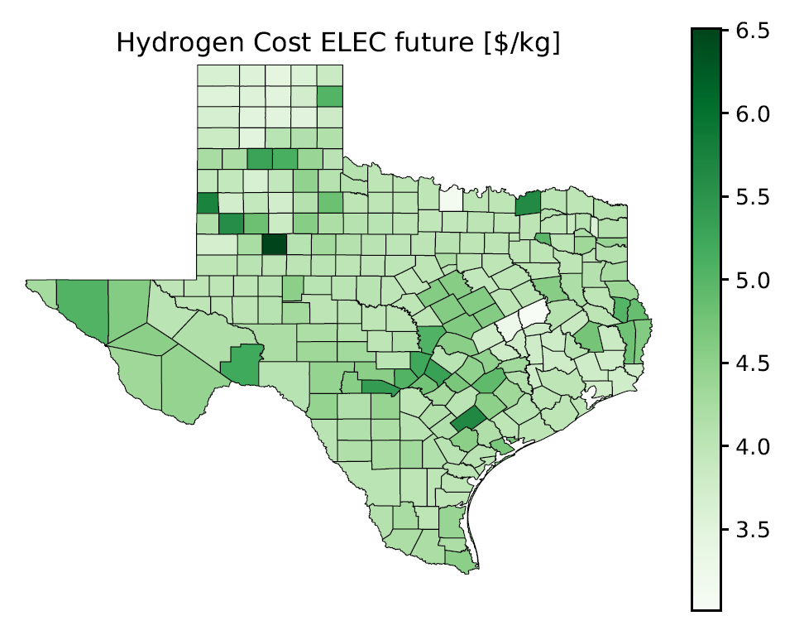
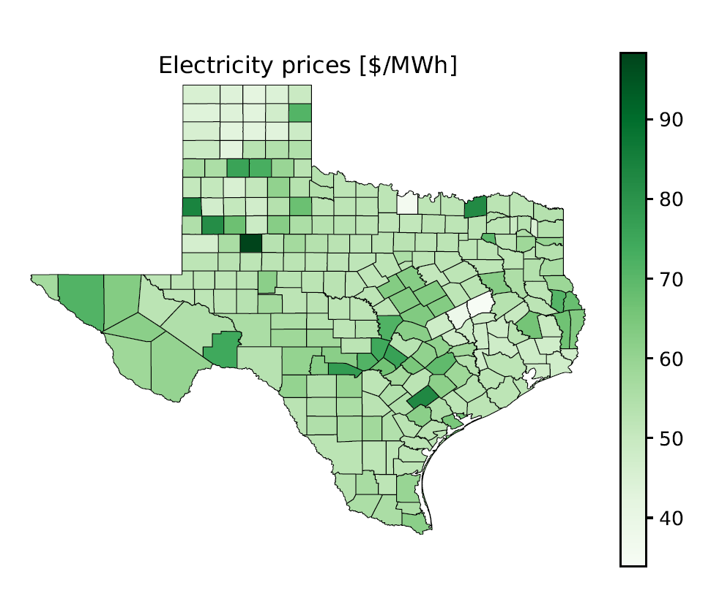
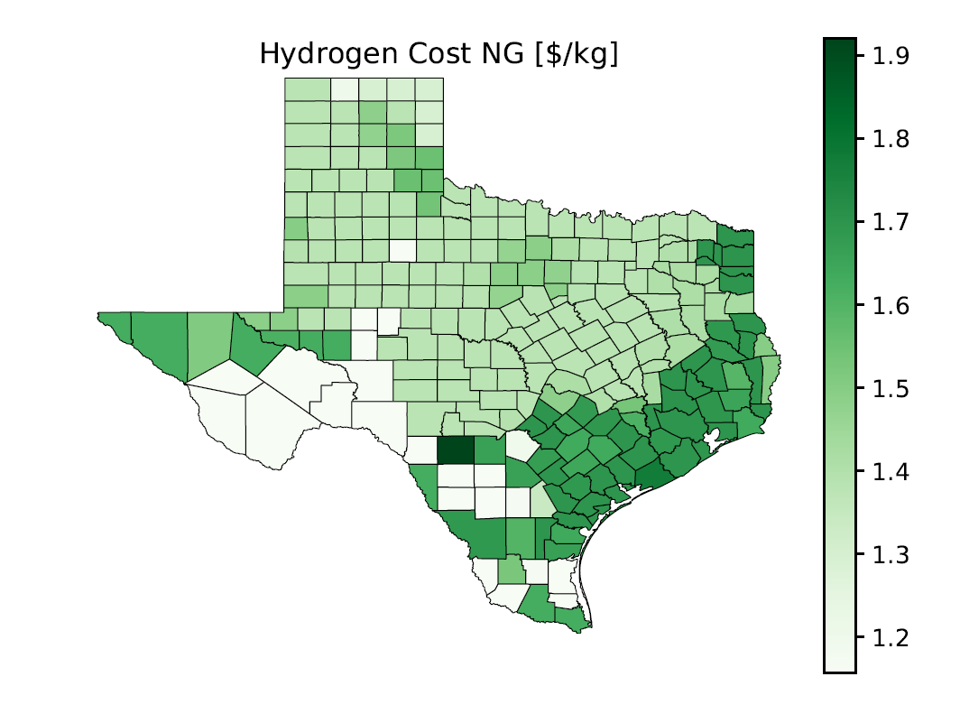
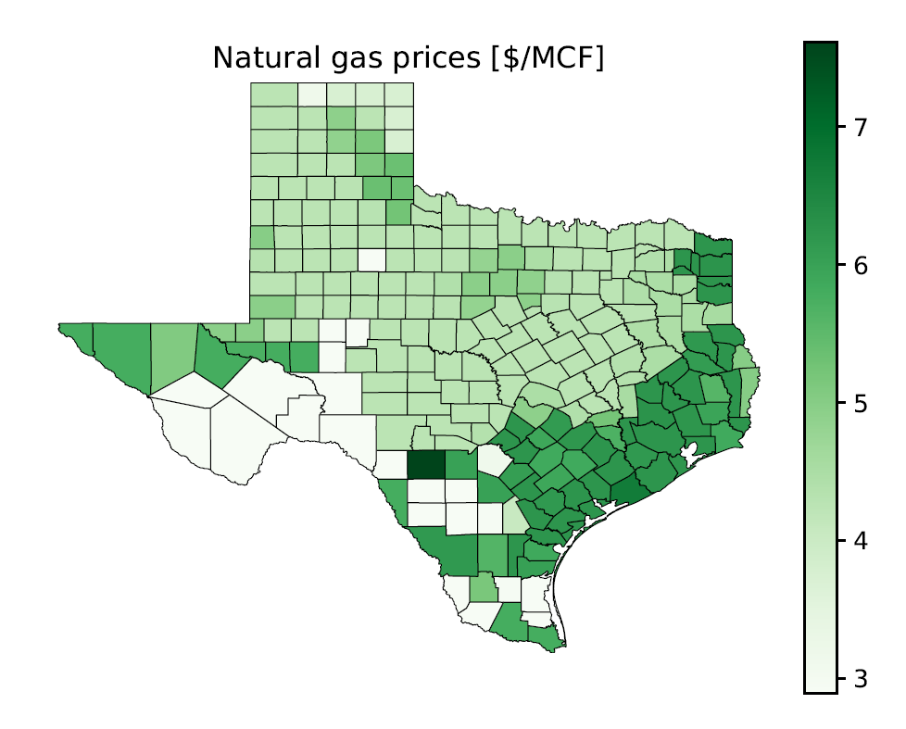

Slide 11
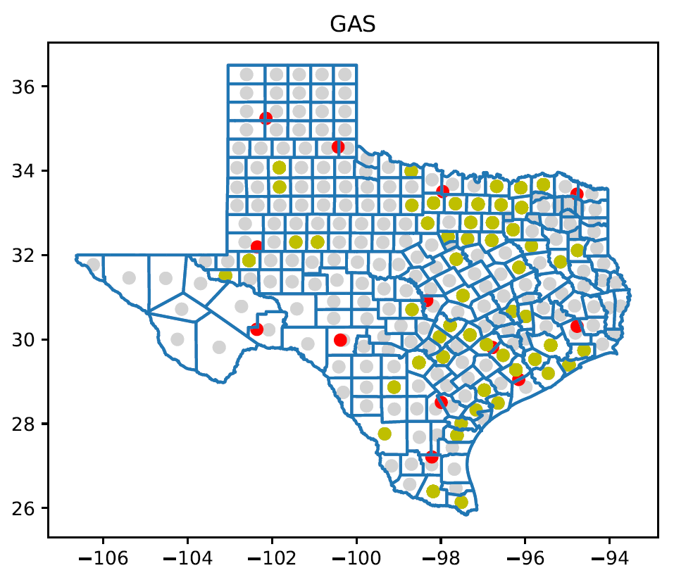
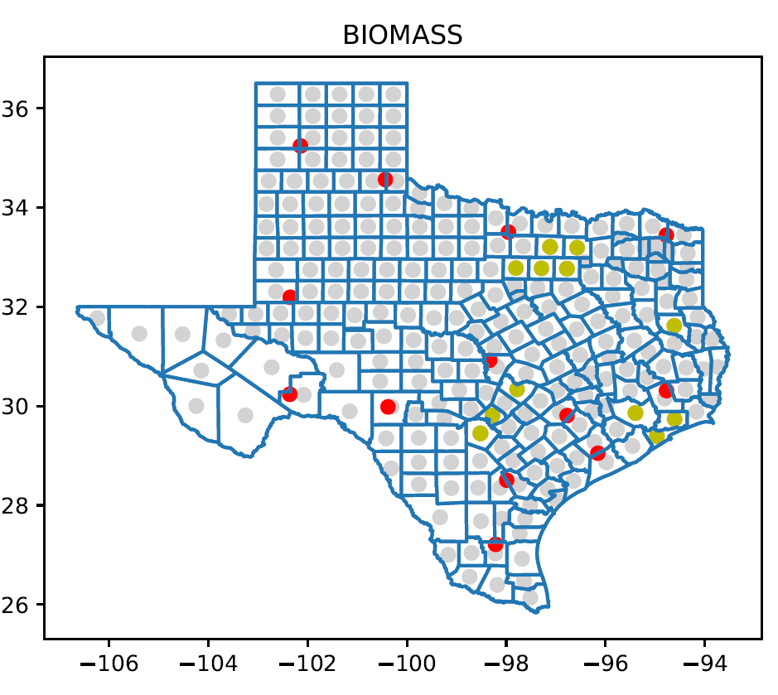
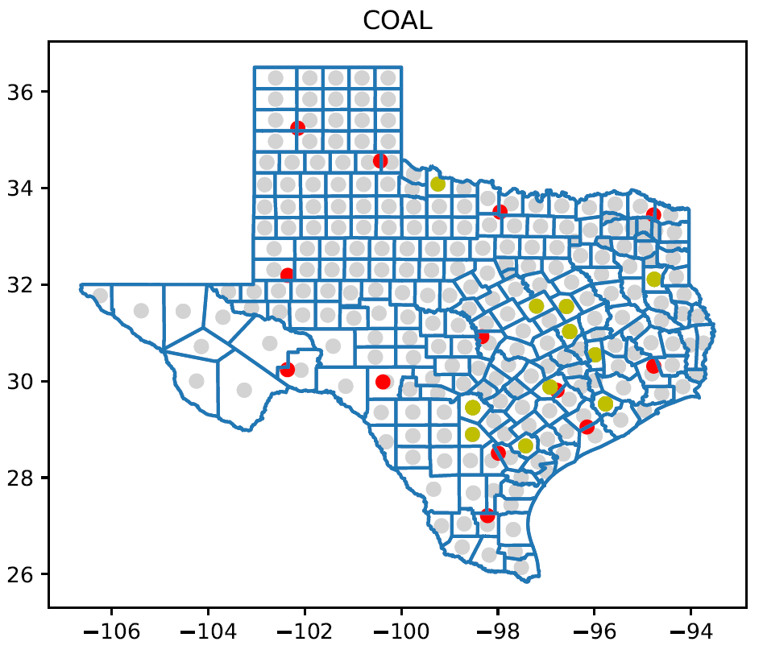
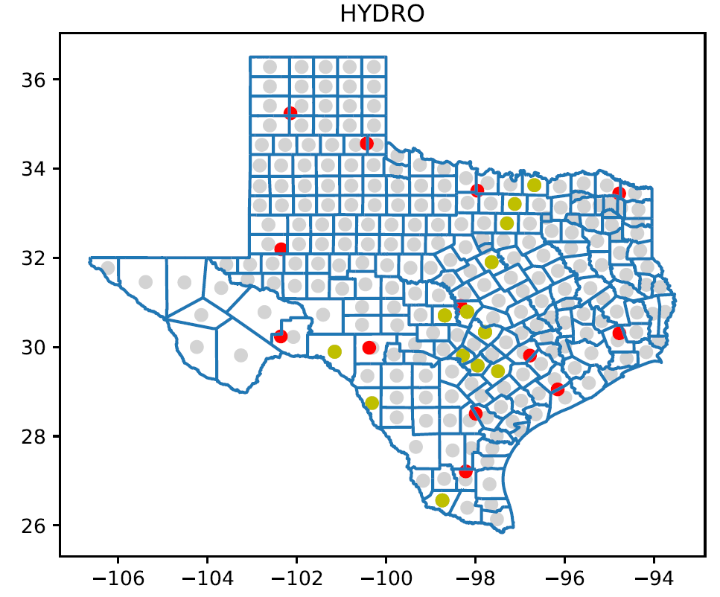

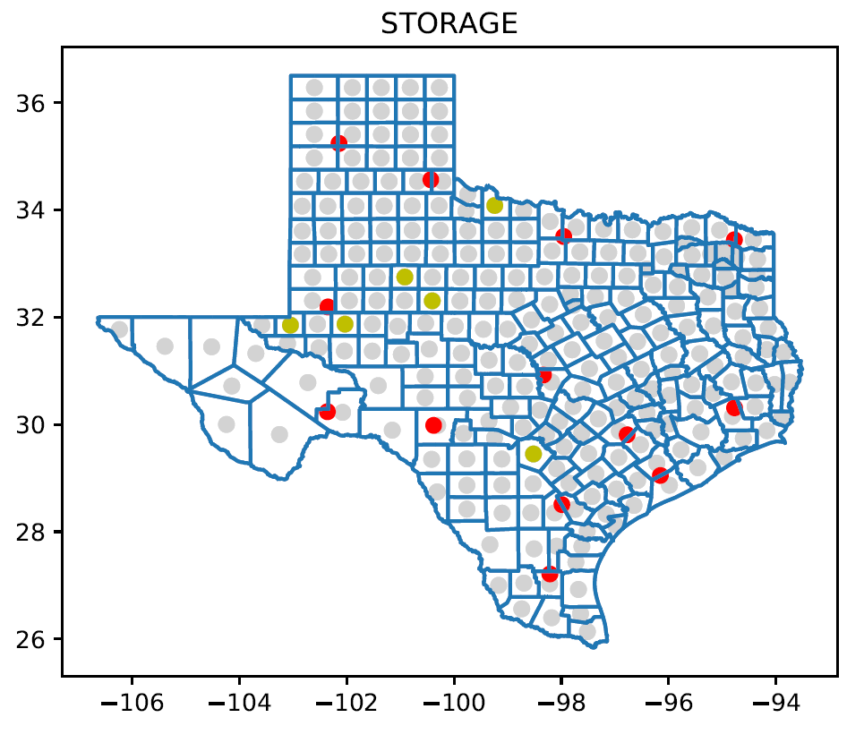

Slide 12
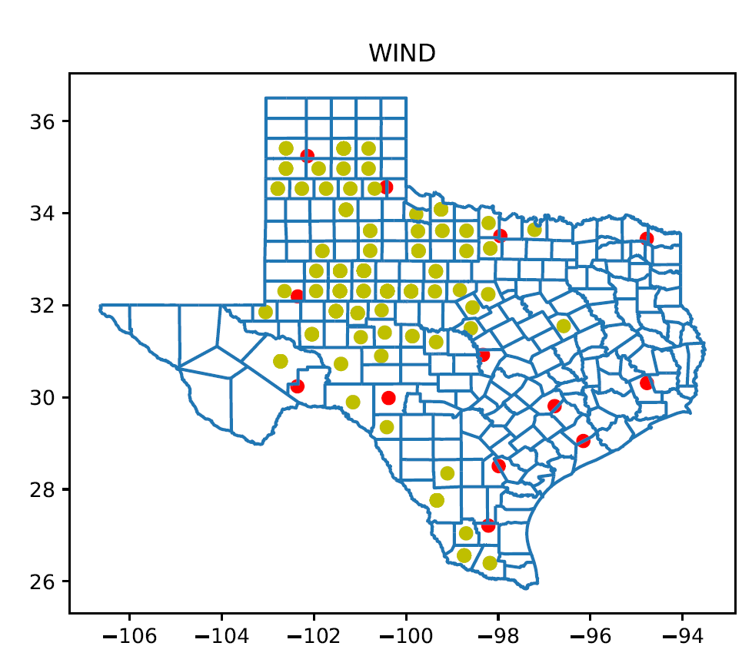
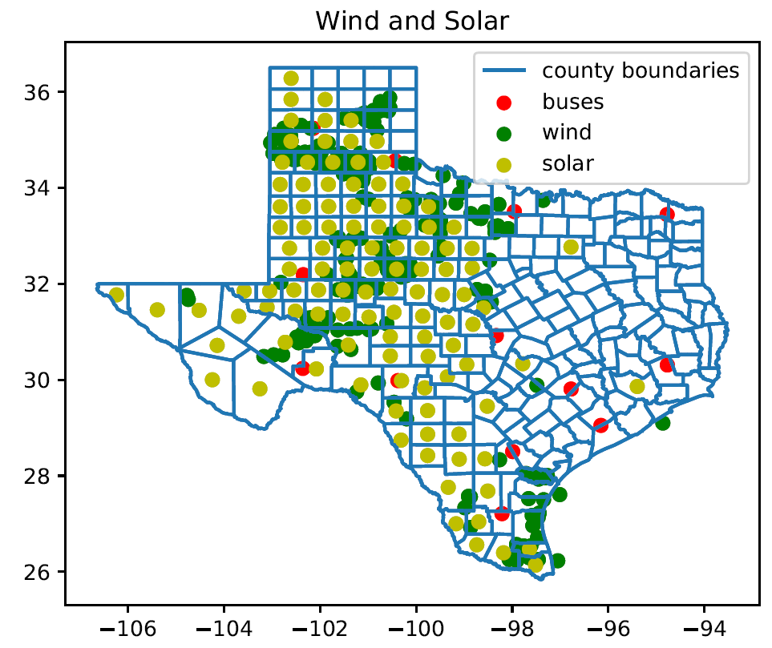
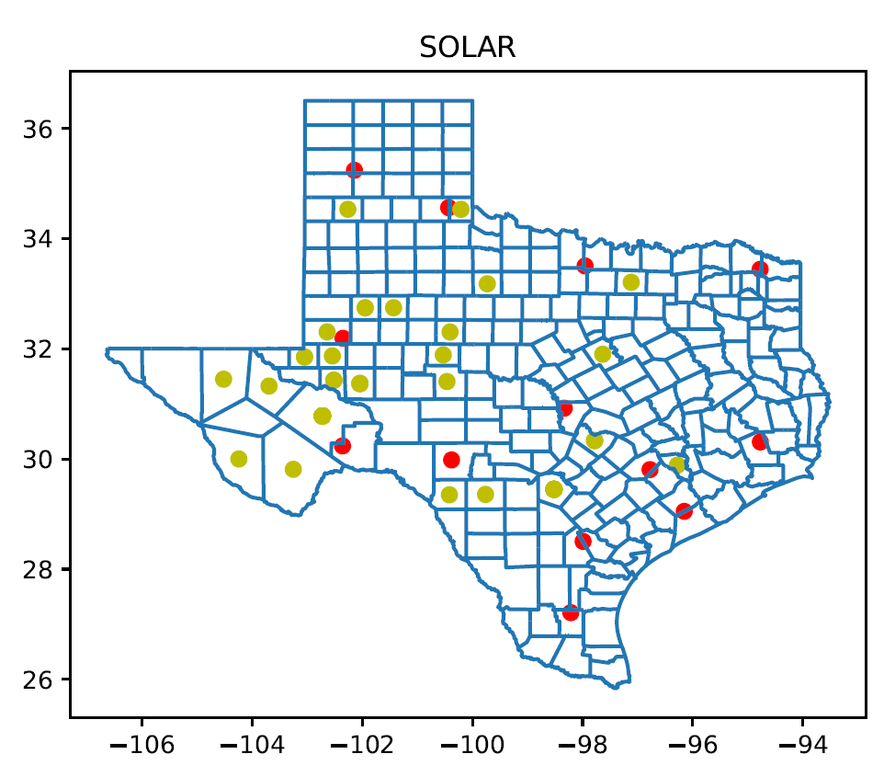

Slide 13
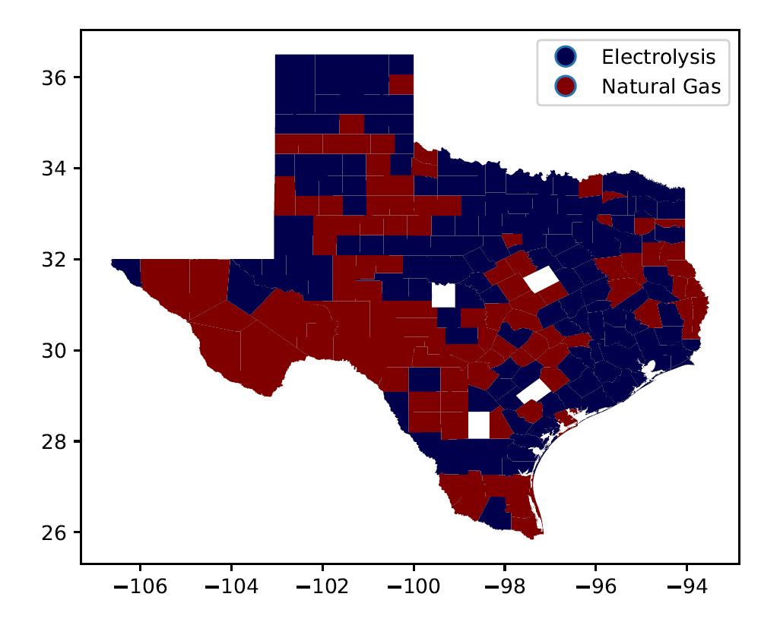
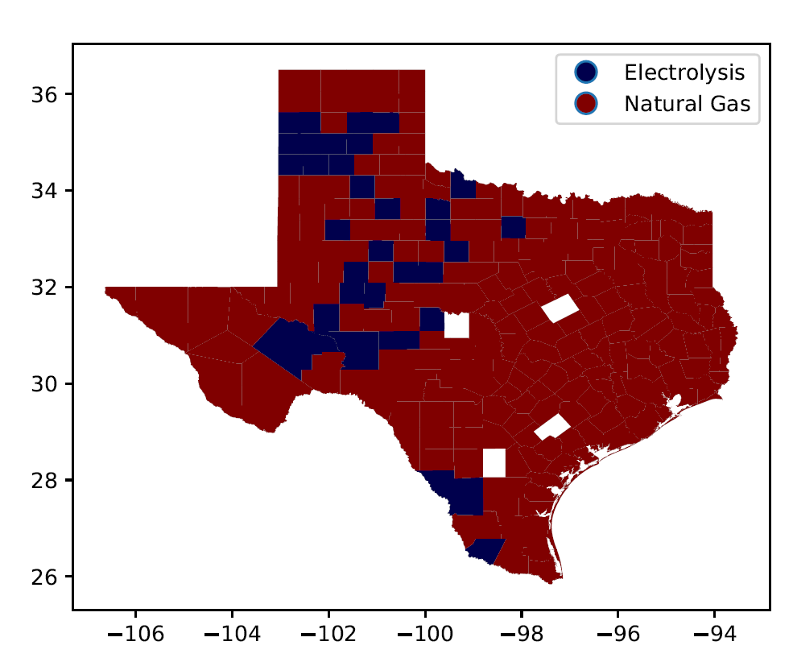
+2 $/kg H2 for NG
- 0.1 *CAP_WIND for EL price

