Slide 1
The best spot for a music festival in Germany
By Esperanza Garijo

Slide 2
The problem
We wish to find the best possible spot for a music festival based on the music scene in the area

Slide 3
The methodology
We will assume that the music scene is related to the amount of music venues in the area.
We therefore need to find all music venues in Germany, cluster them geographically, and find the centre of the clusters

Slide 4
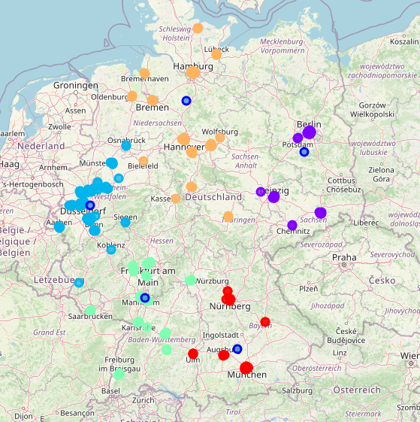
The results
The largest cluster is the one near Düsseldorf
This makes sense, since North Rhine-Westphalia is a very densely populated area

Slide 5
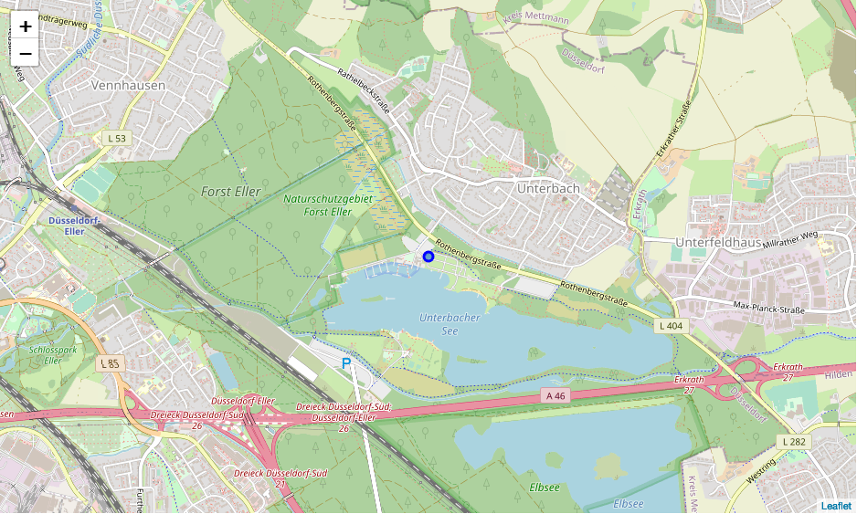
The perfect spot
The perfect camping site to do a music festival is the Campingplatz Unterbacher See (Nord).

