Slide 1
Java hashing
Notes:
These slides were created by Ellen Spertus and placed under a Creative Commons Zero v1.0 Universal (CC0 1.0) license.
There are animations and notes.

Slide 2
Equality and hashing

Slide 3

public class Course {
private String department;
private int number;
public Course(String department, int number) {
this.department = department;
this.number = number;
}
public static void main(String[] args) {
Course course1 = new Course("CS", 2510);
Course course2 = new Course("CS", 2510);
System.out.println(course1 == course2); false
}
}
course1
Course
department: "CS"
number: 2510
course2
Course
department: "CS"
number: 2510
What will this print?
Notes:
Go over the code, pointing out that there are two instances of the class Course. Ask what will be printed. Then, show the answer (false) and explain why.

Slide 4
public class Course {
private String department;
private int number;
public Course(String department, int number) {
this.department = department;
this.number = number;
}
public static void main(String[] args) {
Course course1 = new Course("CS", 2510);
Course course2 = new Course("CS", 2510);
System.out.println(course1.equals(course2); false
}
}
course1
Course
department: "CS"
number: 2510
course2
Course
department: "CS"
number: 2510
What will this print?
Notes:
Point out the one changed line (the last line of main). Ask what will be printed. Show the result (false).
Point out that Course extends Object and inherits its equals() method.

Slide 5
Object
public boolean equals(Object obj) {
return (this == obj);
}
https://github.com/openjdk-mirror/jdk7u-jdk/blob/master/src/share/classes/java/lang/Object.java
Notes:
This is the equals() method for Object. It just checks if this and obj are the same instance.
We usually override this for classes we create.

Slide 6
public class Course {
private String department;
private int number;
public Course(String department, int number) {
this.department = department;
this.number = number;
}
@Override
public boolean equals(Course other) {
if (other == null) {
return false;
}
return this.department.equals(other.department) &&
this.number == other.number;
}
public static void main(String[] args) {
Course course1 = new Course("CS", 2510);
Course course2 = new Course("CS", 2510);
System.out.println(course1.equals(course2));
}
}
course1
Course
department: "CS"
number: 2510
Method does not override method from its superclass
course2
Course
department: "CS"
number: 2510
Notes:
Here’s an equals method. Does anyone see anything wrong with it?
We get a compiler/IDE error because this has a different signature than the equals() method in the superclass. That’s why it’s so important to use the @Override annotation, so you’re warned if the signature doesn’t match.

Slide 7
public class Course {
private String department;
private int number;
public Course(String department, int number) {
this.department = department;
this.number = number;
}
@Override
public boolean equals(Object other) {
if (other instanceof Course otherCourse) {
return this.department.equals(otherCourse.department) &&
this.number == otherCourse.number;
}
return false;
}
public static void main(String[] args) {
Course course1 = new Course("CS", 2510);
Course course2 = new Course("CS", 2510);
System.out.println(course1.equals(course2));
}
}
course1
Course
department: "CS"
number: 2510
course2
Course
department: "CS"
number: 2510
Definition of equals() without corresponding definition of hashCode() [EqualsHashCode]
Notes:
The signature is now correct, but wait, we’re getting a different warning.

Slide 8

Notes:
You can ignore warnings, but only if you like to live dangerously.
What happens if we ignore this warning?

Slide 9
import java.util.HashSet;
import java.util.Set;
public class Course {
private String department;
private int number;
public Course(String department, int number) {
this.department = department;
this.number = number;
}
@Override
public boolean equals(Object other) {
if (other instanceof Course otherCourse) {
return this.department.equals(otherCourse.department)
&& this.number == otherCourse.number;
}
return false;
}
public static void main(String[] args) {
Course course1 = new Course("CS", 2510);
Course course2 = new Course("CS", 2510);
System.out.println(course1.equals(course2)); true
Set<Course> uniqueCourses = new HashSet<>();
uniqueCourses.add(course1);
uniqueCourses.add(course2);
System.out.println(uniqueCourses.size()); 2
}
}
course1
Course
department: "CS"
number: 2510
course2
Course
department: "CS"
number: 2510
Notes:
Step through this code, showing the unexpected behavior when we print the size of the set containing two equal elements.
To understand this behavior, you need to understand hashing.

Slide 10
Hashing

Slide 11
Amazing things about hashing
Hash sets can do these in O(1) time:
  check if an item is in the set
  add an item
Hash tables can do these in O(1) time:
  add a key-value pair to the table
  check if a key is in the table
  get the value associated with a key
  delete a key-value pair
How is this even possible?

Slide 12
What is hashing?
Hashing is mapping a value to an integer.
Hash tables and hash sets use this integer as the index into an array.
Sample hash function: hashCode(i) = i % 8
  set.add(1); // store in position 1
  set.add(10); // store in position 2
  set.add(5); // store in position 5
  set.add(16); // store in position 0
0 | 1 | 2 | 3 | 4 | 5 | 6 | 7
16 | 1 | 10 |  |  | 5

Slide 13
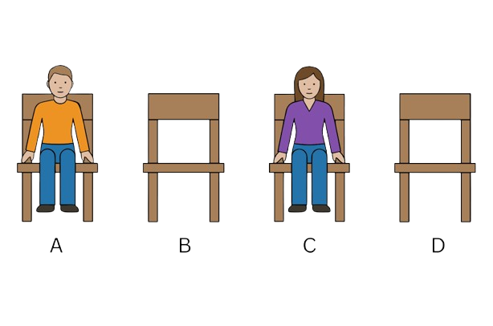
Hashing students to chairs
Alex
Cam

Slide 14
See any problems?
How do you hash non-integers?
  hashCode("hi") = 2
  hashCode("hello") = 5
What if two objects have the same hash value?
  hashCode("hello") = 5
  hashCode("world") = 5
What if the array isn't big enough for all values?
Notes:
Give students a chance to say if the see any problems before showing them.
The hashCode() function for strings shown here just uses the length of the string.

Slide 15
Collisions
collision: When hash function maps two values to same index.
  set.add(1); // position 1
  set.add(10); // position 2
  set.add(5); // position 5
  set.add(16); // position 0
  set.add(13); // position 5 -- but it's already full!
collision resolution: An algorithm for fixing collisions.
0 | 1 | 2 | 3 | 4 | 5 | 6 | 7
16 | 1 | 10 |  |  | 5

Slide 16
Collision resolution 1
Linear probing resolves a conflict by moving to the next position.
  set.add(1); // position 1
  set.add(10); // position 2
  set.add(5); // position 5
  set.add(16); // position 0
  set.add(13); // can't store in position 5
0 | 1 | 2 | 3 | 4 | 5 | 6 | 7
16 | 1 | 10 |  |  | 5 | 13

Slide 17
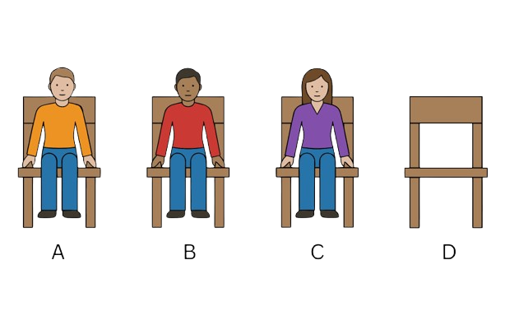
Linear probing
Alex
Amit
Cam
Notes:
Amit was placed in the “B” chair because the “A” chair was full.

Slide 18
Collision resolution 2
Chaining resolves conflicts by storing a list of values in each location.
  set.add(1); // position 1
  set.add(10); // position 2
  set.add(5); // position 5
  set.add(16); // position 0
  set.add(13); // can add to position 5
0 | 1 | 2 | 3 | 4 | 5 | 6 | 7
 |  |  |  |  |  | 13
16
1
10
5
13

Slide 19
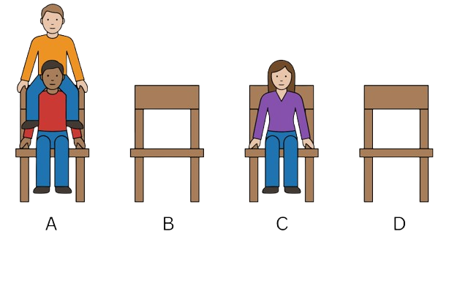
Chaining
Alex
Amit
Cam
Notes:
Each chair can contain multiple students.

Slide 20
import java.util.LinkedList;
import java.util.List;
public class HashIntSet {
private static final int CAPACITY = 8;
private List<Integer>[] elements;
public HashIntSet() {
elements = (List<Integer>[]) (new List[CAPACITY]);
}
public void add(int value) {
int index = hashFunction(value);
if (elements[index] == null) {
elements[index] = new LinkedList<Integer>();
}
elements[index].add(value);
}
// hashing function to convert objects to indexes
private int hashFunction(int value) {
return Math.abs(value) % elements.length;
}
public boolean contains(int value) {
int index = hashFunction(value);
return elements[index] != null &&
elements[index].contains(value);
}
public static void main(String[] args) {
HashIntSet set = new HashIntSet();
set.add(8);
System.out.println(set.contains(8)); // true
System.out.println(set.contains(0)); // false
set.add(2);
set.add(0);
}
0 | 1 | 2 | 3 | 4 | 5 | 6 | 7
8
2
0
Notes:
This is a partial implementation of a set of ints using hashing.
(It does not contain functions such as size().)

Slide 21
import java.util.HashSet;
import java.util.Set;
public class Course {
private String department;
private int number;
public Course(String department, int number) {
this.department = department;
this.number = number;
}
@Override
public boolean equals(Object other) {
if (other instanceof Course otherCourse) {
return this.department.equals(otherCourse.department)
&& this.number == otherCourse.number;
}
return false;
}
public static void main(String[] args) {
Course course1 = new Course("CS", 2510);
Course course2 = new Course("CS", 2510);
System.out.println(course1.equals(course2)); true
Set<Course> courses = new HashSet<>();
courses.add(course1);
courses.add(course2);
System.out.println(courses.size()); 2
}
}
0 | 1 | 2 | 3 | 4 | 5 | 6 | 7
course1
Course
department: "CS"
number: 2510
course2
Course
department: "CS"
number: 2510
Notes:
Now we can understand the mysterious behavior from earlier in lecture.
Because the two instances of Course have different hash values, they are both stored separately in the hash set.

Slide 22
hashCode()

Slide 23
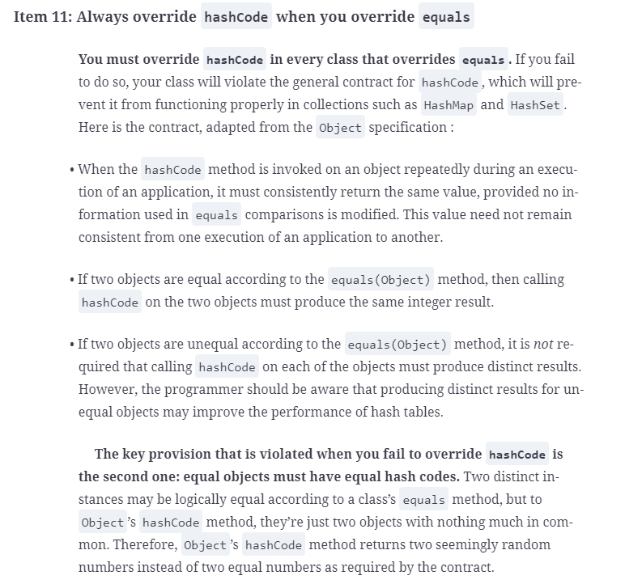



Slide 24
Rules for hashCode()
hashCode() must always return the same value for a given object.
If two objects are equals(), hashCode() must return the same values for them.
Is this a legal hash function?
@Override
public int hashCode() {
return 37;
}
Notes:
Surprisingly, this is a legal hash function! It follows all the rules, but it’s an awful hash function.
Every object will hash to the same position, so we won’t get O(1) performance.

Slide 25
What's a good hash function for String?
Desired characteristics
  Different strings have different hash values.
  Quick to compute.
How are these values?
  37
  string.length()
  Character.codePointAt(string.toCharArray(), 0)
Notes:
The third function gets the Unicode numeric value of the first character.
(This may prove useful during the exercise.)

Slide 26
Exercise

Slide 27
import java.util.LinkedList;
import java.util.List;
public class HashSet<T> {
private final int capacity;
private List<T>[] elements;
private int numCollisions;
public HashSet(int capacity) {
this.capacity = capacity;
elements = (List<T>[]) (new List[capacity]);
numCollisions = 0;
}
public void add(T value) {
int index = value.hashCode();
if (elements[index] == null) {
elements[index] = new LinkedList<T>();
} else {
numCollisions++;
}
elements[index].add(value);
}
public int getNumCollisions() {
return numCollisions;
}
}
Notes:
This is an implementation of HashSet. Note that it counts the number of collisions.
(It’s an incomplete implementation because it doesn’t include contains() or size methods.)

Slide 28
class MyString {
private final String s;
public MyString(String s) {
this.s = s;
}
@Override
public boolean equals(Object other) {
if (other instanceof MyString) {
return s.equals(((MyString) other).s);
}
return false;
}
@Override
public int hashCode() {
// Try to make different strings return different values.
// You must not call any other implementation of hashCode().
return 37;
}
}
public static void main(String[] args) {
String[] testStrings = {"hello", "world"};
for (String s : testStrings) {
System.out.printf("%s -> %d\n", s, new MyString(s).hashCode());
}
}
Notes:
Here’s the code you will be working with.
After explaining it, say to only change the hashCode() implementation and possibly the main() method to test it.
Put QR Code/link to contest.

Slide 29
Discussion
Notes:
The discussion should take place after the contest, either that day or on the next day.

Slide 30
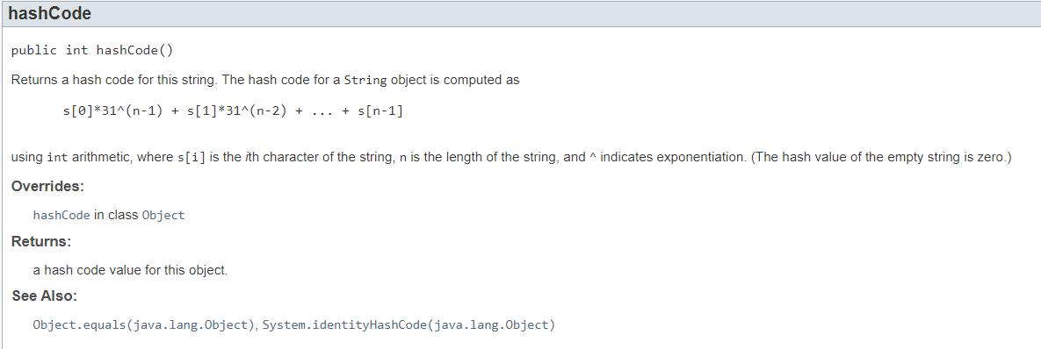
String
What is the time complexity? O(n)
Notes:
This is how String’s hashCode() method behaves. (The caret indicates exponentiation.)
This has the required property that if two strings are equals (have the same length and characters), they will have the same hash code.
This takes O(n) time (where n is the length of the string) because one value is added for each character in the string.

Slide 31
Java 1 String
public int hashCode() {
int h = 0;
int off = offset;
char val[] = value;
int len = count;
if (len < 16) {
for (int i = len; i > 0; i--) {
h = (h * 37) + val[off++];
}
} else {
int skip = len / 8;
for (int i = len; i > 0; i -= skip, off += skip) {
h = (h * 39) + val[off];
}
}
return h;
}
https://github.com/barismeral/Java-JDK-1.0-src/blob/master/src/java/lang/String.java
Notes:
Here’s the version of hashCode() that was in Java 1 but was replaced because it led to many collisions.
Surprisingly, it runs in constant time…

Slide 32
Time complexity of hashing
Should be O(n) with a low constant
Fun fact: The Java 1 String.hashCode() function ran in O(1) time
  For n < 16, every character was considered
  for n >= 16, 8 characters were considered
CS 0500 – Artificial Intelligence and Machine Learning for Strategic Planning

Slide 33
Summary
If you override equals(), override hashCode()
  obj1.equals(obj2) -> obj1.hashCode() == obj2.hashCode()
  Try to get different hashCode() values for different objects
  Let the IDE or library help you
Hash set/table performance
  O(1) lookup expected case
  Time-space trade-offs
  Not as simple or fast as arrays
import java.util.Objects;
@Override
public int hashCode() {
// Call Objects.hash() on all fields used for equality.
return Objects.hash(s);
}

Slide 34
