Slide 1
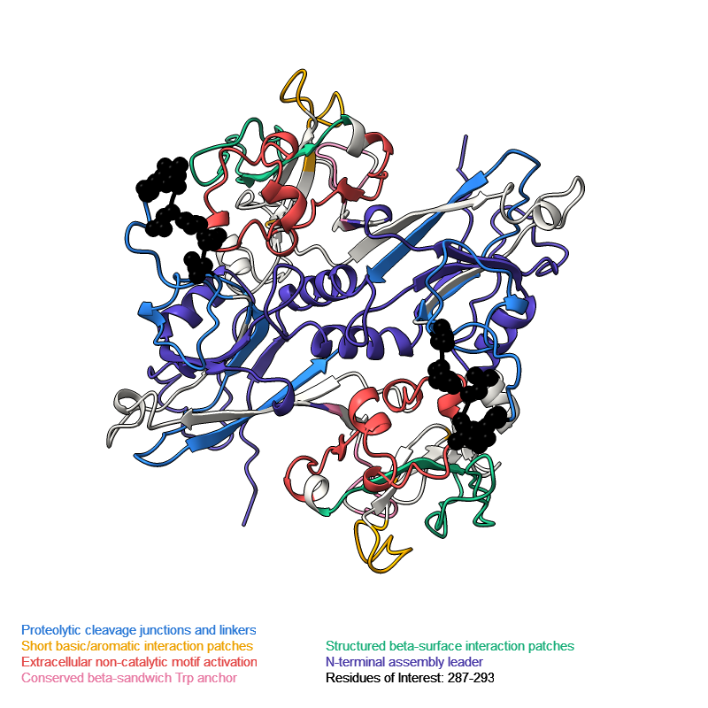
Evolved gp8 ROI (287-293): SAE feature summary
Ranks 1-2 are identical across all of 287-293, in both variants: dominant “whole-chain activation / central peaks” (Disorder, feature 15659, ~0.60–0.65) plus a weaker “catalytic/interface βαβ module” (Structural motif, feature 15513, ~0.40–0.44) — this region reads primarily as a flexible surface loop.
Rank 3 is where the two variants diverge — but at the same sequence position in both: the first DPN copy (D287-P288-N289) always reads “Phage and viral structural proteins” (Interaction site, feature 7819); V290 (WT) and the inserted second copy D290-P291-N292-V293 (evolved) both read “Extended structured domain surfaces” (Domain, feature 3038) instead.
Conclusion: the duplication relocates the interaction site rather than duplicating it — ESM-C/SAE only ever calls one DPN copy interaction-relevant, and it's always the first one.
ESM-C is sequence-only — these are learned sequence-context labels, not measured 3D contacts (see Slides 2–3).
Region | Residues (WT) | Residues (Evolved) | Rank 1 (Disorder) | Rank 2 (Struct. motif) | Rank 3
First DPN copy (invariant) | D287-P288-N289 | D287-P288-N289 | 15659 (~0.60-0.65) | 15513 (~0.40-0.44) | 7819 -- Interaction site
V290 / relocated 2nd copy | V290 | D290-P291-N292-V293 | 15659 (~0.60-0.65) | 15513 (~0.40-0.44) | 3038 -- Domain
Notes:
Speaker notes. Evolved 290-293 rank 4 is feature 7819 (Interaction site) on all four residues (~0.34-0.37) -- a secondary echo of the interaction signal, not a second strong site. Rank 5 varies per-residue: D290 -> 7070 "Phage tail attachment segments" (Disorder, 0.295); P291 -> 3509 "C-terminal helix-to-IDR transition" (Disorder, 0.303); N292 -> 12804 "Cysteine-rich LU/CRD domains" (Domain, 0.303); V293 -> 3509 (Disorder, 0.316). WT V290 rank 4/5 = 7819 (0.359) / 7070 (0.309).

Slide 2
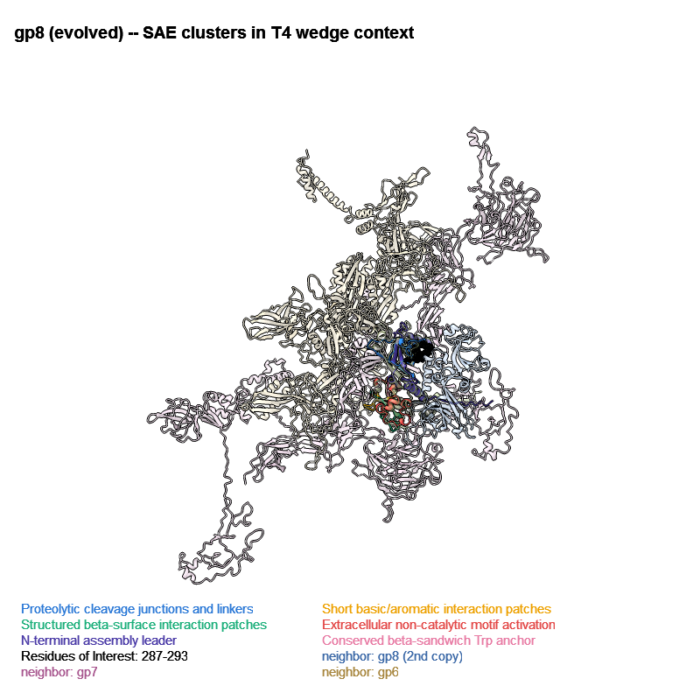
gp8 (evolved) in its real T4 wedge context
Same evolved gp8, SAE-cluster colored, now shown inside its authentic structural neighborhood: the cryo-EM T4 baseplate wedge (PDB 9MKB), not an isolated monomer.
Confirms gp8 is a genuine T4 gp8 baseplate-wedge homolog — CA-centroid overlay onto 9MKB chain ZE differs by only 0.30 Å.
Wedge stoichiometry recovered exactly as expected from T4 biology: 2x gp8 + gp7 + gp6 (pale blue / pink / tan, de-emphasized as background context).
The ROI (287-293, black spheres) sits right at the boundary facing the second gp8 copy — i.e., near a real inter-subunit interface, not buried mid-fold.
Open question this figure sets up: does the newly-inserted second DPN copy make its own contact with a neighboring chain, or is it simply repositioned in place? Requires a direct contact measurement from the aligned-overlay structure — next planned step, not done yet.
Notes:
Speaker notes. 9MKB is the cryo-EM structure of the bacteriophage T4 portal-neck-tail complex (541 chains). A CA-CA contact search (<10 Å) from chain ZE (which overlays our AF3 gp8 model almost exactly) against all 541 other chains finds exactly 6 true neighbors: ZD (2nd gp8 copy), YC/Yc (gp7), eB/eU/f9 (gp6) -- matching the known T4 wedge stoichiometry (2x gp8 + gp7 + gp6 per wedge). All other 534 chains (tail tube/sheath, capsid, portal, fibers) are irrelevant to gp8's immediate context and were dropped, not just hidden.

Slide 3
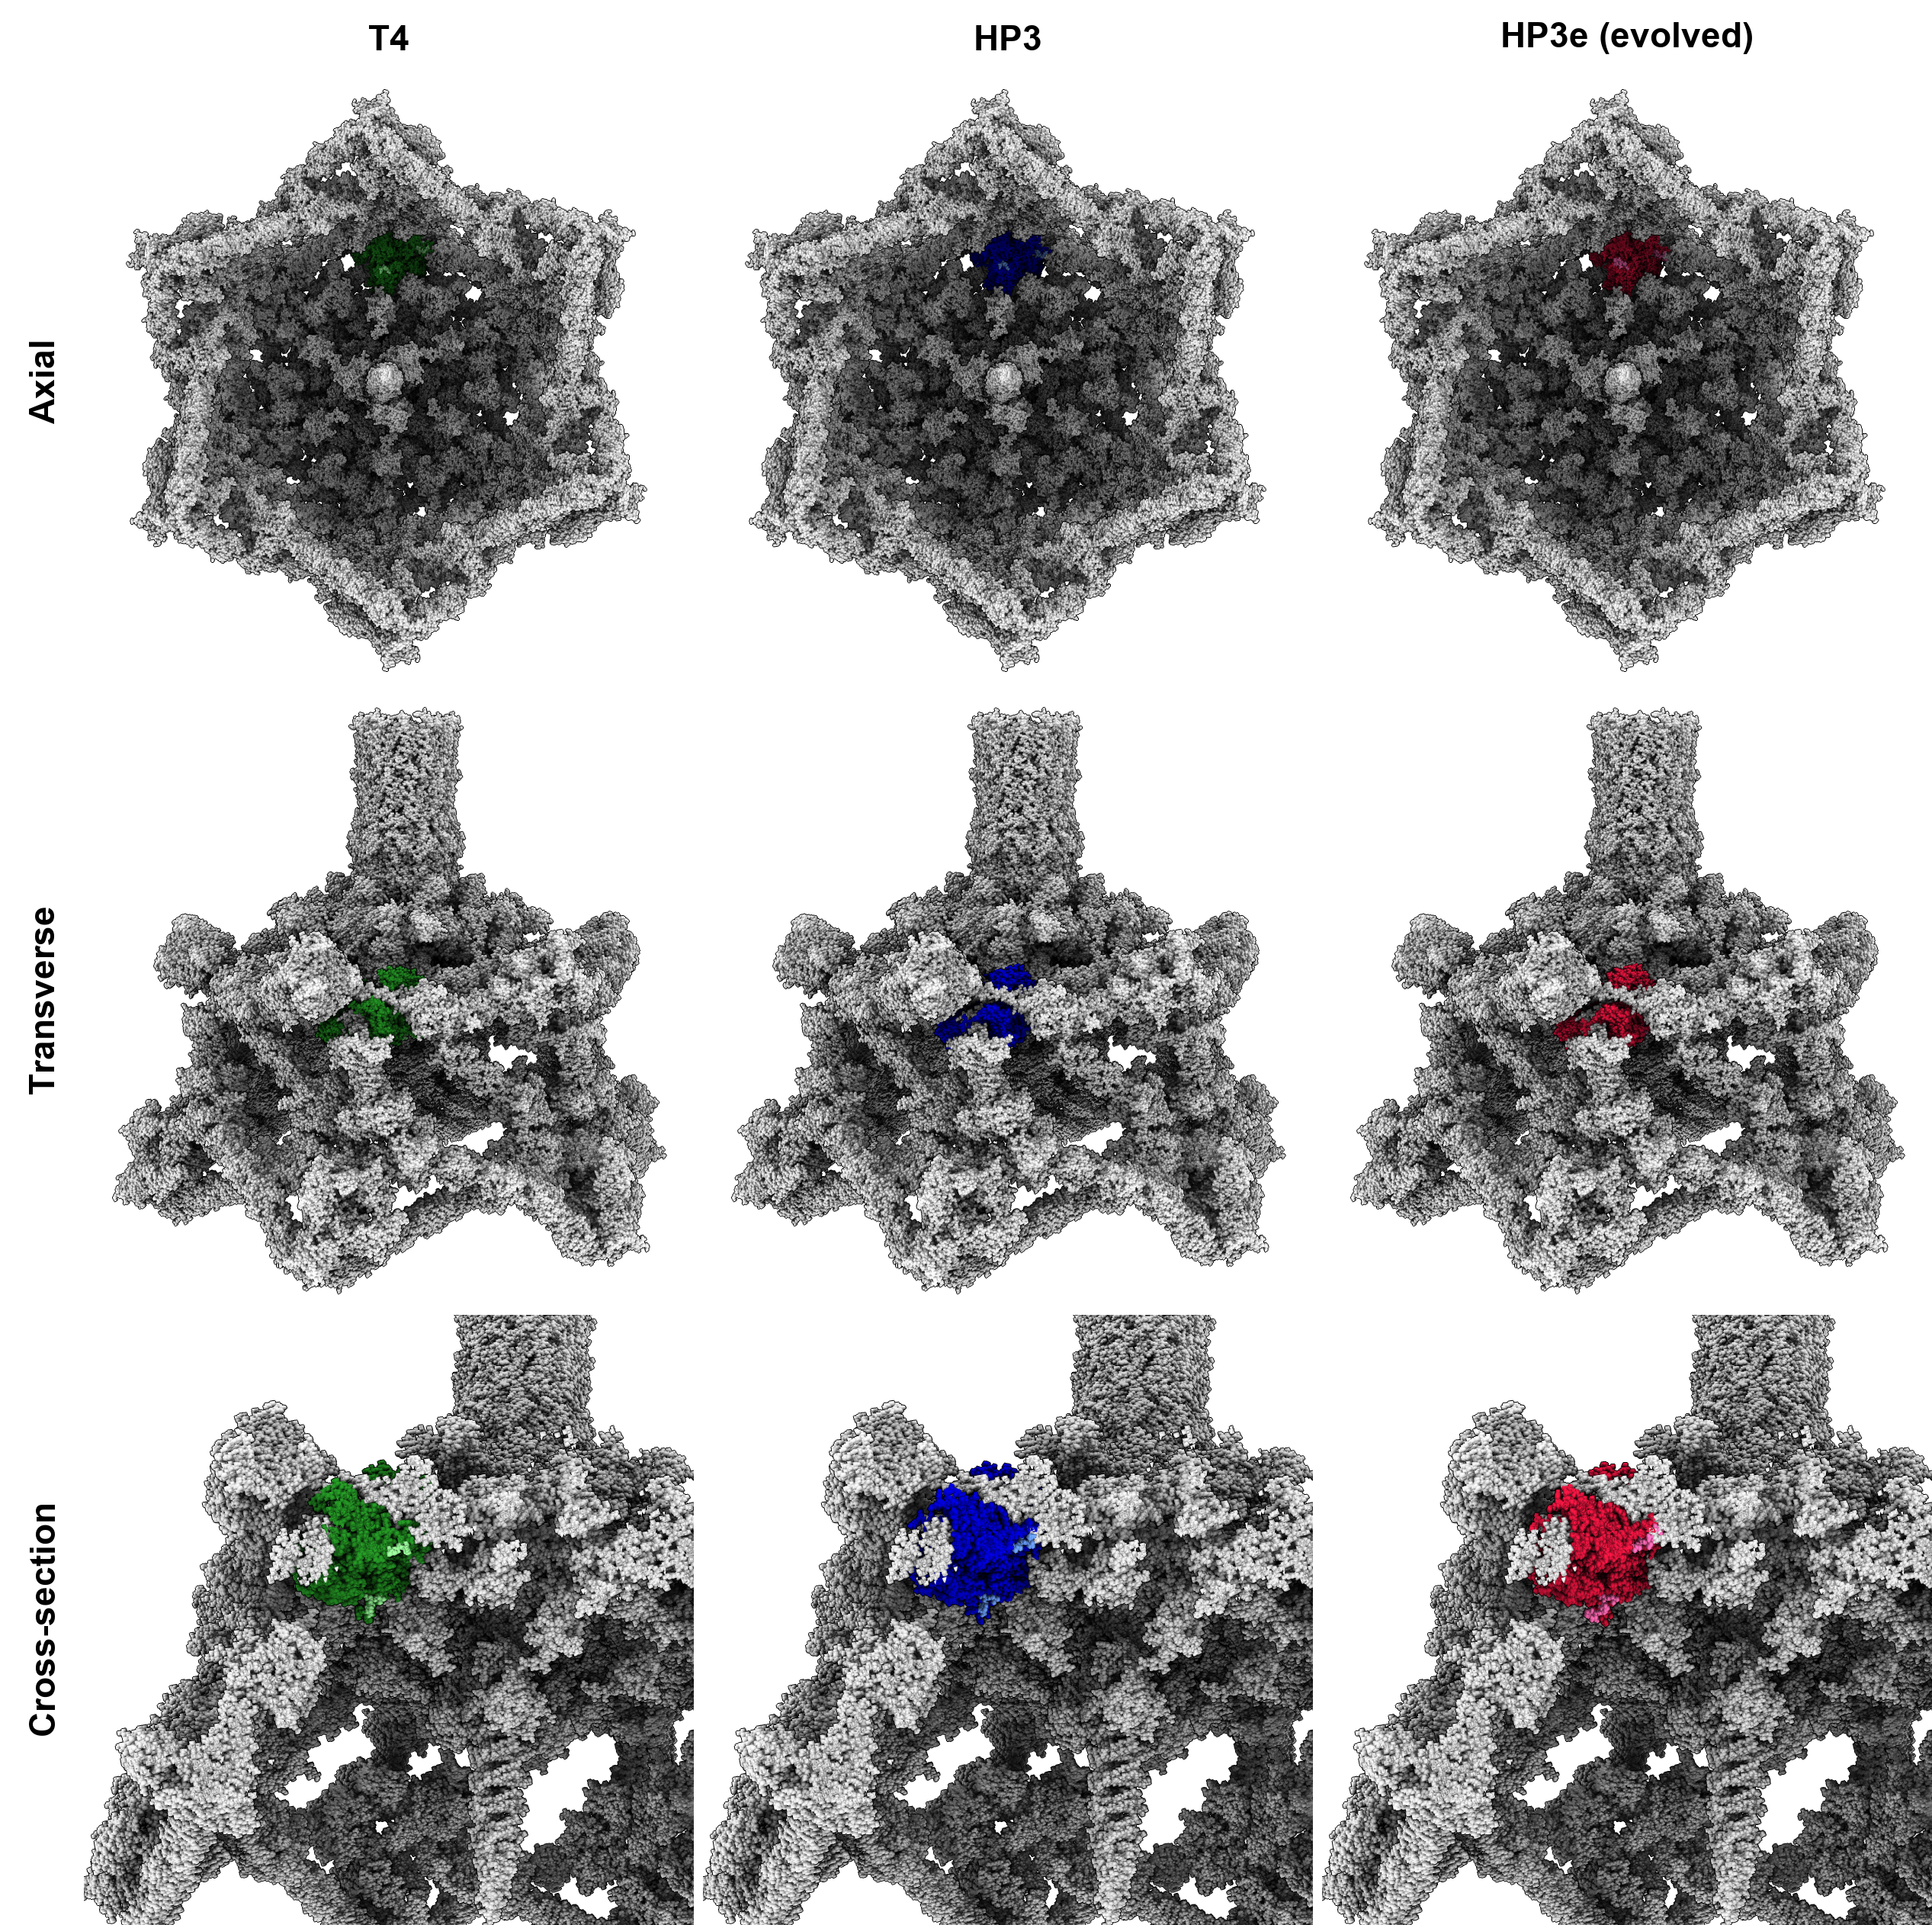
T4 tail overlay: does the duplication move the contact point?
3x3 comparison: columns = T4 gp8 (reference), HP3 (WT), HP3e (evolved); rows = axial, transverse, and cross-section views of gp8 overlaid on the real T4 tail.
Across all three viewing angles, the DPN duplication visibly shifts the first-contact loop's position/orientation relative to WT — independent, structural confirmation of the Slide 1 SAE finding: the interaction footprint doesn't get bigger, it moves.
Why duplicate the whole DPN triplet, and not a partial insertion (DP, P, or PN alone)? DPN is a proline-anchored turn unit — a partial insertion would break the local turn geometry, while duplicating the full triplet preserves the fold and just shifts its downstream position.
Working conclusion: this duplication event repositions the binding location, consistent with the tropism shift observed in HP3e.
Still open: whether the inserted second copy independently contacts the tail (rather than just riding along structurally) isn't resolved by either the SAE features (sequence-only) or this overlay — flagged for the follow-up contact analysis.
Notes:
Speaker notes. Panels built from AF3 models of HP3 (WT) and HP3e (evolved) gp8, structurally aligned onto the real T4 tail (9MKB) coordinate frame, then rendered from three fixed camera angles per variant so the same viewpoint is directly comparable across T4/HP3/HP3e.

