Slide 1

Master's Presentation
Max Espinoza
Master/PhD Student
April 6, 2016

Slide 2

Outline
Motivation
Related Works
Feature Design
Pilot User Study
Feedback Analysis
Conclusions and Future Work

Slide 3
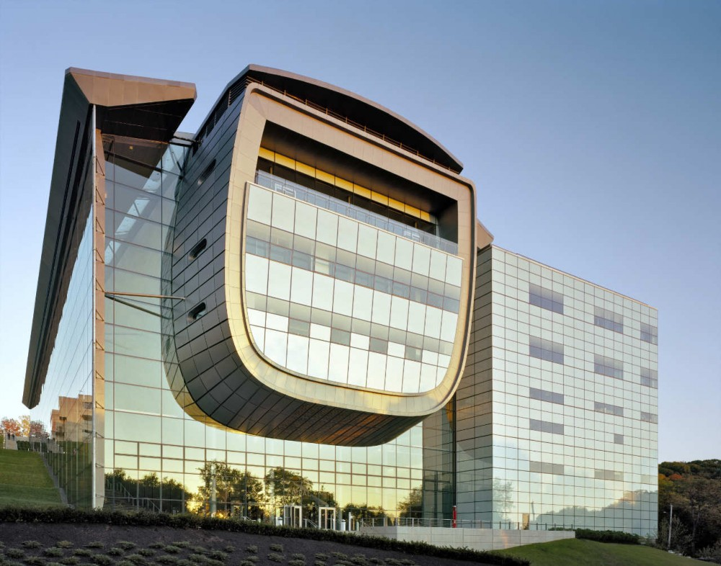
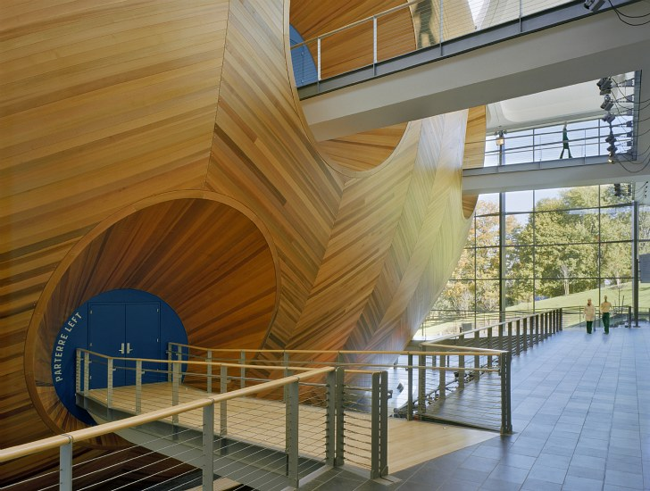
What is Daylighting?
Images: http://www.archinspace.com/

Slide 4
What is Daylighting?
aesthetically pleasing visuals
environmental sustainability
Images: http://www.archinspace.com/

Slide 5
Health Benefits of Daylight

Slide 6
Health Benefits of Daylight

Slide 7
Economic Benefit of Daylight

Slide 8
Challenges Of Designing Daylighting Systems

Slide 9
Economic Benefit of Daylight

Slide 10
Daylighting In The Architectural Design Processes

Slide 11
Outline
Motivation
Related Works
Feature Design
Pilot User Study
Feedback Analysis
Conclusions and Future Work

Slide 12
Outline
Motivation
Related Works
Feature Design
Pilot User Study
Feedback Analysis
Conclusions and Future Work

Slide 13
Outline
Motivation
Related Works
Feature Design
Pilot User Study
Feedback Analysis
Conclusions and Future Work

Slide 14
Outline
Motivation
Related Works
Feature Design
Pilot User Study
Feedback Analysis
Conclusions and Future Work

Slide 15
Outline
Motivation
Related Works
Feature Design
Pilot User Study
Feedback Analysis
Conclusions and Future Work

