Slide 1


JOIN TODAY!

Slide 2

ARCHITECTURE
FRONT-END
FRAMEWORK
DOMAIN SPECIFIC LANGUAGE
(XML, JS)
STYLE, LAYOUT
(CSS)
APP LIFECYCLE
APIs & SERVICES
UI COMPONENTS
Front-end framework
Based on HTML*, CSS, and
JavaScript.
Built-in UI components and
advanced services and APIs.
Two main execution threads:
Rendering and JS engine.
JS Bridge to the OS
JS ENGINE
RENDER ENGINE
BRIDGE
OS &
HARDWARE
GRAPHICS
LIBRARY
NATIVE UI COMPONENTS
NATIVE APIs &
SERVICES
GPU/NPU
05
Quick App Initiative

Slide 3
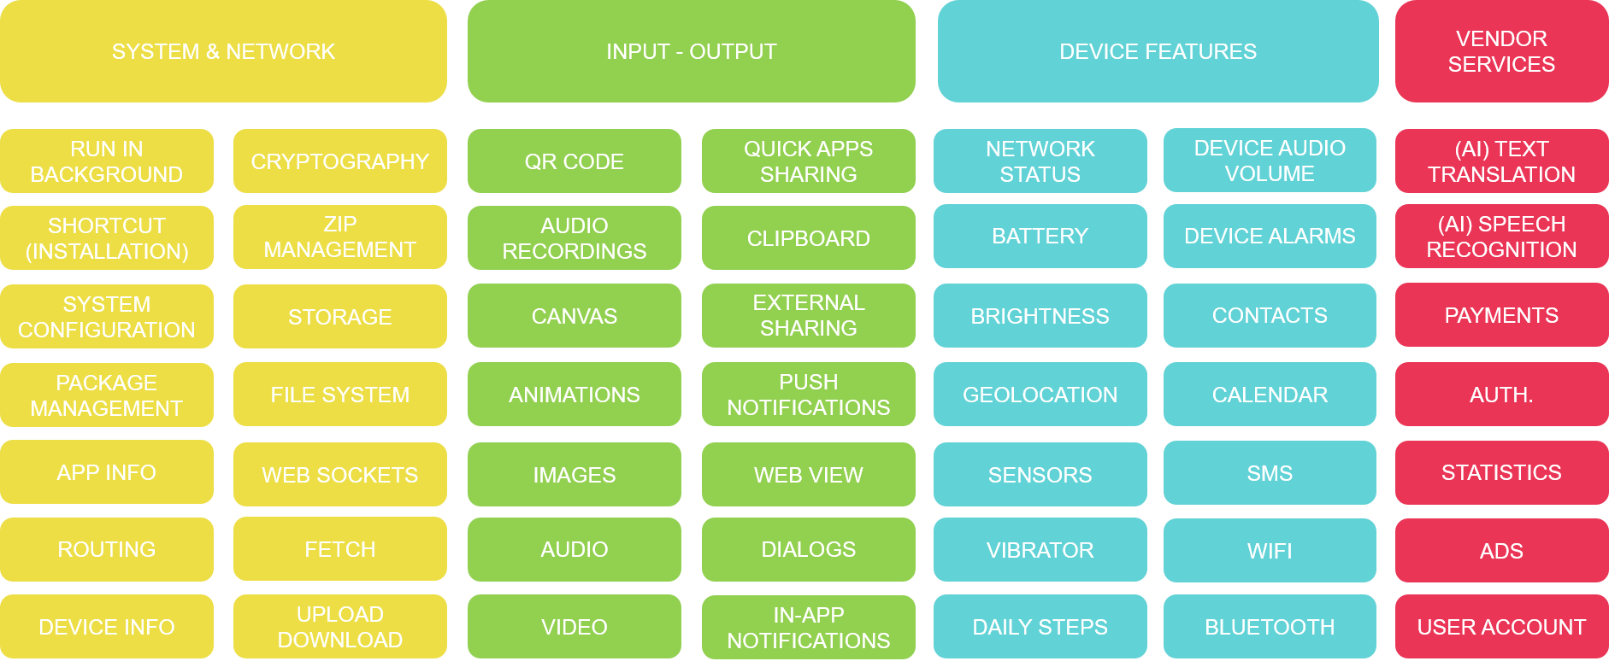
SERVICES
Access to the system:
package manager, storage,
system configuration…
Advanced IO: third-party app
sharing; push notifications,
dialogs…
Device’s features: to battery
status, calendar, brightness,
network status, bluetooth…
05
Quick App Initiative

Slide 4
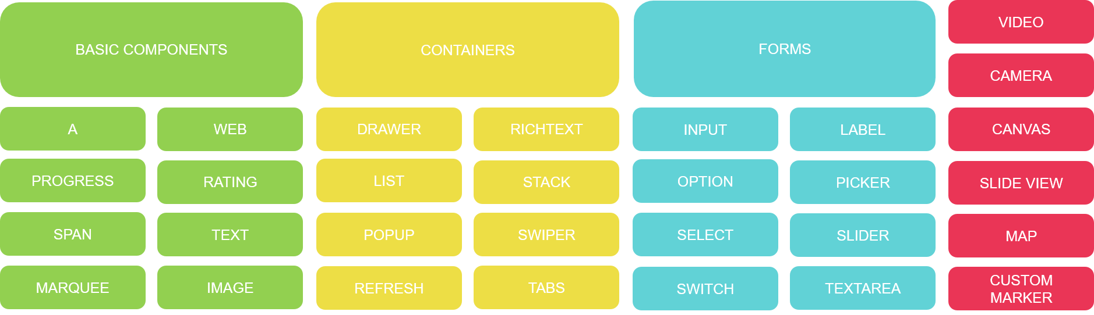
UI Components
Modular and reusable
components: basic containers,
rich text, carrousel/gallery,
pull to refresh, switch buttons,
tabs, advances pickers…
05
Quick App Initiative

Slide 5
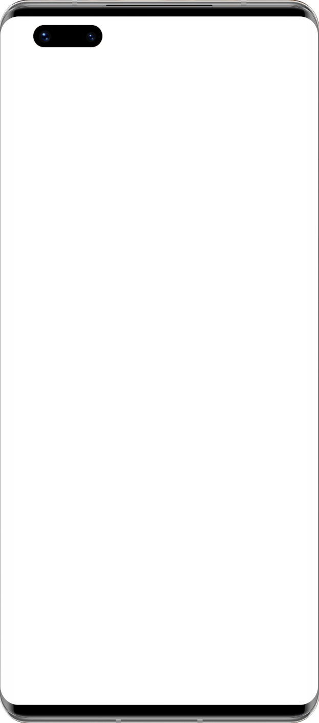
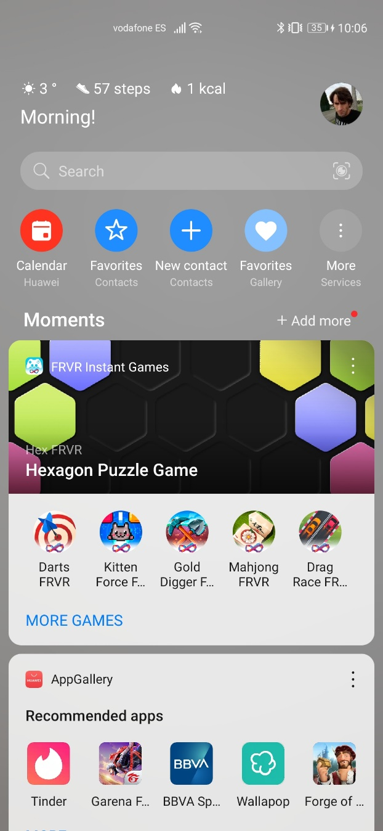
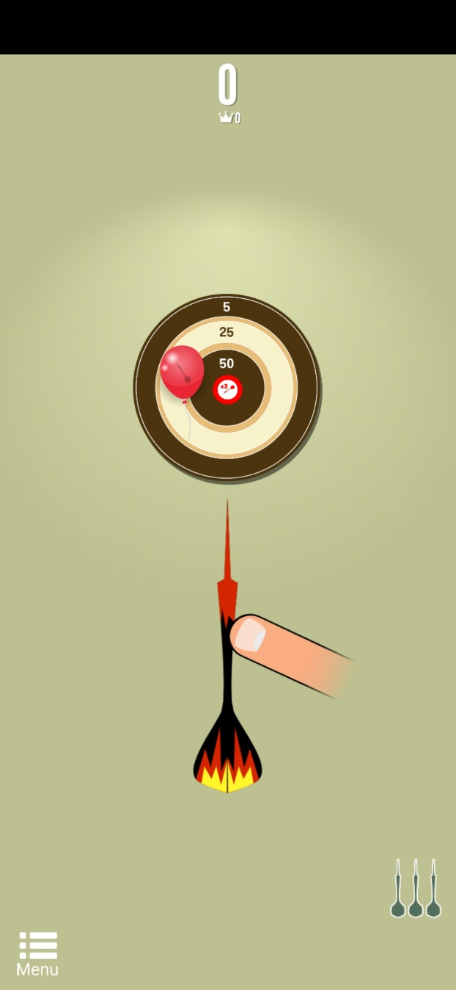
Discoverability
Widgets on dashboard
Global search results
Web sites (URL links)
Links from other apps
Listed in app marketplaces
05
Quick App Initiative

Slide 6
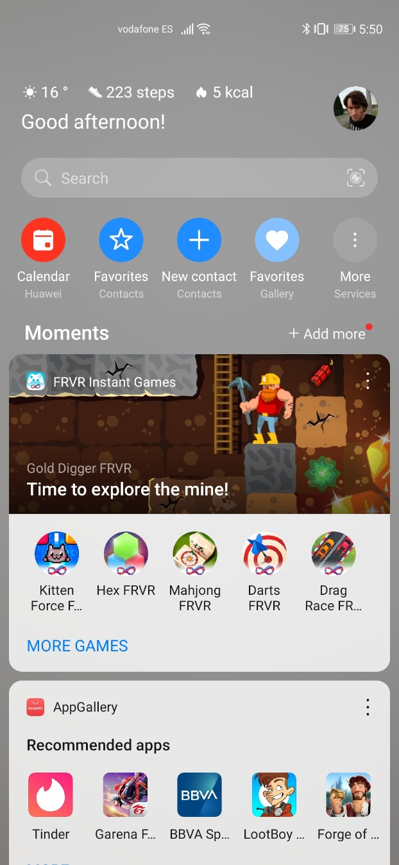
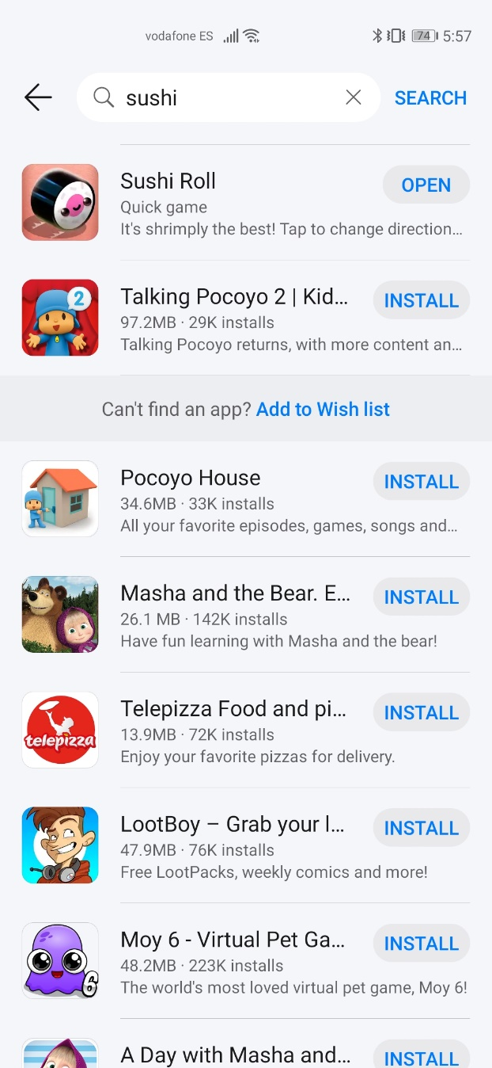
User Acquisition
Huge discoverability
Instant access
Minimum friction
User identification
05
Quick App Initiative

Slide 7
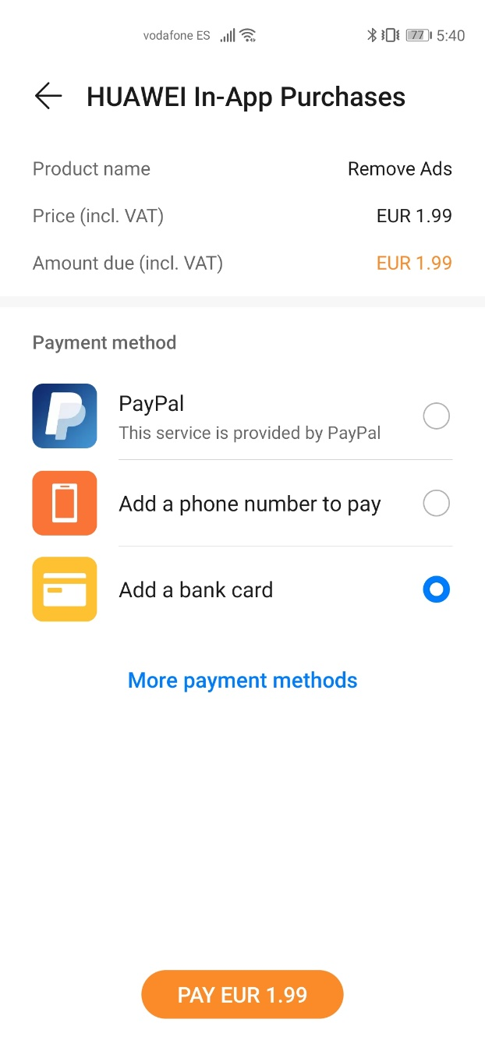
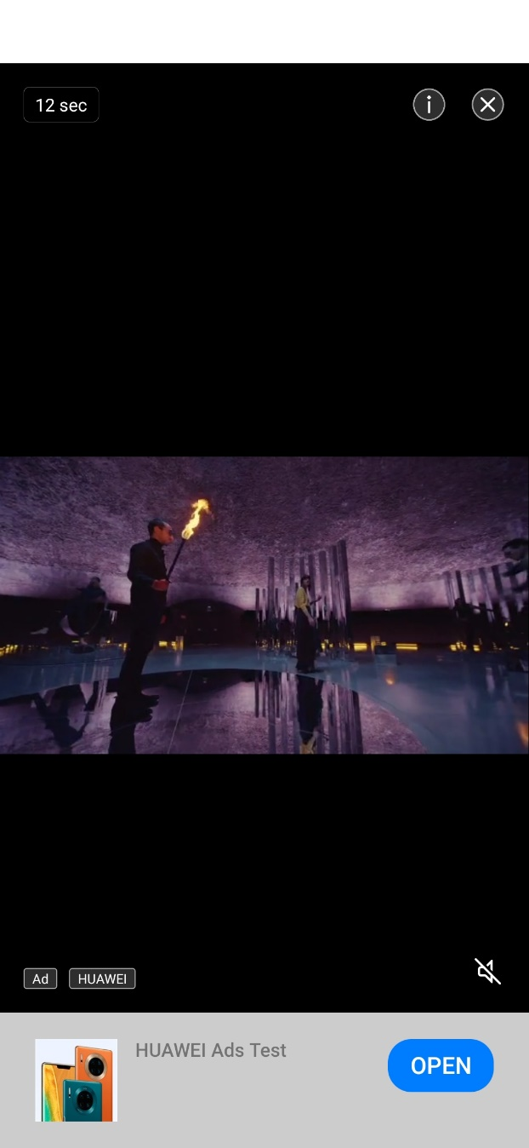
Monetization
In-app purchases
In-app ads
Rewarded ad videos
05
Quick App Initiative

Slide 8
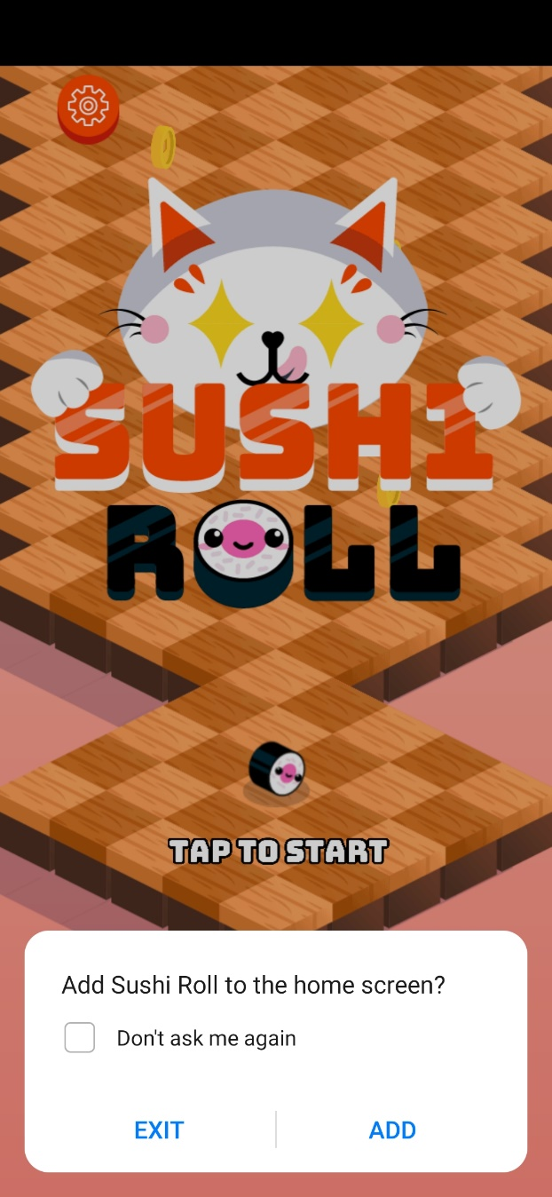
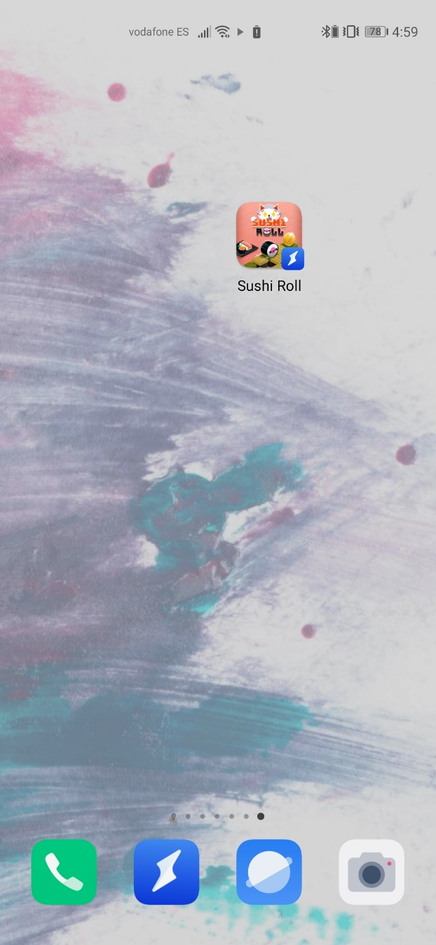

User Retention
Tap to open
Shortcut in home screen
Remember status
Push notifications
05
Quick App Initiative

Slide 9
JOIN TODAY!

