Slide 1

PSI Re-USE in SPAIN
Martin Alvarez
EPSI Platform Tour — 1 OCT 2015, Ljubljana (SI)

Slide 2
About EPSI Platform
PSI Re-use in Spain

Slide 3

ePSI Platform
European Public Sector Information Platform
Funded by the European Commission
Europe's One-Stop Shop on PSI Re-use
News, happenings
Best practices
Engaging the community

Slide 4
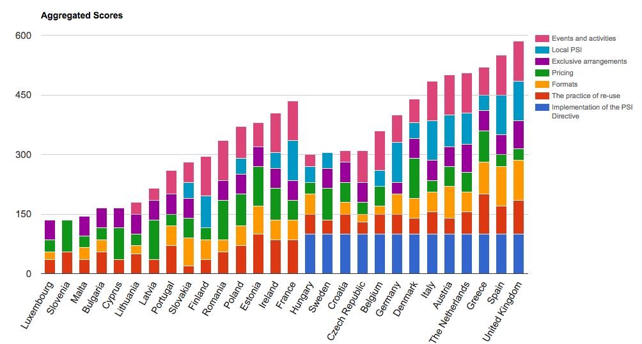
PSI Scoreboard
Status of PSI in EU28
http://www.epsiplatform.eu/content/european-psi-scoreboard
Notes:
There are many differences among countries but it’s clear who are more advanded at a gance.
UK is in the top but too many in the lower part of the ranking.

Slide 5
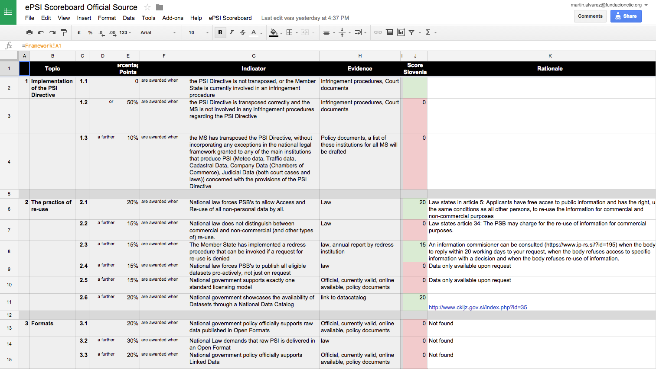
PSI Scoreboard
Crowd-sourced tool
http://goo.gl/3P40M
Notes:
There are many differences among countries but it’s clear who are more advanded at a gance.
UK is in the top but too many in the lower part of the ranking.

Slide 6
Legal background
PSI Re-use in Spain

Slide 7
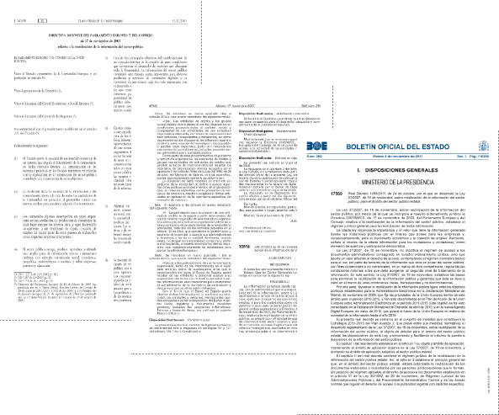
Legal Framework (I)
Directive 2013/37/EU of the European Parliament and of the Council of 26 June 2013 on the reuse of PSI. (Amending 2003/98/EC)
Law 18/2015 of 9th July 2015, transposing the Directive 2013/37/EU
National Interoperability Technical Standard on PSI reuse (2012)

Slide 8
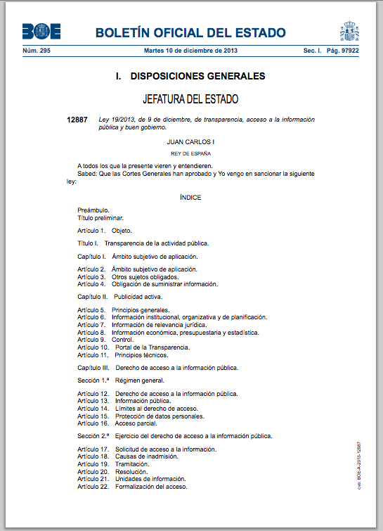
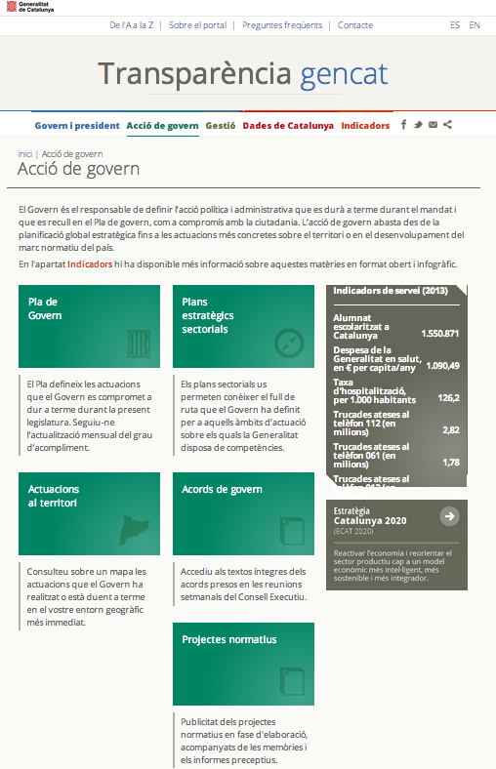
Legal Framework (II)
Law 19/2013 on transparency, information access and good governance
Various regional/local acts on transparency and/or PSI reuse

Slide 9
In brief
Every national-level public body had to:
Appoint a PSI Manager
Publish at least 4 datasets as Open Data
Index that data on datos.gob.es
Implement the Interoperability Technical Standard (ITS) on PSI reuse

Slide 10
ITS on PSI RE-USE
Based on W3C’s DCAT and compliant with ISA’s DCAT Application Profile for data portals in Europe
Technical guidelines for public bodies to implement Open Data strategies.
How to:
Select information;
Identify datasets, catalogues, portal on the Web
Describe metadata on datasets (DCAT)
License (with a model)
Publish and maintain data catalogues
See more
Notes:
Wrote in 2011

Slide 11
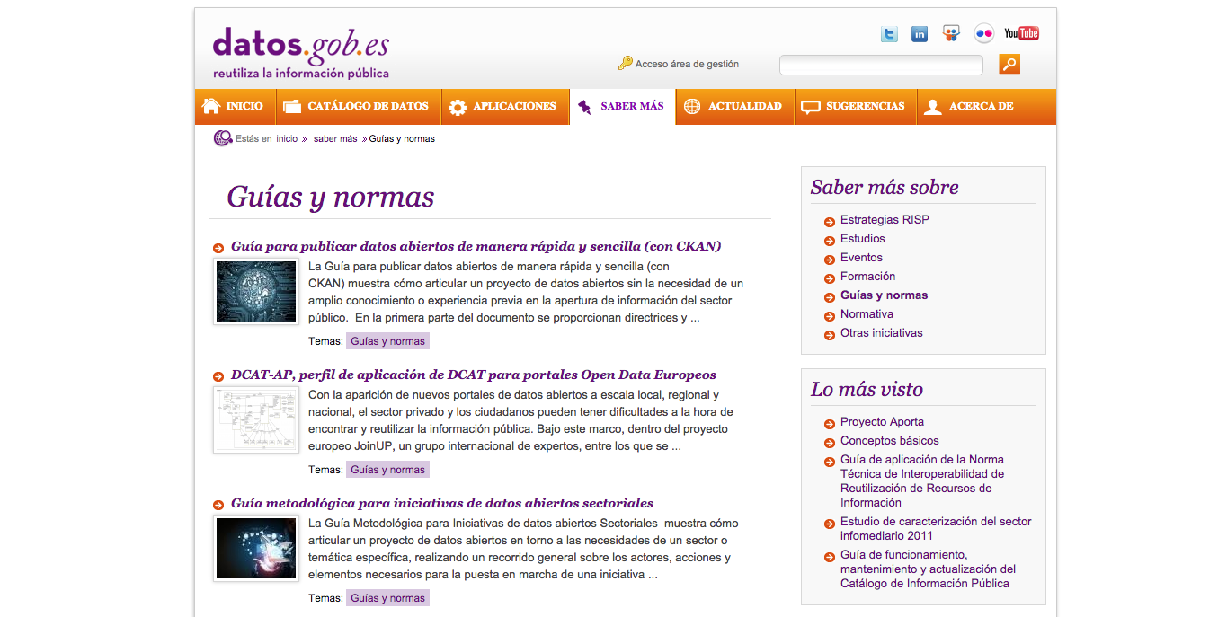
Use Guides to implement Open Data projects

Slide 12
Health of Open Data
PSI Re-use in Spain

Slide 13
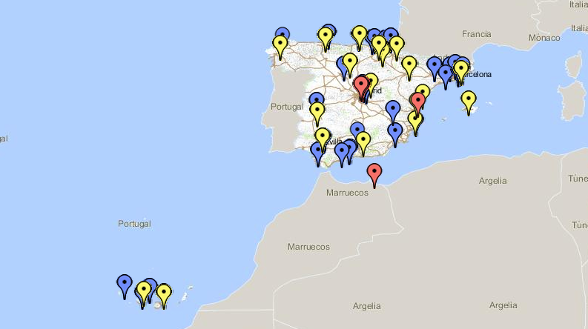
Open Data initiatives in Spain
112 ongoing initiatives (local, regional, national level)
http://mapa.datos.gob.es
Notes:
Includes universitities

Slide 14
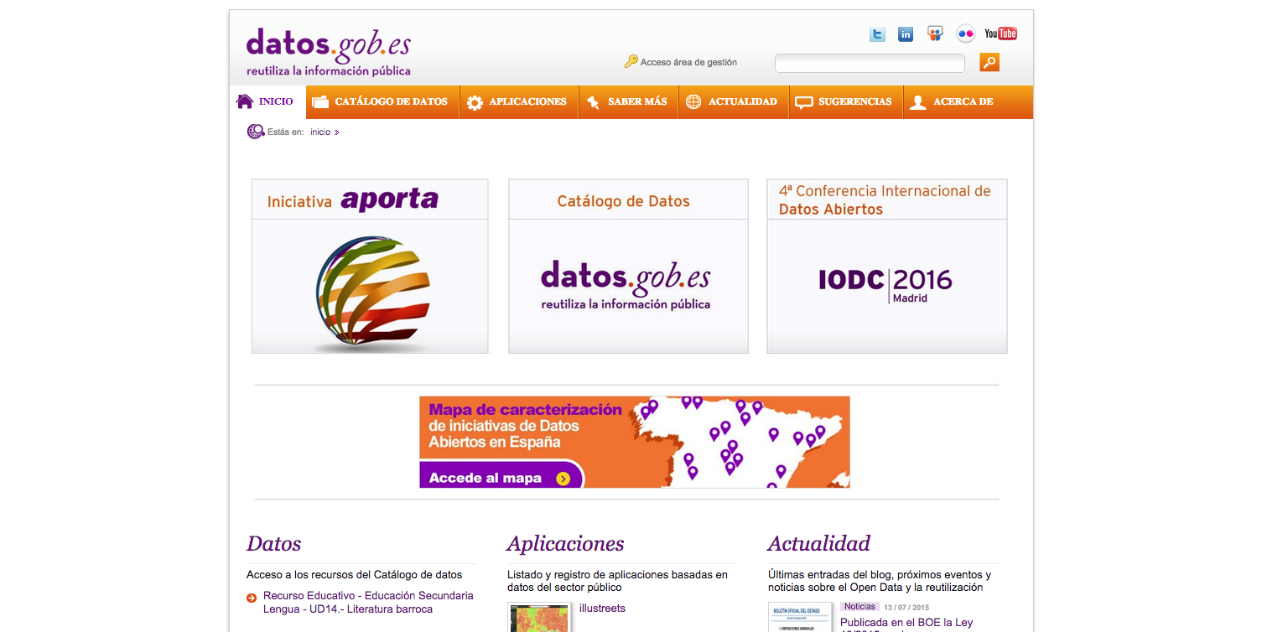
National Open Data Portal
8,816 datasets from 93 public bodies
http://datos.gob.es

Slide 15
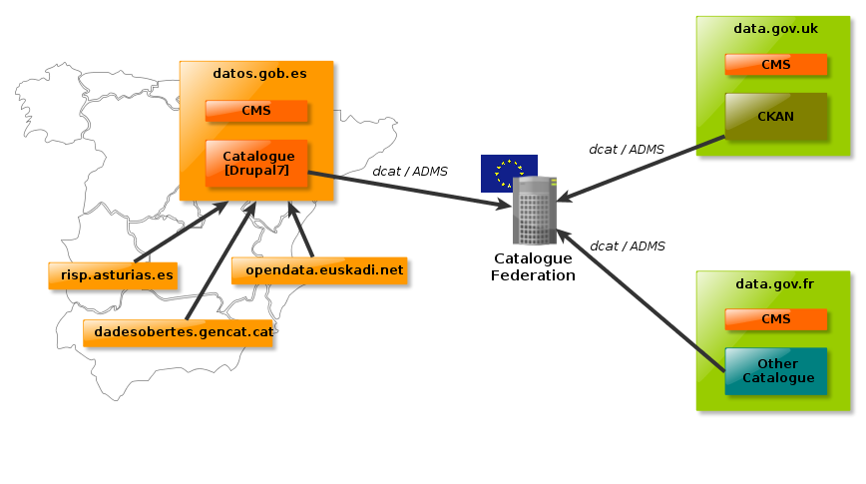
Automatic catalogue Federation
93 public bodies publishing feeds that are collected by datos.gob.es

Slide 16
Health of PSI reuse
PSI Re-use in Spain

Slide 17



Infomediary sector in Spain
€1.1b
Total income
623 Companies
(⬆74)
13.827 Employees
(⬆9%)
Building designed by Kat Tp
Coins designed by Mike Hince
People designed by Benjamin Harlow
http://datos.gob.es/content/informe-del-sector-infomediario-2015
Notes:
70% En Madrid y Cataluña
Building designed by <a href="http://www.thenounproject.com/kathatp">Kat Tp</a> from the <a href="http://www.thenounproject.com">Noun Project</a>
Coins designed by <a href="http://www.thenounproject.com/zer0mike">Mike Hince</a> from the <a href="http://www.thenounproject.com">Noun Project</a>
People designed by <a href="http://www.thenounproject.com/moshiah">Benjamin Harlow</a> from the <a href="http://www.thenounproject.com">Noun Project</a>

Slide 18
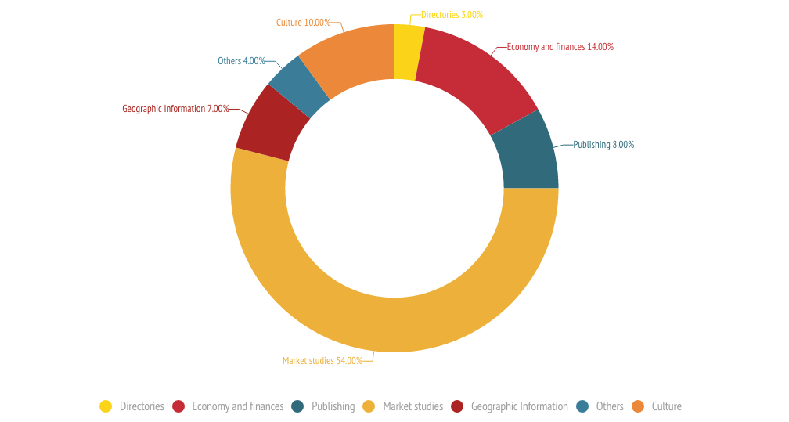
COMPANIES BY SECTOR
54% → market studies

Slide 19
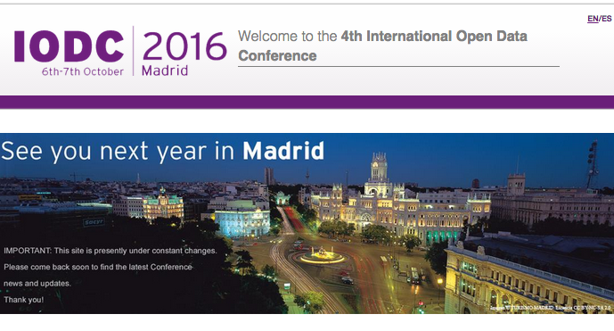
International Open Data Conference
See you there!!!

Slide 20
Thank you!
martin@w3.org
http://epsiplatform.eu
info@epsiplatform.eu
CNECT-OPENDATA@ec.europa.eu

