Slide 1
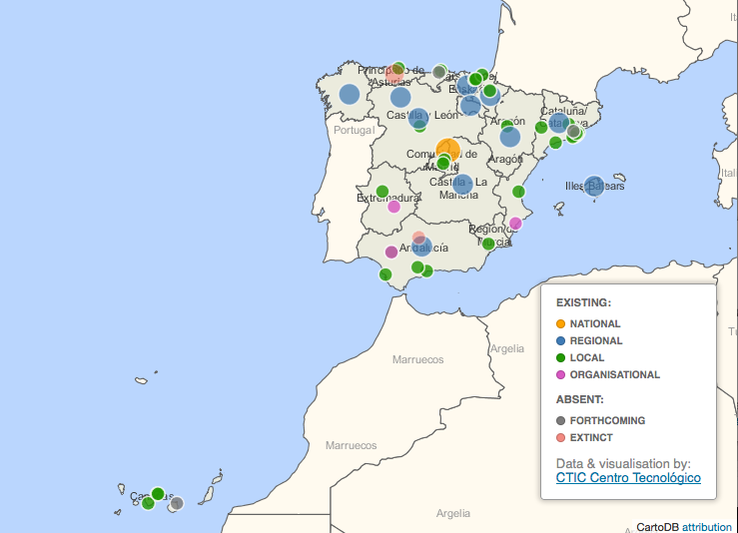
Spain

Slide 2
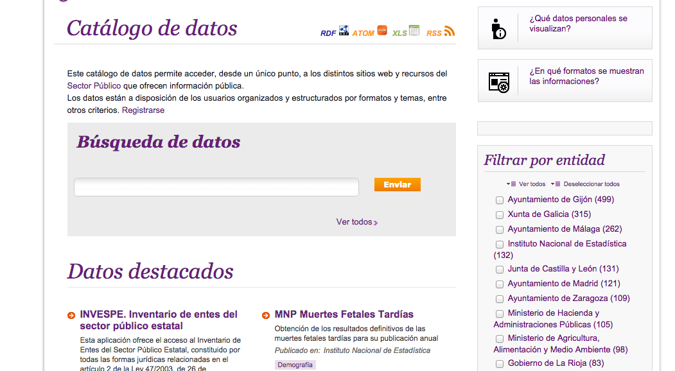
Federation of catalogues in datos.gob.es

