Slide 1



Slide 2
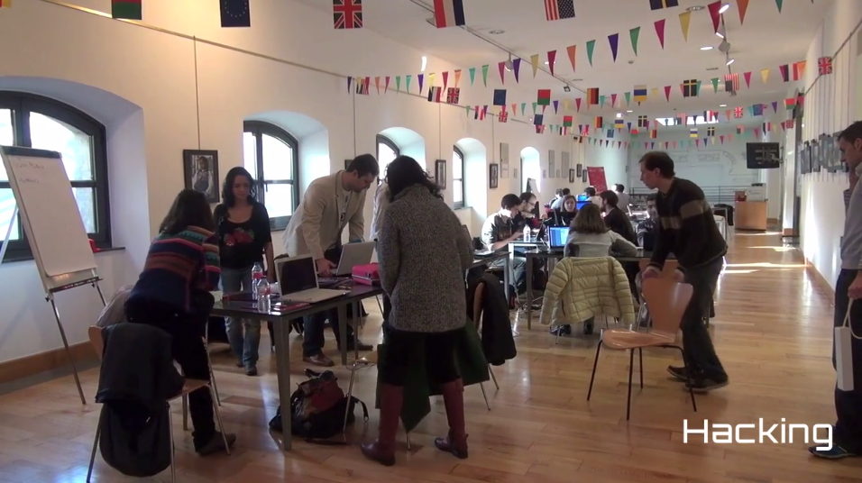

Slide 3
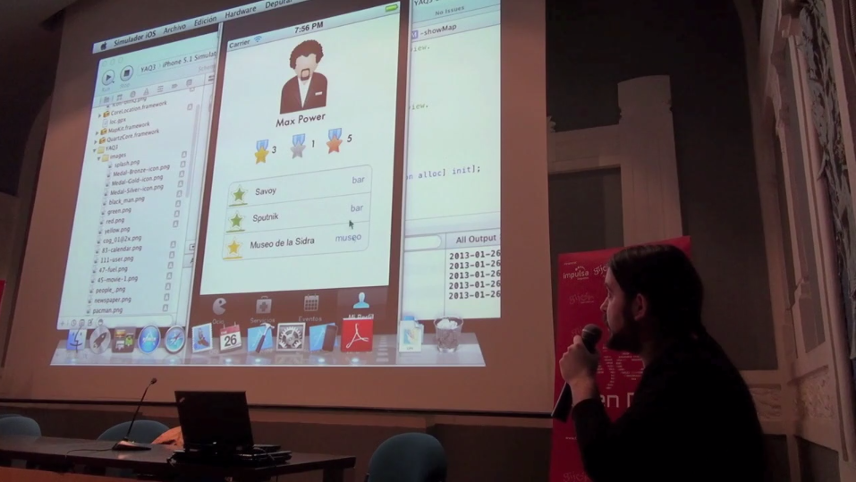

Slide 4
Open Data Lab Gijón
3 winner projects
3 months
App Development based on local Open Data
Team hosted by CTIC & Gijón City Council
Infrastructure
Advise: technical + strategical + business development

Slide 5
Open Data Startups: Catalyzing open data demand for commercial usage
What X is the thing that should be done to publish or reuse PSI?
Why does X facilitate the publication or reuse of PSI?
How can one achieve X and how can you measure or test it?

