Slide 1
OGD Initiatives in Spain
Martin Alvarez-Espinar

Slide 2
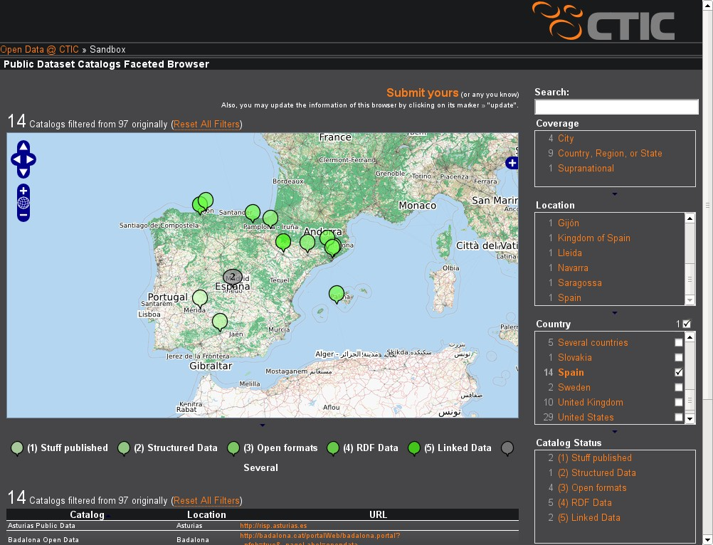

Slide 3
“Semantic” Open Data Initiatives
✩✩✩✩✩
  Saragossa → http://datos.zaragoza.es ✔
  Asturias → http://risp.asturias.es ✔
✩✩✩✩
  Catalonia → http://dadesobertes.gencat.cat ✔
  Gijón → http://datos.gijon.es ✔
  Barcelona →http://w20.bcn.cat:1100/opendata ✔
  Basque Country →http://opendata.euskadi.net ✔
  Balearic Islands → http://www.caib.es/caibdatafront ♲

Slide 4
5-Star Initiatives

Slide 5
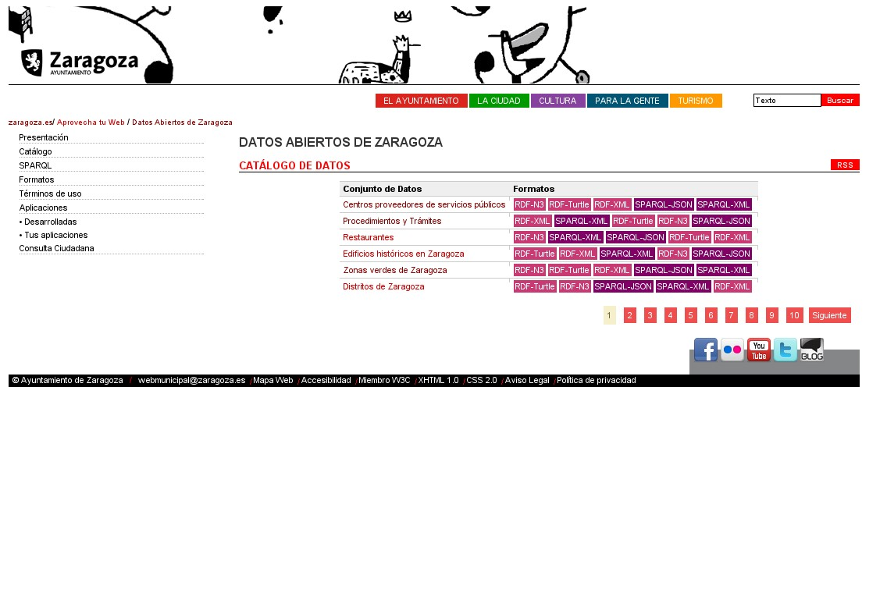

Slide 6
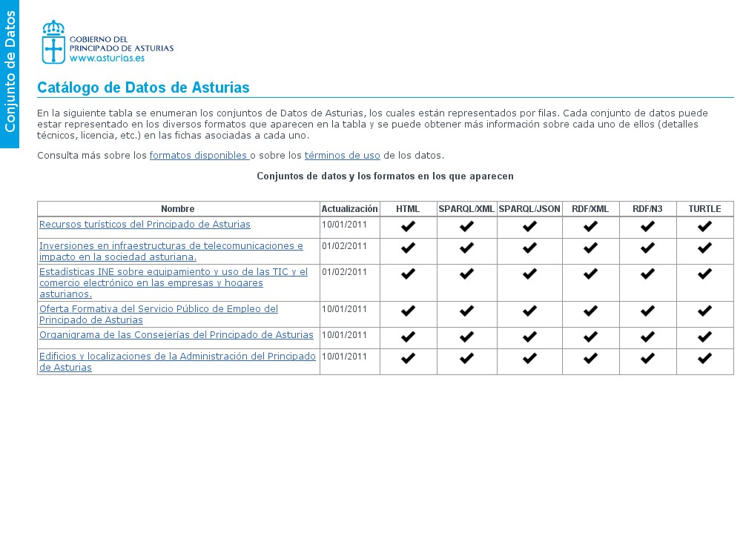
VoId + SPARQL

Slide 7
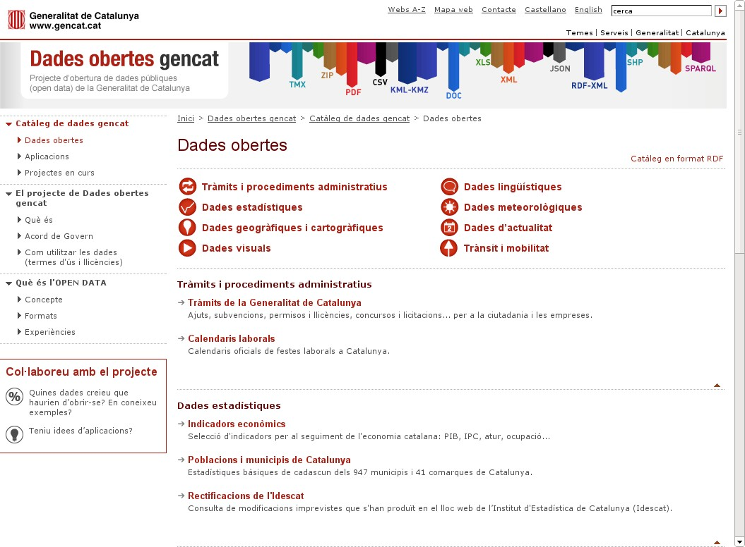
dcat
RDF/XML file
Notes:
http://dadesobertes.gencat.cat/

Slide 8
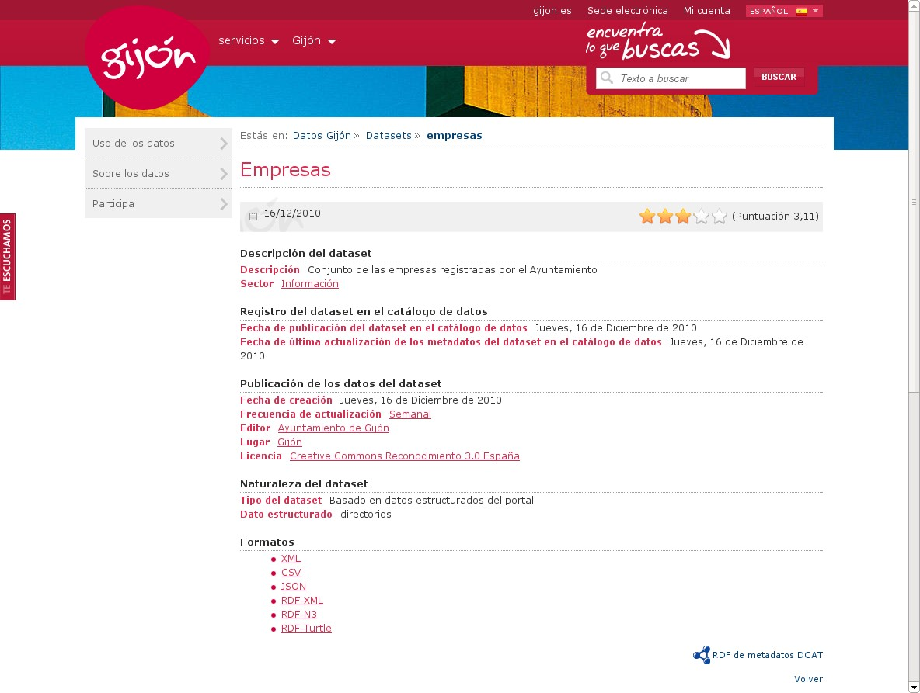
dcat
RDF/XML file

Slide 9
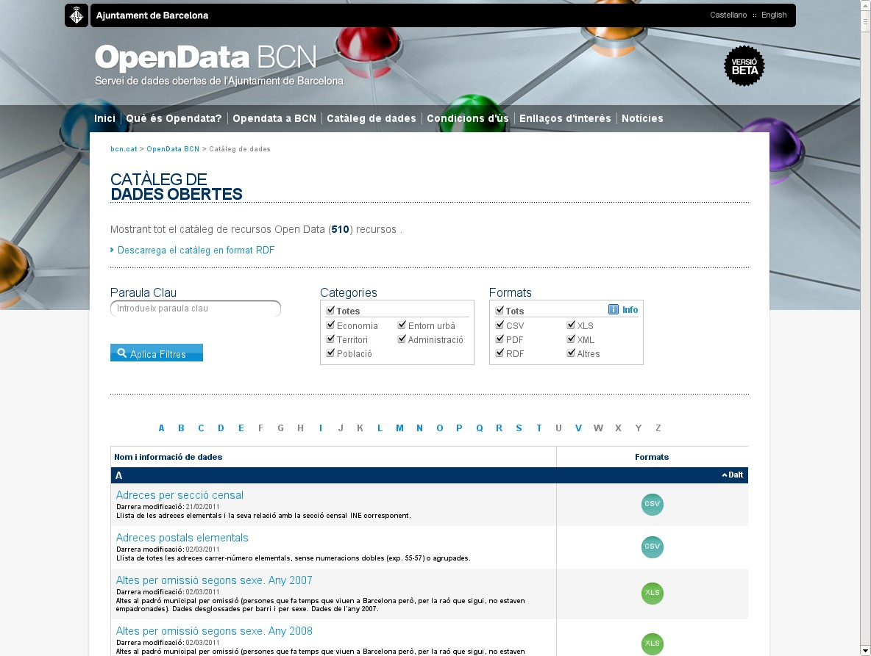
dcat
RDF/XML file

Slide 10
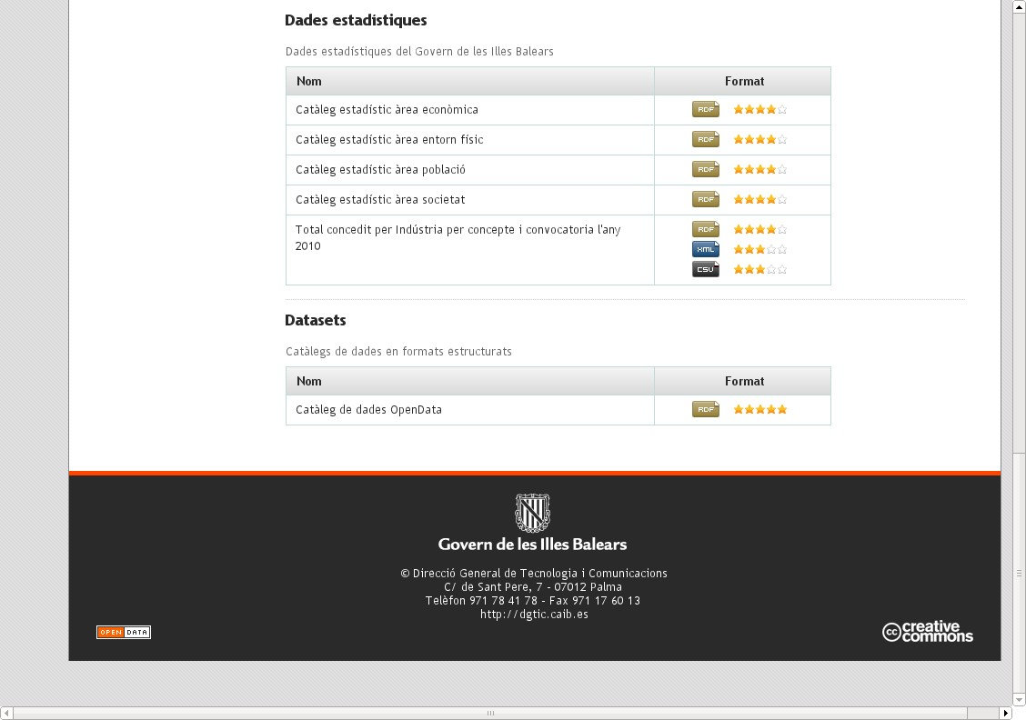
dcat
RDF/XML file

Slide 11
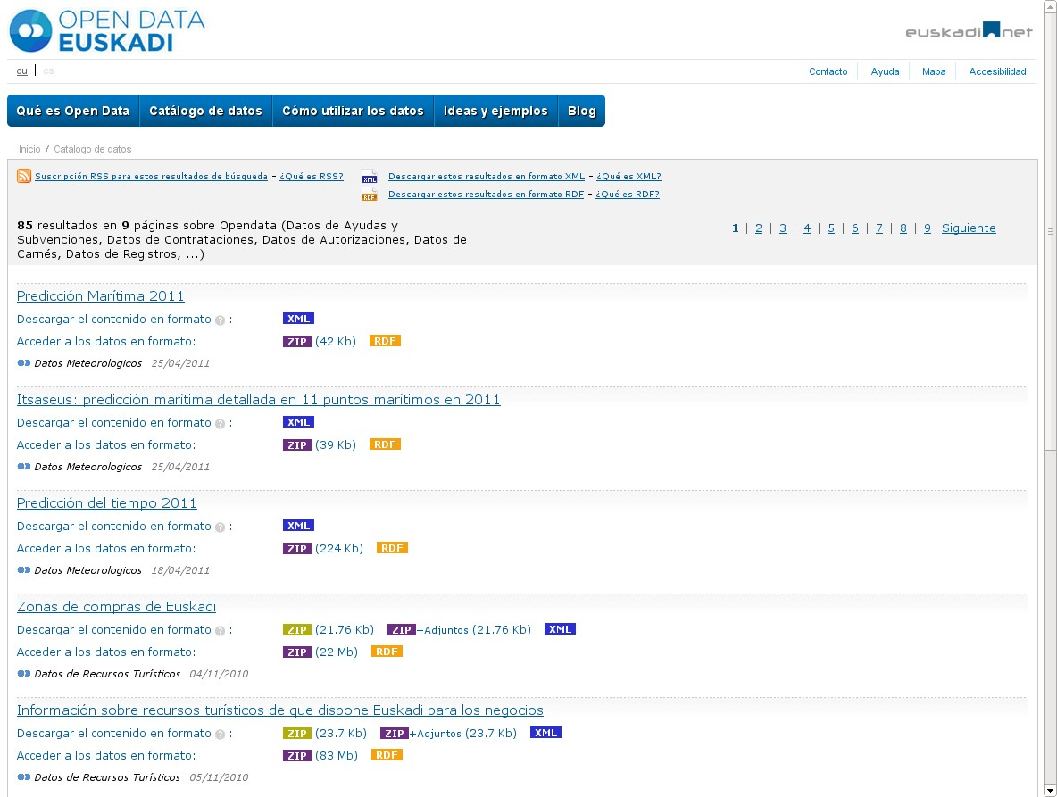
RDF/XML file

Slide 12
Catalogue | Level | dcat |  | CKAN | Other
 |  | RDF/XML | SPARQL
Asturias | Regional |  | ✔
Saragossa | City |  | ✔
Catalonia | Regional | ✔
Barcelona | City | ✔
Gijón | City | ✔
Balearic Islands | Regional | ✔
Basque Country | Regional |  |  |  | RDF/XML (DC)
opengov.es | Nation |  |  | ✔
Lerida | City
Cordoba | City
Extremadura | Region
Navarra | Region
Badalona | City
National | Nation |  |  |  | (Defining strategy)

Slide 13
Requirements for interoperability
Common vocabulary
  dcat
Common taxonomy to classify datasets
  ???
Defined endpoint to get/search the catalogue
  RDF file | SPARQL endpoint

