Slide 1
OGD Initiatives in Spain
Martin Alvarez – Carlos Iglesias
CTIC

Slide 2
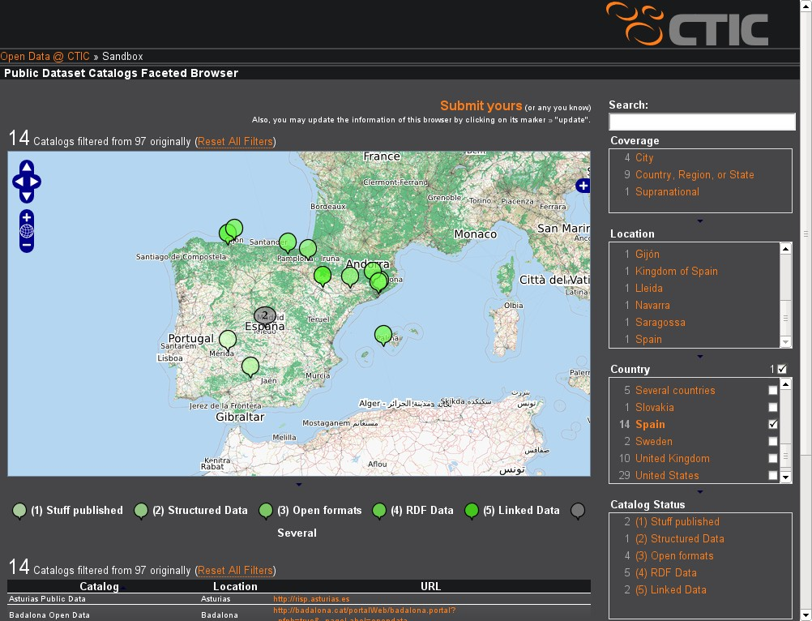

Slide 3
“Semantic” Open Data Initiatives
✩✩✩✩✩
  Saragossa → http://datos.zaragoza.es ✔
  Asturias → http://risp.asturias.es ✔
  Andalusia (2011) ✔
  data.gov.es (2011) ✔
✩✩✩✩
  Catalonia → http://dadesobertes.gencat.cat ✔
  Gijón → http://datos.gijon.es ✔
  Barcelona →http://w20.bcn.cat:1100/opendata ✔
  Basque Country →http://opendata.euskadi.net ✔
  Balearic Islands → http://www.caib.es/caibdatafront ♲

Slide 4
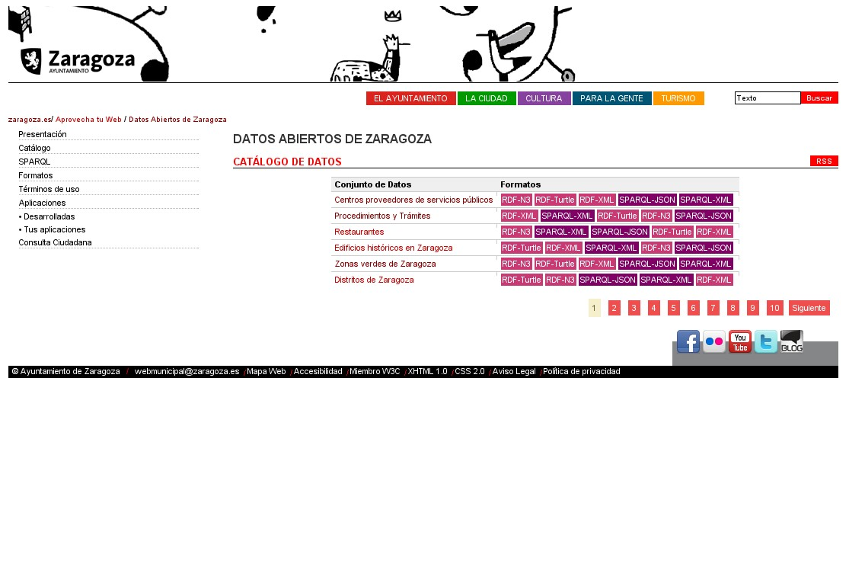

Slide 5
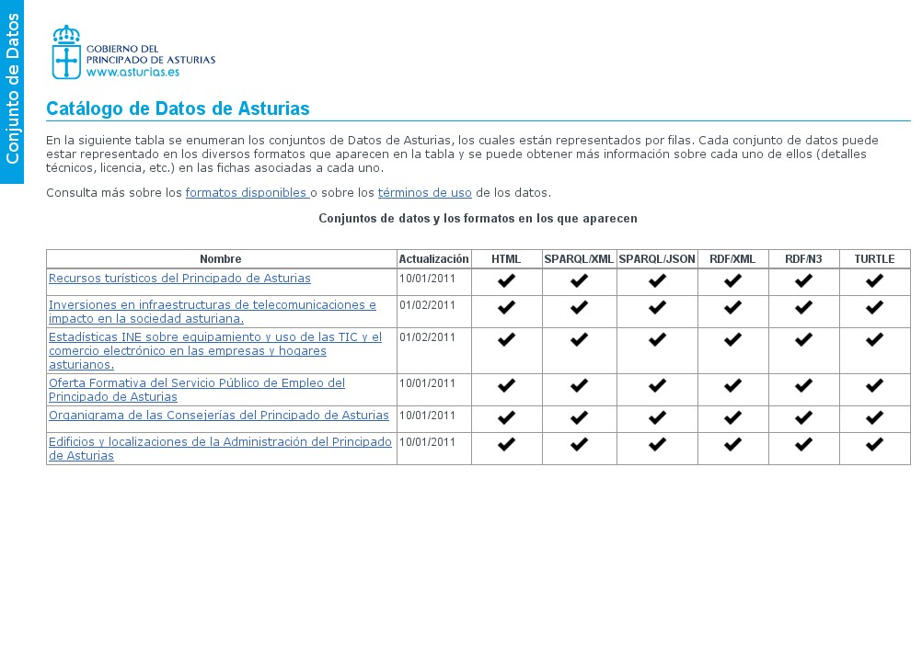
VoId + SPARQL

Slide 6
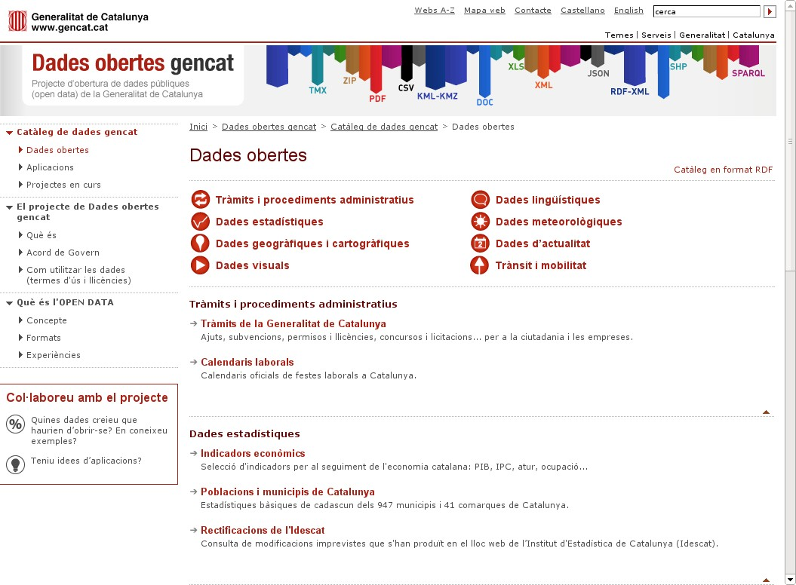
dcat
RDF/XML file
Notes:
http://dadesobertes.gencat.cat/

Slide 7
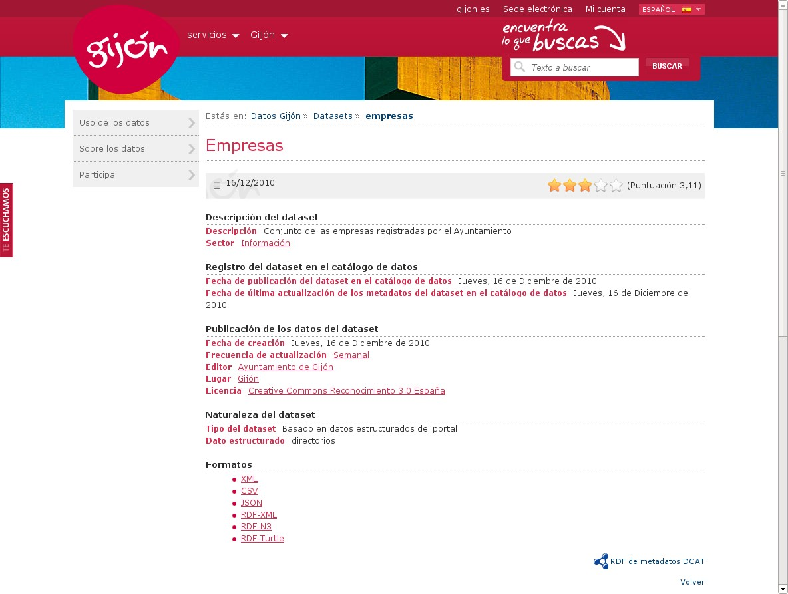
dcat
RDF/XML file

Slide 8
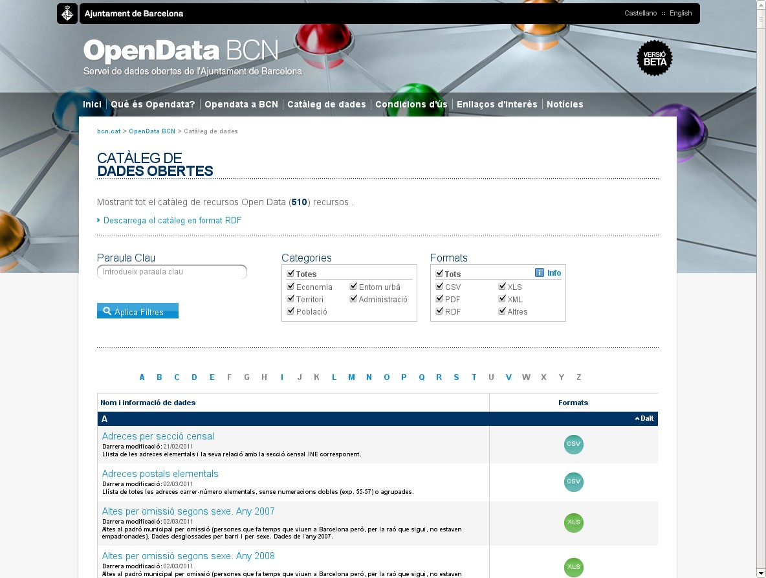
dcat
RDF/XML file
RDF/XML files

Slide 9
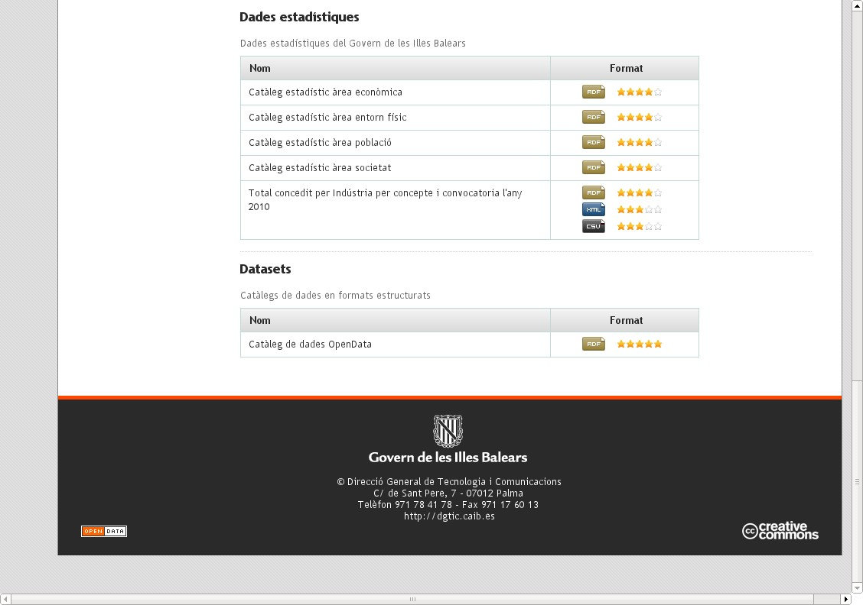
RDF/XML files
dcat
RDF/XML file

Slide 10
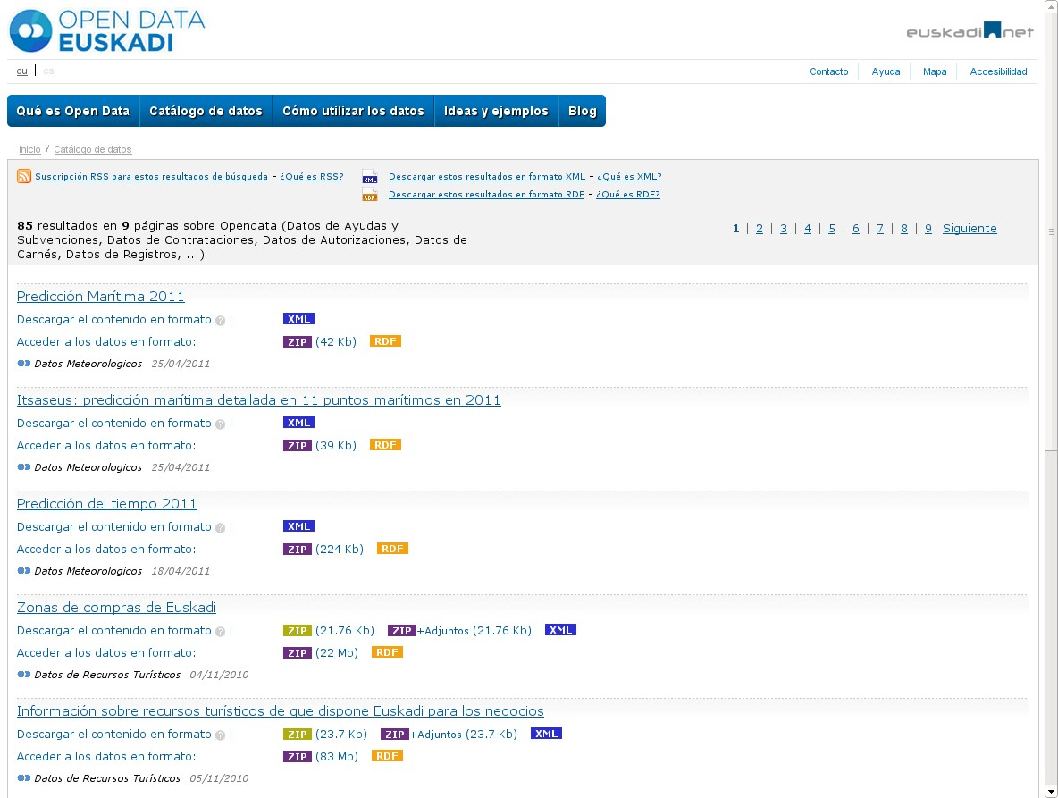
RDF/XML files

Slide 11
CTIC's 5-Star Initiatives

Slide 12
Catalogue | Level | dcat |  | CKAN | Triplestore
 |  | RDF/XML | SPARQL
Asturias | Regional |  | ✔ |  | Java + Oracle
Saragossa | City |  | ✔ |  | Java + Oracle
Catalonia | Regional | ✔
Andalusia | Regional |  | ✔ |  | In progress
data.gov.es | National |  | ✔ |  | Virtuoso
Barcelona | City | ✔
Gijón | City | ✔
Balearic Islands | Regional | ✔
Basque Country | Regional | ✔
opengov.es | National |  |  | ✔
Lerida | City
Cordoba | City
Extremadura | Regional
Navarra | Regional
Badalona | City

