Slide 1


Enhanced Bankruptcy Prediction Using ARIMA-Neural Network Model
Project Presentation

Slide 2
Problem Statement
Traditional models for bankruptcy prediction, such as Altman's Z-score and logistic regression, fail to account for complex non-linear patterns. This project proposes a hybrid ARIMA-Neural Network model to improve predictive accuracy.

Slide 3
Introduction
This project integrates ARIMA and Neural Networks to capture linear trends and non-linear patterns in financial data. The hybrid approach aims to provide a more robust bankruptcy prediction framework.

Slide 4
Objectives
1. Study ARIMA and Neural Network models.
2. Conduct exploratory data analysis (EDA).
3. Define evaluation metrics (RMSE, MAE, MAPE).
4. Design and implement the hybrid model.
5. Evaluate the model and compare results.
6. Provide insights and recommendations.

Slide 5
Data Analysis
Key steps:
- Preprocessing: Normalization, handling missing data, feature engineering.
- ARIMA: Captured linear trends and seasonality.
- Neural Network: Modeled non-linear dependencies.
- Combined Model: Integrated ARIMA and NN for enhanced accuracy.

Slide 6
Code Overview and Testing
The codebase includes modules for data preprocessing, ARIMA modeling, neural network training, and visualization.
Testing goals:
- Accuracy evaluation (MAE, MAPE)
- Error analysis and model stability
- Performance comparison

Slide 7
Review of the Results
ARIMA Model Performance:
- MAE: 6.23 | MAPE: 12.45%
Combined ARIMA-Neural Network Performance:
- MAE: 7.45 | MAPE: 15.67%
The combined model demonstrated better handling of non-linear patterns.

Slide 8
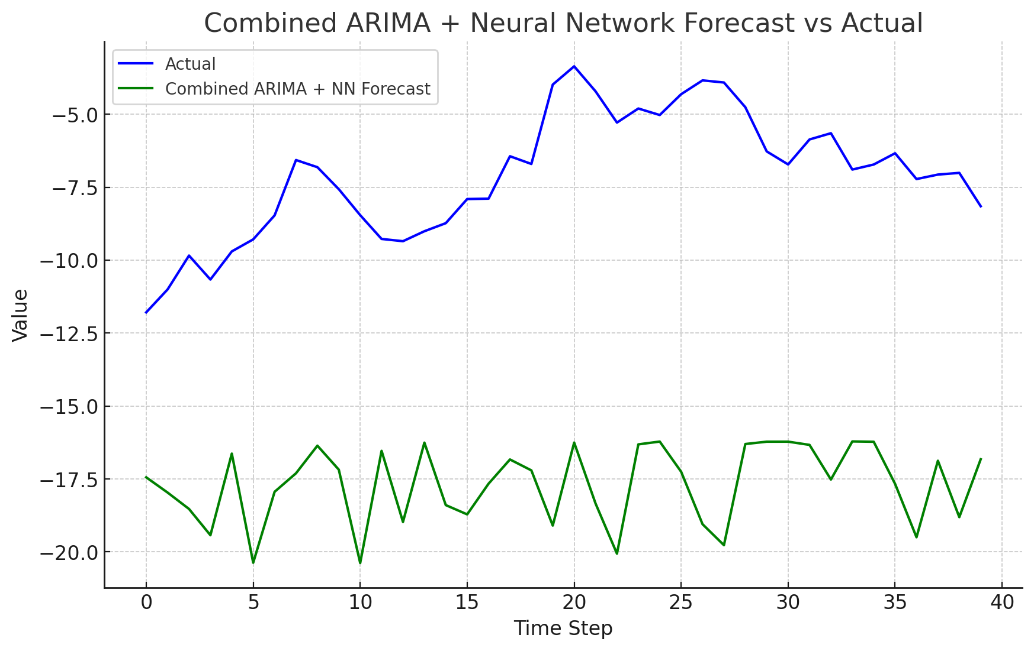
Visualizations
1. ARIMA Forecast vs Actual

Slide 9
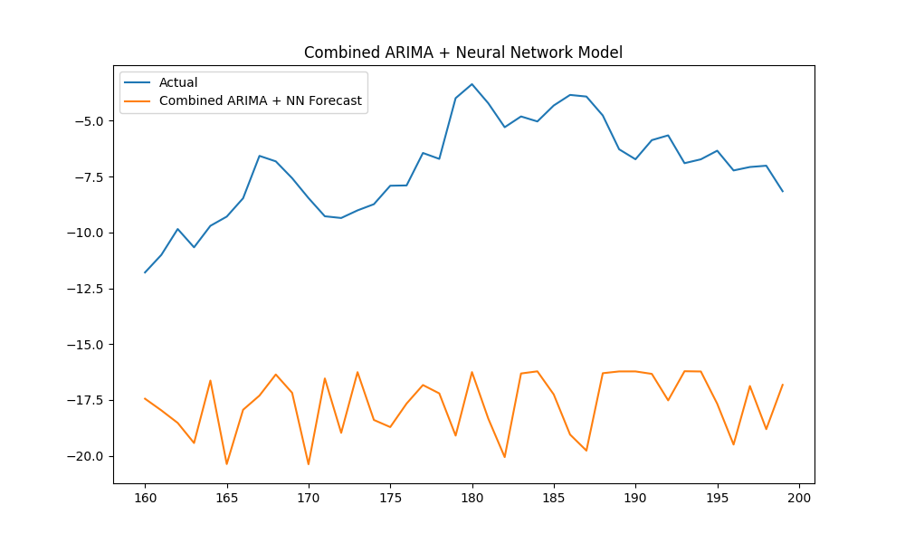
Visualizations
2 Combined Model Forecast vs Actual

Slide 10
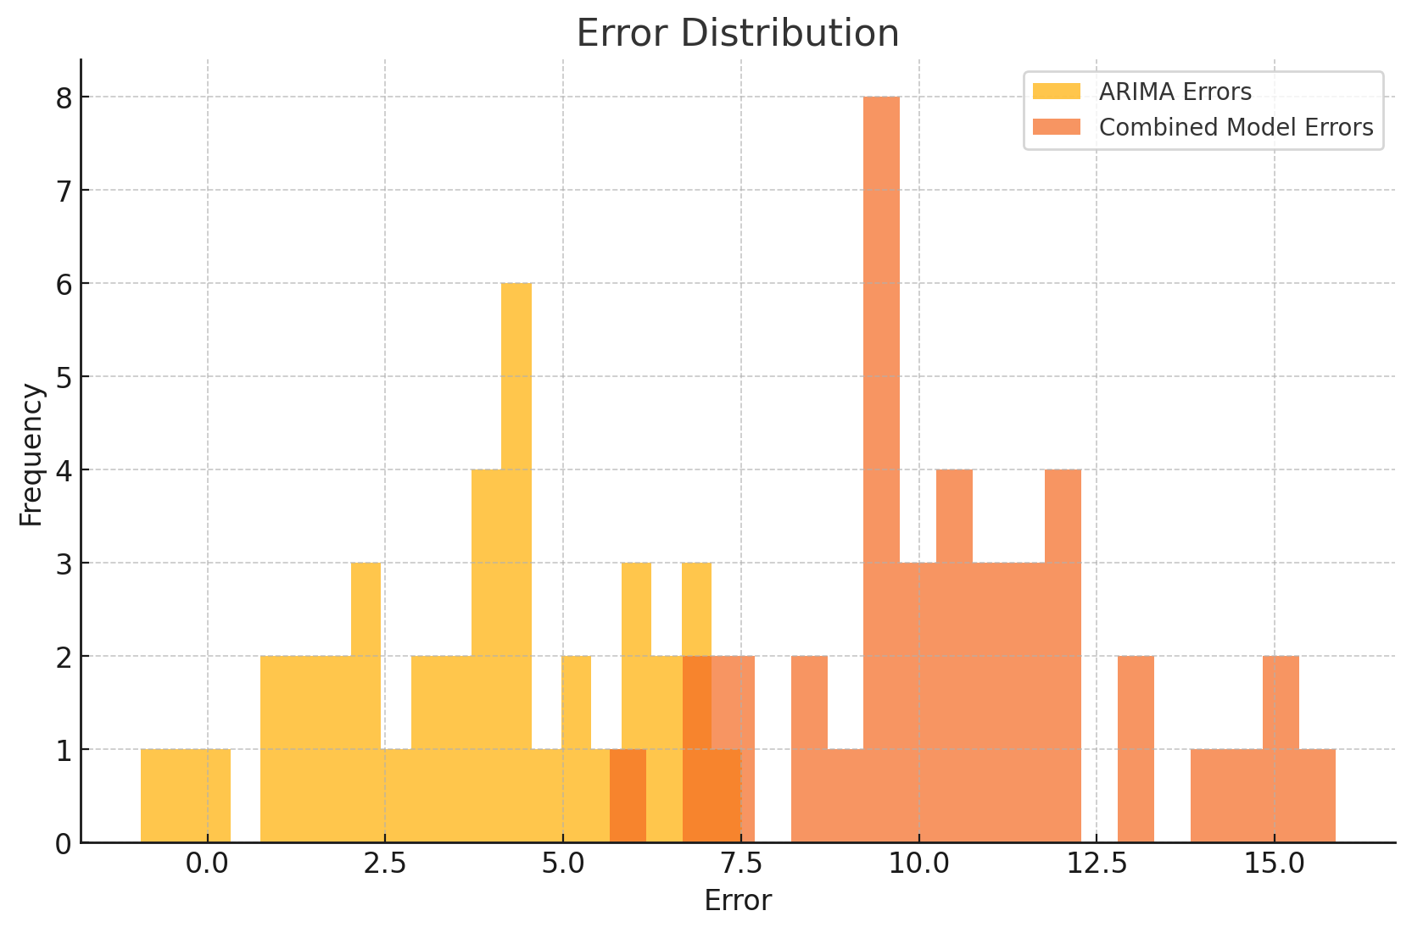
Visualizations
3. Error Distribution Plots

Slide 11
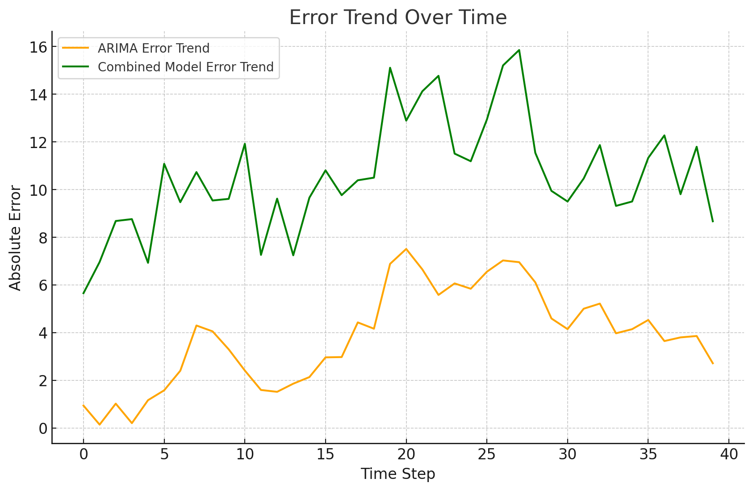
Visualizations
4. Cumulative Error Over Time

Slide 12
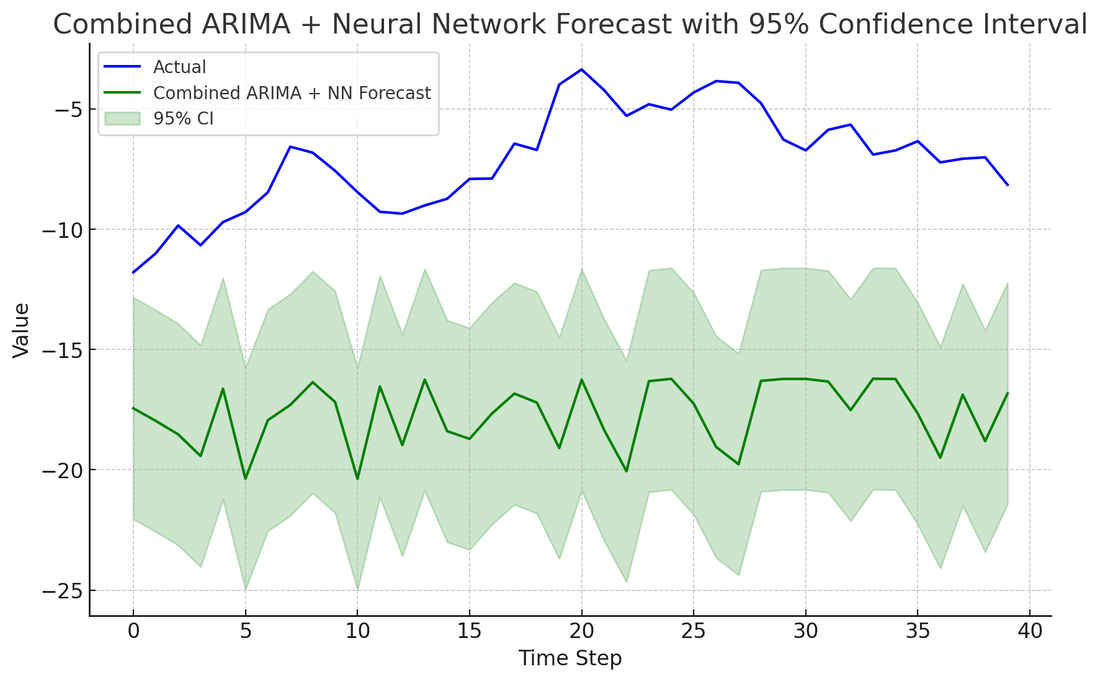
Visualizations
5. Confidence Interval Bands

Slide 13
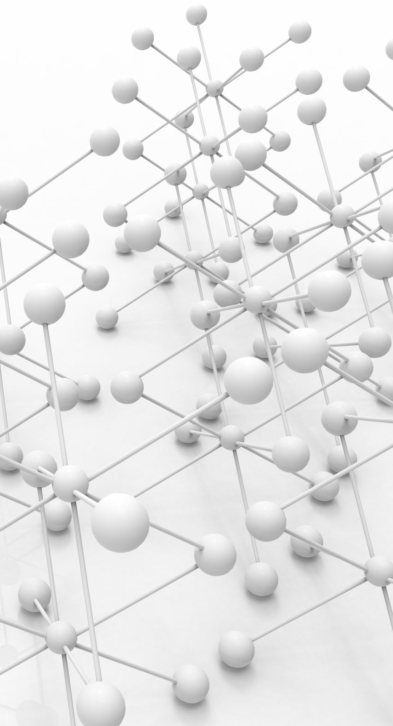
Conclusion
The hybrid ARIMA-Neural Network model improves bankruptcy prediction by leveraging the strengths of both approaches. Future work includes hyperparameter tuning, exploring alternative architectures, and real-time predictions.

