Slide 1
Project 1: Nucleus Detection in Cell (image classification)
Project 2: Parkinson Disease Diagnosis from Acoustic Features
Soonmo Seong

Slide 2
Nucleus Detection in Cell
Purpose
Which model the best classifies cells (lower test error rate by 100 itereations)
- Random Forest, Support Vector Machine, Logistic Regression, Ridge Regression, LASSO Regression
Whether or not larger sample size improves performance (time-saving, cost-effective)
- Case 1: training data(n_{learn}) – n/2 | Case2: training data (n_{learn}) – 0.9n
How well cross-validation estimates the test error rate
Where the nucleus is expected to be in a cell
Which variable(pixel) is important to classify images

Slide 3
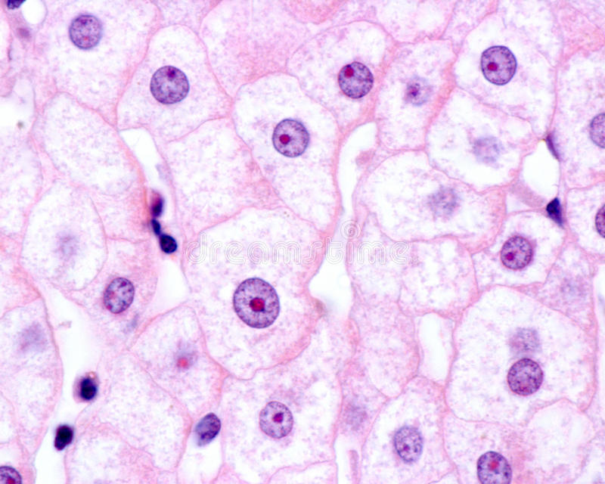
Data Structure
n = 1185 samples, binary classification.
Samples with nucleus(=1) are 43%.
Samples without nucleus(=0) are 57%.
Imbalanced => oversampling is applied.
p = 400
Each sample is a 20x20 pixel image(cell by cell).
The columns of the dataset represent pixel 1 to 400.
Each sample is pre-processed in grayscale.
The pixel value is with a range of 0 to 255.
Nuclei are darker than its surroundings.
Th pixel intensities value will differ at the nucleus
The nucleus contains the majority of the cell's genetic material. So, detecting the nucleus is important.

Slide 4
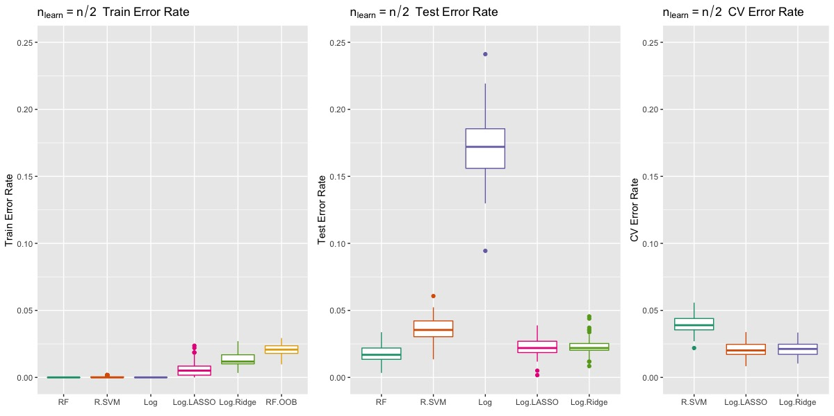
n/2 Error Rates

Slide 5
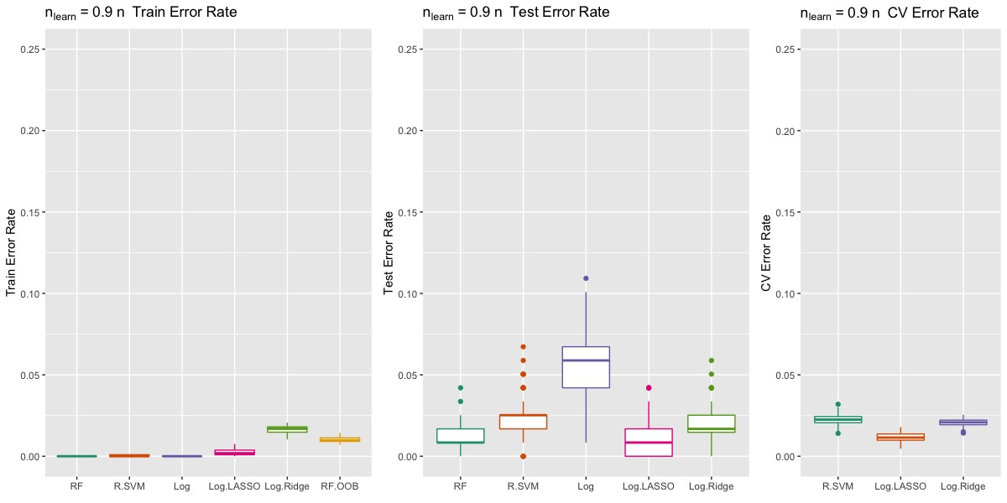
0.9n Error Rates

Slide 6
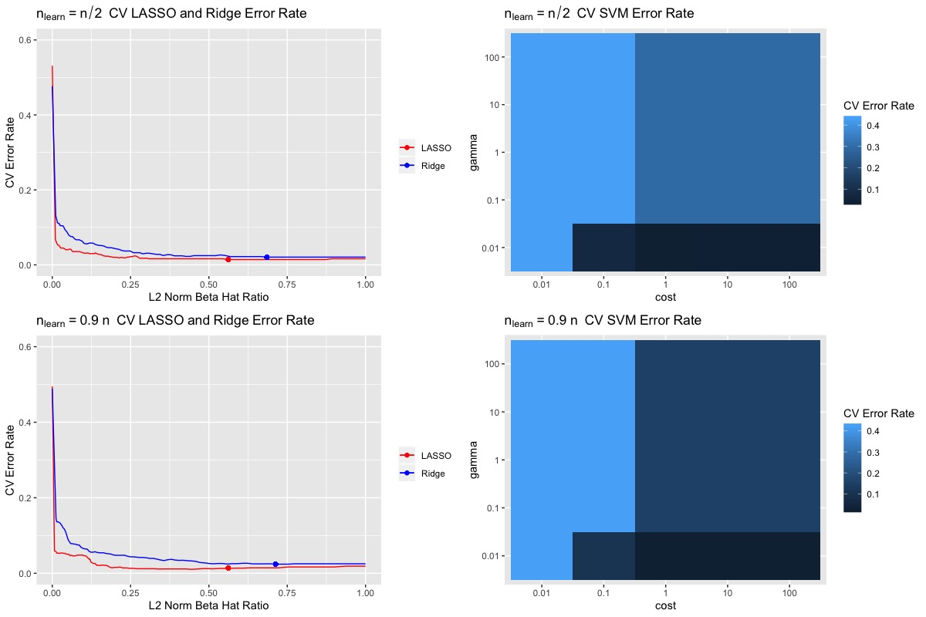
CV Error Rate Analysis for LASSO, Ridge, and SVM

Slide 7
Trade-Off between Time and Test Error Rate
n_{learn} | Method | Time to Cross Validate(sec) | Time to Fit(sec) | Test Error Rate(%) | remarks
n/2 | Ridge | 4.9(se = 1.2) | 0.1(se = 0.05) | 2.3(se = 0.61)
 | LASSO | 2.8(se = 0.6) | 0.4(se = 0.3) | 2.3(se = 0.68) | Fastest CV
 | SVM | 167.8(se = 44.6) | 0(se = 0) | 3.6(se = 0.85) | Worst Test Error
 | Random Forest |  | 2.9(se = 0.8) | 1.8(se = 0.67) | Best Test Error
0.9n | Ridge | 8.5(se = 0.3) | 0.3(se = 0.06) | 2.1(se = 1.2)
 | LASSO | 6.3(se = 0.4) | 1(se = 0.36) | 1.2(se = 1.1) | Fastest CV
 | SVM | 474.9(se = 4.7) | 0(se = 0) | 2.2(se = 1.3) | Worst Test Error
 | Random Forest |  | 5(se = 0.1) | 1.2(se = 0.88) | Best Test Error
Difference | Ridge |  |  | m= 0.2, p-value = 0.14 > 0.05 | No difference in test error rate
 | LASSO |  |  | m = 1.1, p-value = 4e-12 < 0.05 | Difference in test error rate
 | SVM |  |  | m = 1.4, p-value = 9e-14 < 0.05 | Difference in test error rate
 | Random Forest |  |  | m = 0.6, p-value = 2e-7 < 0.05 | Difference in test error rate
As n_{learn} increase upto 90 percentage of n, time to cross-validate and to fit increases more than twice in general.
Ridge doesn’t improve test error rate as n_{learn} increases
LASSO reduces test error rate in half, the most affected by n_{learn}
Radial SVM spends much more time, but results in the worse test error rate.

Slide 8
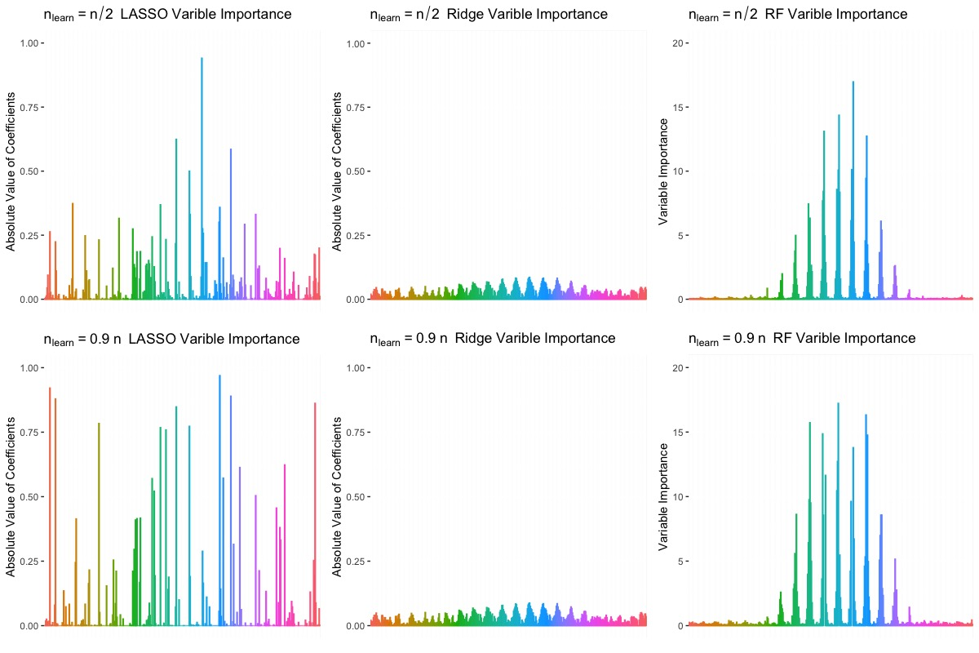
Importance of Variable

Slide 9
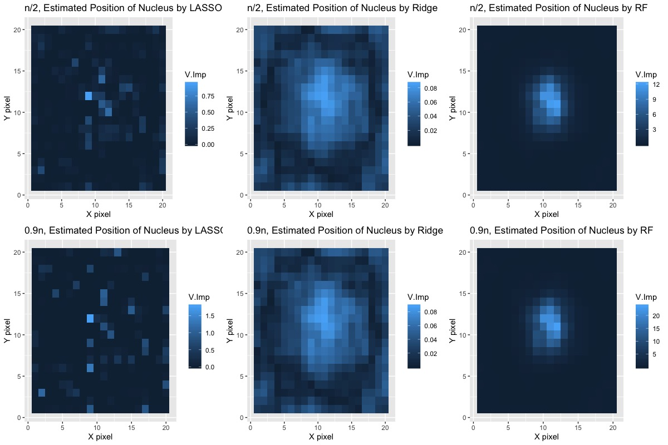
Conclusion
Best method for this dataset is Random Forest in terms of test error rate and time.
As n_{learn} increases, time to train models increases by 200 percentage.
The larger n_{learn} improves test error rates except for Ridge.
Radial SVM is the worst method for this dataset

Slide 10
Parkinson Disease Diagnosis from Acoustic Features
Purpose
The purpose is to build the best model that predicts the positiveness of the Parkinson disease from voice-related data of participants
Logistic Regression, Ridge Regression, LASSO Regression
Lower test error rate by 100 iterations
Confusion matrix
Training data(n_{learn}) = 0.8n
What K-fold cross-validation the best estimates the test error rate
3-folds to Leave-One-Out(15 types of K-fold)
Which value of lhyperparater is optimal for regularization methods

Slide 11
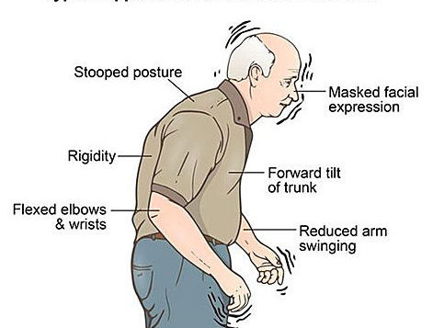
Data Structure
n = 240 samples, binary classification.
Samples with disease (=1) are 50%.
balanced dataset
p = 44
Each sample has 44 acoustic features
- pitch periods, voice noise, and perturbation

Slide 12
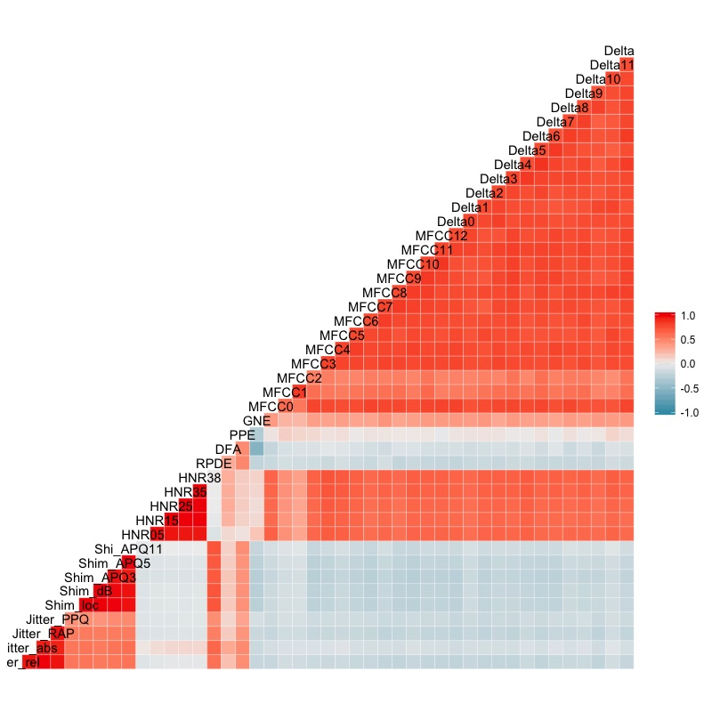
Correlation Analysis
Similar acoustic features have strong positive correlations
MFCC and their derivatives(Delta)
HNR are highly, positively correlated with MFCC and Delta
Negative correlations are not recognized noticeably.
PPE is a new measurement of pitch variation in voice.
MFC is a representation of the short-term power spectrum of a sound
ShimAPQ is a measurement of perturbation to the small, rapid, cycle-to-cycle changes of period in the fundamental frequency

Slide 13
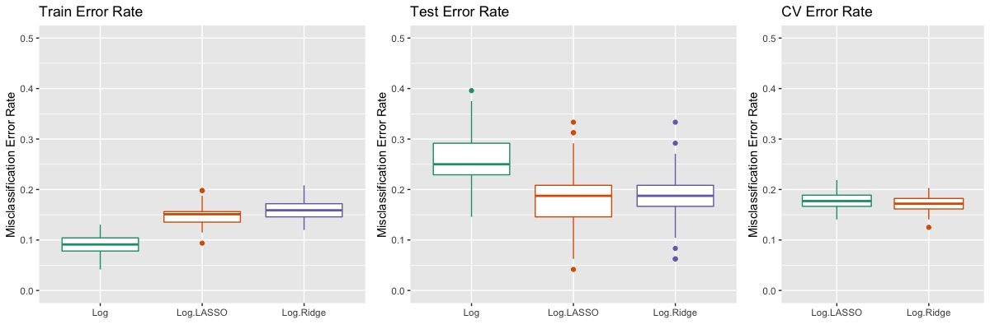
10-fold Cross Validation

Slide 14
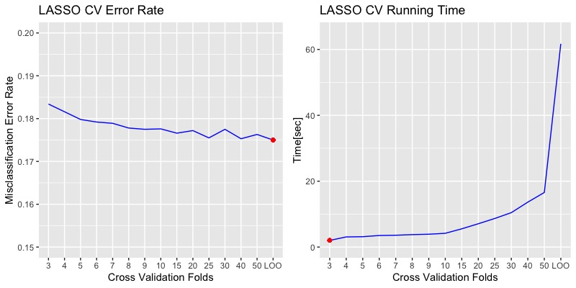
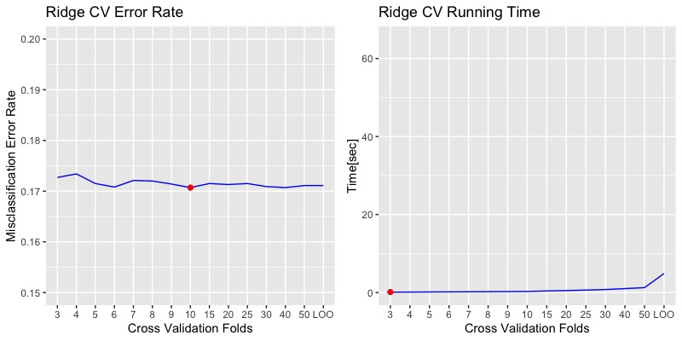
Optimal K-fold Cross Validation
25 folds cross validation for the LASSO regression (trade-off between time and error rates)
10 folds cross validation for the Ridge regression
- time doesn’t matter

Slide 15
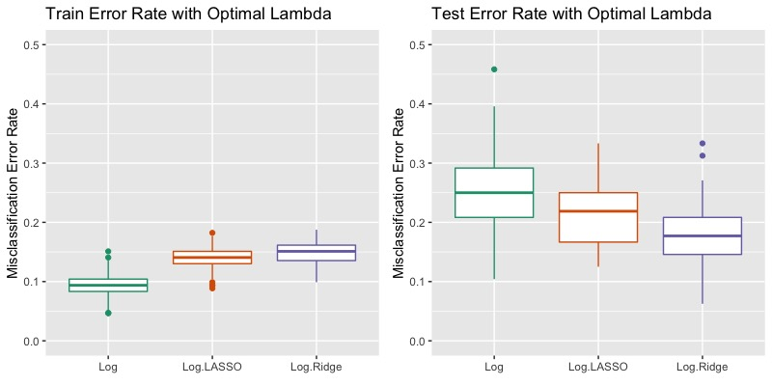
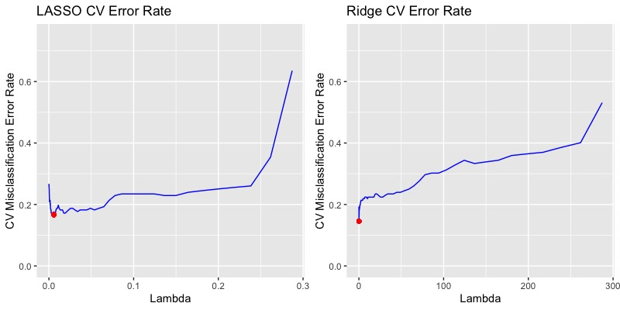
Best Model with Optimal Hyperparameter
The best method for this dataset is the ridge logistic regression with λ = 0.1272 chosen by 10-fold cross validation
Optimal hyperparameter
lasso regression: 0.0058
ridge regression: 0.1272.

Slide 16
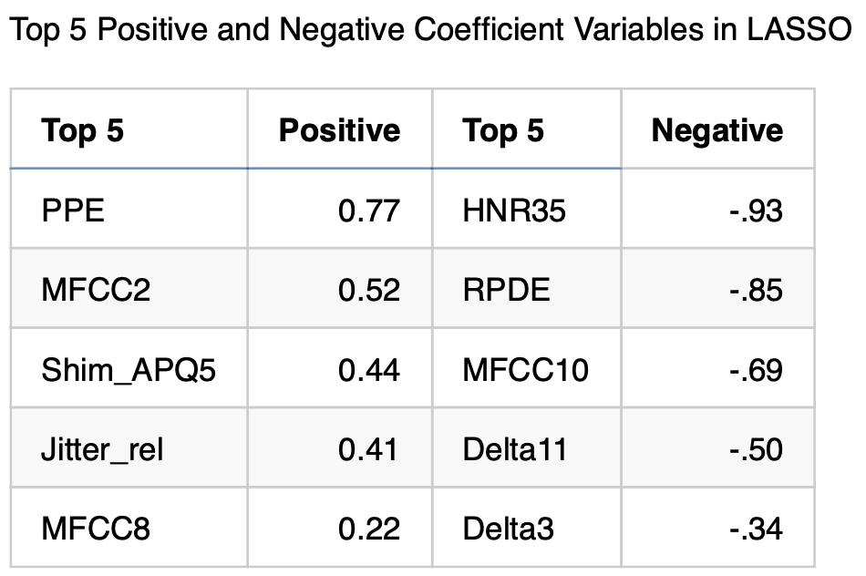
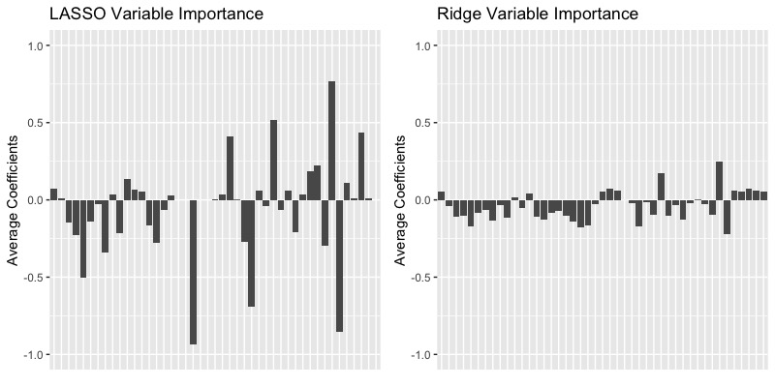
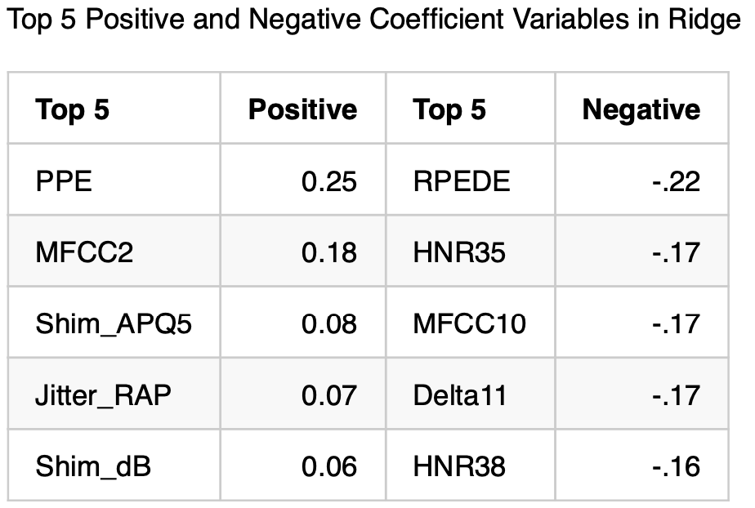
Variable Importance
Variable importance has similar patterns in both cases

Slide 17
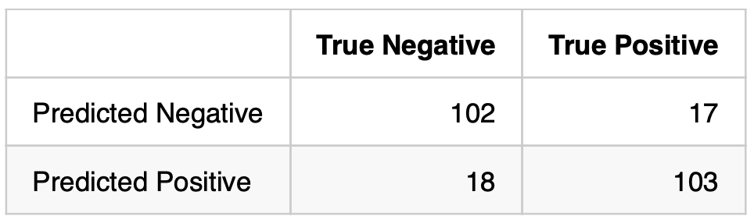
Conclusion
The ridge logistic regression with λ = 0.1272 is the best method since the ridge regression is not overfitted.
This model doesn't spend too much time to cross validate and train the model
We eclectically choose 10-fold cross validation by comparing 15 types of cross validation folds from 3 fold to LO

