Slide 1
Introduction to Biometrics Course Project
MULTIMODAL FUSION: IRIS AND FINGERPRINT
- Rajnish Kumar
-CS21B2031

Slide 2
INTRODUCTION
This project focuses on the development of a multimodal biometric authentication system utilizing iris and fingerprint images.
The goal is to leverage the complementary nature of these biometric modalities to enhance the accuracy and robustness of authentication systems.
The proposed approach involves the extraction of discriminative features from iris and fingerprint images using a pre-trained VGG16 model.
These features are then fused at the feature level using a Siamese neural network architecture.

Slide 3
THE SIAMESE NETWORK
The Siamese network is crucial for combining features from two different biometric modalities (iris and fingerprint). This approach leverages the strengths of both modalities, potentially improving the accuracy of biometric verification compared to using a single modality.
By processing and combining features from both iris and fingerprint inputs through the same base network, the Siamese network learns joint representations. This enables the model to effectively compare and correlate the features, leading to better decision-making for person verification.
The final output of the Siamese network is designed for binary classification, which is well-suited for verification tasks. The sigmoid activation function in the output layer ensures the network outputs probabilities, which can be thresholded to make binary decisions (match or no match).
The design of the Siamese network allows for easy scalability and modularity. Different feature extraction models or base network architectures can be plugged in without significant changes to the overall structure. This flexibility can be useful for experimenting with different approaches or integrating additional modalities in the future.

Slide 4










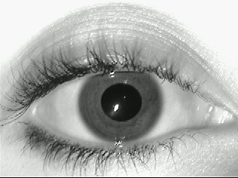
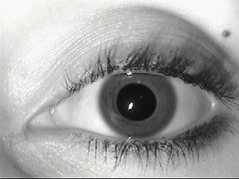
METHODOLOGY
The dataset used in this project consists of 45 subject. Dataset contains 5 scanned image of left and right iris and each finger’s print of the subject.
The data is meticulously organized for efficient processing. We implemented a system where each individual has their own dedicated folder containing their corresponding iris and fingerprint images.
Image showcasing a sample iris and fingerprint image

Slide 5
In the first part, we cleaned and organized the data. Now, we'll use a powerful tool to extract meaningful information from the images. This tool is called VGG16.
VGG16 is a pre-trained convolutional neural network (CNN) that has been trained on a massive dataset of images. It's known for its excellent performance on image classification tasks.
But in our case, we're not using VGG16 for classification. Instead, we're using it as a feature extractor. VGG16 has learned valuable features from analyzing a vast amount of images. We can leverage this knowledge to extract relevant features from our iris and fingerprint images.
A pre-trained VGG16 model (trained on ImageNet) is used to extract features from the images. The model's output (feature maps) from the last convolutional layer is used as the feature representation for the images.
Flattens the features extracted by the VGG16 model before further processing. Flattening is essential to convert the multi-dimensional feature maps into a one-dimensional feature vector that can be fed into subsequent dense layers of the network.
Siamese network implementation
A Siamese neural network is created, consisting of a base network that is shared for both iris and fingerprint inputs. The base network extracts meaningful embeddings from the input features.
The embeddings from both inputs are concatenated and passed through additional dense layers to produce the final output, which is a binary classification indicating whether the combined input belongs to the same person.

Slide 6
Input Layers:
Two separate input layers are defined: one for the iris features and another for the fingerprint features.
Base Network:
A base network is defined and shared between the iris and fingerprint inputs. This base network consists of:
A dense layer with 128 neurons and ReLU activation.
A dropout layer with a dropout rate of 30% to prevent overfitting.
Another dense layer with 64 neurons and ReLU activation.
A second dropout layer with a dropout rate of 30%.
A final dense layer with 32 neurons and ReLU activation.
Feature Extraction:
The iris input and fingerprint input are passed through the shared base network to generate their respective embeddings (feature vectors).
Concatenation:
The embeddings from the iris and fingerprint inputs are concatenated to form a single feature vector representing the combined input.

Slide 7
Fully Connected Layers:
The concatenated feature vector is passed through additional dense layers:
A dense layer with 128 neurons and ReLU activation.
A dropout layer with a dropout rate of 30%.
Another dense layer with 64 neurons and ReLU activation.
Another dropout layer with a dropout rate of 30%.
A final dense layer with 32 neurons and ReLU activation.
Output Layer:
The output layer consists of a single neuron with sigmoid activation, producing a binary output indicating whether the combined input (iris and fingerprint) belongs to the same person.

