Slide 1
Adapting Transparent Recommendation Model for Explainable Candidate Evaluation
CSCI-B659: Mini Conference Presentation
BY: ETHAN ELDRIDGE

Slide 2
Problem Statement/Solution
SECTION 1

Slide 3

Problem Statement
Evaluation of candidates can be tedious and information-saturated
Evaluation criteria is usually ill-defined or defined abstractly
Hard to keep track of subjective or abstract judgements on candidates
Need a way to objectively measure evaluator preferences and compare candidates at scale

Slide 4

Proposed Solution
A candidate evaluation system with scoring and explainable recommendations.
Based on Balog, et al.’s “Transparent, Scrutable, and Explainable User Models for Personalized Recommendation.”
Makes use of user-selected tags.
Particularly useful for adjusting preferences for different evaluators.
Gives explainable recommendations that allow evaluator to understand their own preferences and the candidates’ qualities relative to others
Ranking and Selection components

Slide 5
Grad Degree
(strongly like)
Grad Degree
(strongly like)
Purdue Grad
Little Work Experience
| | | | | | | | | | | | | | | | | | | | | | | | | | | | | |
Volunteer
From Indiana
Bad GPA (disliked)
Good GPA (liked)

Slide 6
Current Progress/Lessons Learned
SECTION 2

Slide 7
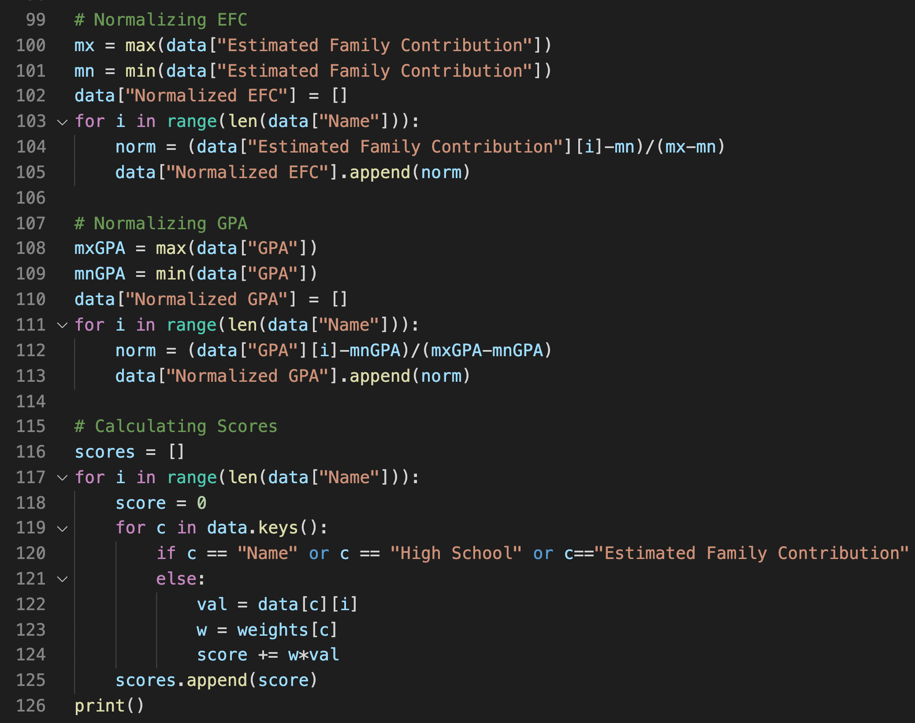
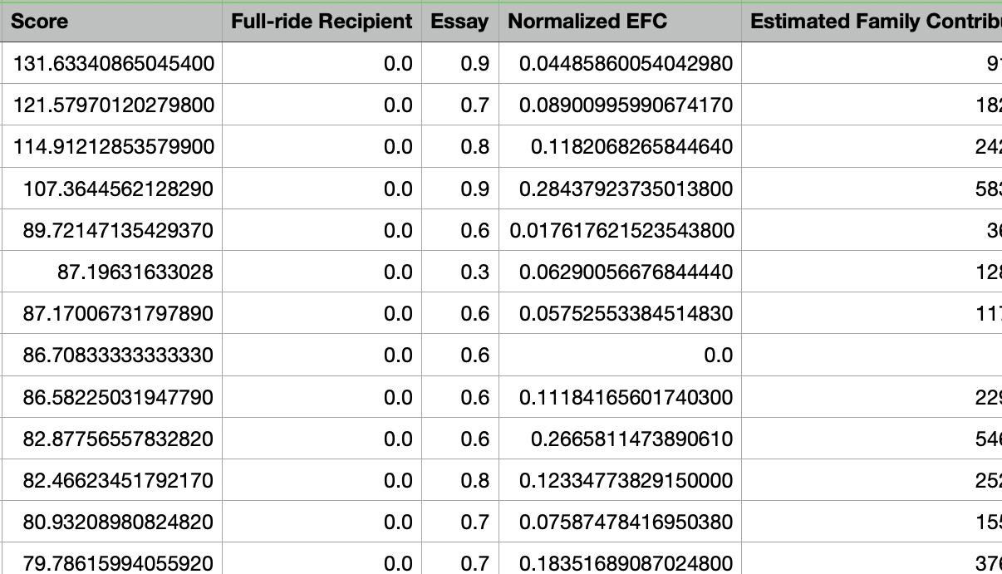
Current Progress:
Designed and coded a ranking algorithm
Created data collection program
Collected and cleaned real-world data
Applied algorithm to real-world data to test reliability
Began coding of recommendation system.

Slide 8
Lessons Learned/Conclusions
Evaluation criteria can be quantified effectively
Hope to learn more about other methods or modules that could improve the system
Curious to find out more domain-specific quirks/info
Could extend to any other domain requiring candidate evaluation or recommendations.

Slide 9
Questions?

