Slide 1
Engineering 441/541 (Spring 2022) Final Presentation: Carcinomas of Unknown Primary
Allie Godfrey, Brian Yu, Ethan Nguyen, Jay Ermi, & Ethan Eldridge
May 3, 2022

Slide 2
Problem to Study
Post-mortem lung tumors are the most common origin of unknown primary cancers.
Two main types of lung cancer.
Small Cell.
Non-small Cell.
Investigate metastasis, growth, and death of primary lung tumors
Under what conditions can a primary tumor disappear after metastasizing?
Immune and/or Resource Related?
Is this different between the two main types of primary lung tumors?

Slide 3
Problem to Study
Project Outcomes
Create an ODE that can be applied to the two types.
Create a profile of how these cancers develop and die.
Hope to learn desired treatment characteristics of the two types.
Scientific Question
What conditions do each type of lung cancer, Small Cell (SCLC) and Non-Small Cell (NSCLC), create when growing and metastasizing in the body? Is one type more likely than the other to disappear after metastasizing?
Hypotheses
SC will create conditions that be much more likely to lead to primary tumor death.

Slide 4
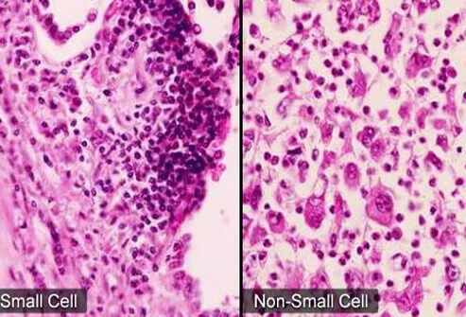
Approach Background
Small Cell (SC) Characteristics
Higher doubling time
Metastasis to Liver > Bone > Brain
Non-Small Cell (NSC) Characteristics:
Lower doubling time
Metastasis to Bone > Brain > Liver
Investigating hypoxia and primary tumor death in each given these differences

Slide 5
Approach
Using Ordinary Differential Equations (ODE)
Built off of existing work, adjusting for the researched metastatic profiles
Implement tissue oxygen and blood oxygen into model
Implement immune system into model
Was straightforward to implement
Model Investigation
Running 1-2 year simulations
Analyze when a tumor becomes detectable
See how the immune response differs if any
Notes:
ODE is straightforward to implement. Tissue oxygen and blood oxygen into the model. 1-2 year simulations.

Slide 6
Possible Approach to Implement Spontaneous Regression
How can we model spontaneous extinction of the primary site?
Could create a mini stochastic model with birth and death and incorporate it into our model
Pick a bunch of random seeds using the random number generator and calculate the number of times the tumor lives and the number of times the tumor dies. Function of birth rate, death rate, and time.
When birth rate is high compared to death rate, we expect to see the rate of survival is ~100%. Likewise, if death rate is high compared to birth, we’d expect ~0%
Decided not to implement for sake of time

Slide 7
Pseudocode
Suppose:
N = number of total cells
N_b = number of birthed cells
N_d = number of dead cells
dt = step size
b = birth rate
d = death rate
prob_b = probability of birth
prob_d = probability of death
T_max = max time
t = time
t = 0
while (t < T_max):
N_b = 0
N_d = 0
for each cell:
prob_b = b*dt
roll dice
if true:
N_b++
prob_d = d*dt
roll dice
if true:
N_d++
N(t+dt)= N(t) + N_b - N_d # Update N
t = t + dt # Update time

Slide 8
Team Structure
Two subteams
Small Cell
Non-Small Cell
Work was subdivided, delegated, and overseen by Ethan E. based on each team member’s strengths and interest
Parameter research
ODE formulation
Model programming

Slide 9
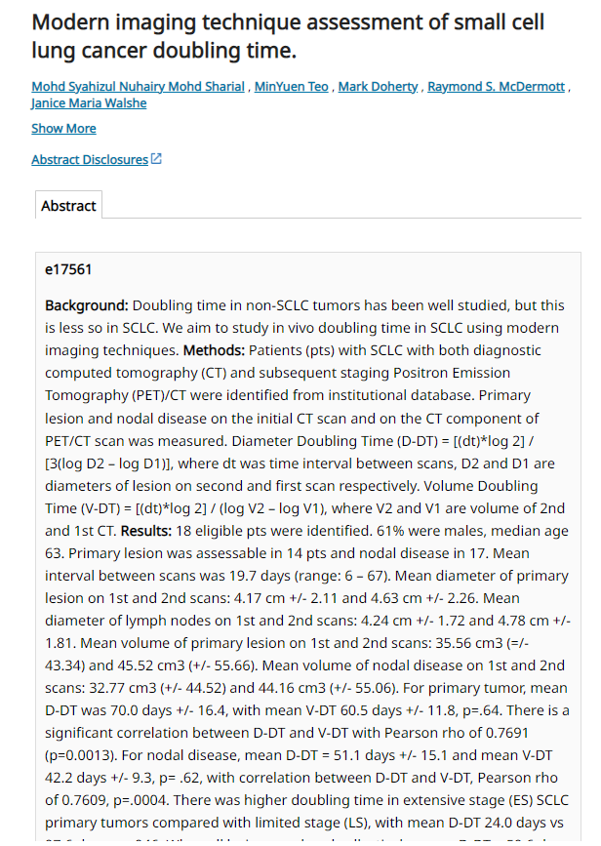
Parameter Research
Already difficult to determine the difference between two different primary origin cancers
Very difficult to locate parameters of the same primary origin for two different types
Sources used
The National Library of Medicine
The National Cancer institute
The American Cancer Society
Lesser-known sources used
Department of Oncology and Pathology (Stockholm, Sweden)
Institute of Pathology Medical-University of Graz-(Austria)
The American Society of Clinical Oncology
The journal of Clinical Oncology provided a great start for determining small-cell lung cancer doubling time.
Mohd Sharial, Mohd Syahizul, et al. “Modern Imaging Technique Assessment of Small Cell Lung Cancer Doubling Time.” Journal of Clinical Oncology, vol. 30, no. 15_suppl, 2012, https://doi.org/10.1200/jco.2012.30.15_suppl.e17561.

Slide 10
Parameter List: See Notion

Slide 11
Final ODE Model

Slide 12
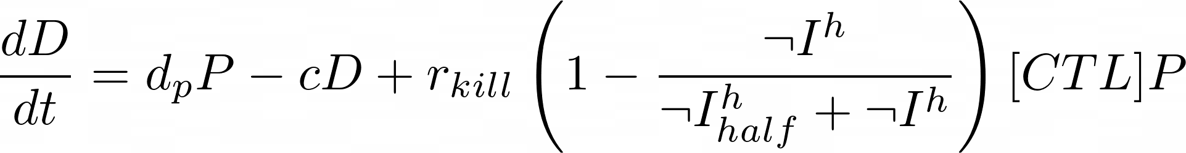
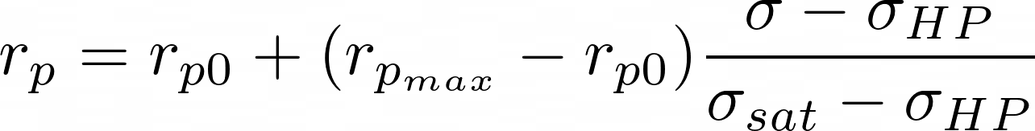
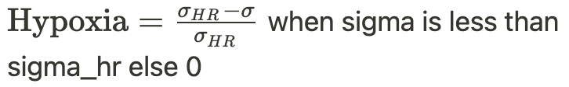
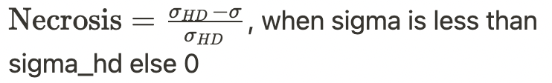
Primary Growth (P) / Death (D)
Cap for 0, 1

Slide 13
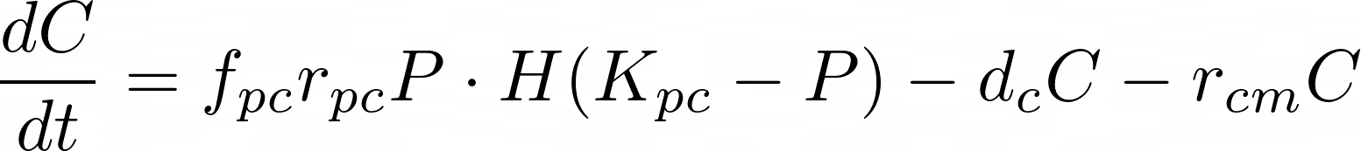
Blood Circulation (C)

Slide 14
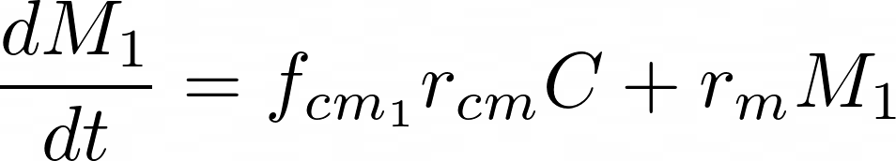
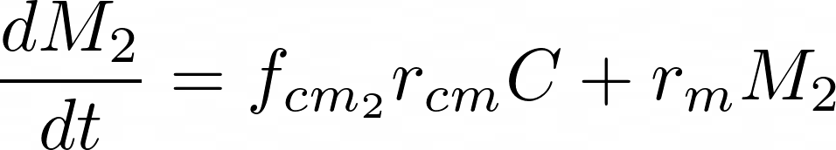
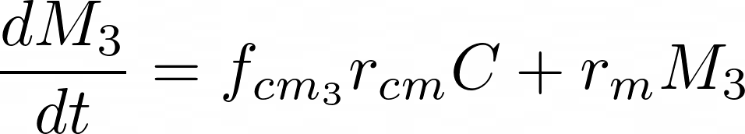
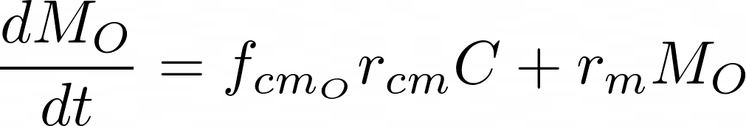
Top Three Metastatic Sites
Bucketed Minor Metastatic Sites
Immune predation is only considered for the primary tumor

Slide 15
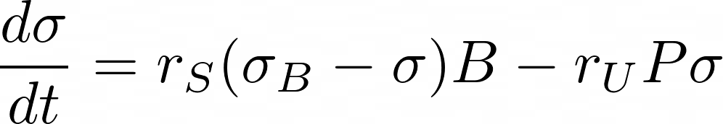
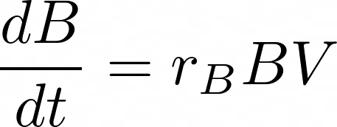
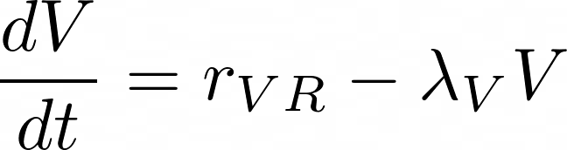
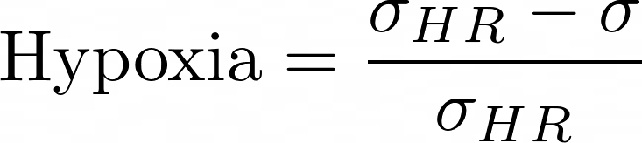
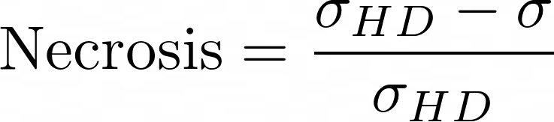
Tissue Oxygen and Blood Oxygen (Primary)
When sigma is less than sigma_hr else 0

Slide 16
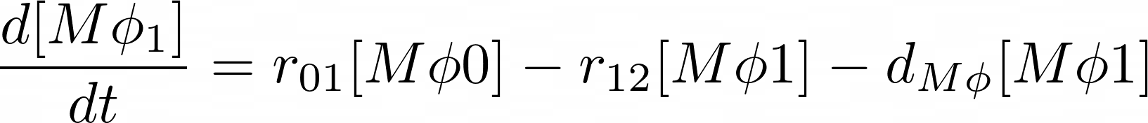
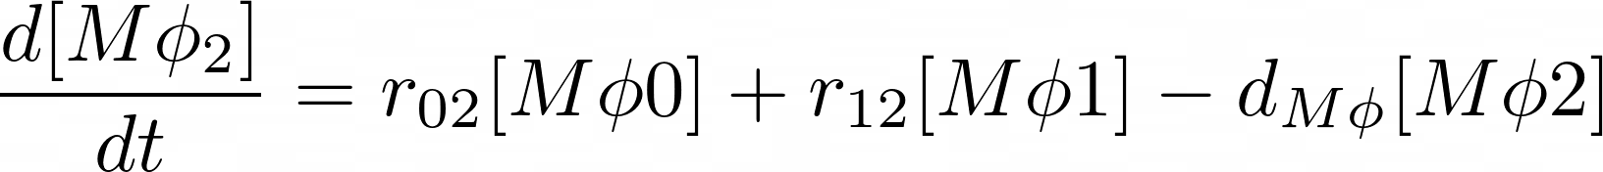
Macrophage Cycling

Slide 17
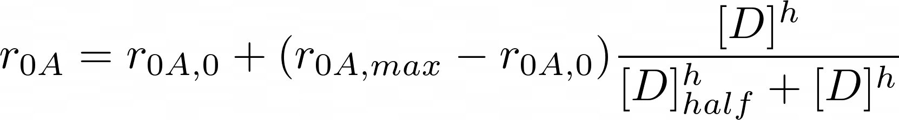
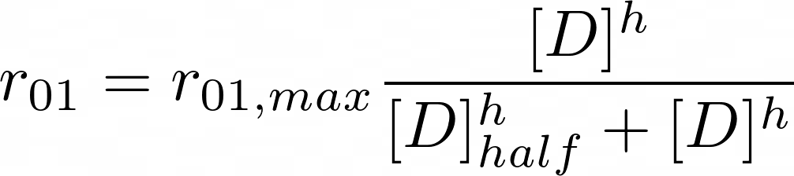
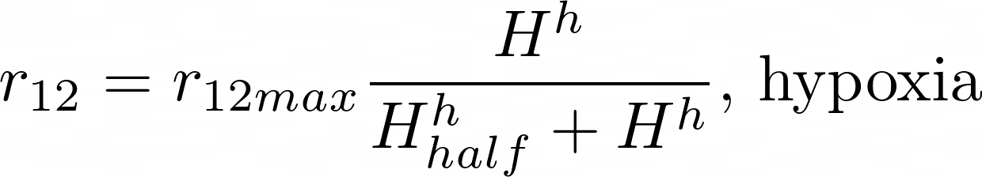
Macrophage Rates

Slide 18
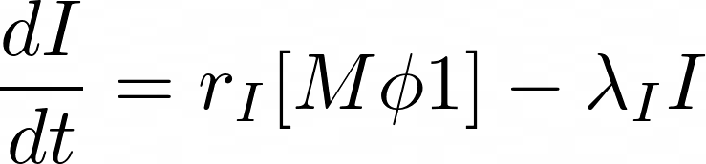
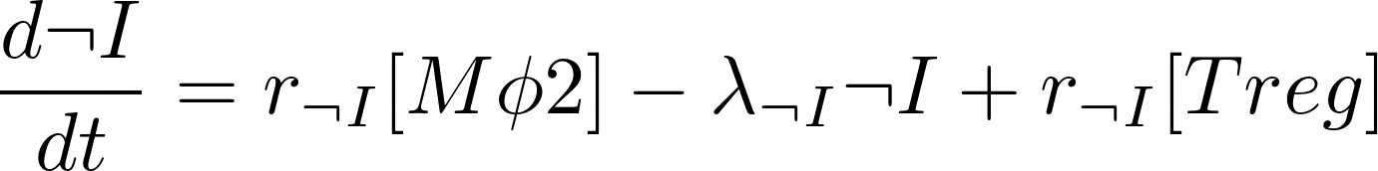
Pro-Inflammatory Factors (I)
Anti-Inflammatory Factors (-I)

Slide 19
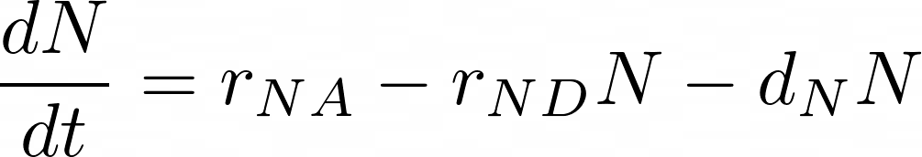
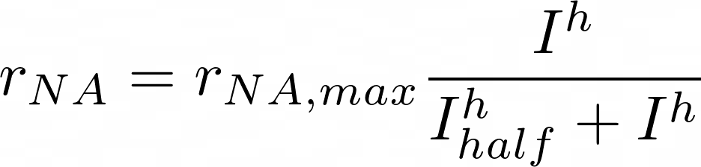
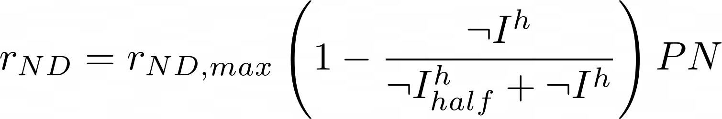
Dendritic Cells (N)

Slide 20
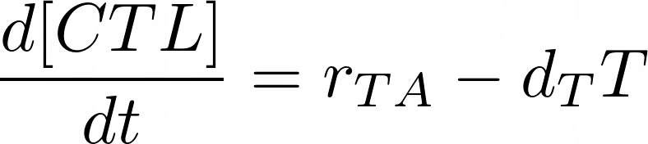
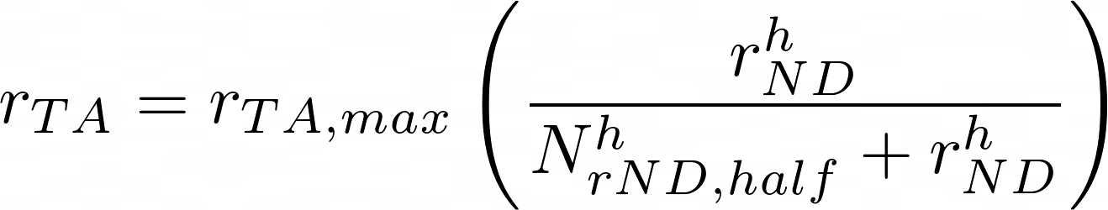
CTLs

Slide 21
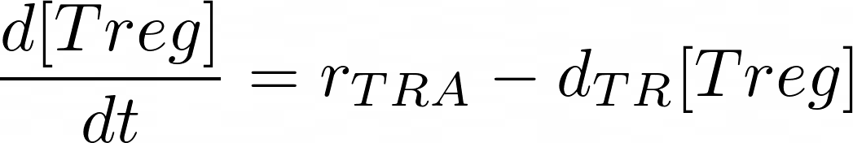
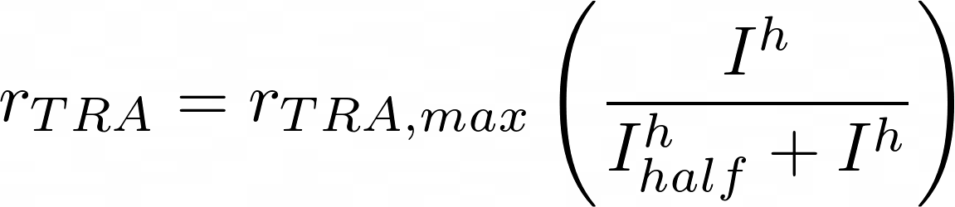

Tregs

Slide 22
Results!
Function based with set parameters.
Did not have time to implement class based modeling
Interesting parameters
Doubling time of the two types
Oxygen consumption

Slide 23
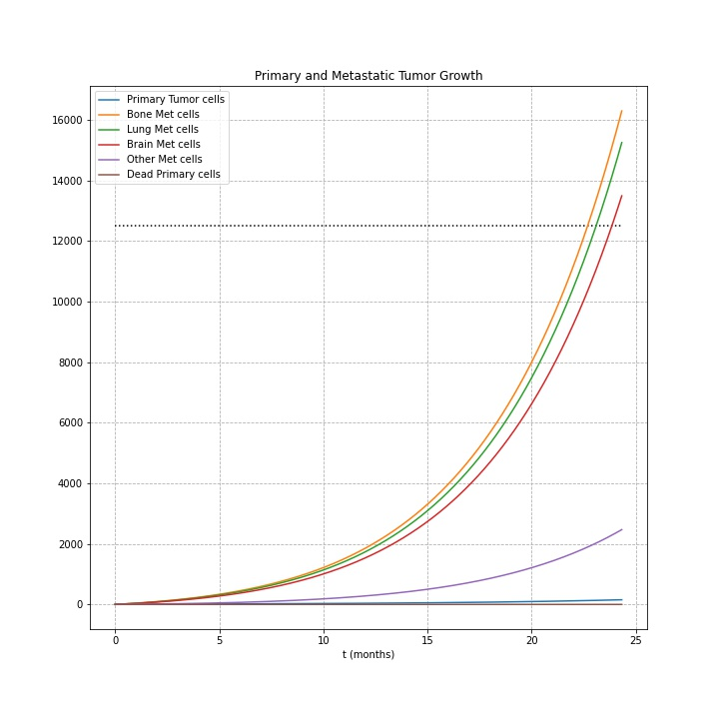
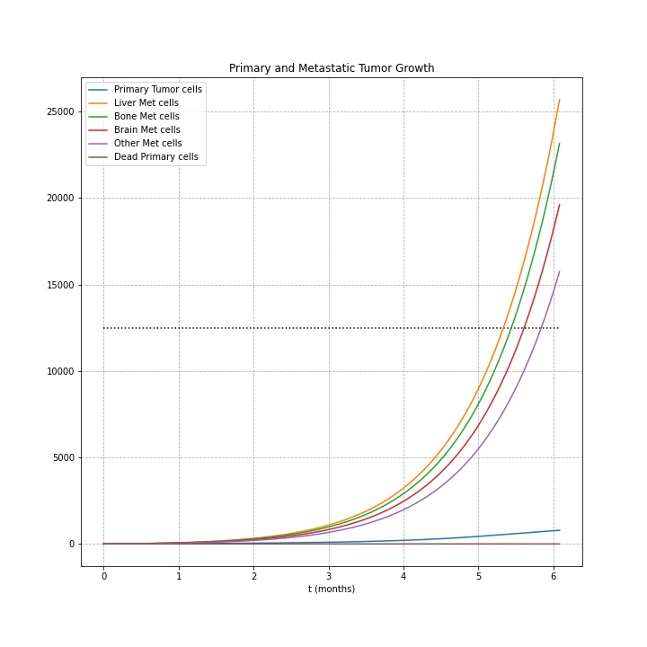
SC mets reached detectable size much faster than NSC!
Non-small cell after 2 years
Small cell after 6 months

Slide 24
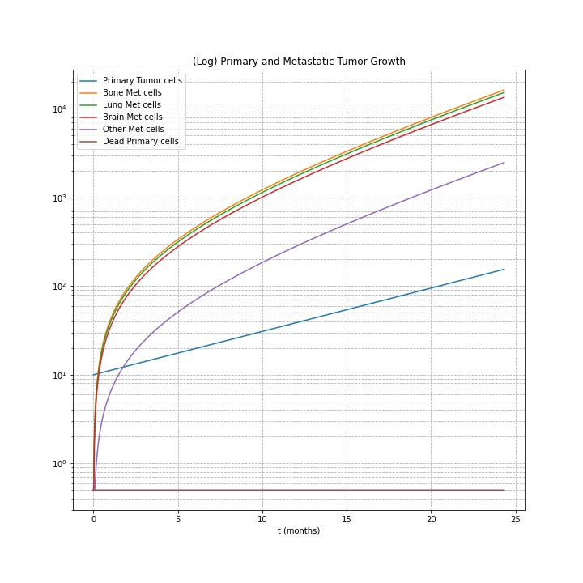
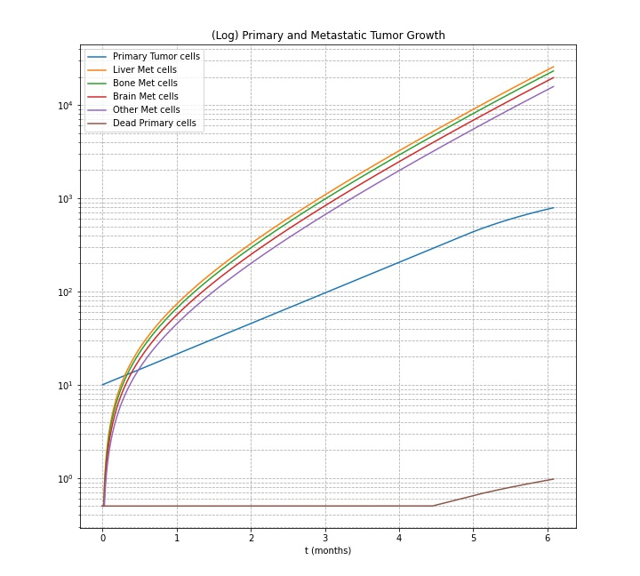
(Log) SC mets reached detectable size much faster than NSC!
Non-small cell after 2 years
Small cell after 6 months

Slide 25
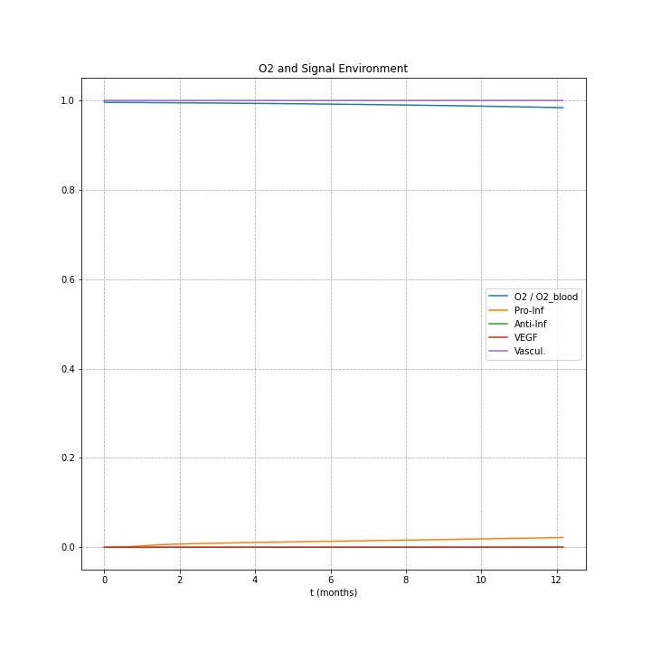
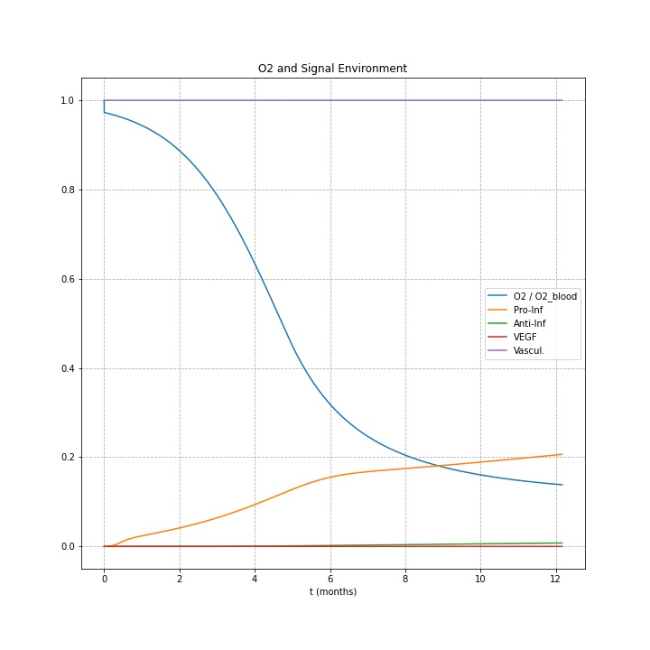
SC consumed Oxygen size much faster than NSC!
Non-small cell after 1 year
Small cell after 1 year

Slide 26
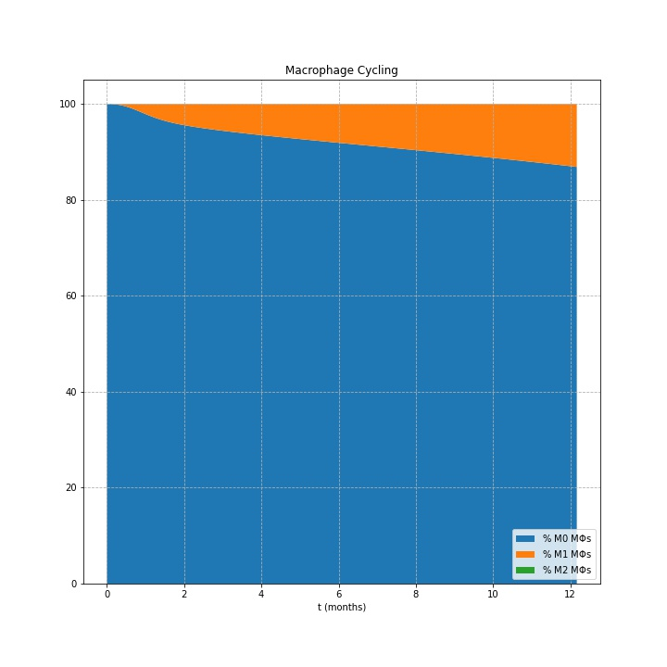
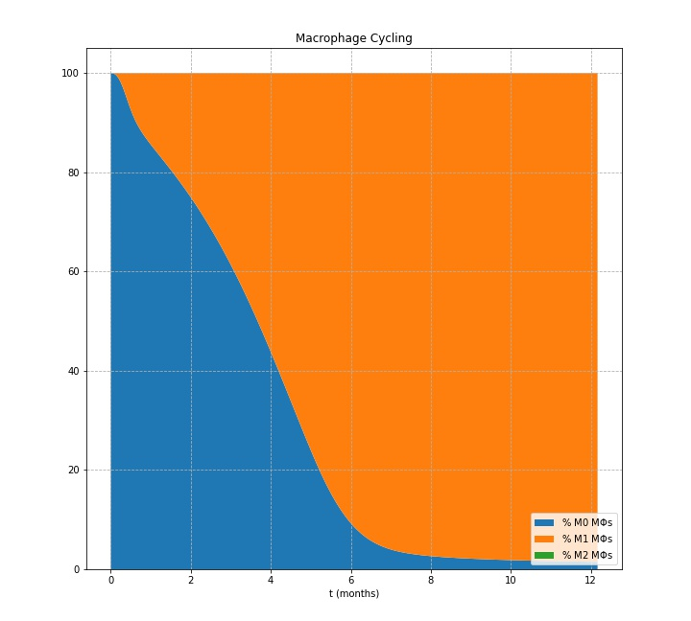
SC cycled through many more M0 macrophages @ 1yr!
Non-small cell after 1 year
Small cell after 1 year

Slide 27
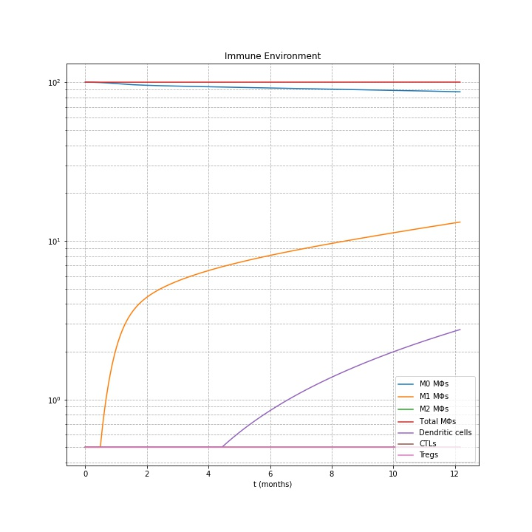
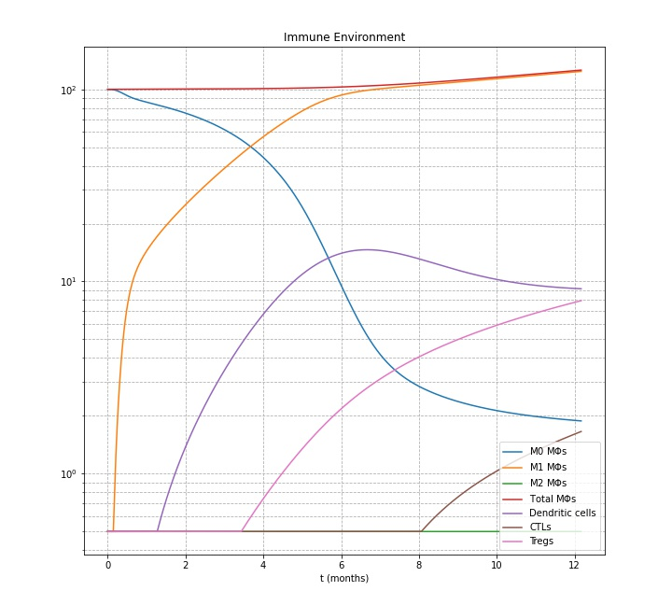
SC has a much larger immune response @ 1yr!
Non-small cell after 1 year
Small cell after 1 year

Slide 28
Discussion (1)
Changes made to original approach
Originally planned on doing an agent based model as well as a set of ODEs and testing the limits of hypoxia and necrosis to see if the primary would die.
Due to time spent researching, constructing model, decided to focus on accurate model construction.
What did you learn from your model?
Confirmed much of what we hypothesized
Offered more detail than we had initially thought of
Better understanding of differences via visual representations

Slide 29

Discussion (2)
What are the possible implications of your findings?
SC more likely than NSC to elicit a potentially fatal hypoxic response
SC also more likely than NSC to suffer immune death
What did your model do well?
It worked :)
Clearly demonstrated the differences between the two LC types
What are some areas for future improvement?
Limit the growth of metastatic tumors with similar constraints
Test slight variations in hypoxia, necrosis, CTL kill rate to find point at which tumor size decreases
Complementary agent-based model to visualize how primary is affected
“All models are wrong, it’s only a
matter of how wrong.”
–Paul Macklin, Phd

Slide 30

Questions?

