Slide 1

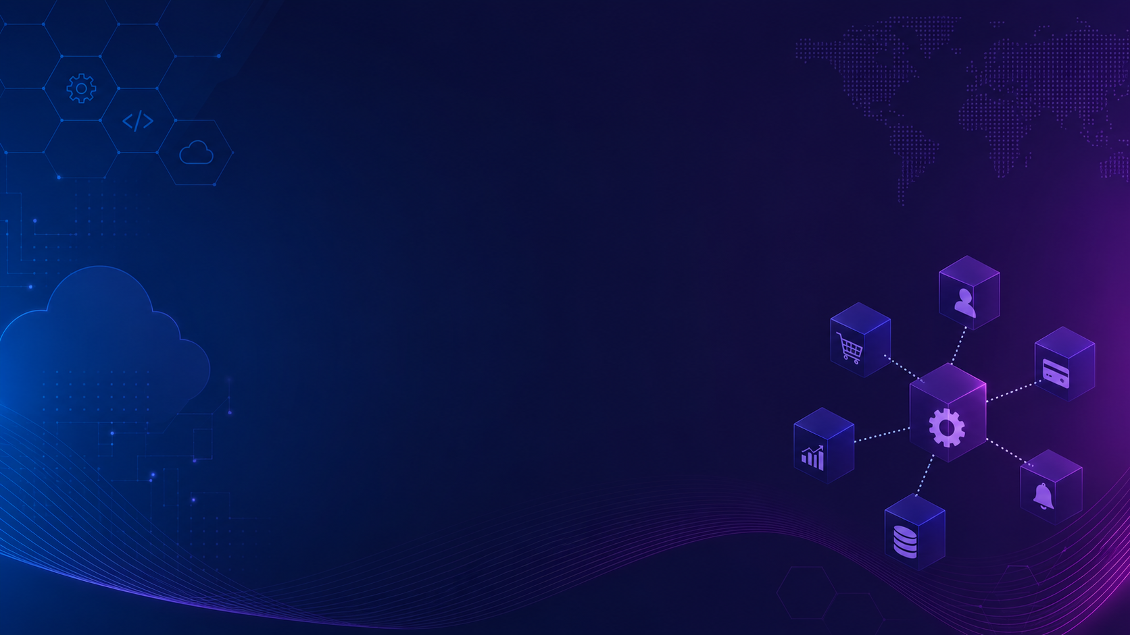

Microservices: a philosophically different way of solving modern software problems
From one codebase in Dubai to a fleet of services on AWS — in 90 minutes.

Slide 2

A TRUE STORY · PART 1
Dubai, 2012: three founders and one codebase
Careem started the way every startup does, i.e. a single ride-hailing app, built fast, shipped as one deployable unit. Booking, drivers, payments, maps: all one program, one database.
And that was the right choice. Remember this — it matters later.
Notes:
Set the scene: 2012, Dubai. Mudassir Sheikha and Magnus Olsson leave consulting to build a ride-hailing app for a region the big players ignored. Like every startup: one app, one codebase, one database.
Magnus Olsson, Mudassir Sheikha, Abdulla Elyas (joined later in 2015)

Slide 3
A TRUE STORY · PART 2
Growth arrived faster than the architecture
100+
14
1
cities
countries
codebase
Middle East, North Africa, South Asia with Karachi and Lahore among its largest markets
Different currencies, languages, payment habits but cash still king in Pakistan
Every new feature, every city launch, every fix is merged into the same program
Ask yourself: what happens to one program when dozens of engineers update it every day?
Notes:
By 2016–17 Careem is in dozens of cities across the Middle East, North Africa, and Pakistan. Karachi and Lahore become some of its biggest markets. Every new city, currency, and payment method lands in the same codebase.

Slide 4
A TRUE STORY · PART 3
The monolith became the bottleneck
One bug, total outage. A fault in a payment module could take down ride booking in every city at once.
Deploys became events. Shipping anything meant re-deploying everything, which is slow, risky and scheduled.
Scaling was all-or-nothing. Ramadan-night demand spikes hit ride matching but you had to scale the entire app to cope up.
Teams stepped on each other. Dozens of engineers, one merge queue. Coordination cost grew faster than the team.
”
The problem wasn't bad code. It was good code trapped in one body.
Notes:
Students who've only seen monoliths will recognize the first two from group projects. The Ramadan point tells peak demand in this region is extreme and predictable.

Slide 5
A TRUE STORY · PART 4
Careem rebuilt itself as a fleet of services
BEFORE
Rides
Scheduling
Payments
The Careem App
booking + drivers + pricing
→
Deliveries
Identity
Maps
+ payments + wallets
+ food + deliveries + maps
→ one deploy, one database
Wallet
Notifications
…dozens more
Not one big-bang software rewrite; services were dismantled one at a time while the monolith kept running.
This is called strangler pattern.
Notes:
The monolith was gradually decomposed into independent services: ride matching, pricing, payments, food delivery, each owned by a team, each deployable on its own.

Slide 6
A TRUE STORY · The Payoff
$3.1 billion
Uber's 2019 acquisition of Careem — the largest tech exit the region had seen.
Today Careem is a super app — rides, food, groceries, payments — and every one of those verticals shipping independently, because everyone is its own service.
Yet! It is one system. Or more accurately, one ecosystem.
The architecture didn't just survive the growth. It enabled it.
Notes:
In 2019 Uber agreed to acquire Careem for $3.1 billion which was the region's biggest acquisition. How? That's what's at stake in today's lecture.

Slide 7
01
Part One
Microservices
A philosophy, not just an architecture, to solve Scale/Scope trap
Notes:
What exactly did Careem adopt? Not a library. Not a framework. A philosophy about how software and the people who build it, should be organized.

Slide 8
The monolith mindset vs the service mindset
MONOLITH MINDSET
SERVICE MINDSET
Build one system that does everything
Build small systems, each doing one thing well
Share one database, one schema, one truth
Each service owns its own data
Pick one language for the whole company
Pick the right tools per job
Release everything together, carefully
Release each piece independently, constantly
Organize teams by layer: UI, Backend, Data
Organize teams by business capability like orders, payments, notifications, etc.
Notes:
This is the core mental shift. Read each row as a pair. The left column is how they've been taught to think; the right column is the new discipline.

Slide 9
Each service owns its data, its stack, its fate
DB
{}
↑
Its data
Its stack
Its fate
Nobody else queries your tables. Other services must ask through your API . The database is an implementation detail, not a contract.
Java here, Python there, JavaScript over there. As long as you speak HTTP or events to communicate externallly, the internals are your business.
The team that builds it, runs it, deploys, scales, and gets paid for it. “You build it, you run it.” Werner Vogels, Amazon CTO
Notes:
Data ownership is the single most violated principle in practice. If two services touch the same tables, you have a distributed monolith, not microservices.

Slide 10
The Definition
Small, loosely coupled, independently deployable services, each built around a business context.
Small
Loosely coupled
Independently deployable
Fits in one team’s scope. Rewritable in weeks, not years.
Talks through API calls and events. No shared internals.
Ships on its own schedule without asking anyone's permission.
Business context means Rides, Payments, Delivery, NOT SQL layer; NOT controllers
Notes:
Three properties; if any one is missing, it's not microservices.

Slide 11
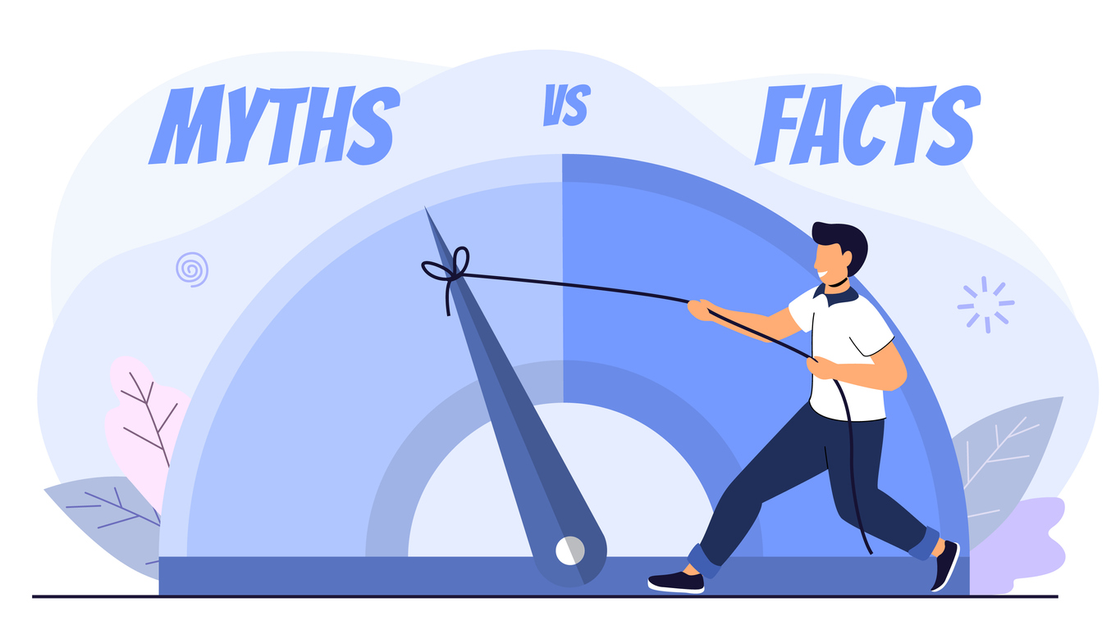
02
Part Two
What microservices are not
Notes:
Five myths, each one heard in real interviews and real teams.

Slide 12
MYTH 1 OF 5
“Microservices just means small codebases.”
Word “micro” can be mistaken with small in size
REALITY
“Micro” measures responsibility, not lines of code. A service is sized by its bounded context — one business capability, one team, one reason to change.
A payments service with 80k lines is a fine microservice.
Two 500-line services that must always deploy together are a broken monolith.
Notes:
Size is measured in responsibility, not lines. Amazon's ordering services are large codebases — but each has exactly one job and one owner.

Slide 13
MYTH 2 OF 5
“It's just REST APIs.”
REpresentational State Transfer is quite common, so are Microservices. Therefore, the misconception.
REALITY
REST is a transport; microservices is an ownership model. A monolith with REST endpoints is still a monolith. And real systems talk over RPC, and event streams as much as HTTP.
The question is never “does it have an API?” — it's “can this piece change and ship without permission from the others?”
Notes:
REST is one transport among several. The defining property is autonomy — and much inter-service traffic is asynchronous events, which we'll meet later with Kafka.

Slide 14
MYTH 3 OF 5
“Docker and Kubernetes make it microservices.”
Containerization/Orchestration and Microservices do coexist but are not same.
REALITY
Containers are about packaging, not architecture. A monolith in a container is a monolith with better shipping.
In fact, today we'll run true microservices on plain Lightsail VMs, no Kubernetes.
Tools follow the architecture. They never create it.
Notes:
You can containerize a monolith (many companies do) and you can run microservices on plain VMs.

Slide 15
MYTH 4 OF 5
“Microservices are always better.”
Since Microservices do wonders in many consumer-end products, even the architects start believing this.
REALITY
You trade code complexity for operational complexity. Network calls fail. Debugging crosses machines. Data becomes eventually consistent.
That price is worth paying at Careem's scale, not at every scale.
Remember slide two: Careem's monolith was the right first choice. We return to this at the end.
Notes:
Microservices trade code complexity for operational complexity: network failures, distributed debugging, eventual consistency. Careem needed them; a 4-person startup usually doesn't. Recall: Careem's monolith was the right first choice.
Also, imagine writing an OS for a formula 1 car where every millisecond counts. That’s where you use a tightly coupled architecture.

Slide 16
MYTH 5 OF 5
“We can share one database.”
Downright wrong and breaking the whole argument to adopt Microservices.
REALITY
A shared database is a shared fate. One ALTER TABLE command and three teams break at once. The schema becomes a secret API everyone depends on and no one owns.
This is why our demo runs MySQL, MongoDB, and in-memory state. Three services, three completely different stores.
Notes:
The most tempting shortcut. A shared database couples every service's schema to every other — one ALTER TABLE breaks three teams. Independent deployability dies first.

Slide 17
More Myths
Honorable mentions
Each service in Microservice follows same design.
More services = more Agile
More secure
Always stateless
And personally, my favourite:
You can go Microservice from day one…

Slide 18
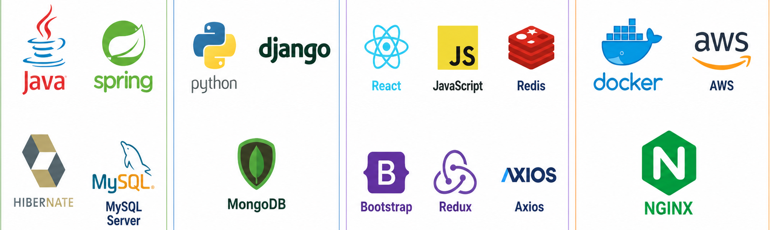
03
Part Three
Building a real system
We build a mini ride-hailing app (like Careem) where every stack choice is forced by the data.
Notes:
Three services, three languages, three stores and this time each stack choice is forced by the nature of the data.

Slide 19
One app; three services; three stacks
Wallet
:8080
Drivers
:8000
Tracking
:3000
Java · Spring Boot
Python · Django
JavaScript · React + Node
Handles real money: Fares, ledgers, refunds
Profiles & KYC documents, endlessly varied
Live GPS pings, life in seconds
⛁ MySQL
⛁ In-memory
⛁ MongoDB
API Gateway
A mini ride-hailing app call it mini-Careem. This time each stack isn't just allowed to differ.
Each one is the only sane choice.
Notes:
The system map for the rest of the lecture. We build mini-Careem. Point out: each column is a different language AND a different store and each choice is forced by the nature of the data. Money wants ACID. KYC documents want schemaless. GPS pings want RAM.

Slide 20
SERVICE 1 OF 3
Wallet — Java, Spring Boot, MySQL
// FareController.java @RestController @RequestMapping("/fares") public class FareController { @PostMapping // HTTP request type @Transactional // for rollbacks public Receipt settle(@RequestBody Fare f) { ledger.debit(f.rider(), f.amount()); ledger.credit(f.captain(), f.amount()); return receipts.save(Receipt.of(f)); } }
Fares are money. Money means ACID transactions, double-entry ledgers, and battle-tested tooling (the boring stuff).
✓
Rider debit + captain credit commit together.
✓
Strict schema rejects an invalid fare at write time
✓
Its MySQL is private and reachable only through this API
Notes:
Why Java/Spring/MySQL for the wallet: fares are money, and money wants ACID and double-entry bookkeeping — rider debit and captain credit must commit together or not at all. Walk the @Transactional method line by line. Nobody else may touch this MySQL.

Slide 21
SERVICE 2 OF 3
Drivers — Python, Django, MongoDB
# views.py — Drivers service def driver(request, driver_id): # reads THIS service's MongoDB doc = db.drivers.find_one( {"_id": driver_id}) if doc is None: return JsonResponse(status=404) # bike/car/rickshaw: different fields, one collection return JsonResponse(serialize(doc))
Driver profiles are documents. A bike rider, a car captain, and a rickshaw driver share little info: license and papers, identity scans, fare, all different.
✓
One collection absorbs every vehicle type.
✓
KYC fields evolve as fast as regulators change the rules.
✓
The Wallet team never sees or cares that this is Python.
Notes:
Why Python/Django/Mongo for drivers: a bike rider, a car captain, and a rickshaw driver share almost no fields — licences, vehicle papers, CNIC scans all differ, and regulators change the rules constantly. Documents fit; rigid tables fight. The Wallet team never needs to know this is Python.

Slide 22
SERVICE 3 OF 3
Tracking — JavaScript, React, in-memory
// tracking.js — no database, on purpose const live = new Map(); app.post('/ping', (req) => { const { id, lat, lng } = req.body; live.set(id, { lat, lng, at: Date.now() }); }); // nearest captain = scan the Map. // this data goes stale faster than DB can commit it.
A GPS ping is outdated in seconds. Persisting it means paying a database to store the past.
So, a Map should be in RAM. That's the right call.
✓
Thousands of pings per second — µs writes, zero I/O
✓
Restart? The map rebuilds from live pings within seconds
✓
A React ops dashboard renders the city straight from memory
Notes:
The mind-blow slide. A GPS ping is worthless seconds after it arrives — persisting it means paying a database to store the past. So: a Map in RAM. If the service restarts, the map rebuilds itself from live pings within seconds — the data is self-healing. A React ops dashboard renders straight from memory. Let the 'no database' point sink in.

Slide 23
Gateway
The API Gateway: one front door
# nginx.conf — the whole gateway server { listen 80; location /api/wallet/ { proxy_pass http://wallet:8080/; } location /api/drivers/ { proxy_pass http://drivers:8000/; } location / { proxy_pass http://tracking:3000/; } }
Clients see one address . The gateway routes by path and becomes the natural home for similar concerns like:
authentication
rate limiting
TLS/SSL
request logging
Notes:
Riders shouldn't memorize three hosts and three ports. The gateway is the single front door: routing by path, plus the natural home for auth, rate limiting, TLS. In our demo it's a dozen lines of Nginx.

Slide 24
One ride, three services, three stores
A rider in Karachi taps “Book ride.”
1
Browser → Gateway
POST /api/rides { pickup: latitude, longitude, customer id, etc. }
2
Gateway → Tracking (Node)
nearest captains from the in-memory map — no disk touched
3
Tracking → Drivers (Django)
GET drivers:8000/drivers/D-204 — API, never the DB
4
Drivers → MongoDB
find_one({_id}) → name, vehicle, rating · rider sees the match
5
Trip ends → Wallet (Spring)
POST wallet:8080/fares → double-entry commit in MySQL
Every hop crosses a network. Every store is touched only by its owner. That's the whole architecture, in one ride.
Notes:
Trace one ride end to end. Emphasize hop 3: Tracking asks Drivers through its API, never its database. And hop 2 touches no disk at all. Each store is touched only by its owner.

Slide 25
04
Part Four – Putting it all together
Deploying the assembly on Amazon Cloud
Checkout this project on your computers: github.com/seekme94/mini-careem
Notes:
Live session begins. Everything so far was theory on slides — now the same three services go onto real machines, in front of them.

Slide 26
DEPLOY · STEP 1
Create three instances
# from the AWS CLI aws lightsail create-instances \ --instance-names \ wallet-vm drivers-vm tracking-vm \ --availability-zone me-south-1a \ --blueprint-id ubuntu_22_04 \ --bundle-id micro_3_0 # then, on each VM: $ curl -fsSL get.docker.com | sh # me-south-1 = Bahrain, i.e. the closest region to us
Each AWS Lightsail instance will host one containerized service. The VMs share a private network out of the box.
wallet-vm
Ubuntu · 1 GB · Java 17
drivers-vm
Ubuntu · 1 GB · Python 3.12
tracking-vm
Ubuntu · 1 GB · Node 20
Notes:
Lightsail = AWS with the sharp edges filed off: fixed monthly price, one screen. Create three small instances, one per service. Bahrain (me-south-1) is the closest region. Instances share a private network by default.

Slide 27
DEPLOY · STEP 2
One composer per VM
# wallet-vm — docker-compose.yml services: wallet: image: minicareem/wallet:1.0 ports: ["8080:8080"] environment: DB_URL: jdbc:mysql://db:3306/wallet restart: always db: image: mysql:8 # no ports: — private to this VM $ docker compose up -d ✔ wallet ✔ db — running
Each VM gets a docker-compose.yml: the service container plus its private database, side by side. The entire deployment is one command.
✓
Config environment: same file can run on your laptop
✓
restart: always survives crashes and reboots
✓
MySQL's port stays inside the VM and not opened publicly
Notes:
Lightsail = AWS with the sharp edges filed off: fixed monthly price, one screen. Create three small instances, one per service. Bahrain (me-south-1) is the closest region. Instances share a private network by default.

Slide 28
DEPLOY · STEP 3
Gateway across VMs
# nginx.conf routes by path to each VM's PRIVATE IP location /api/wallet/ { proxy_pass http://172.26.4.11:8080/; } location /api/drivers/ { proxy_pass http://172.26.4.12:8000/; } location / { proxy_pass http://localhost:3000/; }
Nginx runs as a container on tracking-vm and proxies each path to the right VM's private IP. Only its :80 faces the internet and every other port stays on the private network.
THE KILL TEST
When we run docker compose down on wallet-vm,
Booking and tracking keep working.
Only /api/wallet returns error 502.
PUBLIC: TRACKING-VM on port 80 ONLY
EVERYTHING ELSE PRIVATE
wallet-vm wallet + mysql
drivers-vm drivers + mongo
tracking-vm tracking + nginx
Notes:
Lightsail = AWS with the sharp edges filed off: fixed monthly price, one screen. Create three small instances, one per service. Bahrain (me-south-1) is the closest region. Instances share a private network by default.

Slide 29
When NOT to use microservices
Small team, small product. Five engineers running twelve services spend their week on fire fighting, not product.
Unclear domain boundaries. Services are cut in the wrong places, and every feature change affects all of them.
No DevOps yet. Monitoring, tracing, CICD cost is real and paid regularly.
Strong consistency everywhere. If everything must be transactional with one database telling everything.
”
Start with a monolith. Move to microservices later (exactly what Careem did)
Notes:
End honestly. Monolith-first is the professional default — Fowler's advice, and Careem's actual path. Microservices solve organizational scaling problems; if you don't have those problems, you're paying the tax without the benefit.

Slide 30
What to remember from today
01
02
It's a philosophy of ownership. Small teams owning small services, including data, stack, and risks.
The boundary is the API. Spring + MySQL, Django + Mongo, React + memory are irrelevant to each other by design.
03
04
Failure becomes partial. We killed Wallet and rides kept moving. Monoliths can't do that.
It's earned, not default. Careem started as a monolith and became a $3.1B super app by knowing when to change.
Notes:
Close the loop with the story. Four things to remember. If they remember only one: microservices are an organizational technology as much as a technical one.

Slide 31
Questions?
Notes:
The repo with all three services + deploy scripts as follow-up material.

Slide 32
Assignment
Add another microservice to this suite of projects to cache shared metadata to survive rush-hour surges using a Redis cache.
Fork the repository
Read GUIDE.md and follow the instructions to try end-to-end workflow
Add your contribution
Review within team
Use Claude code to evaluate
Submit to your LMS
Notes:
The repo with all three services + deploy scripts as follow-up material.

