Slide 1

Siesta
Notes:
Time for Action
(Intermediate)
To reproduce the video effects on this slide, do the following:
On the Home tab, in the Slides group, click New Slide, and then click Video With Caption.
On the slide, click the Movie Icon to launch the Insert Video dialog box.
In the left pane of the Insert Video dialog box, click the drive or library that contains the video. In the right pane of the dialog box, click the video that you want and then click Insert.
On the Animations tab, in the Animation group, select Play.
Also on the Animations tab, in the Timing group, click the arrow to the right of Start and select With Previous.
To reproduce the text effects on this slide, do the following:
In the Caption Text Box, type, “Time for Action.”
To reproduce the Master Layout text effects on this slide, do the following:
On the View tab, in the Master Views group, select Slide Master.
On the Slide Master tab, in the Edit Master group, select Insert Layout.
On inserted slide, select the preset text box at top. Under Drawing Tools, on the Format tab, in the Size group, click the arrow at the bottom right launching the Format Shape dialog box.
In the Format Shape dialog box, select Position in the left pane, under Position on Slide in the right pane set the Horizontal to .5” and the Vertical to 5.6”.
Select the text box, on the Home tab in the Font group, select Calibri from the Font list, then select 36 pt from the Font Size list, and then click the Bold icon.
To reproduce the Master Layout video effects on this slide, do the following:
On the View tab, in the Master Views group, select Slide Master.
On the Slide Master tab, in the Master layout group, click Insert Placeholder and select Media, then on the side, drag to draw box.
Under Drawing Tools, on the Format tab, in the Size group, click the arrow to the right of Size launching the Format Shape dialog box.
In the Format Shape dialog box, select Size in the left pane, under Size and Rotate in the right pane set the Height to 5” and the Width to 6.67”.
Also in the Format Shape dialog box, select Position in the left pane, under Position on Slide in the right pane set the Vertical to 0.55”.
Also in the Format Shape dialog box, select Line Color in the left pane, under Line Color in the right pane select Solid Line, and then click the arrow to the right of Color and under Theme Colors select, Black, Text 1, Lighter 25% (fourth row, second option from left).
Also in the Format Shape dialog box, select Line Style in the left pane, under Line Style in the right pane set the Width to 15 pt.
Also in the Format Shape dialog box, select Shadow in the left pane, under Shadow in the right pane click the arrow to the right of Color and under Theme Colors select, Black, Text 1 (first row, second option from left), and then do the following:
In the Transparency box, enter 60%.
In the Size box, enter 100%.
In the Blur box, enter 21 pt.
In the Angle box, enter 40 degrees.
In the Distance box, enter 19 pt.
Also in the Format Video dialog box, select 3-D Format in the left pane, under Bevel in the right pane click the arrow to the right of Top and under Bevel, select Relaxed Inset (first row, second option from left), and then do the following:
To the right of Top, in the Width box, enter 6 pt.
To the right of Top, in the Height box, enter 16.5 pt.
Close the Format Video dialog box.
Select the video frame, on the Home tab, in the Drawing group, click Arrange, point to Align, and then do the following:
Click Align Center.
To reproduce the Master Layout background effects on this slide, do the following:
On the View tab, in the Master Views group, select Slide Master.
Select the Master Slide (on top of Master Layouts). On the Slide Master tab, in the Background group, click the arrow at the bottom right corner launching the Format Background dialog box.
In the Format Background dialog box, select Fill in the left pane, under Fill in the right pane select Gradient fill, in the Angle box, enter 90 degrees, and then under Gradient stops, click Add gradient stop or Remove gradient stop until eight stops appear on the slider. Customize the gradient stops as follows:
Select the first stop on the slider, and then do the following:
In the Position box, enter 0%.
Click the button next to Color, and then under Theme Colors select White, Background 1, Darker 25% (Fourth row, first option from left).
Select the second stop on the list, and then do the following:
In the Position box, enter 11%.
Click the button next to Color, and then under Theme Colors select Black Text 1, Lighter 35% (third row, second option from the left).
Select the third stop on the slider, and then do the following:
In the Position box, enter 22%.
Click the button next to Color, and then under Theme Colors, select Black Text 1, Lighter 35% (third row, second option from the left).
Select the fourth stop on the list, and then do the following:
In the Position box, enter 63%.
Click the button next to Color, and then under Theme Colors select White, Background 1 (first row, first option from the left).
Select the fifth stop on the list, and then do the following:
In the Position box, enter 81%.
Click the button next to Color, and then under Theme Colors select White, Background 1 (first row, first option from the left).
Select the sixth stop on the slider, and then do the following:
In the Position box, enter 89%.
Click the button next to Color, and then under Theme Colors, select Black Text 1, Lighter 35% (third row, second option from the left).
Select the seventh stop on the list, and then do the following:
In the Position box, enter 92%.
Click the button next to Color, and then under Theme Colors select Black Text 1, Lighter 15% (fifth row, second option from the left).
Select the eighth stop on the list, and then do the following:
In the Position box, enter 100%.
Click the button next to Color, and then under Theme Colors select White, Background 1, Darker 5% (second row, first option from the left).
On the Slide Master tab, in the Close group, click Close Master Views.

Slide 2
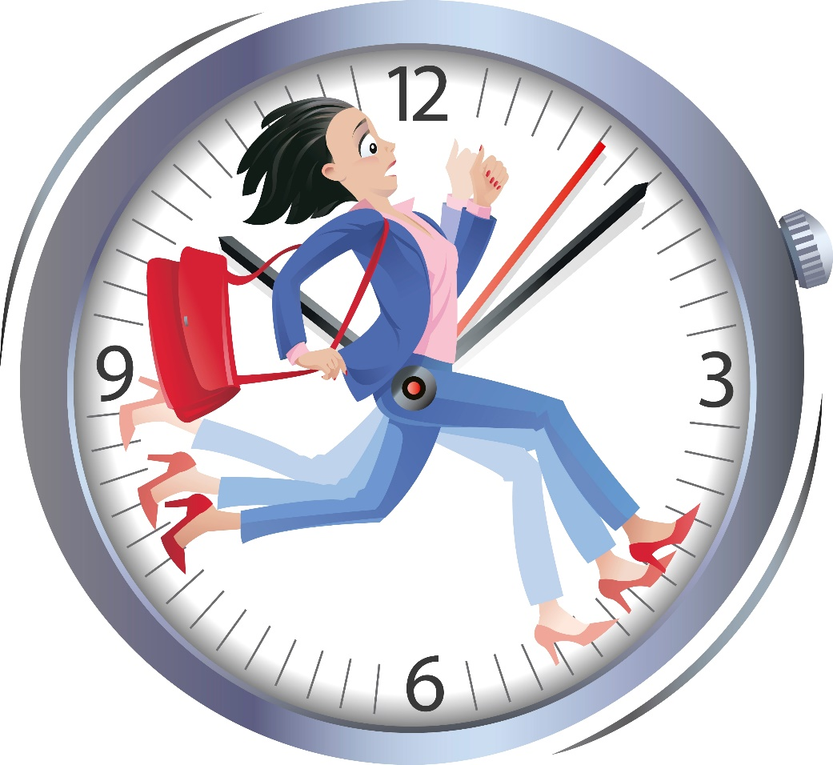
A day in your life
How many hours are there in your day?

Slide 3
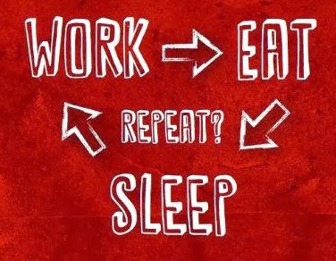
A day in your life
How many hours are their in your day?
How do you divide your day?

Slide 4
A day in your life
How many hours are their in your day?
How do you divide your day?
What is your average sleep in hours?

Slide 5
A day in your life
How many hours are their in your day?
How do you divide your day?
What is your average sleep in hours?
1/3 of your life to be spent sleeping?!

Slide 6
A day in your life
How many hours are their in your day?
How do you divide your day?
What is your average sleep in hours?
1/3 of your life to be spent sleeping?!
There is a measure of everything about human body

Slide 7
A day in your life
Lo! We have created every thing by measure [Al-Qamar: 49]

Slide 8
A day in your life
How many hours are their in your day?
How do you divide your day?
What is your average sleep in hours?
1/3 of your life to be spent sleeping?!
There is a measure of everything about human body:
Vital signs
Senses
Each within a range

Slide 9
Stretching your day
How much do you really work in a day?

Slide 10
Stretching your day
How much do you really work in a day?
A well managed person can work 8 hours

Slide 11
Stretching your day
How much do you really work in a day?
A well managed person can work 8 hours
What does it mean to save 2 hours a day?

Slide 12
Stretching your day
How much do you really work in a day?
A well managed person can work 8 hours
What does it mean to save 2 hours a day?
730 hours a year – 3 months of work hours

Slide 13
Stretching your day
How much do you really work in a day?
A well managed person can work 8 hours
What does it mean to save 2 hours a day?
730 hours a year – 3 months of work hours
Successful people that didn’t have a sleeping pattern! There aren’t any.
Mufti M. Shafee about Hakim Mohammad Saeed (Allah bless them)

Slide 14
Managing Sleep
Fajr
Getting up
Getting ready
Tea break
Zohr/Lunch
Packing up
University
Home
Sweet dreams
Family time
Home
Office
Meetings
Class
Lucky break
Resume
Getting up
…
Exercise

Slide 15
Managing Sleep
Have you tried to measure your energy?

Slide 16
Managing Sleep
Have you tried to measure your energy?
Energy levels throughout a day

Slide 17
Managing Sleep
Have you tried to measure your energy?
Energy levels throughout a day
Your solution…

Slide 18



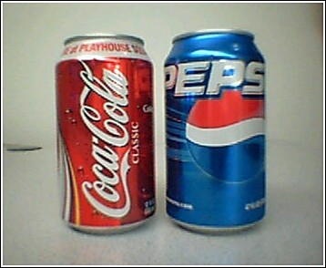
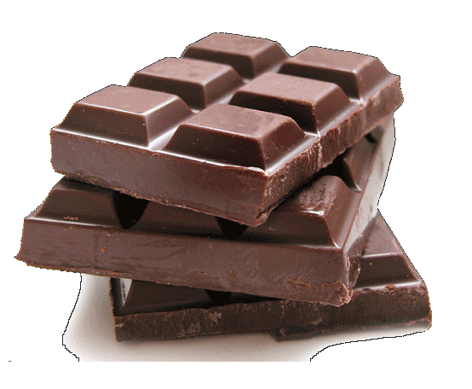
Your Solution

Slide 19
Managing Sleep
Have you tried to measure your energy?
Energy levels throughout your day
Your solution – Tea/Coffee/Drink/Chocolate
The problem with your solution – Caffeine

Slide 20
Caffeine
Bind with brain receptors
Improves athletic performance
Acts as a stimulant
Triggers the ‘the fight or flight’ instinct of the human body providing extra energy so-called ‘coffee kick’

Slide 21
Caffeine
Boost of energy is followed by Depression
Causes High-blood pressure due to increase in blood flow
Cholesterol imbalance
Half life of 7 hours
5gm of Caffeine is lethal, i.e.:
40 cups of Coffee
131 cans of Pepsi/Coke
63 cans of Energy drink

Slide 22
Caffeine
Iftar Mein Cold Drinks Pepsi, Coca Cola, 7up, Dew etc na Piyain Kyun K Is K Istemal Se Kidney (Gurday) Expire Ho Jate Hain.. So Don't Drink Any Cold Drink Plz.. Specially At Iftar. Use Fresh Juices etc.
Says: Dr. Adeeb Rizvi – Civil Hospital Karachi

Slide 23
Human Science
What’s the thing we understand the least?

Slide 24
Human Science
What’s the thing we understand the least?
What do not even know what we do not know

Slide 25
Human Science
What’s the thing we understand the least?
What do not even know what we do not know
Why do we sleep? Theories
Brain: 20% mass consuming 70% energy
The purpose of sleep is to sequence the information the brain learns
If brain does not optimize itself, it will consume more energy
Sleep refines skills learnt, like riding, playing piano

Slide 26
Human Science
What’s the thing we understand the least?
What do not even know what we do not know
Why do we sleep? Theories
Brain: 20% mass consuming 70% energy
The purpose of sleep is to sequence the information the brain learns
If brain does not optimize itself, it will consume more energy
Sleep refines skills learnt, like riding, playing piano
There is one commonality. Brain, not the rest

Slide 27
Sleep Cycle
The primary purpose of Sleep is not rest

Slide 28
Sleep Cycle
The primary purpose of Sleep is not rest
Brain’s function is transmission of electrical impulse – generating magnetic waves

Slide 29
Sleep Cycle
The primary purpose of Sleep is not rest
Brain’s function is transmission of electrical impulse – generating magnetic waves
Sleeping activity has 5 stages
Stage 1: Drowsiness/Sub-consciousness
Stage 2: Heart-rate slows down, brain performs light activities. Recurses.
Stage 3: Internal body repairs (happens even when laying down)
Stage 4: very deep sleep, low breathing/movement
Stage 5: Rapid eye movement, a recurring stage

Slide 30
REM
REM occurs in all stages after stage 1
All functions of Sleep complete in REM
No REM, no sleep

Slide 31
REM
REM occurs in all stages after stage 1
All functions of Sleep complete in REM
No REM, no sleep
Person A: Sleep = 8h & REM = 2.5h
Preson B: Sleep = 5h & REM = 3.0h

Slide 32
REM
REM occurs in all stages after stage 1
All functions of Sleep complete in REM
No REM, no sleep
Person A: Sleep = 8h & REM = 2.5h
Preson B: Sleep = 5h & REM = 3.0h
Dreams occur in REM, but not other way round

Slide 33
REM
REM occurs in all stages after stage 1
All functions of Sleep complete in REM
No REM, no sleep
Person A: Sleep = 8h & REM = 2.5h
Preson B: Sleep = 5h & REM = 3.0h
Dreams occur in REM, but not other way round
Human body has a biological Clock. Suprachiasmatic Nucleus is a part of brain that tracks time

Slide 34
Brain’s Clock
Human body has a biological Clock

Slide 35
Brain’s Clock
Human body has a biological Clock
Suprachiasmatic Nucleus is a part of brain that tracks time

Slide 36
Brain’s Clock
Human body has a biological Clock
Suprachiasmatic Nucleus is a part of brain that tracks time
Brain gives a signal when SCN asks for REM
Same goes for meals

Slide 37


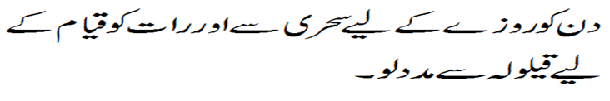
Siesta (قیلولہ)

Slide 38

Siesta (قیلولہ)
قِيلُواَفَإن الشَّيۡطانُ لايَقٰي۔ الطبرانی

Slide 39
Energy Levels after Siesta

Slide 40
Siesta
Stop sleeping after Fajr

Slide 41
Siesta
Stop sleeping after Fajr
Start practicing Qailoola

Slide 42
Siesta
Stop sleeping after Fajr
Start practicing Qailoola
Regularity will set your Brain’s clock

Slide 43
Siesta
Stop sleeping after Fajr
Start practicing Qailoola
Regularity will set your Brain’s clock
Stop all Stimulations. You won’t need them

Slide 44
Siesta
Stop sleeping after Fajr
Start practicing Qailoola
Regularity will set your Brain’s clock
Stop all Stimulations. You won’t need them
Reach optimal sleep pattern

Slide 45
Siesta
Stop sleeping after Fajr
Start practicing Qailoola
Regularity will set your Brain’s clock
Stop all Stimulations. You won’t need them
Reach optimal sleep pattern
Weekends will try to deceive you

Slide 46
Siesta
YOU ARE AMONG LESS THAN 2% OF THE POPULATION
“SHAITAN WILL TRY HIS LEVEL BEST”

Slide 47
Ask away: owaishussain@outlook.com
?

Slide 48

Inspired by…
Timelenders: http://www.timelenders.com/workshops/sleep-management

