Slide 1
BLOCKCHAIN & DECENTRALIZED FINANCE
What if traditional banks no longer control our money?
“Banking is necessary, banks are not.”
— attributed to Bill Gates
Notes:
This is the promise of DeFi. Over the next minutes, we’ll explore why this matters for business and how you can master it.

Slide 2
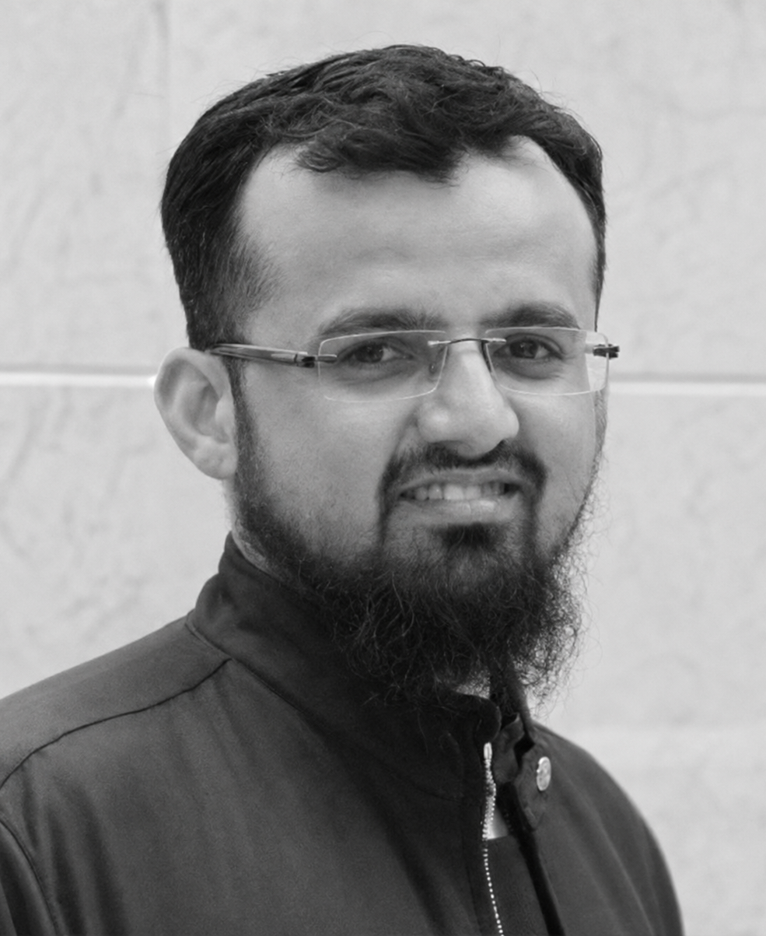
INTRODUCTION
Owais Hussain
Data Scientist / CTO
Network science · Blockchain · Applied machine learning
17
11 / 250
5
Years in industry
Papers / Citations
Theses/FYPs supervised
44
24
8
Industry projects shipped
Countries worked with
Countries travelled to
CURRENT AFFILIATIONS
TechThree — Chief Technology Officer
KIET — Associate Professor
Esquared Systems — Co-founder, Acting CEO
GWML — Trainer (volunteer)
http://esquaredsystems.github.io/founder
Notes:
Holding PhD in Data Science – Complex Network Analysis. My research focuses on blockchain security and network analysis. Also built production systems in healthcare, education and blockchain.

Slide 3
VISION
To bridge the gap between academia and industry.
Industry
Niche
Academia
Notes:
Some context: My core background is in industry that is where I learned to turn technology into something that actually ships. I opted into academia after realising there is a social gap between the two worlds, and that it is a gap I am placed to close. Staying close to state-of-the-art research also lets me foresee what is about to reach the mainstream. In practice that means the use cases I bring into the classroom are live ones from my own experience, not textbook examples.

Slide 4
Blockchain & DeFi – Day 1
The story of Money
Early civilization (6000 BC): Barter system
  Problem! Wealth existed but not easily moved.
Solution: common commodities
  Problem! Wheat – rotted; cattle – undividable; salt – inconvenient.
Solution: Gold (scarce, durable, accepted)
  Problem: no denomination. Difficult to weigh, prone to tempering.
Solution: King’s mark (1200 BC)
Notes:
Barter system. Farmer needed a hammer; blacksmith wanted milk; the shepherd didn’t want wheat from farmer to exchange milk.
King’s mark. In China’s Shang Dynasty, the gold coins were standardized to one size and sealed by the King. No more the need to weigh.

Slide 5
Blockchain & DeFi – Day 1
The story of Money
Solution: King’s mark (1200 BC)
  Problem! Heavy/risky for traders to carry
Solution: 3rd party IOU (I owe you) – initial form of paper Money
  Problem! Goldsmith started lending… more than reserves.
Solution: State-controlled Money
  Problem! Inconvenience.
Solution: Electronic ledgers, Plastic money, Mobile transfers, …
Notes:
From 3rd party IOUs in Tang Dynasty to Govt. issued in Song Dynasty, all happened in 7th century
Banking: If I have 1,000 coins in my vault, perhaps I don't need to keep all 1,000 sitting there.
After govt. issued IoU, people stopped conversion. Paper became Money itself.
Today, International Transfers: SWIFT, PayPal, Alipay, etc.

Slide 6
Blockchain & DeFi – Day 1
The Big Question
A Central authority controls access/deposit/withdraw/spending
A bank can deny a transaction.
A government can confiscate an account.
A court can seize the assets.
They can spend, lend, trade and invest that money without your consent, or knowledge.
They can have an insider that leaks out your business secrets or financial history.
In return, they promise convenience and security, for which they charge considerable money. A promise broken regularly.
Notes:
Of all the issues highlighted. The biggest one is mostly undermined, i.e. privacy. The threats are real. Anyone from clerical to officer rank is prone to exploitation, directly or indirectly.
Truth be told, blockchain isn’t the first or only solution that maneuvers to evade central bodies. There’s a good example of M-pesa (Safaricom, Kenyna – 2007). The idea came from Kenyans’ informal workaround of using mobile minutes as currency.

Slide 7
The Premise of DeFi
Should someone else hold the keys to your safe?
Why not:
A bank where no central authority controls your account?
An open marketplace that is difficult to censor?
A ledger with no single point of failure?
A system that is transparent by design, yet can preserve your privacy?
A clerk that settles transactions in seconds?
A broker that can operate for a fraction of the cost?
An arbitrator that treats a transaction from Karachi and one from London equally?
Notes:
Truth be told, blockchain isn’t the first or only solution that maneuvers to evade central bodies. There’s a good example of M-pesa (Safaricom, Kenyna – 2007). The idea came from Kenyans’ informal workaround of using mobile minutes as currency.

Slide 8
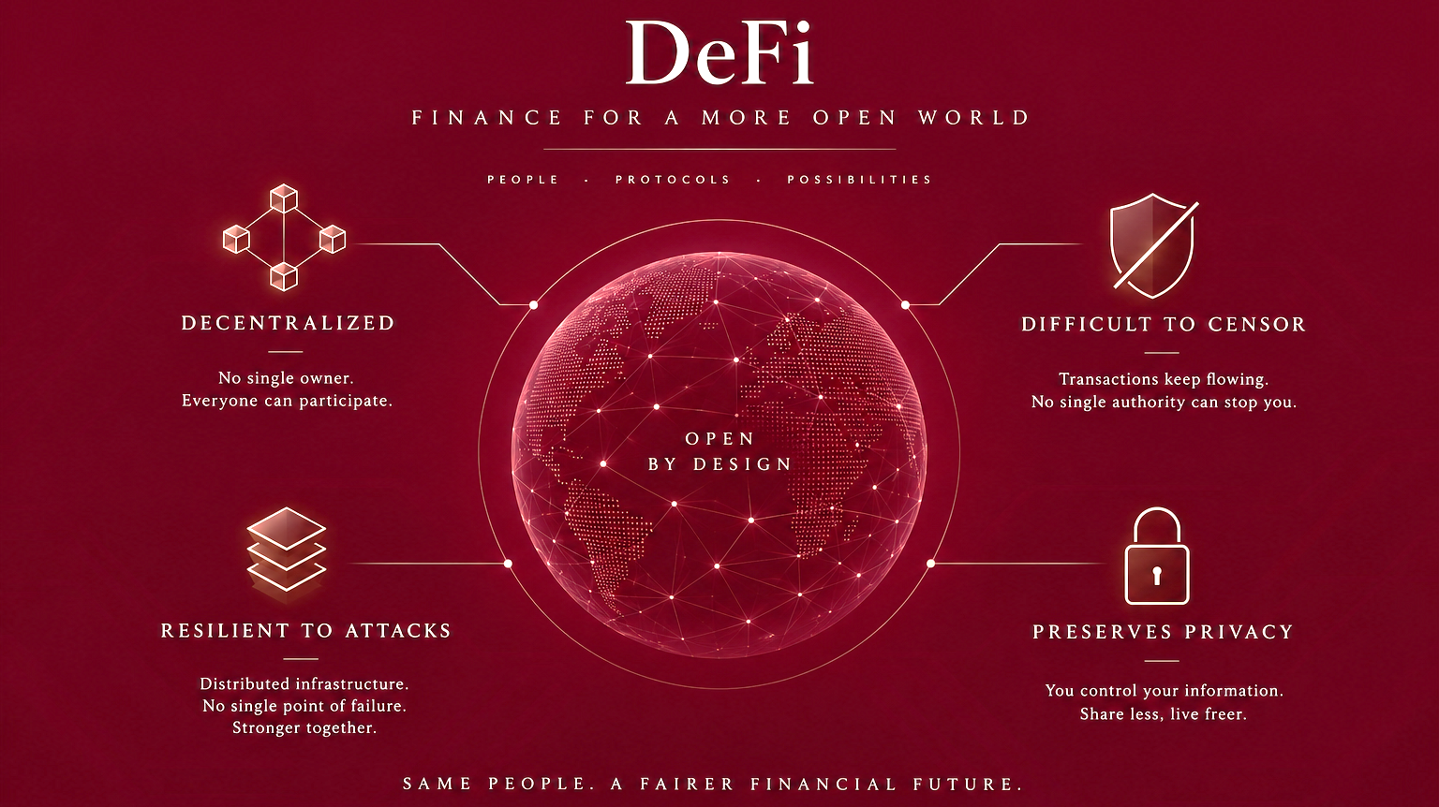
Notes:
Truth be told, blockchain isn’t the first or only solution that maneuvers to evade central bodies. There’s a good example of M-pesa (Safaricom, Kenyna – 2007). The idea came from Kenyans’ informal workaround of using mobile minutes as currency. Blockchain itself is a highly secure technology to implement Decentralized Finance.
Disclaimer! This image is AI-generated.

Slide 9
SCALE
The Scale of DeFi Today
$2.6T
January 2026
$3.0T
Today
$2.6T
in total crypto market value… though, down from $3 trillion in January.
121
$942M
exploits recorded in 2026
stolen in those exploits
Source: CryptoRank / DefiLlama, June 2026
Notes:
For scale: the whole crypto market is around 2.6 trillion dollars today, down from about 3 trillion in January. Two facts matter here. It is large enough that our students will meet it. And it is volatile and exploitable enough that they must be taught the risk, not the hype.

Slide 10
BUSINESS CONTEXT
Opportunities and Risks for Business
WHERE VALUE IS BEING CREATED
WHAT WARRANTS CAUTION
Cross-border settlements
Regulatory position
Instantaneous remittance and supplier payment at negligible cost
Unregulated in most jurisdictions, including Pakistan
Tokenised assets
Contract and bridge risk
Fractional real estate, receivables, treasury instruments
$942M lost to exploits in 2026 alone
Programmable trade finance
No recourse
Payment releases on a verified event rather than a signature
No chargeback, no ombudsman, no reversal
New funding routes
Direct issuance to holders
Notes:
Bringing it to business: DeFi isn’t just theory. Companies are already using it for supply-chain payments and cross-border remittances, reducing delay and cost.
Asset managers are tokenizing real estate and art, opening new markets. But there are challenges: regulations are evolving, scams exist, and technology changes fast. In a classroom, I stress not just the buzz, but the responsible use of DeFi. Assessments will include case analyses of real DeFi failures, such as smart-contract hacks, to teach risk management and ethics.

Slide 11
Decentralized finance is being built with or without us.
The question is whether we arrive as participants or as spectators.
Notes:
In summary: DeFi has moved from fringe to mainstream in under a decade. It offers huge opportunities and responsibilities for future leaders. As a faculty member, I’m committed to teaching it rigorously: from core technology to business strategy to ethics. I believe students can become pioneers in this space. Thank you for your attention. I welcome your questions.

Slide 12
TEACHING
Workshop in a glance
On completing this workshop, the participants will be able to
Explain trust, transparency and settlement problems that blockchains solve, and evaluate when a blockchain is (and is not) the right solution.
Describe the mechanics of Bitcoin and Ethereum and independently verify transactions and contract state using block explorers.
Use smart contracts to financial logic (escrow, voting, token issuance)..
Analyze DeFi primitives: stablecoins, DEXs, AMMs, DAOs, token standards, their pricing mechanics, incentive structures and failure methods.
Assess the security and market-integrity risks of a DeFi protocol (reentrancy, oracle manipulation, MEV, Sybil attacks) and interpret audit reports.

Slide 13
TEACHING
What is NOT covered
The workshop will steer clear from Crypto trading.
Market forecasting and trend analysis.
Pump-and-dump strategies.
Shilling meme tokens and NFTs.
Insider trading a.k.a. “signals”.
Hustle-culture mythologies.

Slide 14
TEACHING
Methodology
Continuous evolution via feedback from participants.
All experiments on public Test nets.
Tools: free and open-source.
Business-focused: emphasis on application over computational algorithms and data structures.

