Slide 1
BLOCKCHAIN & DECENTRALIZED FINANCE
Recap…

Slide 2
Blockchain & DeFi – Day 4
Recap
We discussed Bitcoin, the first truly distributed ledger.
We understood the shortcomings of Bitcoin in creating an ecosystem.
We talked about Ethereum and its emergence.
We took a deep dive into how Proof of Stake replaces Proof of Work.
Last week’s objective was to connect your wallet and submit a feedback on the DApp I deployed using Sepolia.

Slide 3
Blockchain & DeFi – Day 4
Agenda
We will look into how the data appears in the Ethereum’s blockchain explorer as opposed to Bitcoins.
Smart Contracts and how they changed the game.
Why develop your Finance ecosystem on Ethereum?
Revisiting the Decentralized Application.
The road so far and the road ahead.

Slide 4

BLOCKCHAIN & DECENTRALIZED FINANCE
Exploring Ethereum

Slide 5
Blockchain & DeFi – Day 4
Ethereum’s Ledger
Every transaction in Ethereum is:
  Authorized
  Immutable
  Non-repudiable
Ethereum’s ledger is more than transactions. It contains:
  Transfers
  Approvals
  Burn/Mint
  Stake/Unstake
  Ownerships

Slide 6
Blockchain & DeFi – Day 4
Etherscan.io transactions
Etherscan: https://etherscan.io (https://sepolia.etherscan.io testnet)
One stop shop to audit everything about a Wallet, a Smart contract, a Transaction.
E.g. t.ly/xH85M says:
  0.5SepoliaETH were transferred
  from 0x47f90658033B95af18923d410821b1ee0A9EF465 to 0xF9782CFc0a29Dd8EA72f27F7db3Db037691b82F5
  Sender paid gas fee of 0.000051493158SETH or 51493.1578GWEI (10⁹) for this transaction
  Gas fee per unit then was 2.452055127GWEI.
Notes:
Transaction fee = gas used x gas price per unit. A single transaction involves several steps, each consuming one or more units of gas.
The fee works out to about 21,000 gas × 2.45 gwei, which matches a plain ETH transfer.

Slide 7
Blockchain & DeFi – Day 4
Etherscan.io blocks
An Ethereum Block consists of:
  Block Header: parent hash, timestamp, block hash, gas limit, etc.
  List of Ommers (uncles)
  List of Transactions
E.g. https://etherscan.io/block/12571309 (Yes, the real one)
This is Block no. 12,571,309, which contained 126 transactions.
It was mined by the SparkPool miner (0x5A0b…9c4c) in the PoW era.
The block’s header included a parent hash linking to the previous block (hash 0x7ca6...148a) and recorded a Gas Used 14987590 out of 15000000 available (99.9%), indicating it was very full.
The miner earned a reward of 2.2498ETH (2ETH base + 0.2498ETH Tx fees)

Slide 8
Blockchain & DeFi – Day 4
Etherscan.io accounts
You can audit an Account by searching
Go to “from” account from the previous transaction.
  The Account address is 0x47f90658033B95af18923d410821b1ee0A9EF465 and it currently holds 3.2556SETH.
  It was created over a year ago and has made >50 Txns.
Notice the “method” column. These are the functions executed.
Switch to Token Transfers (ERC-20) tab. These are tokens.
Notes:
The topic of Tokens is covered thoroughly in the next module.

Slide 9
Blockchain & DeFi – Day 4
Smart Contracts and how they changed the game
A real-life transaction: Omar is selling his car. Sara is buying a car.
  Omar places an Ad on a 3rd party classified platform - PakWheels for 3M.
  Sara contacts him and expresses her interest in the car.
  Sara calls a 3rd party inspection service – Ali.
  Ali contacts Omar and comes for inspection.
  Ali rates the car and send an inspection report to Sara.
  Sara contacts Omar and negotiates the price to 2.8M.
  Omar and Sara sign a Sale deed via a 3rd party – Excise & Taxation Dept.
  Sara deposits 2.8M into Omar’s bank account.
  The Sale deed is executed, and car Ownership is transferred to Sara.

Slide 10
Blockchain & DeFi – Day 4
Smart Contracts and how they changed the game
How many 3rd parties are involved in this transaction?
These 3rd parties are:
  Getting paid
  Obtaining personal information
  Gaining control
  Manipulatable
What if we were to remove all 3rd parties?
Each 3rd party is executing a series of steps and producing an output.
Each step expects some input, a process and produces a result.
If a step can be expressed as a function, it can be automated.

Slide 11
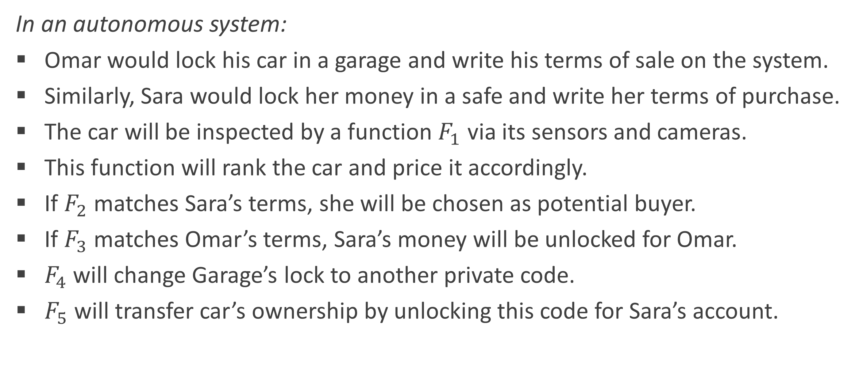
Blockchain & DeFi – Day 4
Smart Contracts and how they changed the game
In an autonomous system:
Omar would lock his car in a garage and write his terms of sale on the system.
Similarly, Sara would lock her money in a safe and write her terms of purchase.
The car will be inspected by a function $F_{1}$ via its sensors and cameras.
This function will rank the car and price it accordingly.
If $F_{2}$ matches Sara’s terms, she will be chosen as potential buyer.
If $F_{3}$ matches Omar’s terms, Sara’s money will be unlocked for Omar.
$F_{4}$ will change Garage’s lock to another private code.
$F_{5}$will transfer car’s ownership by unlocking this code for Sara’s account.
Notes:
Now these functions can be anything from one line calculation to an entire expert system.

Slide 12
Blockchain & DeFi – Day 4
Smart Contracts and how they changed the game
This system will ensure:
Either both the payment and the ownership happen, or neither does.
Removes Sara's fear of paying and getting nothing.
Removes Omar's fear of handing over the car and not being paid.
WYSIWYG! An expert system is assessing the car condition.
Bidding replaces Negotiation.
Sara and Omar never had to meet.
Notes:
WYSIWYG: What you see is what you get

Slide 13
Blockchain & DeFi – Day 4
Smart Contracts and how they changed the game
Smart contracts enable building systems like these.
Accurate, Autonomous, Fast, Secure, Backed-up and Economic programs.
Steps to execute certain transaction are predefined.
Traditional contracts are enforceable by law; smart contracts are enforceable by code.
Smart contracts execute simple IF-THEN logic, for example:
  If you send NFT 0xaabb…eeff, then 0.025ETH will be transferred to your wallet.
  If you transfer 0.1ETH to wallet address 0xa1b2…d4e5, domain name “vasilius.eth” will be registered to your address.
  If “sarathedev” deploys v0.1.5 of project “github.com/ethereum/verkletree-api” AND the QC = PASS, transfer 1.5ETH to wallet address 0xa1b2…d4e5.
Notes:
Smart contracts are open-source and hosted in the EVM in form of bytecode and ABIs.

Slide 14
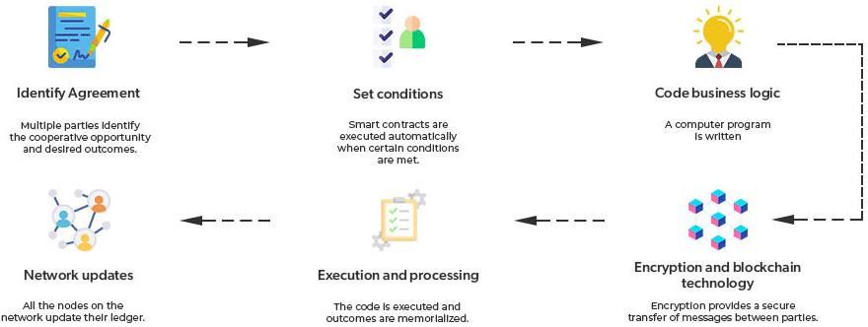
Blockchain & DeFi – Day 4
Smart Contracts and how they changed the game

Slide 15
Blockchain & DeFi – Day 4
Having said that…
Smart contracts have some pitfalls:
Weak Regulation: a fraudulent activity committed via Smart contracts is difficult to take any action against.
  Fixes! EU has Markets in Crypto-Assets Regulation (MiCA) and the US has its stablecoin law. Pakistan’s has PVARA initiative.
Must be Autonomous: with zero human intervention, each process must be fully automated. This makes complex contracts hard to implement.
Immutable: a new contract must be deployed to make any change, even if it’s a bug fix.

Slide 16
Blockchain & DeFi – Day 4
Why develop your Finance ecosystem on Ethereum?
Bitcoin proved digital money works. Ethereum made money programmable, and finance needs more than money: it needs agreements, standards and liquidity.
ERC-20 standard. Any wallet, exchange or app can handle any ERC-20 token without integration work.
Liquidity: The same reason the NYSE and the US dollar persist despite faster or cheaper alternatives.

Slide 17
Blockchain & DeFi – Day 4
Why develop your Finance ecosystem on Ethereum?
What finance needs | What Ethereum provides | Evidence
Programmable agreements | Smart contracts run any financial logic: lending, exchange, escrow, insurance | Bitcoin's script can't; the EVM can
Common standards | ERC-20 (tokens), ERC-721 (NFTs), ERC-4626 (vaults): one format every app understands | The SWIFT equivalent of on-chain money
Composability | Contracts can use contracts: borrow, swap and repay in one transaction | Lego-like Money: Aave + Uniswap + Market Makers
Liquidity | Capital is mapped to where capital already is | ~56% of all DeFi value backed by real assets
Credibility & neutrality | Producing blocks non-stop since 2015; no owner, open to anyone | BlackRock launched BUIDL on Ethereum; ~60% of tokenized real-world assets
Markets don’t pick the fastest or cheapest venue. They pick the one where liquidity and standards already exist.
Notes:
Aave is a non‑custodial liquidity protocol launched in 2017 that lets users lend and borrow crypto assets.
Sources: DefiLlama (DeFi TVL and stablecoin share, Sep 2026).
If a faster, cheaper chain exists, why hasn't capital moved? (Answer: liquidity, standards, trust)

Slide 18
Blockchain & DeFi – Day 4
Acknowledging counterarguments
Ethereum's share is slipping. It was well above 60% a few years ago.
Mainnet is slow and can be expensive; most activity now runs on Layer-2s (Base, Arbitrum) that settle back to Ethereum.
There are other players in the arena
Countering counterarguments:
Every rival either copies Ethereum (BNB Chain), skips smart contracts (XRP Ledger), wins on speed (Solana), wins on cheap payments (Tron), or holds your money and identity (Binance).
Smart contracts came a bit late. Therefore, DeFi activity is relatively small.
Notes:
BNB Chain didn't beat Ethereum's standards; it adopted them.

Slide 19
Practical Exercise/Demo
Instructions
Visit https://github.com/esquaredsystems/web3-feedback-dapp
Give this link to ChatGPT and ask it to explain its smart contract in plain English.
Open the Feedback Dapp again – this time you’ll submit a real feedback.
Add a new account on MetaMask specifically for this transaction. Never to be touched later.
Send enough SETH into new account to submit the feedback form.

Slide 20
Blockchain & DeFi – Day 4
The road so far, and the road ahead
We moved trust out of institutions and into code.
09 - 12 · FINAL MODULE
Threats & attacks
Who attacks DeFi, how, and how to defend it
05 - 08 · NEXT MODULE
Decentralized Finance
Banks, exchanges and brokers, rebuilt as code
04
Smart contracts
Agreements that execute themselves
MEV & front-running
03
Ethereum
The ledger learns to run code
02
Bitcoin
Money with no bank in the middle
DAOs
Reentrancy
01
Blockchain
A shared ledger nobody owns, everybody verifies
CEX/DEX trading
Sybil attacks
AMMs
Oracle manipulation
Multi-sig Wallets
Flash attacks & slippage
Tokenomics
Rug pulls & phishing

