Slide 1

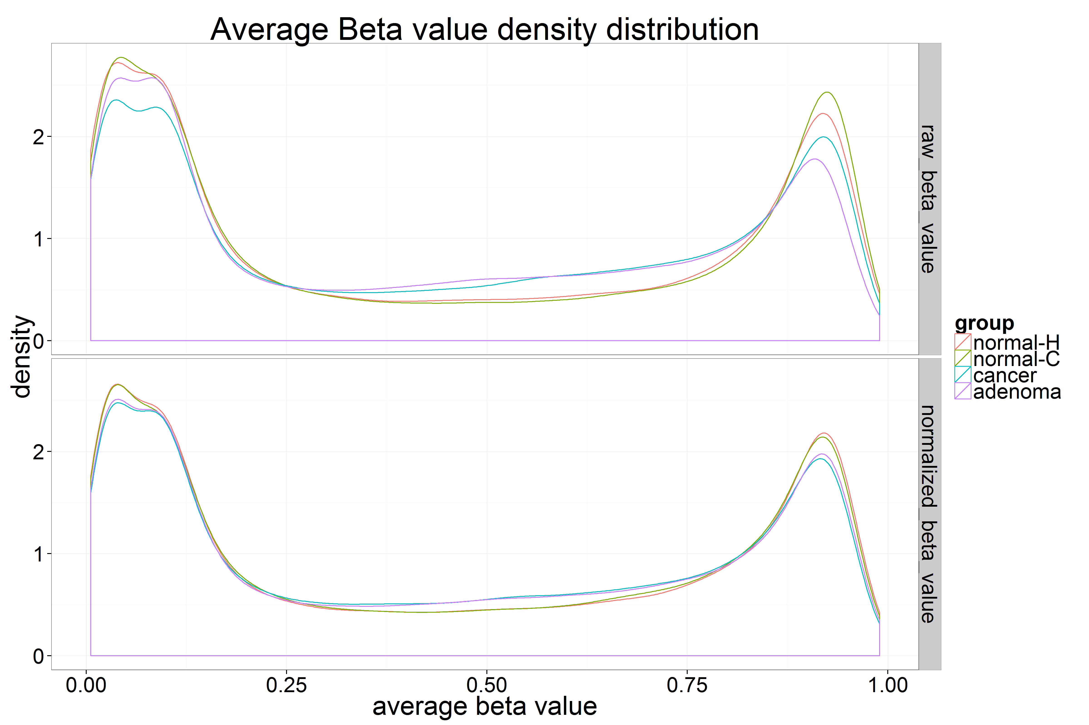
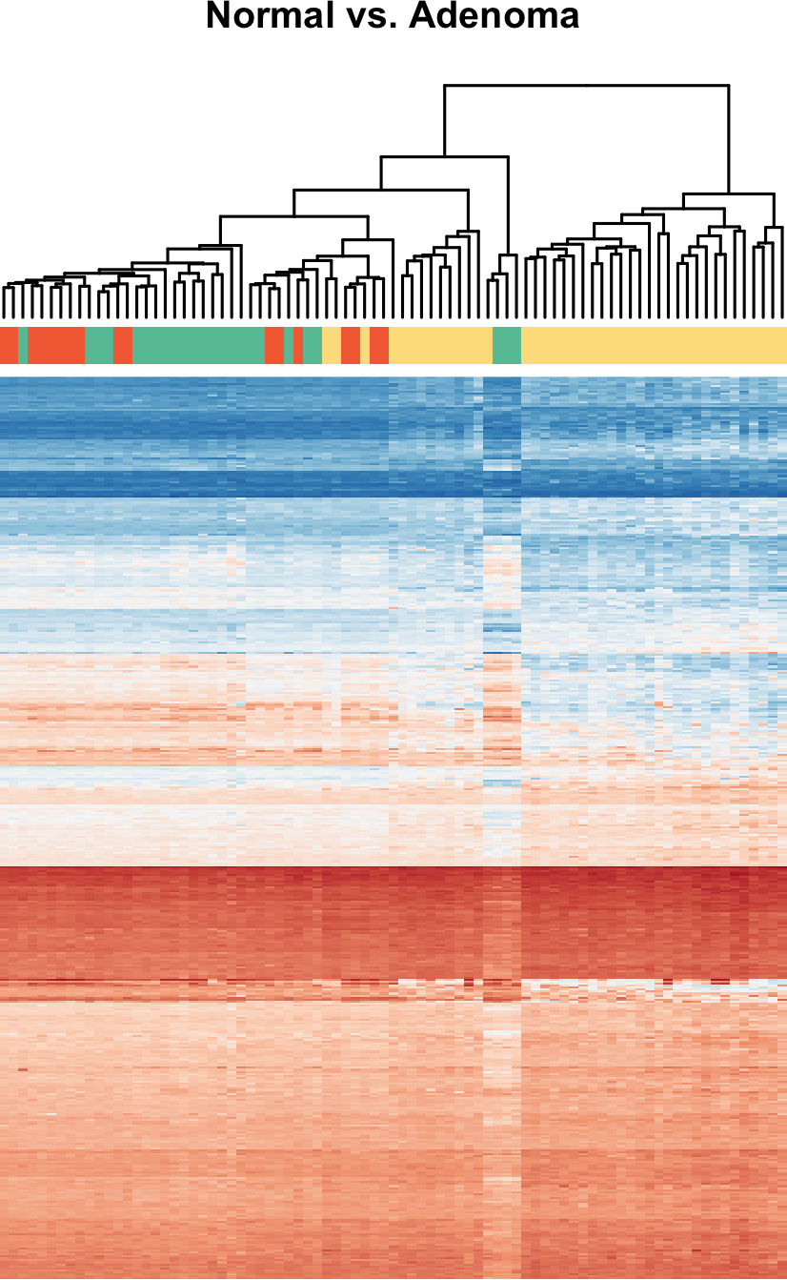
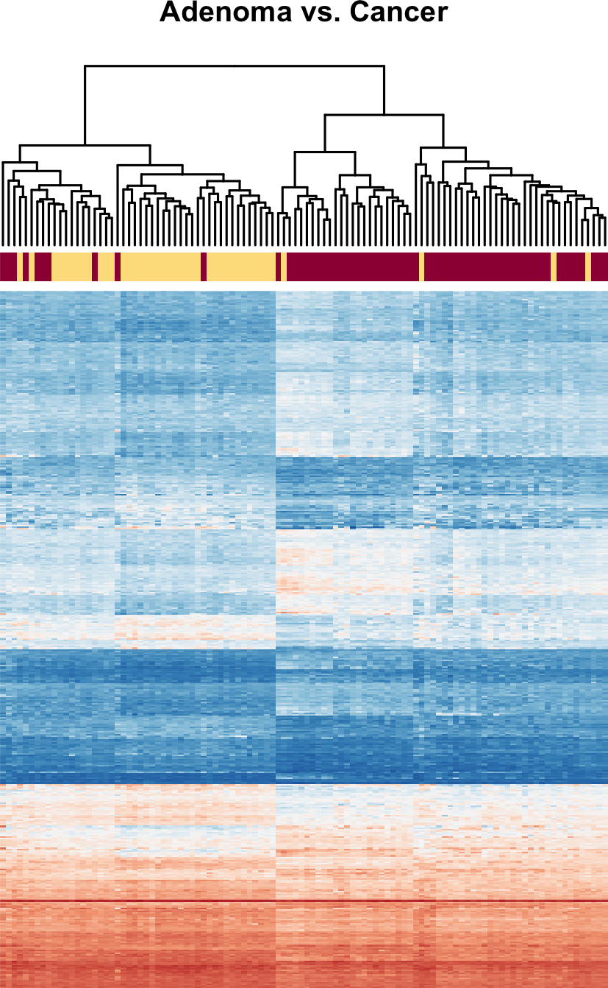

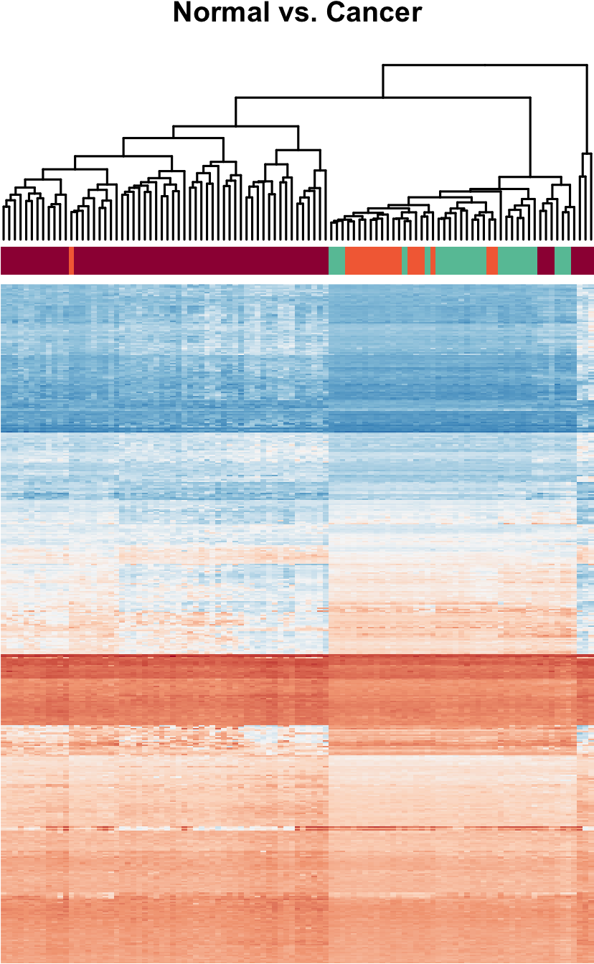
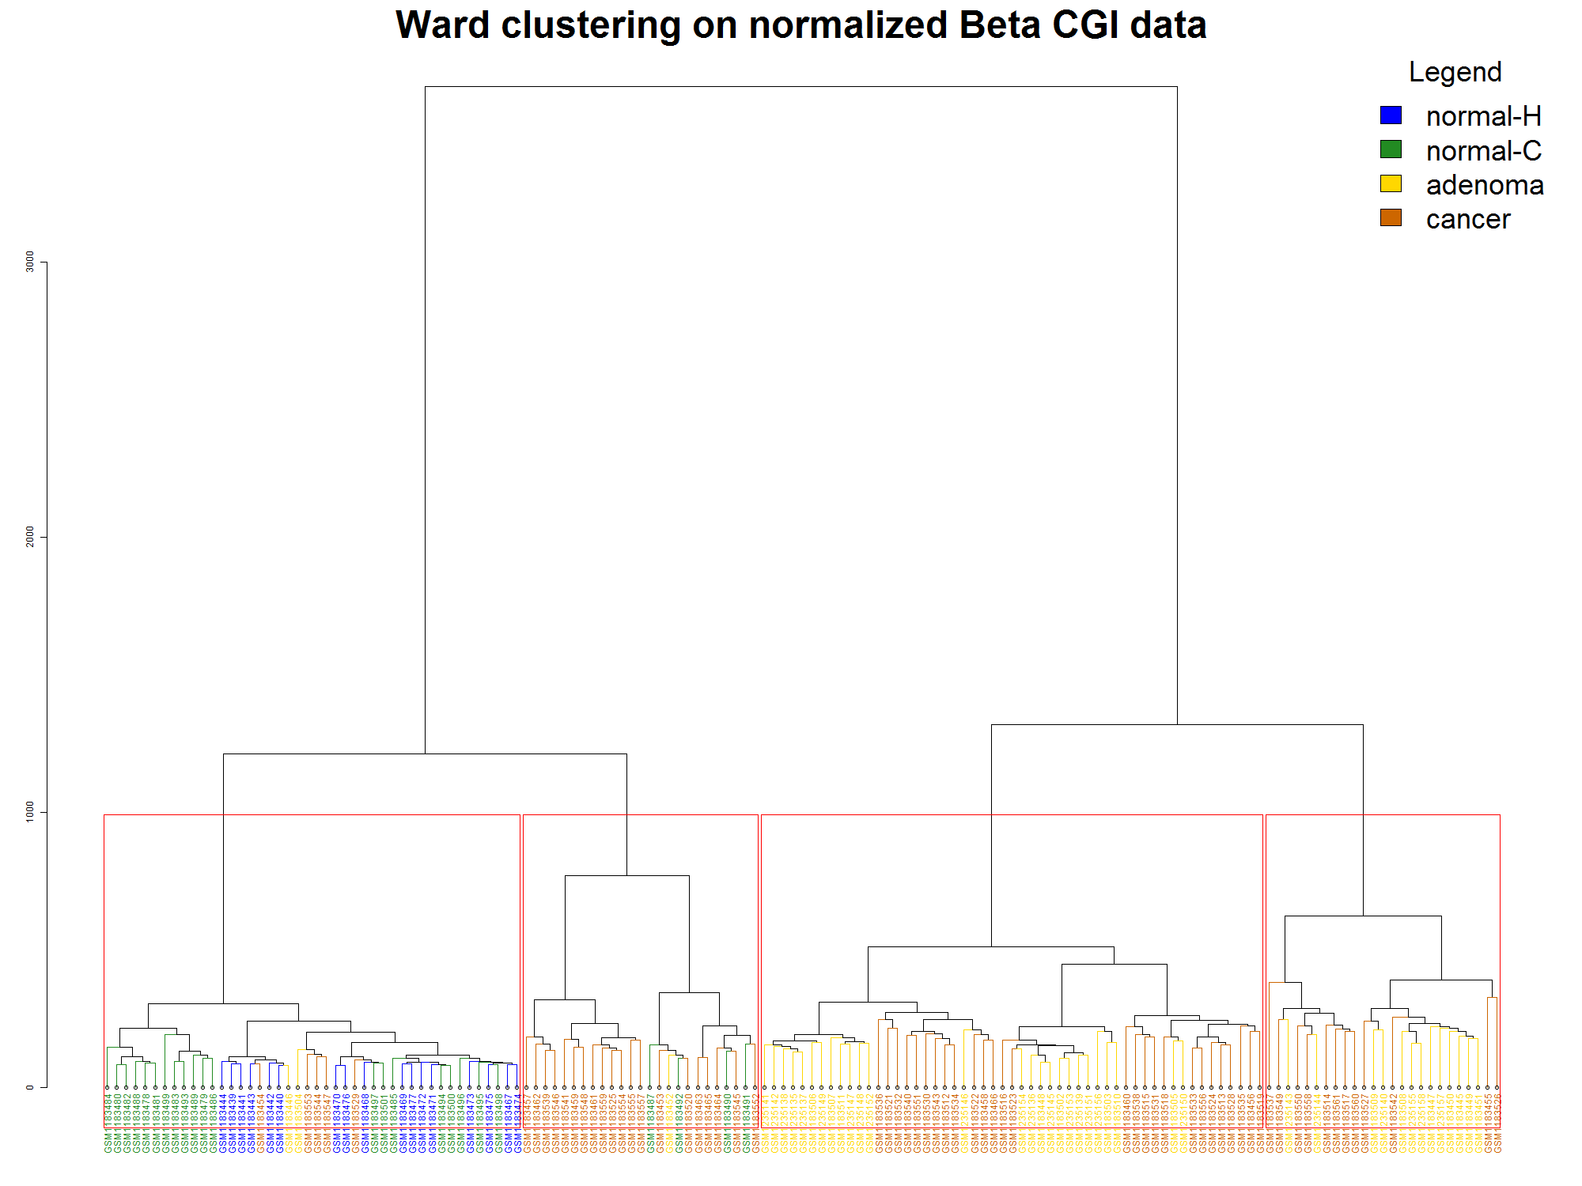
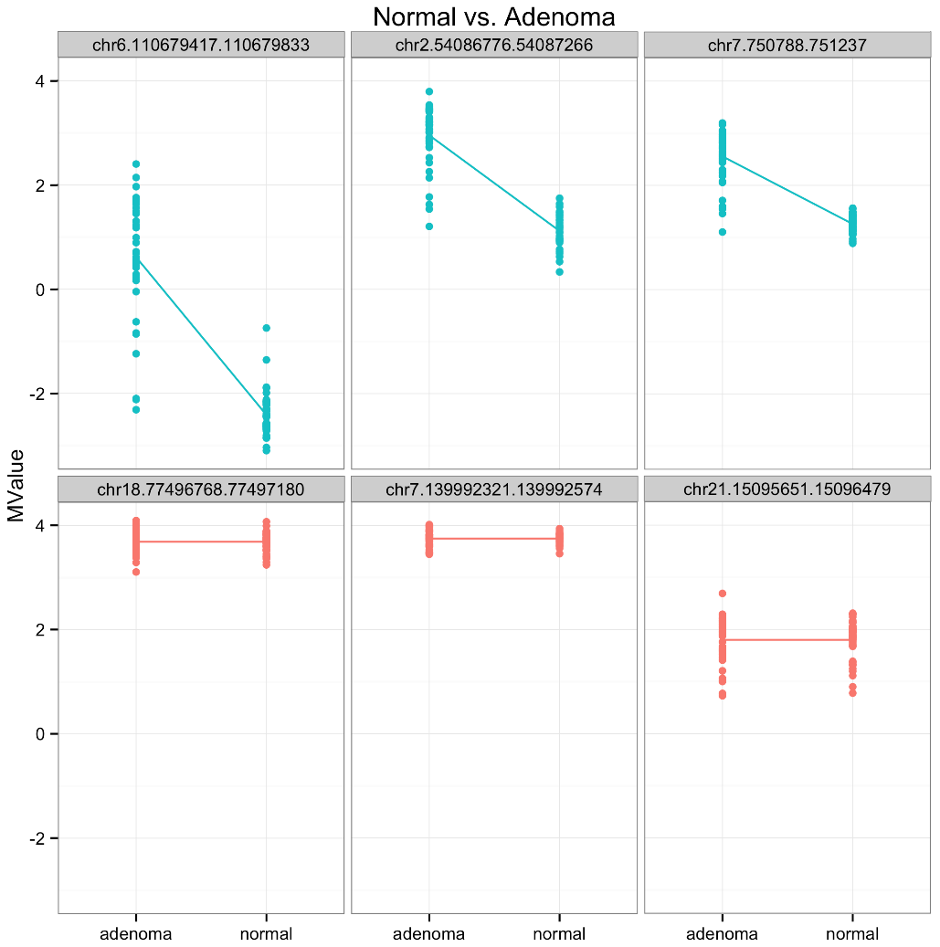
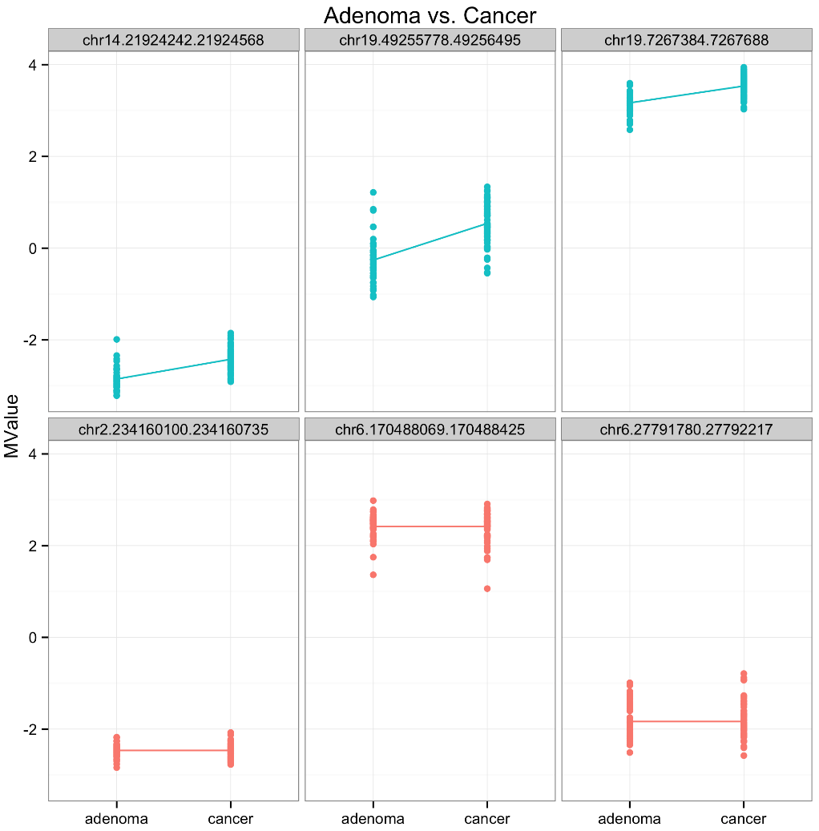
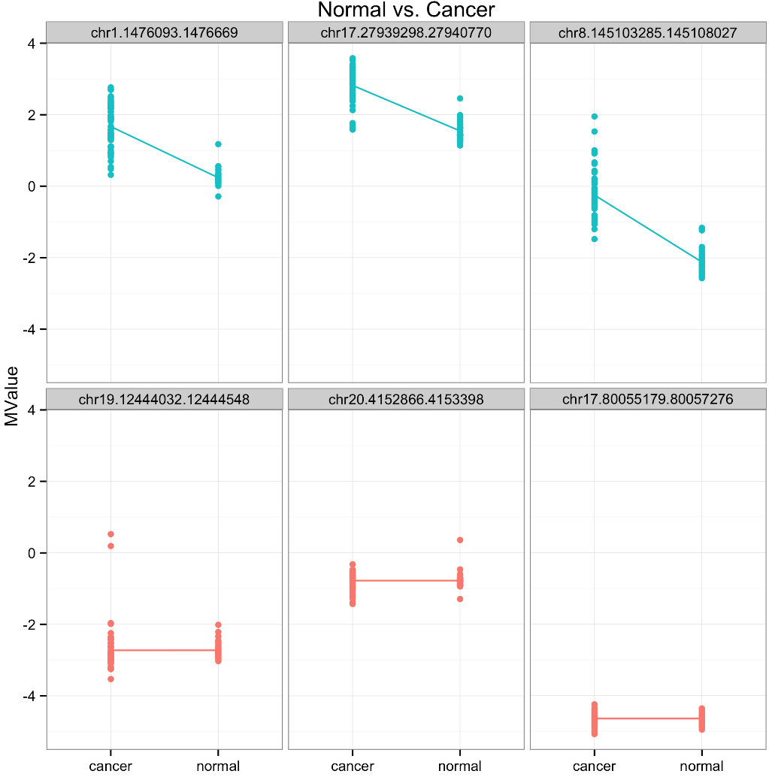
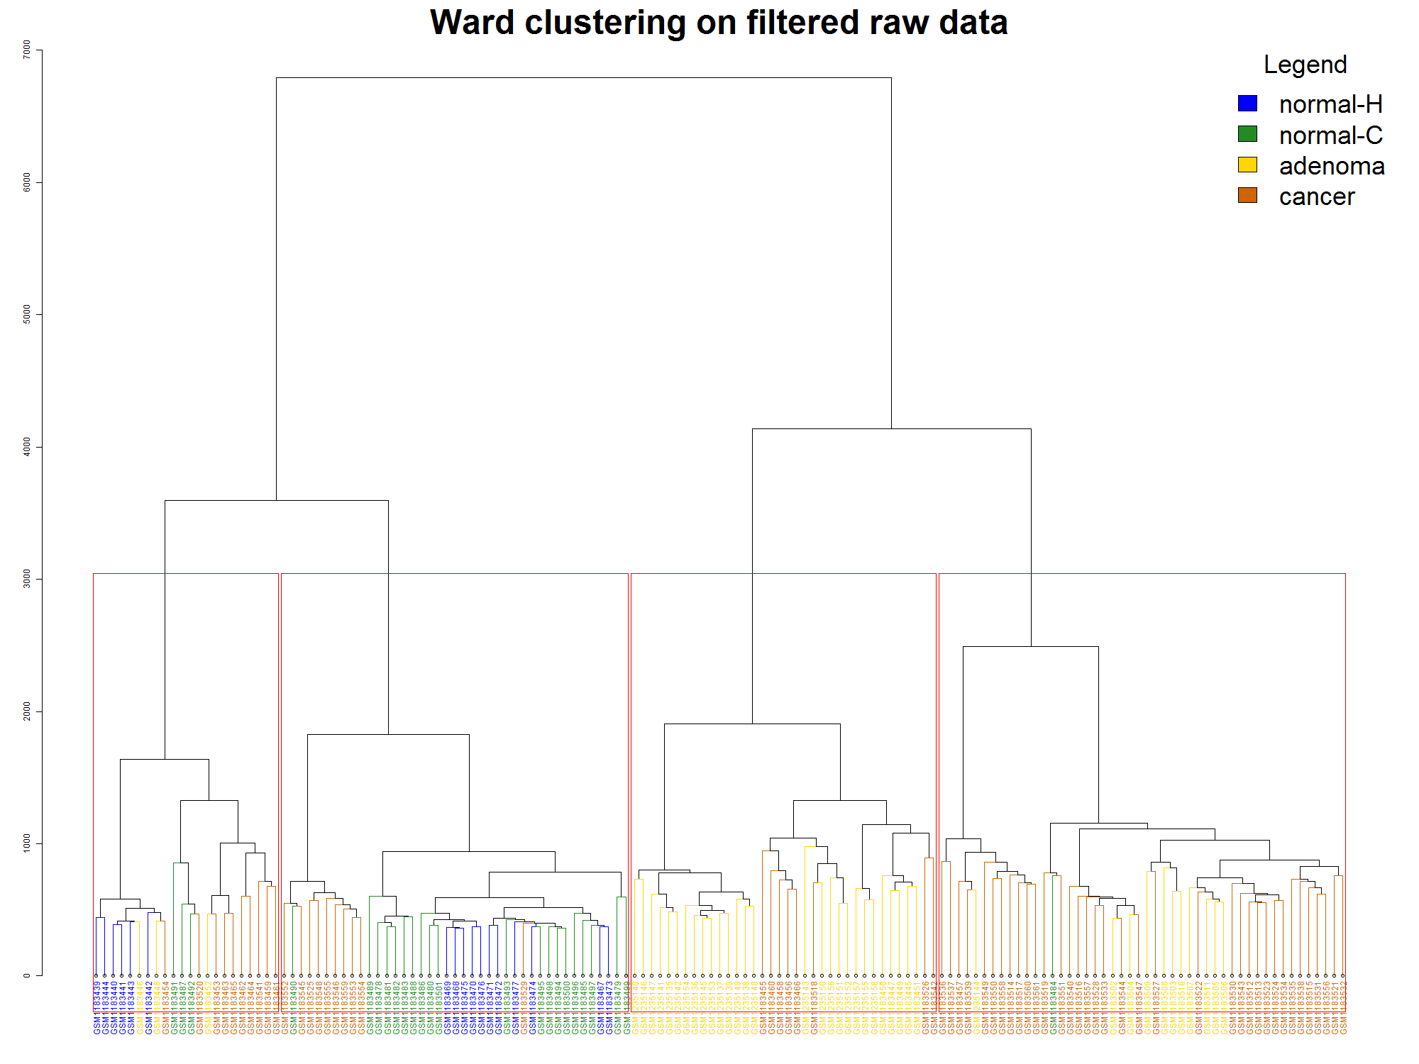
Identifying aberrant methylation patterns underlying colorectal cancer progression
 Beryl Zhuang  Eva Yap  Ka Ming Nip  Rashedul Islam  Santina Lin
 Research Question 
 Data Normalization 
 Differential Methylation Analysis 
Changes in DNA methylation is one of the early molecular events involved in cancer progression [1]. In this study, we identified differentially methylated CGI underlying CRC progression.
Colorectal cancer (CRC) is associated with the accumulation of aberrant DNA methylation [1]. This includes hyper-methylation of CpG islands (CGI) which are sequences with high CpG fraction (>50%) located within gene promoters resulting in transcriptional silencing of tumour suppressor genes [1].
normal
Figure 2. Density plot of average beta values before and after quantile normalization.
Figure 3. Ward’s method of hierarchical clustering using the Euclidean distance function on normalized average beta values for CpG islands.
Figure 4. Heatmaps of M values top hits from limma at FDR of 1e-7.
Figure 5. Top 3 differentially methylated and 3 non-differentially methylated CpG islands for each comparison.
adenoma
DM?
DM?
cancer
DM?
 Dataset 
Our Illumina HumanMethylation450 array dataset from the Gene Expression Omnibus (GSE48684) consists of 147 colon samples, each with recorded beta values of 485,577 probes [2].
Table 1. Description of 147 colon samples.
Group | Description | Sample Size
normal-H | normal colon from healthy individuals | 17
normal-C | normal colon from CRC patients | 24
adenoma | colon adenoma | 42
cancer | tumor colon from CRC patients | 64
 Exploratory Analysis 
Figure 1. Ward’s method of hierarchical clustering using the Euclidean distance function after removing probes in chrX and those not in CpG islands.
 Functional Enrichment Analysis 
 References 
 Conclusion 
Li, J. et al. "Epigenetic Biomarkers: Potential Applications in Gastrointestinal Cancers." ISRN gastroenterology. Mar 6;2014:464015.
Luo, Y. et al. "Differences in DNA methylation signatures reveal multiple pathways of progression from adenoma to colorectal cancer." Gastroenterology. 2014 Aug;147(2):418-29.e8.
Maksimovic, J. et al. "SWAN: Subset-quantile within array normalization for illumina infinium HumanMethylation450 BeadChips." Genome Biol. 2012 Jun 15;13(6):R44.
Yasukochi, Y. et al. "X chromosome-wide analyses of genomic DNA methylation states and gene expression in male and female neutrophils." Proc Natl Acad Sci U S A. 2010 Feb 23;107(8):3704-9
TODO: Conclusion…
 Acknowledgements 
UBC 2015 W2 STAT 540 instructors and teaching assistants.

