Slide 1

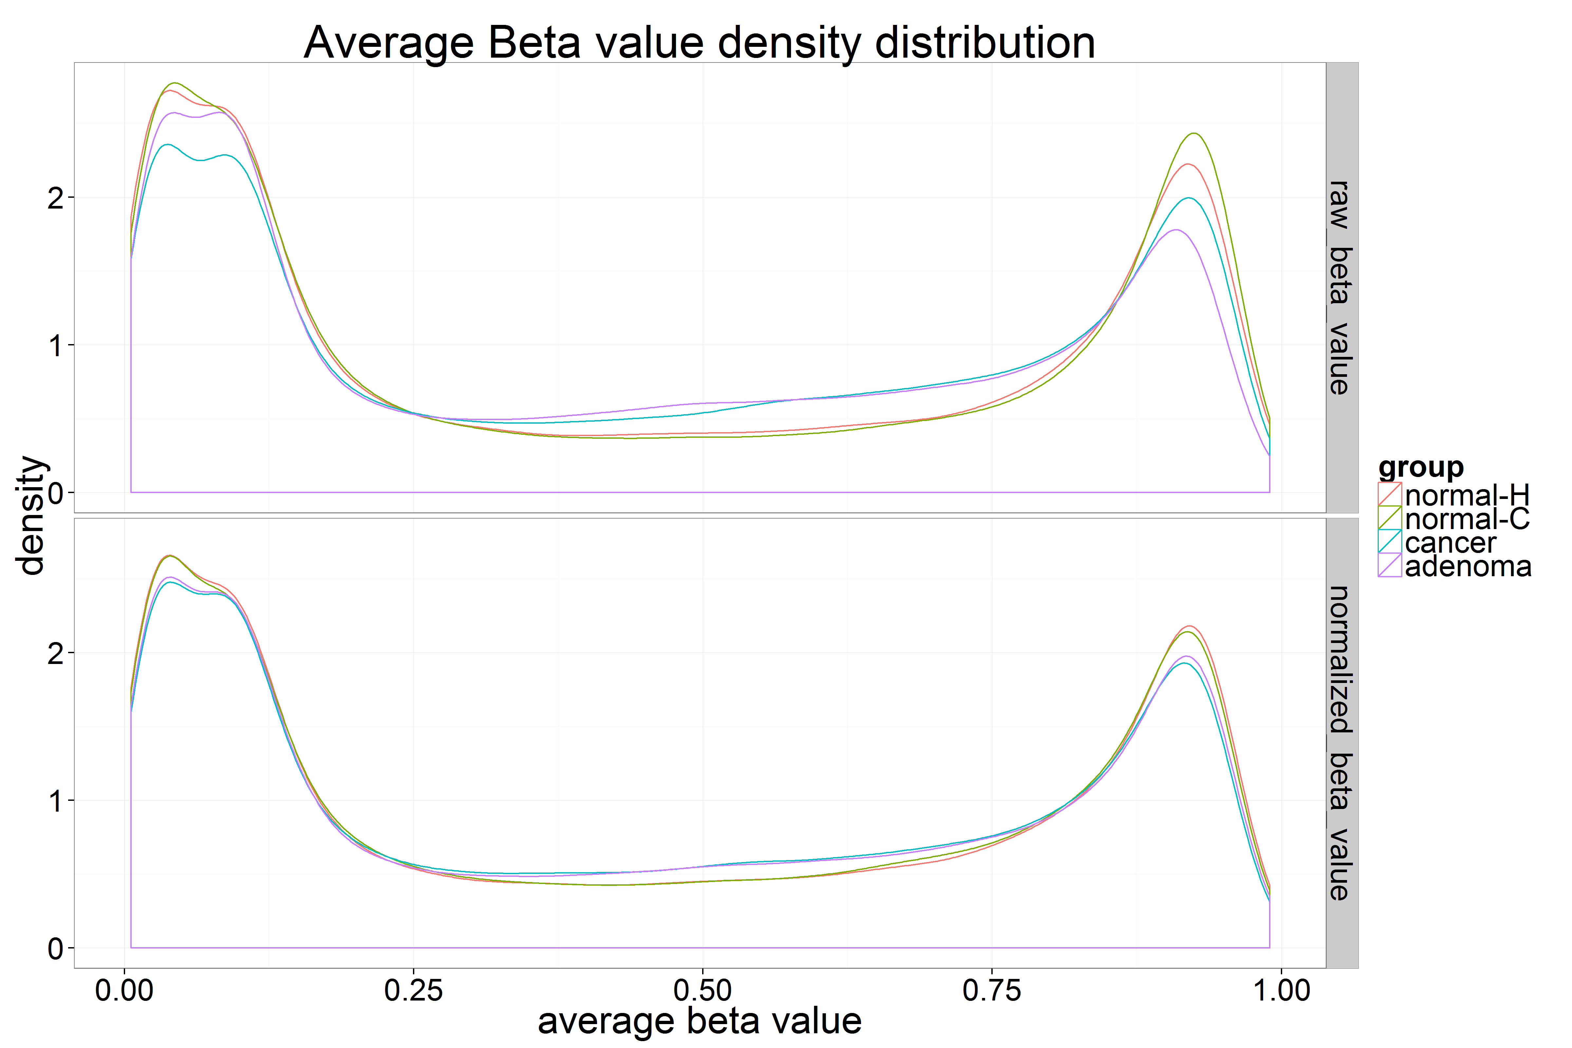
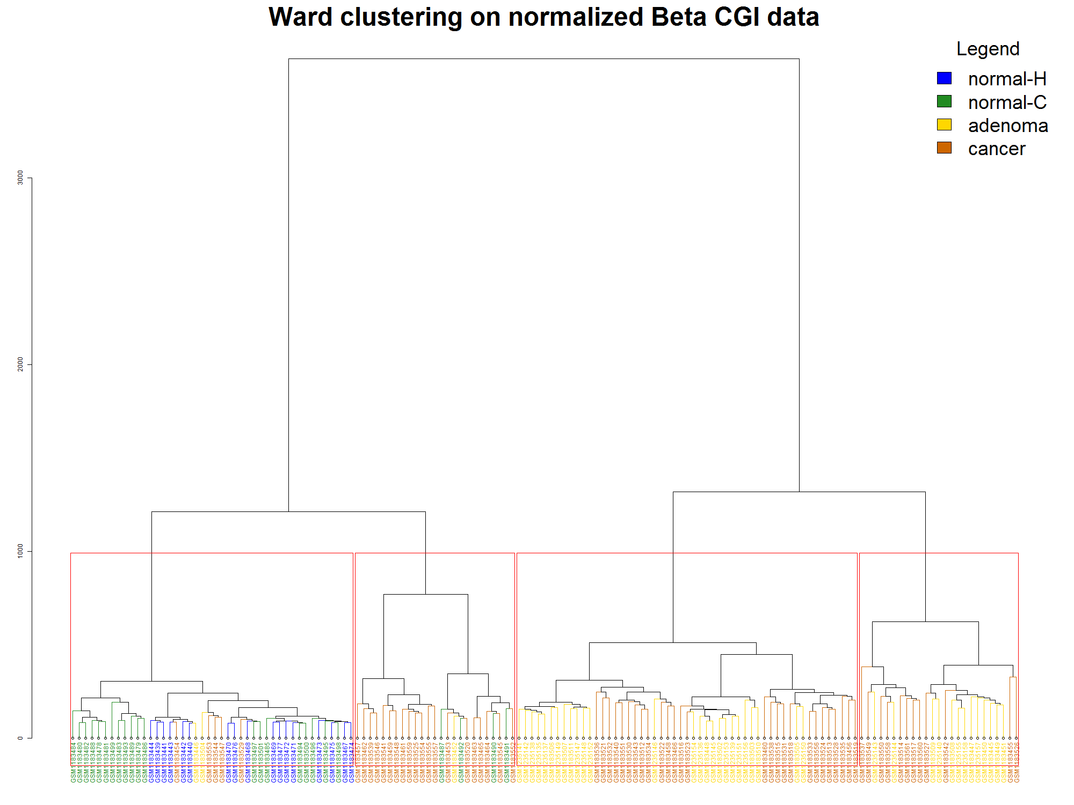
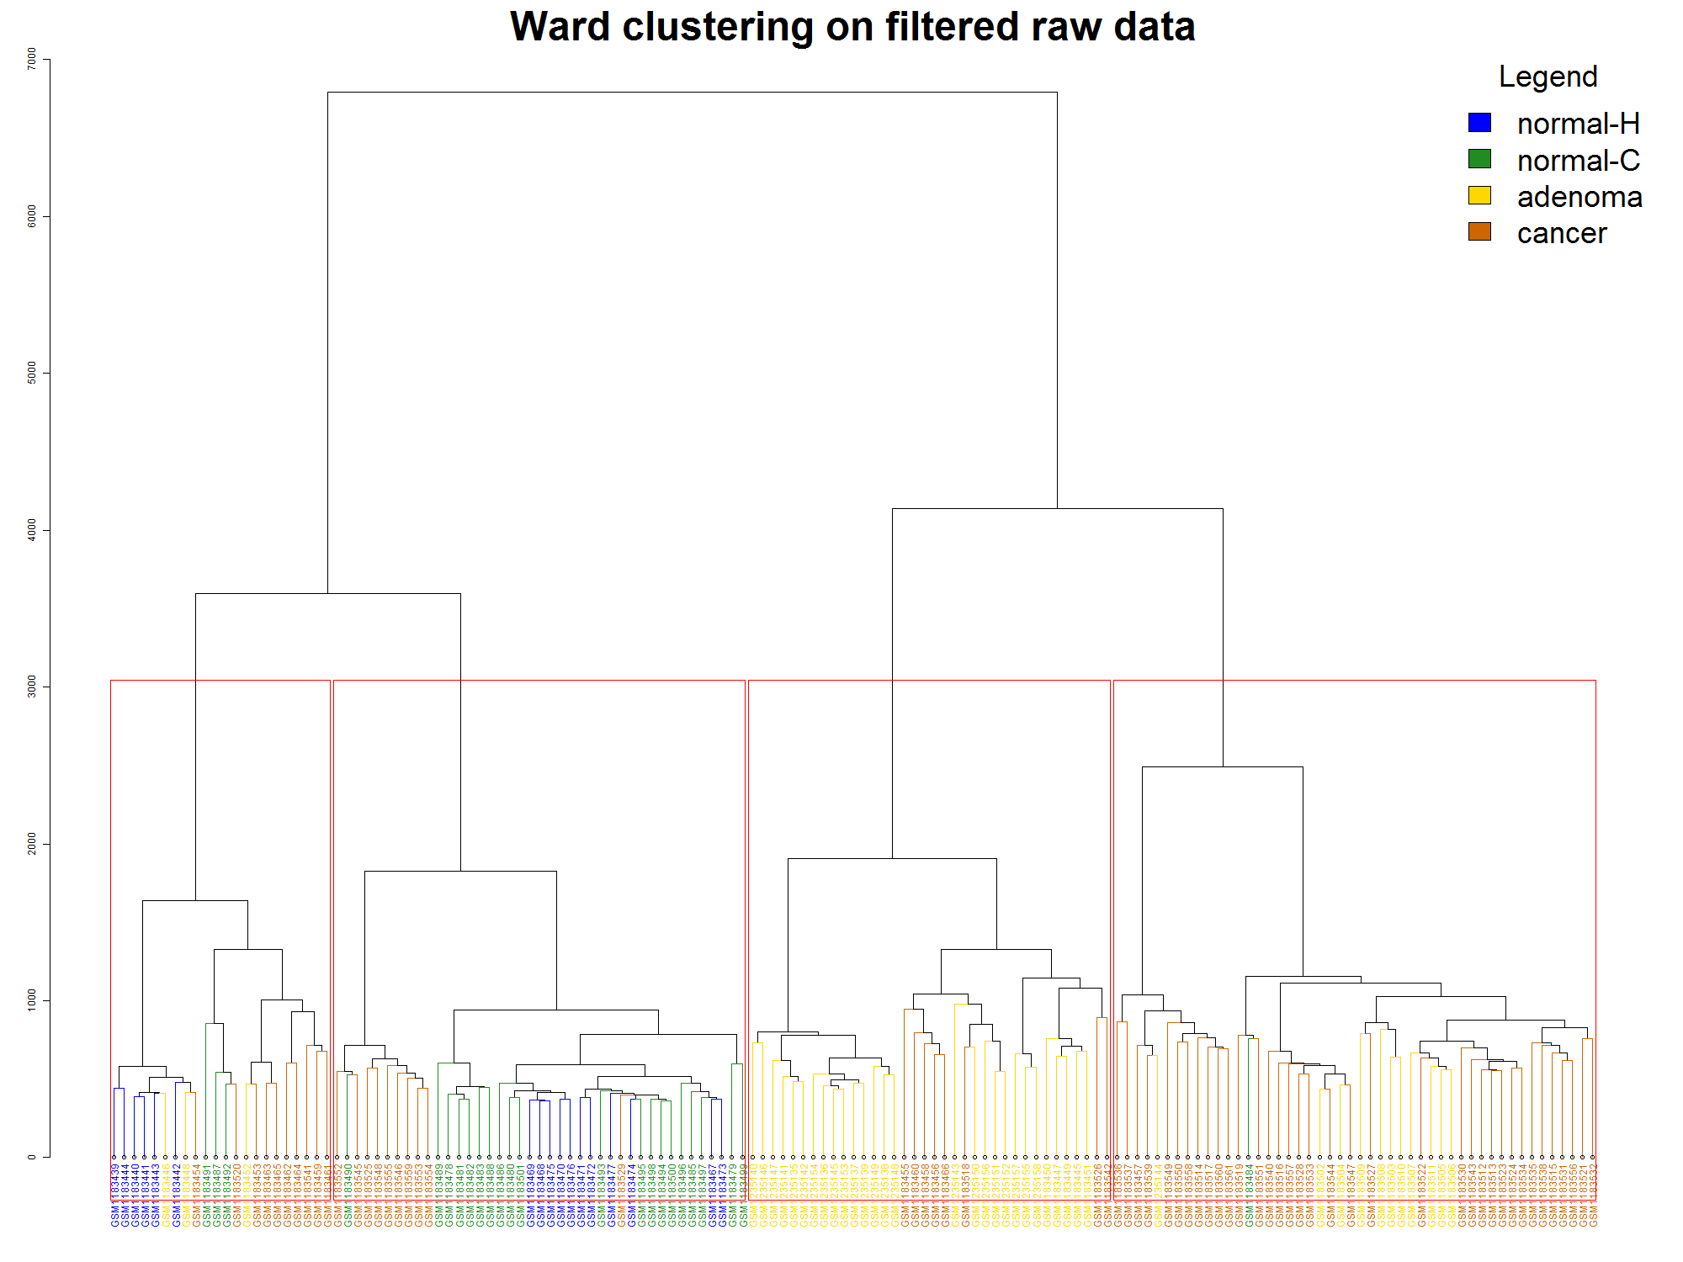
Identifying aberrant methylation patterns underlying colorectal cancer progression
 Beryl Zhuang  Eva Yap  Ka Ming Nip  Rashedul Islam  Santina Lin
 Research Question 
 Data Normalization 
 Differential Methylation Analysis 
Genetic alteration and epigenetics modifications contribute to the pathogenesis of colorectal cancer (CRC) [1]. The best-characterized epigenetic process DNA methylation, regulates gene transcription. For example, aberrant DNA methylation can lead to malignancy by hypermethylation of CpG islands resulting in transcriptional silencing of tumour suppressor genes [1].
In this study, we examined DNA methylation patterns in CRC progression in order to identify differentially methylated genes that might play a role in CRC, following commonly used methylation analysis pipeline [2].
Figure 2. Average beta value density distribution comparing distributions before and after normalization.
Figure 3. Hierarchical clustering using ward method and Euclidean distance function on normalized and averaged beta values for each CpG island. The results shows a better clustering than that in Figure 1.
DMA…
 Dataset 
Our Illumina HumanMethylation450 array dataset from the Gene Expression Omnibus (GSE48684) consists of 147 colon samples, each with recorded beta values of 485,577 probes [2].
Table 1. Description of 147 colon samples.
Group | Description | Sample Size
normal-H | normal colon from healthy individuals | 17
normal-C | normal colon from CRC patients | 24
adenoma | colon adenoma | 42
cancer | tumor colon from CRC patients | 64
 Exploratory Analysis 
 Functional Enrichment Analysis 
Figure 1. Hierarchical clustering using ward method and Euclidean distance function on raw data filtered by probes not in the X-chromosome.
FEA…
 References 
 Conclusion 
Li, J. et al. "Epigenetic Biomarkers: Potential Applications in Gastrointestinal Cancers." ISRN gastroenterology. Mar 6;2014:464015.
Luo, Y. et al. "Differences in DNA methylation signatures reveal multiple pathways of progression from adenoma to colorectal cancer." Gastroenterology. 2014 Aug;147(2):418-29.e8.
Maksimovic, J. et al. "SWAN: Subset-quantile within array normalization for illumina infinium HumanMethylation450 BeadChips." Genome Biol. 2012 Jun 15;13(6):R44.
Yasukochi, Y. et al. "X chromosome-wide analyses of genomic DNA methylation states and gene expression in male and female neutrophils." Proc Natl Acad Sci U S A. 2010 Feb 23;107(8):3704-9
Conclusion…
 Acknowledgements 
UBC 2015 W2 STAT 540 instructors and teaching assistants.

