Slide 1


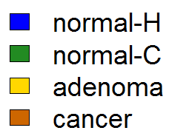
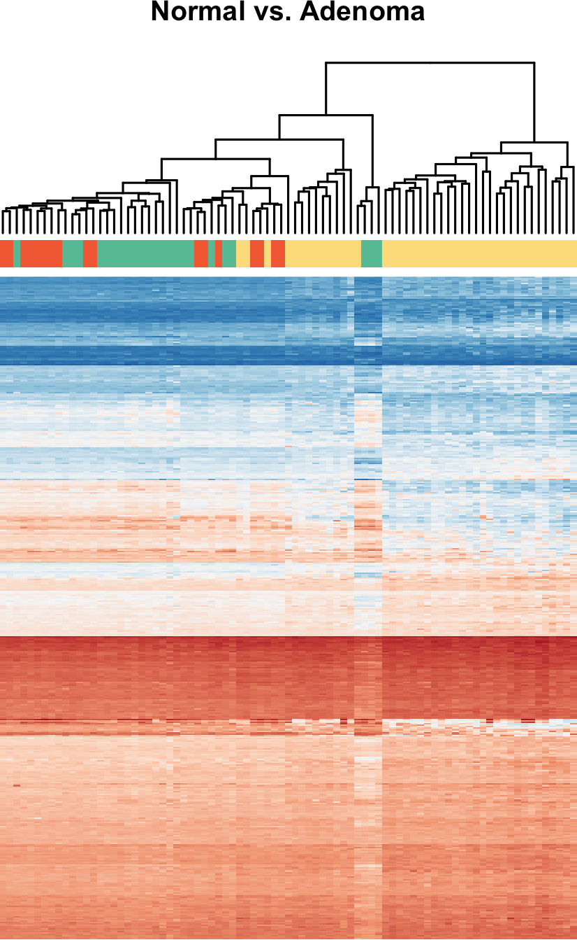
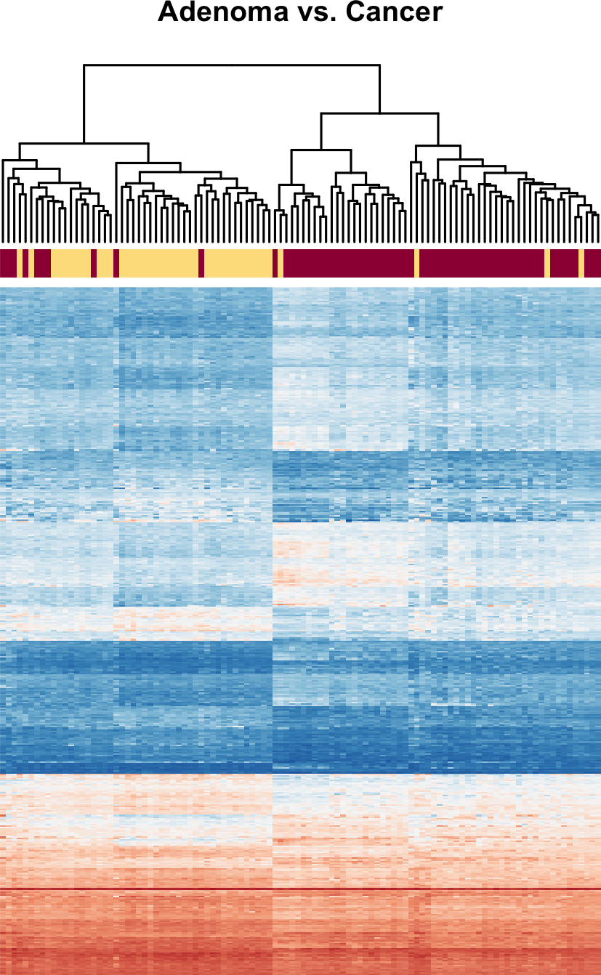

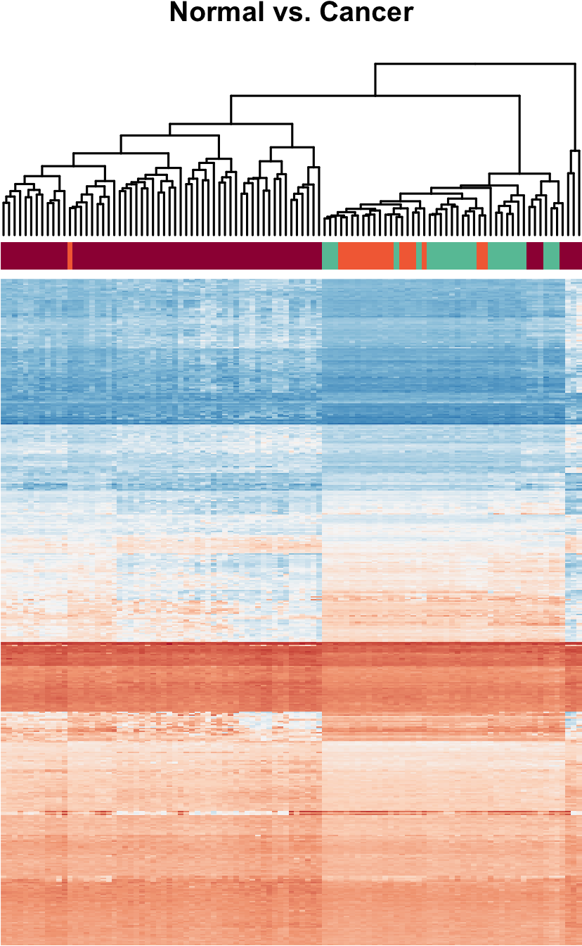
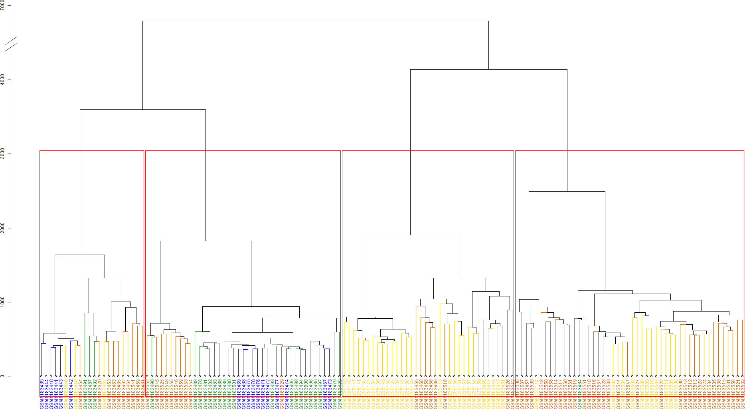
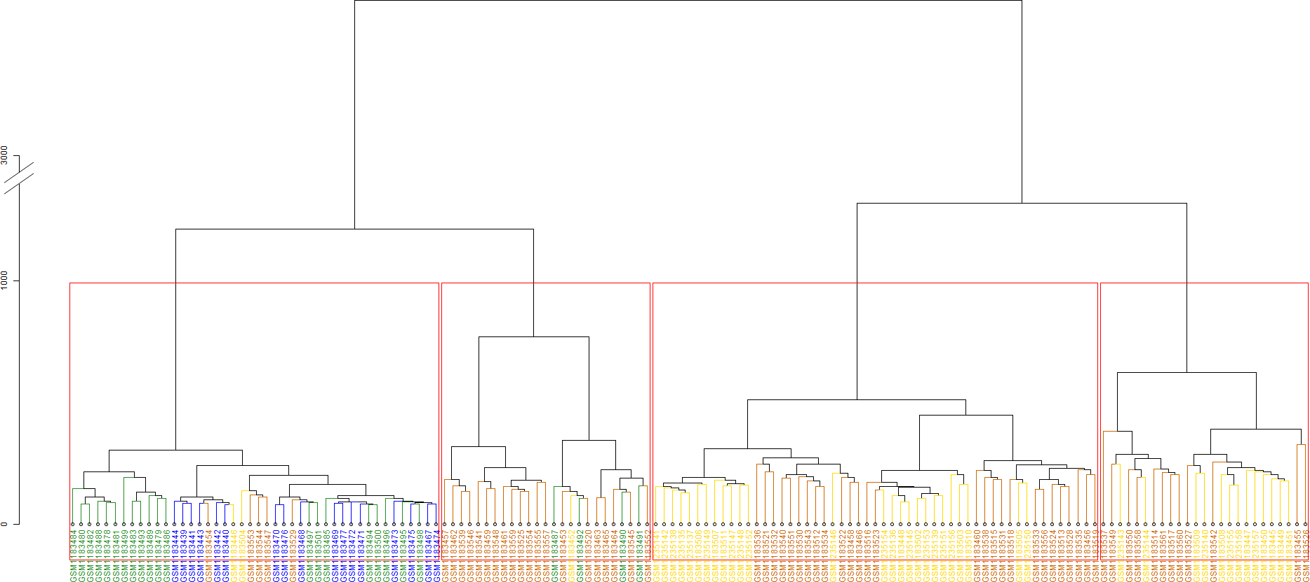
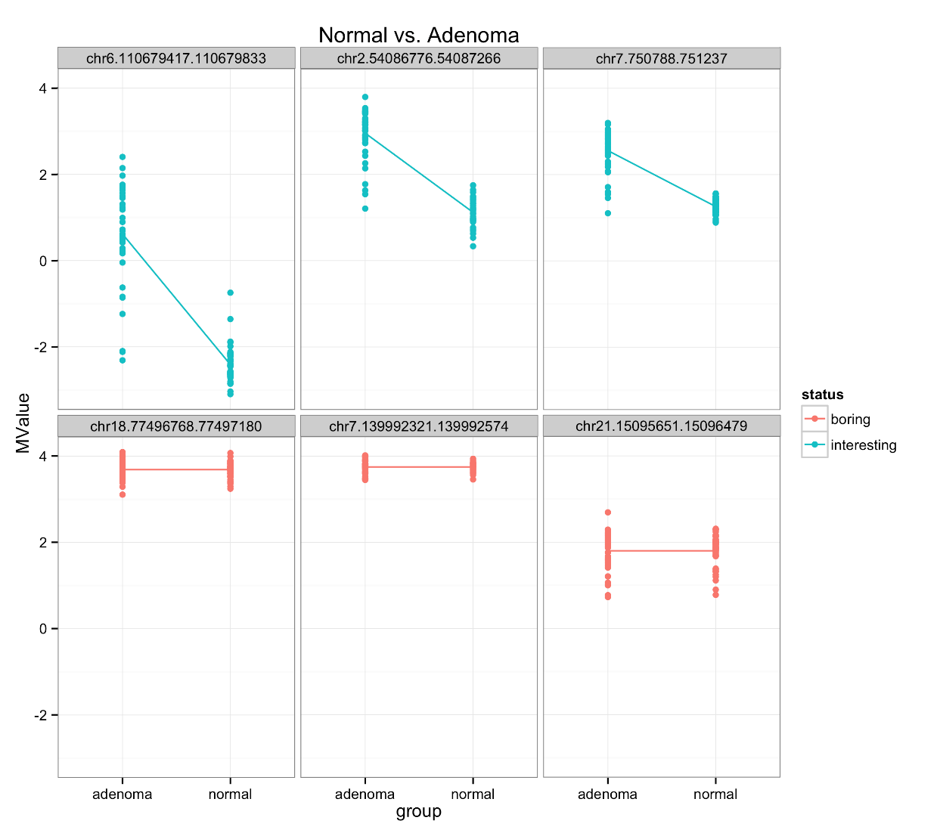
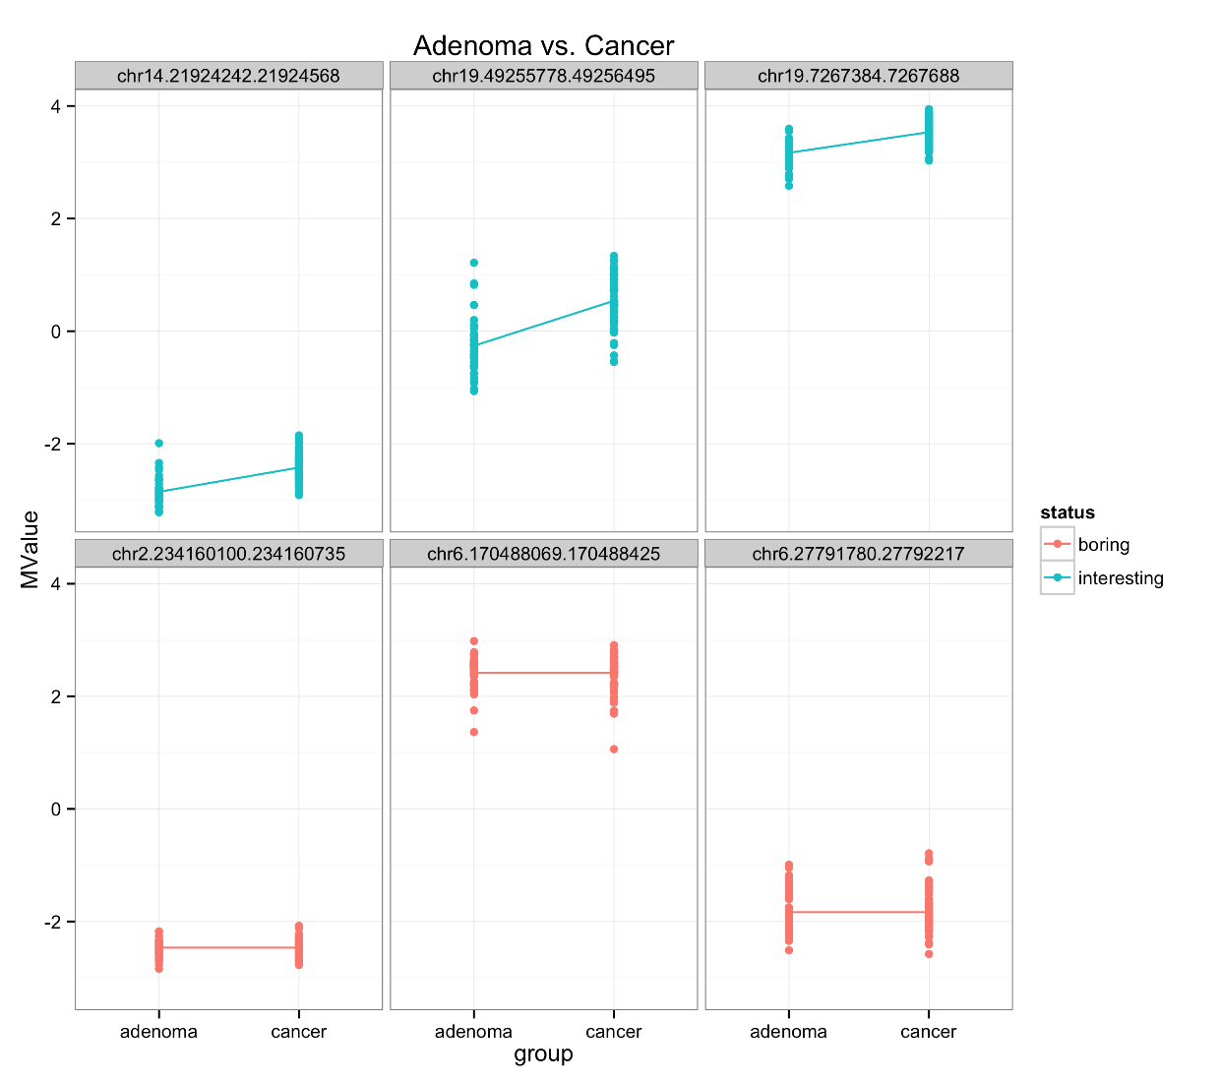
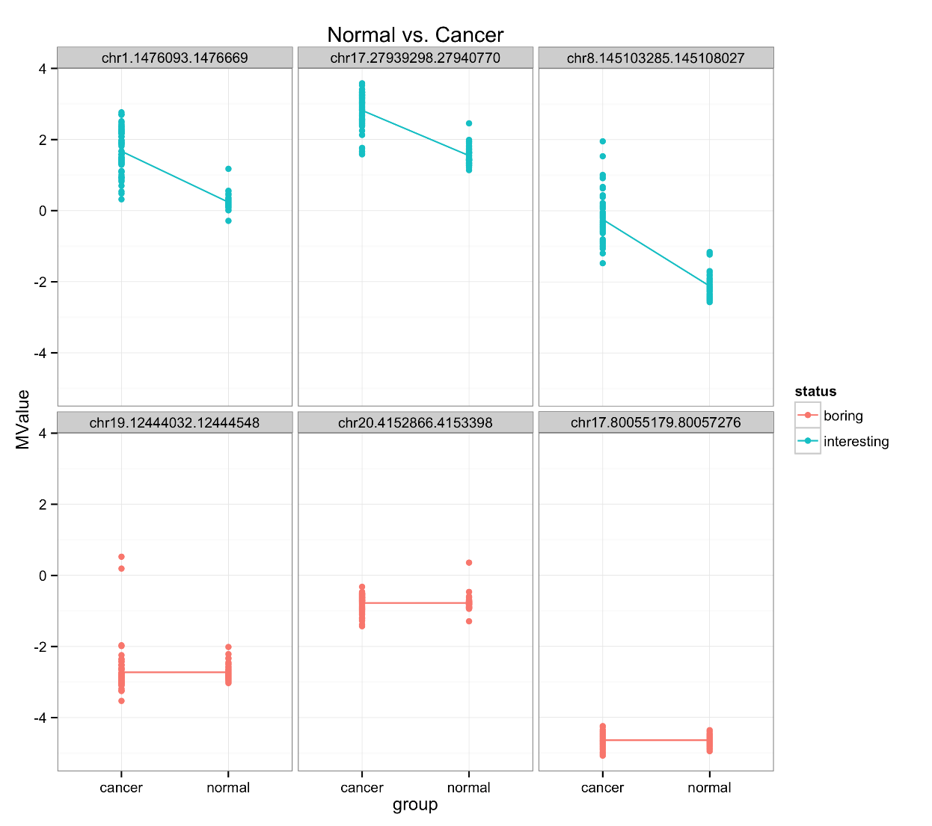
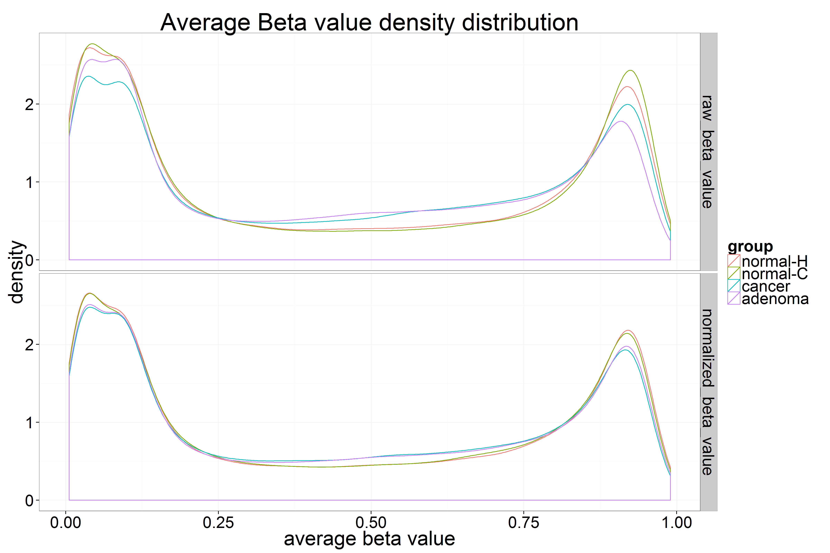
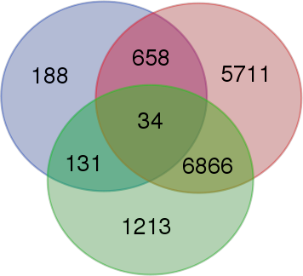
Identifying aberrant methylation patterns underlying colorectal cancer progression
Beryl Zhuang  Eva Yap  Ka Ming Nip  Rashedul Islam  Santina Lin
The University of British Columbia, Vancouver, BC, Canada
 Research Question 
 Exploratory Analysis 
 Differential Methylation Analysis 
Aberrant DNA methylation can lead to malignancy by hyper-methylation of CpG islands (CGIs) resulting in transcriptional silencing of tumor suppressor genes. CGIs are sequences with high CpG fractions (>50%) located within gene promoters and methylation at these sites promotes association of methyl-binding proteins and subsequent recruitment of transcriptional repressors^{1,2}.
normal
(a)
adenoma
DM?
DM?
CpG islands
cancer
DM?
Colorectal cancer (CRC) accounts for the second highest cancer-related mortality among men and third among women in Canada, and it progresses from precursor lesions such as adenomas^{1,3}. For our project, we compared methylation patterns between normal mucosa, adenoma, and colorectal tumor. By identifying differentially methylated (DM) CGIs between these three groups, we hope to determine aberrant methylation underlying CRC progression.
FDR < 3.94e-17
FDR < 9.51e-6
FDR < 3.36e-13
 Dataset 
(b)
Figure 3. Heatmaps of M values of top 450 hits from Bioconductor Linear Models for Microarray Data (limma).
Table 1. Illumina HumanMethylation450 array dataset of 147 colon samples from the Gene Expression Omnibus GSE48684.
Group | Description | Sample Size
normal-H | normal colon from healthy individuals | 17
normal-C | normal colon from CRC patients | 24
adenoma | colon adenoma | 42
cancer | tumor colon from CRC patients | 64
 Data Normalization 
Figure 4. Top 3 differentially methylated and 3 non-differentially methylated CGIs for each pairwise group comparison.
Figure 2. Unsupervised hierarchical clustering using Ward’s method on (a) raw beta values after removing probes in chrX and those not in CGIs and (b) normalized beta values averaged across each CGI⁴.
Adenoma vs Cancer
Normal vs Adenoma
Y = Xα₁ + α₀ + ε
where:
Y = methylation levels (M value)
X = design matrix indicating different
sample groups
α₁ = change in mean M value
α₀ = mean M value for reference
sample group
ε = error ~ N(0, σ²)
 Functional Enrichment Analysis 
Table 2. Enrichment of GO terms in differentially methylated CGIs according to Fisher’s exact test and Kolmogorov-Smirnov test.
GO.ID | Term | Annotated | Significant | Expected | Rank in classic Fisher | Classic Fisher | Classic KS
GO:0003674 | molecular_function | 15366 | 11 | 9.33 | 106 | 0.330 | < 1e-30
GO:0005001 | transmembrane receptor protein tyrosine phosphatase (TR-PTP) activity | 98 | 0 | 0.06 | 123 | 1.000 | 1.1e-11
GO:0046332 | SMAD binding | 128 | 0 | 0.08 | 124 | 1.000 | 1.8e-10
GO:0042288 | MHC class I protein binding | 10 | 0 | 0.01 | 126 | 1.000 | 0.0094
Normal vs Cancer
Figure 5. Venn diagram of differentially methylated CGIs at FDR < 1e-4.
Equation 1. Linear model of methylation level of each CGI using sample groups as single covariate.
 Conclusion 
Figure 1. Density plot of average beta values for each probe across all samples before and after quantile normalization.
TR-PTPs carry out tumour-suppressing activity through antagonizing RTK signaling and inactivation of TR-PTP has been implicated in CRC⁵.
SMAD proteins are transcriptional activators and their suppression leads to the progression of various cancer types including CRC⁶.
Most cancer cells express low levels of MHC class I molecules to evade immune clearance⁷.
Enrichment of GO terms like molecular function and binding (not shown) are uninformative and likely caused by over-citations.
We identified 34 DM CGIs associated with 21 genes in our pairwise comparisons between sample groups. Enriched functions are implicated in progression of various cancer types including CRC. Given that these DM CGIs are also identified in adenomas compared to normal mucosa, these aberrant methylation patterns could be markers for early detection, risk assessment, and disease monitoring of CRC.
Acknowledgements
UBC 2015 W2 STAT 540 instructors and teaching assistants.
References
Li, J. et al. "Epigenetic Biomarkers: Potential Applications in Gastrointestinal Cancers." ISRN gastroenterology. Mar 6; 2014:464015.
Luo, Y. et al. "Differences in DNA methylation signatures reveal multiple pathways of progression from adenoma to colorectal cancer." Gastroenterology. 2014 Aug; 147(2):418-29.e8.
Canadian Cancer Society’s Advisory Committee on Cancer Statistics. Canadian Cancer Statistics 2014. Toronto, ON: Canadian Cancer Society; 2014
Yasukochi, Y. et al. "X chromosome-wide analyses of genomic DNA methylation states and gene expression in male and female neutrophils." Proc Natl Acad Sci U S A. 2010 Feb; 107(8):3704-9.
Ostman, A. et al. "Protein-tyrosine phosphatases and cancer." Nat Rev Cancer. 2006 Apr; 6(4):307-20.
Derynck, R. et al. “ TGF-β signaling in tumor suppression and cancer progression.” Nat Genet. 2001 Oct; 29(2): 117-29.
Garcia-Lora, A. et al. “MHC Class I Antigens, Immune Surveillance, and Tumour Immune Escape.” J Cell Physiol. 2003 Jun; 195(3): 346-55.

