Slide 1
Intro to NLP
# named entity recognition
150116884 Esra Polat
150116071 Nur Deniz Çaylı
150116028 Minel Saygısever

Slide 2









Detail of Implementation
This program was implemented with Python 3.6 on the Kaggle Notebook using the below libraries and compiled with GPU. We used the openly shared github codes of scientific conference or journal publications.

Slide 3
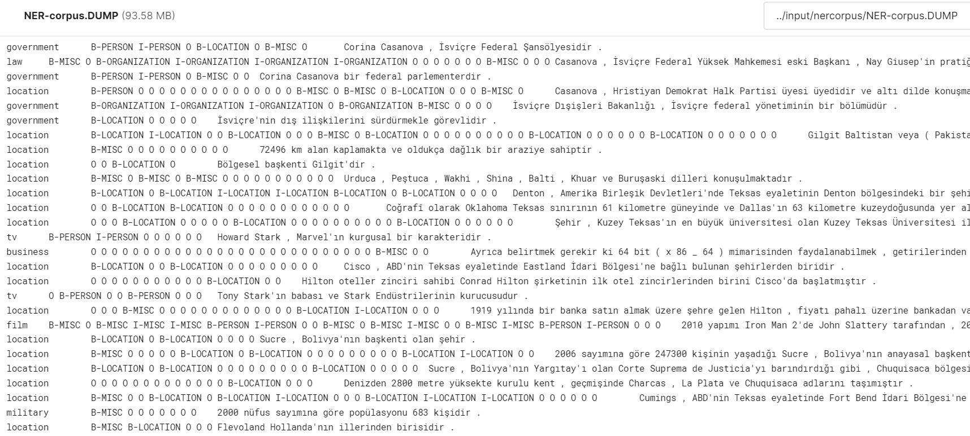
Detail of Dataset
We used the TBMM Dataset labelled versions. We convert to appropriate format and save it as csv file.

Slide 4
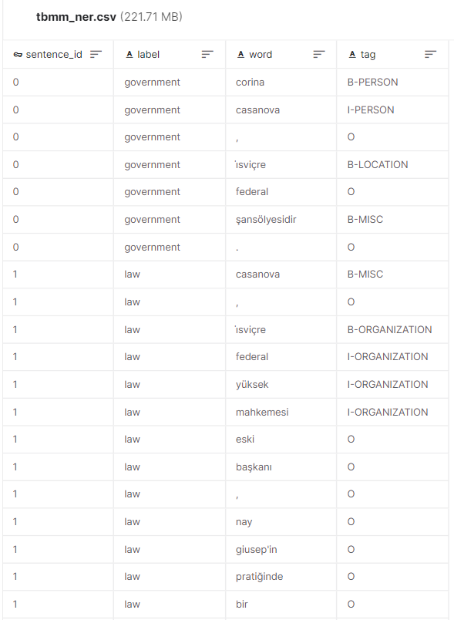
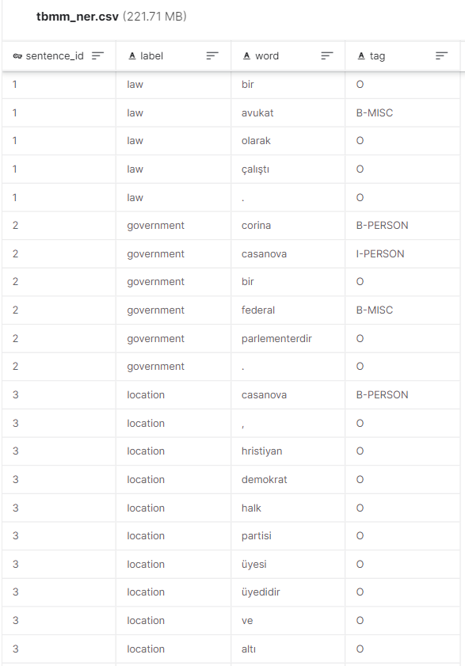

Formatting Dataset
import csv
# reading dump file
ner_rows = []
sentence_id = 0
with open("../input/nercorpus/NER-corpus.DUMP", "r") as ner_file:
for line in ner_file:
label = line.split('\t')[0]
tags = line.split('\t')[1].split()
words = line.split('\t')[2].split('\n')[0].split()
for tag, word in zip(tags, words):
ner_rows.append([sentence_id, label, word.lower(), tag])
sentence_id+=1
# dump to csv for appropriate format
fields = ['sentence_id', 'label', 'word', 'tag']
filename = "tbmm_ner.csv"
with open(filename, 'w') as csvfile:
csvwriter = csv.writer(csvfile)
csvwriter.writerow(fields)
csvwriter.writerows(ner_rows)

Slide 5
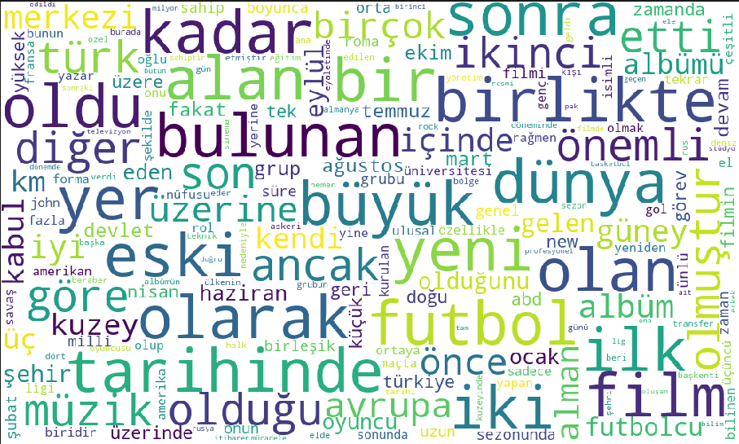
Data Observe
We can see the word cloud of the most common 500 word using in the dataset.

Slide 6
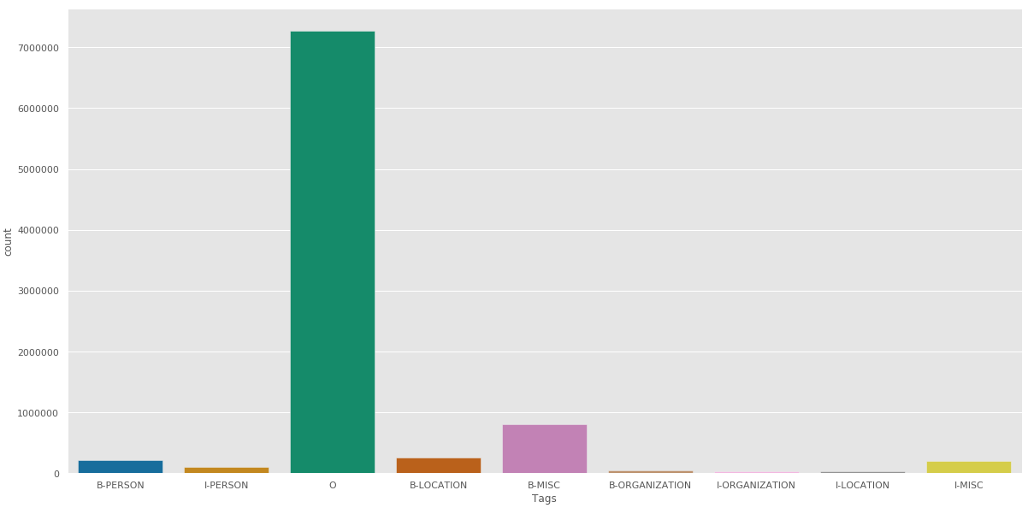
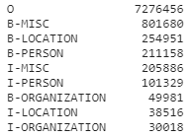
Data Observe
We can see the distribution of tags.

Slide 7
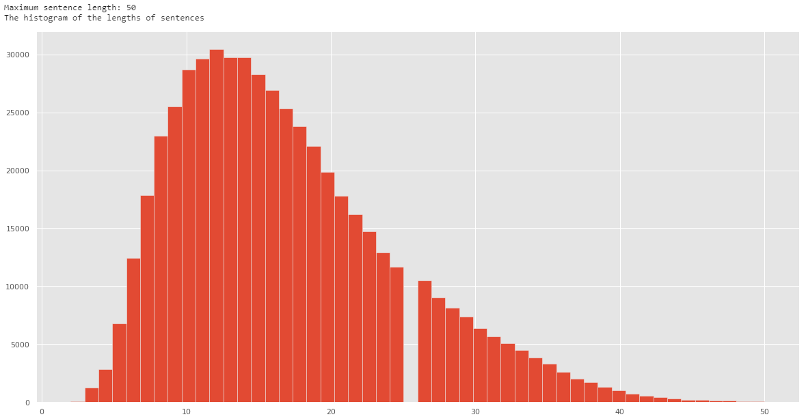
Data Observe

Slide 8
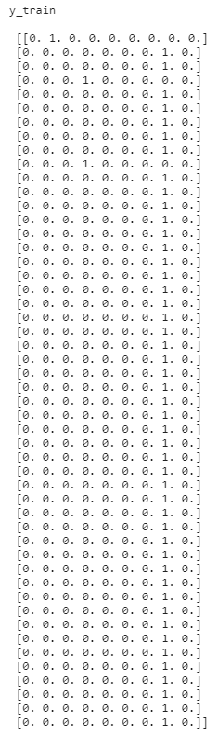
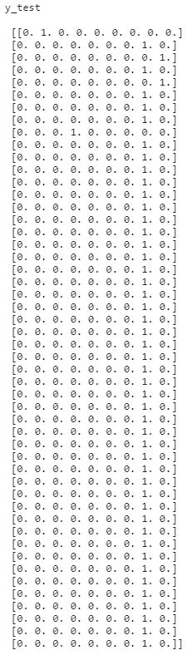
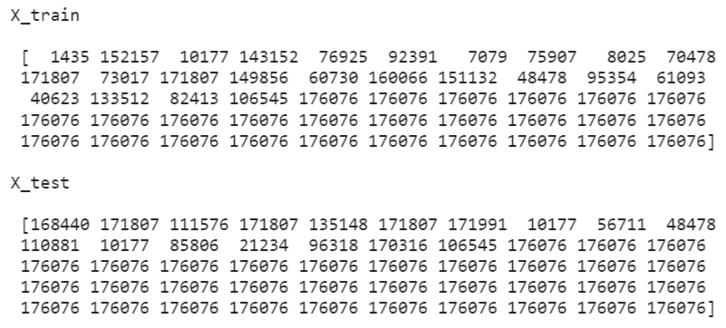
Train and Test Sets
X = [[word2idx[w[1]] for w in s] for s in sentences]
X = pad_sequences(maxlen=maxlen, sequences=X, padding="post",value=n_words - 1)
y = [[tag2idx[w[2]] for w in s] for s in sentences]
y = pad_sequences(maxlen=maxlen, sequences=y, padding="post", value=tag2idx["O"])
y = [to_categorical(i, num_classes=n_tags) for i in y]
X_train, X_test, y_train, y_test = train_test_split(X, y, test_size=0.3)
print("X_train", X_train[2])
print("X_test", X_test[2])
print("y_train", y_train[2])
print("y_test", y_test[2])

Slide 9
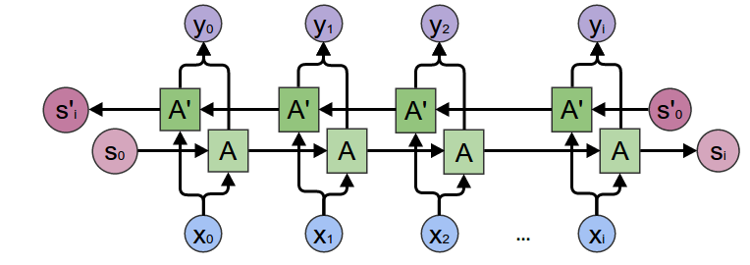
BI-LSTM
(Bidirectional Recurrent Neural Networks)
Bidirectional recurrent neural networks(RNN) are really just putting two independent RNNs together. This structure allows the networks to have both backward and forward information about the sequence at every time step. Using bidirectional will run your inputs in two ways, one from past to future and one from future to past and what differs this approach from unidirectional is that in the LSTM that runs backward you preserve information from the future and using the two hidden states combined you are able in any point in time to preserve information from both past and future.

Slide 10
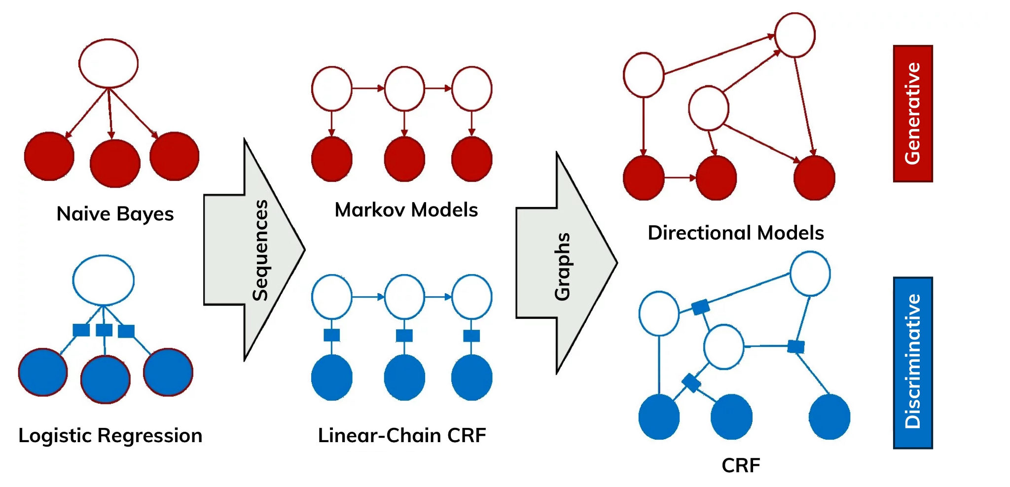
CRF (Conditional Random Fields)
CRF is a discriminant model for sequences data similar to MEMM. It models the dependency between each state and the entire input sequences. Unlike MEMM, CRF overcomes the label bias issue by using global normalizer.
In this article, we are focusing on linear-chain CRF which is a special type of CRF that models the output variables as a sequence. This fits our use case of having sequential inputs. For example, in natural language processing, linear chain CRFs are popular, which implement sequential dependencies in the predictions. In image processing the graph typically connects locations to nearby and/or similar locations to enforce that they receive similar predictions.

Slide 11
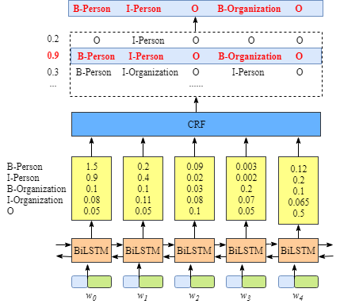
biLSTM + CRF
input = Input(shape=(50,))
word_embedding_size = 150
# Embedding Layer
model = Embedding(input_dim=n_words, output_dim=word_embedding_size, input_length=50)(input)
# BI-LSTM Layer
model = Bidirectional(LSTM(units=word_embedding_size,
return_sequences=True, dropout=0.5, recurrent_dropout=0.5, kernel_initializer= k.initializers.he_normal()))(model)
model = LSTM(units=word_embedding_size * 2, return_sequences=True,
dropout=0.5, recurrent_dropout=0.5,
kernel_initializer=k.initializers.he_normal())(model)
# TimeDistributed Layer
model = TimeDistributed(Dense(n_tags, activation="relu"))(model)
# CRFLayer
crf = CRF(n_tags)
out = crf(model)
model = Model(input, out)

Slide 12
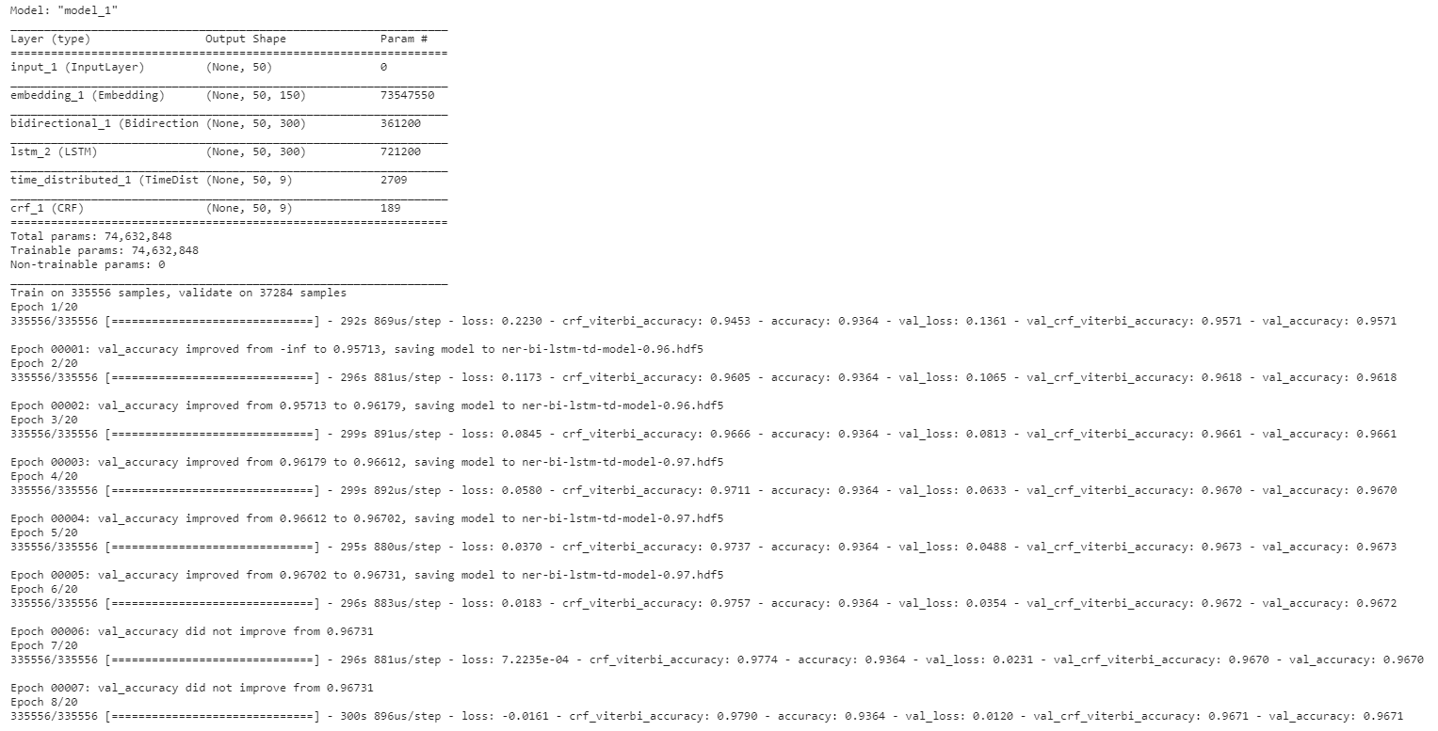
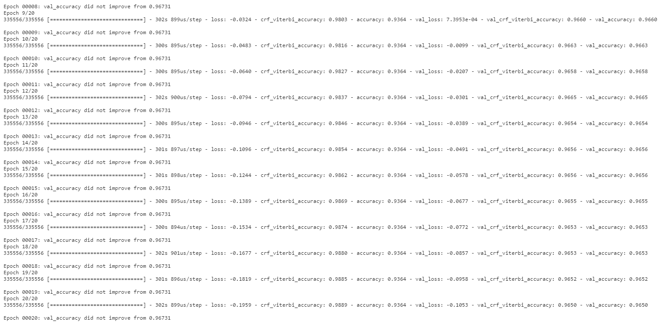

Slide 13
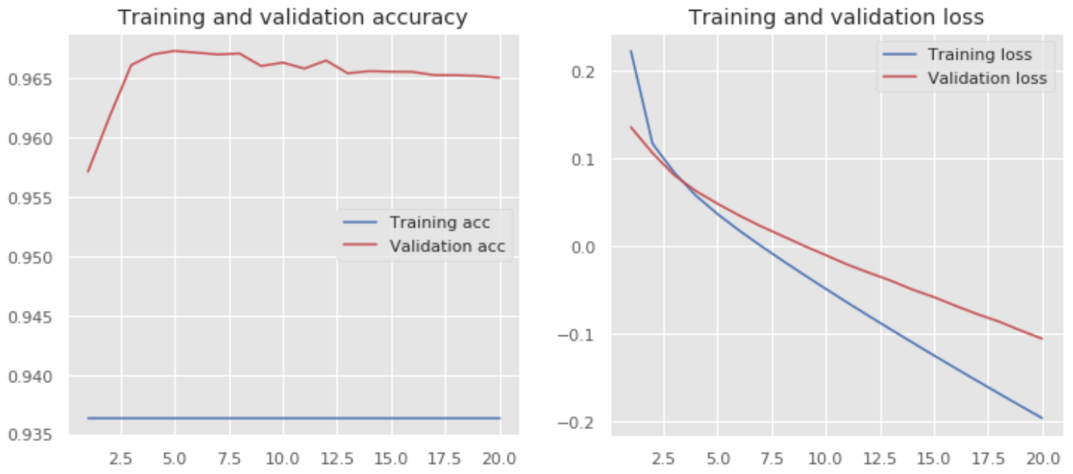
Our traning and validation graps and they look good.

Slide 14
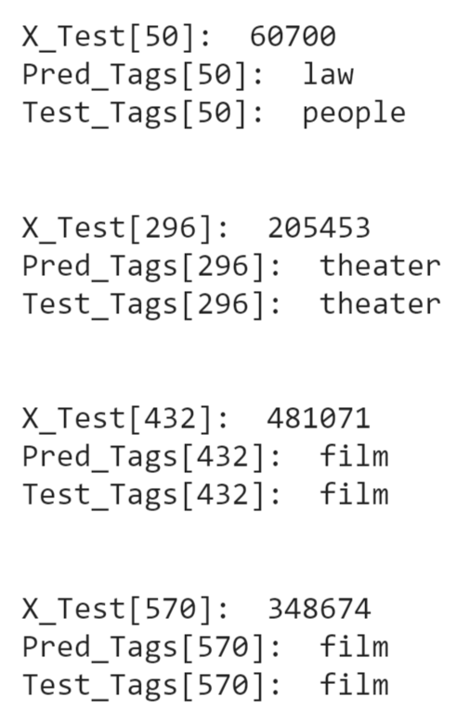
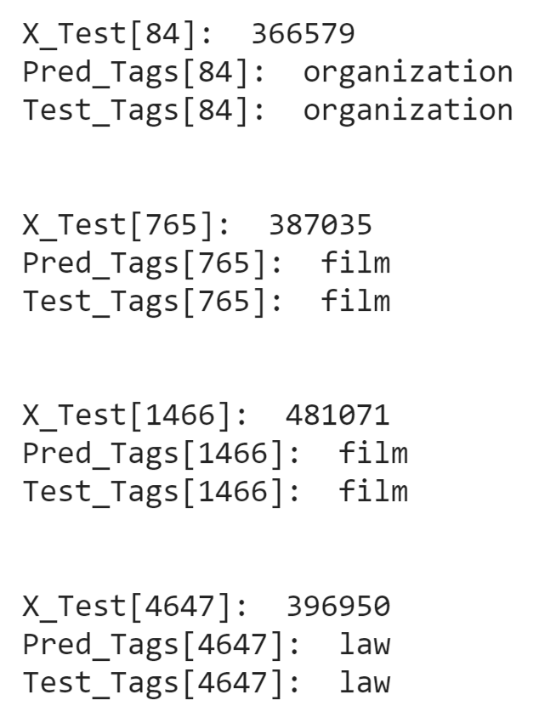
Prediction with Test Set
a few example

Slide 15
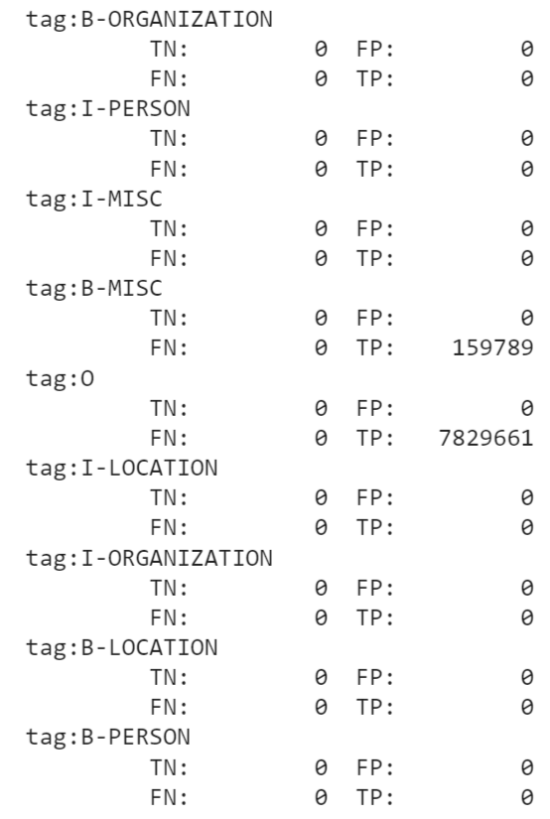
Sensitivity and Specificity

Slide 16
Utilized Resources
Conditional Random Field
Keras-based BiLSTM and CRF implement NER
Bidirectional LSTM
Building a Text Classification model using BiLSTM
Bi-LSTM
Sensitivity and Specificity

