Slide 1
Turkish NLP
#collocations
150116884 Esra Polat
150116071 Nur Deniz Çaylı
150116028 Minel Saygısever

Slide 2
Code Detail of Initializing
corpus = readFile('filtered-corpus/filtered-donemX.txt')
tokenized = [idx.lower() for idx in corpus.split()]
bigrams = nltk.collocations.BigramAssocMeasures()
trigrams = nltk.collocations.TrigramAssocMeasures()
bigramFinder = nltk.collocations.BigramCollocationFinder.from_words(tokenized)
trigramFinder = nltk.collocations.TrigramCollocationFinder.from_words(tokenized)
bigramFinder.apply_freq_filter(30)
trigramFinder.apply_freq_filter(30)
bigram_freq = bigramFinder.ngram_fd.items()
bigramFreqTable = pd.DataFrame(list(bigram_freq),columns=['bigram','freq']).sort_values(by='freq',ascending=False)
trigram_freq = trigramFinder.ngram_fd.items()
trigramFreqTable = pd.DataFrame(list(trigram_freq),columns=['trigram','freq']).sort_values(by='freq',ascending=False)

Slide 3


Method 1: Pointwise Mutual Information
The Pointwise Mutual Information (PMI) score for bigrams is:
For trigrams:
The main intuition is that it measures how much more likely the words co-occur than if they were independent. However, it is very sensitive to rare combination of words. For example, if a random bigram ‘abc xyz’ appears, and neither ‘abc’ nor ‘xyz’ appeared anywhere else in the text, ‘abc xyz’ will be identified as highly significant bigram when it could just be a random misspelling or a phrase too rare to generalize as a bigram. Therefore, this method is often used with a frequency filter.

Slide 4
Code Detail of PMI
_product = lambda s: reduce(lambda x, y: x * y, s)
_SMALL = 1e-20
NGRAM = 0 #Marginals index for the ngram count
UNIGRAMS = -2 #Marginals index for a tuple of each unigram count
TOTAL = -1 #Marginals index for the number of words in the data
@classmethod
def pmi(cls, *marginals):
return (_log2(marginals[NGRAM] * marginals[TOTAL] ** (cls._n - 1)) -
_log2(_product(marginals[UNIGRAMS])))

Slide 5
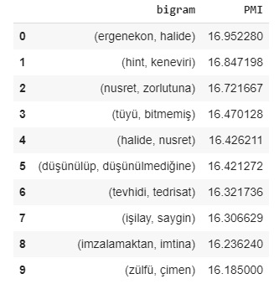
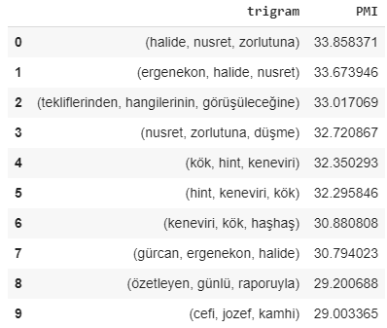
DONEM20

Slide 6
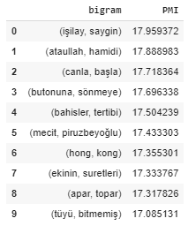
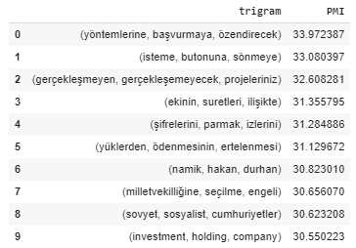
DONEM21

Slide 7
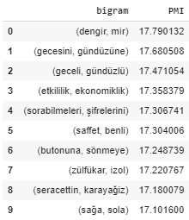
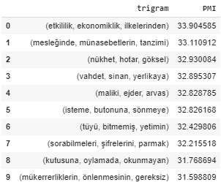
DONEM22

Slide 8
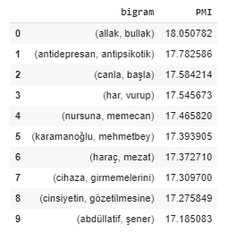
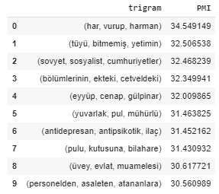
DONEM23

Slide 9
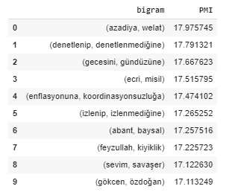
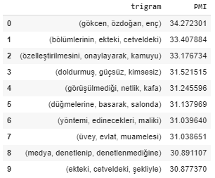
DONEM24

Slide 10
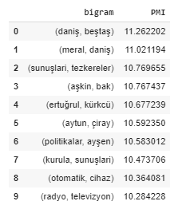
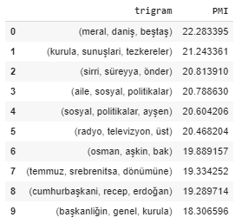
DONEM25

Slide 11
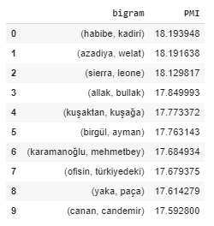
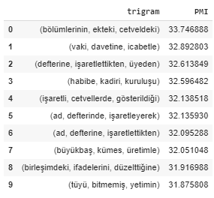
DONEM26

Slide 12
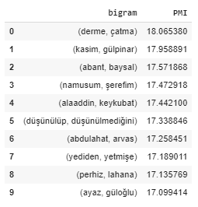
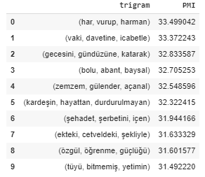
DONEM27

Slide 13

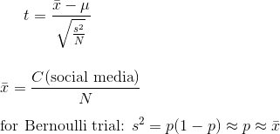
Method 2: The T-Test
The t test looks at the mean and variance of a sample of measurements, where the null hypothesis is that the sample is drawn from a distribution with mean .
Consider if we have a corpus with N words, and social and media have word counts C(social) and C(media) respectively. Assuming null hypothesis with social and media being independent:
The test statistic is:
However, the same problem occurs where pairs with prepositions, pronouns, articles etc. come up as most significant. Therefore, we need to apply the same filters from 1. Results are similar to the frequency count technique from 1. T-test has been criticized as it assumes normal distribution. Therefore, we will also look into the chi-square test.

Slide 14
Code Detail of T-Test
_product = lambda s: reduce(lambda x, y: x * y, s)
_SMALL = 1e-20
NGRAM = 0 #Marginals index for the ngram count
UNIGRAMS = -2 #Marginals index for a tuple of each unigram count
TOTAL = -1 #Marginals index for the number of words in the data
@classmethod
def student_t(cls, *marginals):
return ((marginals[NGRAM] -
_product(marginals[UNIGRAMS]) /
(marginals[TOTAL] ** (cls._n - 1))) /
(marginals[NGRAM] + _SMALL) ** .5)

Slide 15
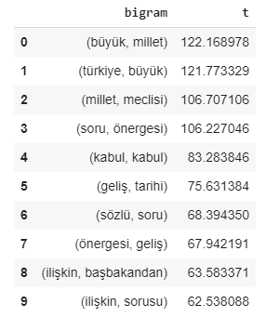
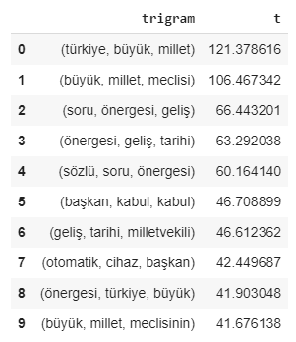
DONEM20

Slide 16
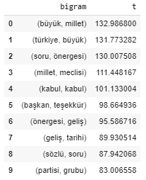
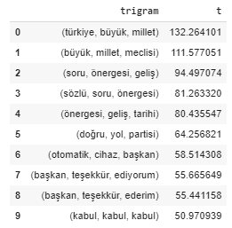
DONEM21

Slide 17
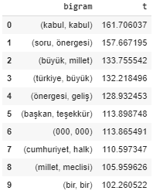
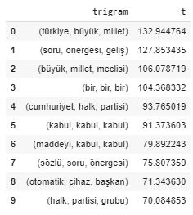
DONEM22

Slide 18
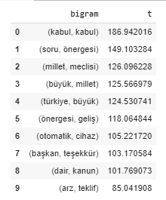
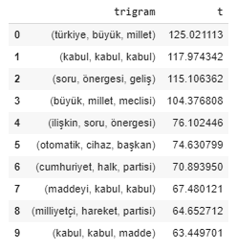
DONEM23

Slide 19
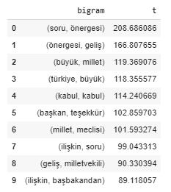
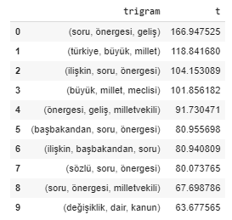
DONEM24

Slide 20
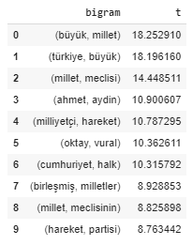
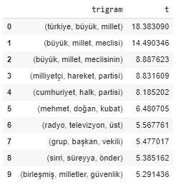
DONEM25

Slide 21
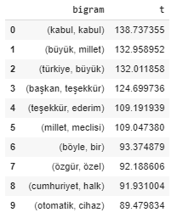
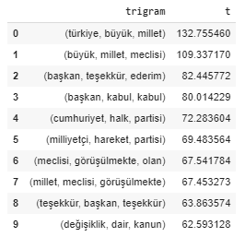
DONEM26

Slide 22
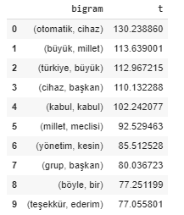
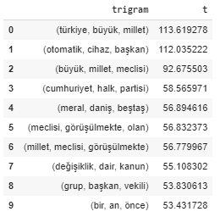
DONEM27

Slide 23
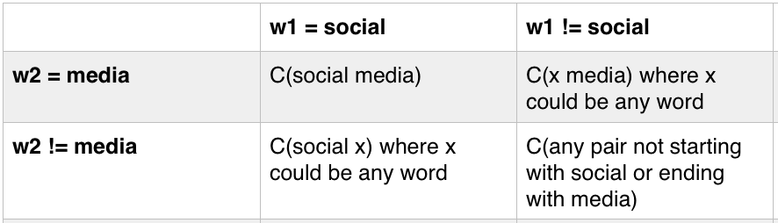
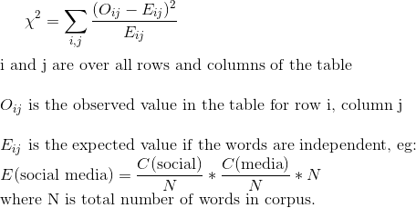
Method 3: Chi-Square Test
First, we compute a table like that for each word pair:
The chi-square test assumes in the null hypothesis that words are independent, just like in t-test. The chi-square test statistic is computed as:

Slide 24
Code Detail of Chi-Square
_product = lambda s: reduce(lambda x, y: x * y, s)
_SMALL = 1e-20
NGRAM = 0 #Marginals index for the ngram count
UNIGRAMS = -2 #Marginals index for a tuple of each unigram count
TOTAL = -1 #Marginals index for the number of words in the data
@classmethod
def chi_sq(cls, *marginals):
cont = cls._contingency(*marginals) #Calculates values of a contingency
table from marginal values
exps = cls._expected_values(cont) #Calculates expected values for a contingency table
return sum((obs - exp) ** 2 / (exp + _SMALL)
for obs, exp in zip(cont, exps))

Slide 25
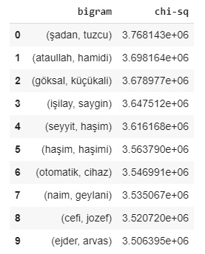
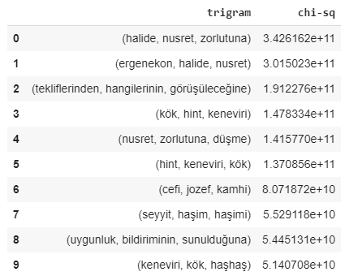
DONEM20

Slide 26
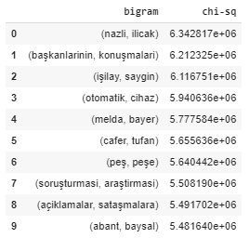
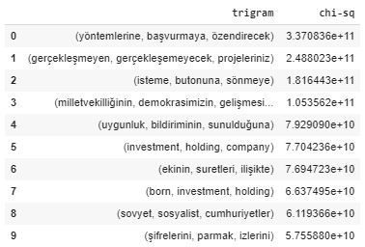
DONEM21

Slide 27
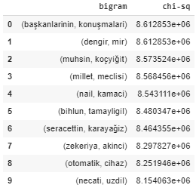
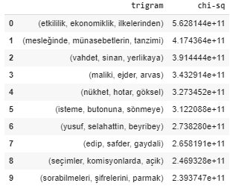
DONEM22

Slide 28
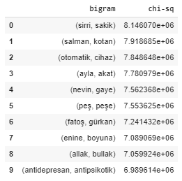
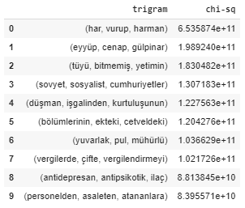
DONEM23

Slide 29
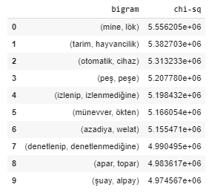
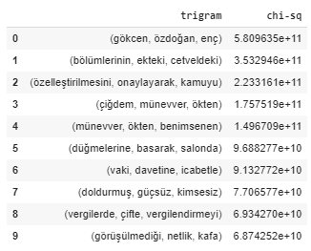
DONEM24

Slide 30
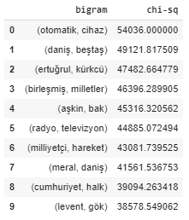
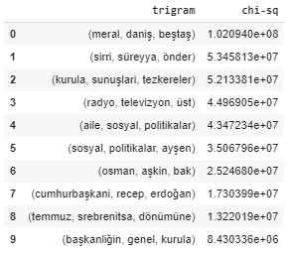
DONEM25

Slide 31
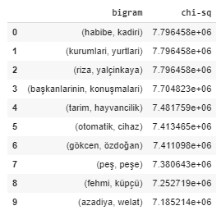
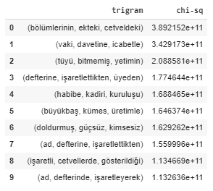
DONEM26

Slide 32
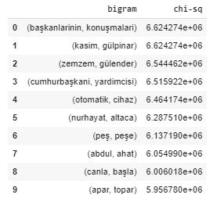

DONEM27

Slide 33

Comparison Bigrams for Donem20

Slide 34

Comparison Trigrams for Donem20

Slide 35

Comparison Bigrams for Donem21

Slide 36

Comparison Trigrams for Donem21

Slide 37

Comparison Bigrams for Donem22

Slide 38

Comparison Trigrams for Donem22

Slide 39

Comparison Bigrams for Donem23

Slide 40

Comparison Trigrams for Donem23

Slide 41

Comparison Bigrams for Donem24

Slide 42

Comparison Trigrams for Donem24

Slide 43

Comparison Bigrams for Donem25

Slide 44

Comparison Trigrams for Donem25

Slide 45

Comparison Bigrams for Donem26

Slide 46

Comparison Trigrams for Donem26

Slide 47

Comparison Bigrams for Donem27

Slide 48

Comparison Trigrams for Donem27

Slide 49
ALL CORPUS
RESULTS

Slide 50


ALL CORPUS (PMI)

Slide 51


ALL CORPUS (T-Test)

Slide 52


ALL CORPUS (Chi-Square)

Slide 53
ALL CORPUS (PMI)

Slide 54
ALL CORPUS (T-Test)

Slide 55
ALL CORPUS (Chi-Square)

Slide 56


ALL CORPUS (Bigrams)
biagram result of previous part

Slide 57


ALL CORPUS (Trigrams)
trigram result of previous part

Slide 58
Comparison Results
We can see that T-test method give very good results. These results are also very similar with our n-grams results. Frequency and T-test methods are also similar. When we compare the T-test results with n-gram results, we can say that PMI and Chi-Square methods did not give successful results. We can also run different tests to see which list makes the most sense for a particular dataset. Alternatively, we can combine results from multiple lists. We find it effective to multiply T-test and frequency, taking into account both the probability increase and the frequency of its occurrence.

