Slide 1
Intro to NLP
#sentiment-classification
150116884 Esra Polat
150116071 Nur Deniz Çaylı
150116028 Minel Saygısever

Slide 2









Detail of Implementation
This program was implemented with Python 3.6 on the Kaggle Notebook using the below libraries and compiled with GPU. We used the openly shared github codes of scientific conference or journal publications.

Slide 3
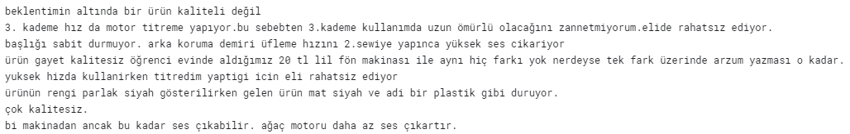
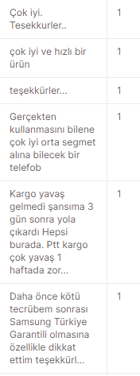
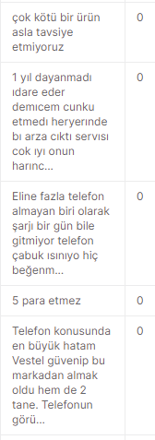
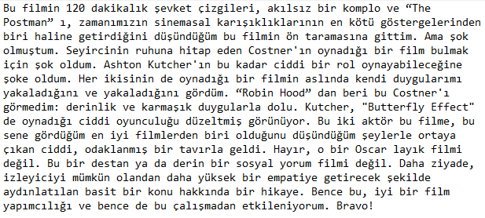
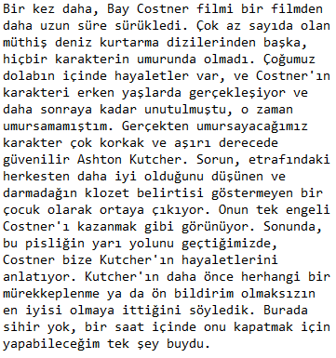
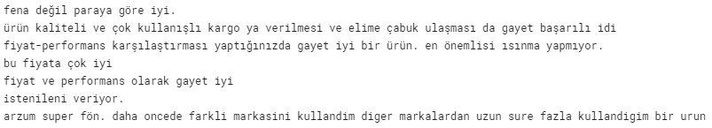
Detail of Dataset
We used the combine of three datasets.
The first dataset is about product comments. The second dataset is about IMDB comments and the last dataset is again product comments. They contain a text column and a sentiment column. We combined them and created one big dataset.

Slide 4
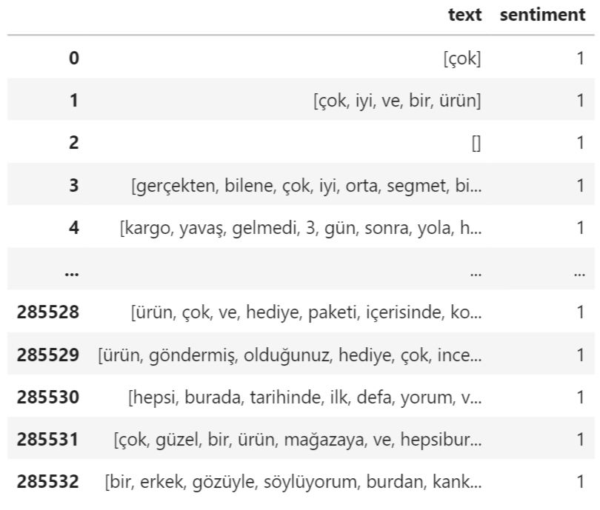
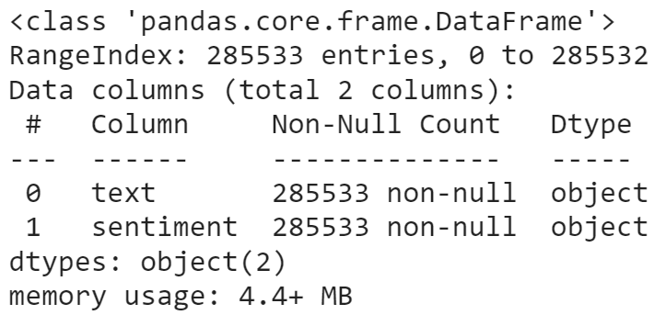
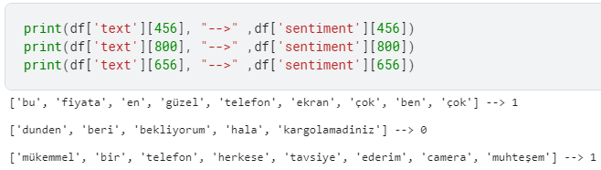
View Dataset
Our new dataset
is 285533 x 2 matrix.

Slide 5
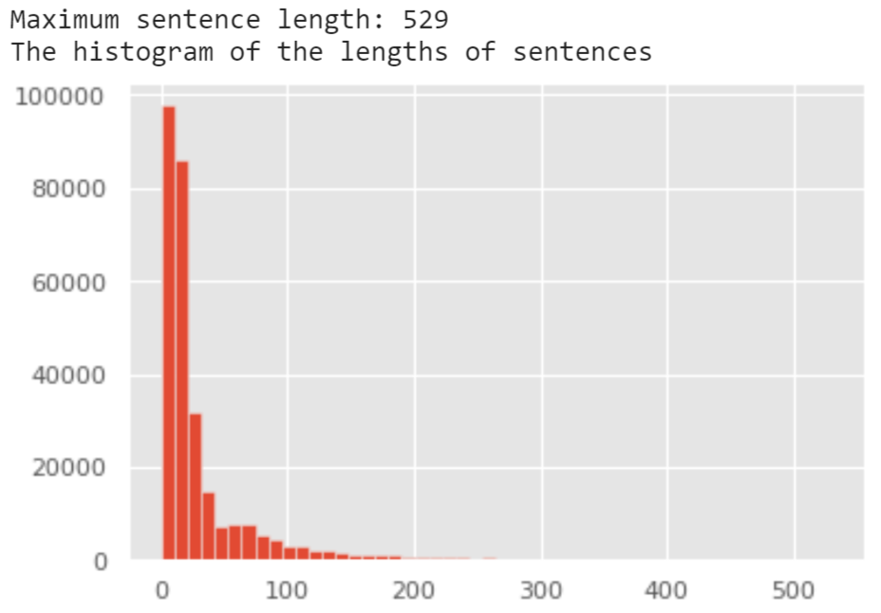
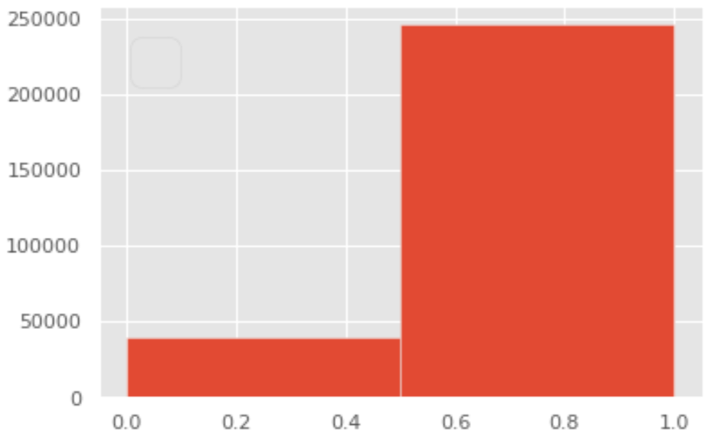
View Dataset
The length of sentiments
The length of texts

Slide 6
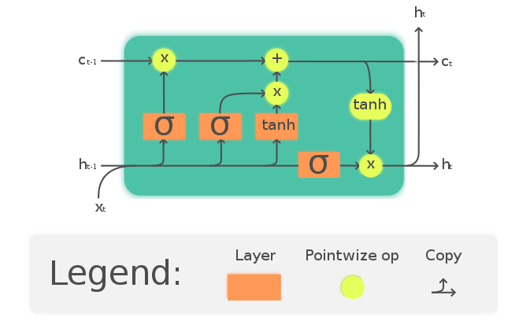
LSTM (Long Short-Term Memory)
Long short-term memory (LSTM) is an artificial recurrent neural network (RNN) architecture^{[1]} used in the field of deep learning. Unlike standard feedforward neural networks, LSTM has feedback connections. The Long Short-Term Memory (LSTM) cell can process data sequentially and keep its hidden state through time.

Slide 7
Our Model (LSTM)
max_fatures = 236141
tokenizer = Tokenizer(num_words=max_fatures, split=' ')
tokenizer.fit_on_texts(df['text'].values)
X = tokenizer.texts_to_sequences(df['text'].values)
X = pad_sequences(X)
embed_dim = 128
lstm_out = 196
model = Sequential()
model.add(Embedding(max_fatures, embed_dim,input_length = X.shape[1]))
model.add(SpatialDropout1D(0.4))
model.add(LSTM(lstm_out, dropout=0.2, recurrent_dropout=0.2))
model.add(Dense(2,activation='softmax'))
model.compile(loss = 'categorical_crossentropy', optimizer='adam',metrics = ['accuracy'])
print(model.summary())
Y = pd.get_dummies(df['sentiment']).values
X_train, X_test, Y_train, Y_test = train_test_split(X,Y, test_size = 0.33, random_state = 42)
print(X_train.shape,Y_train.shape)
print(X_test.shape,Y_test.shape)
model.fit(X_train, Y_train, epochs = 7, batch_size=256, verbose = 1)

Slide 8
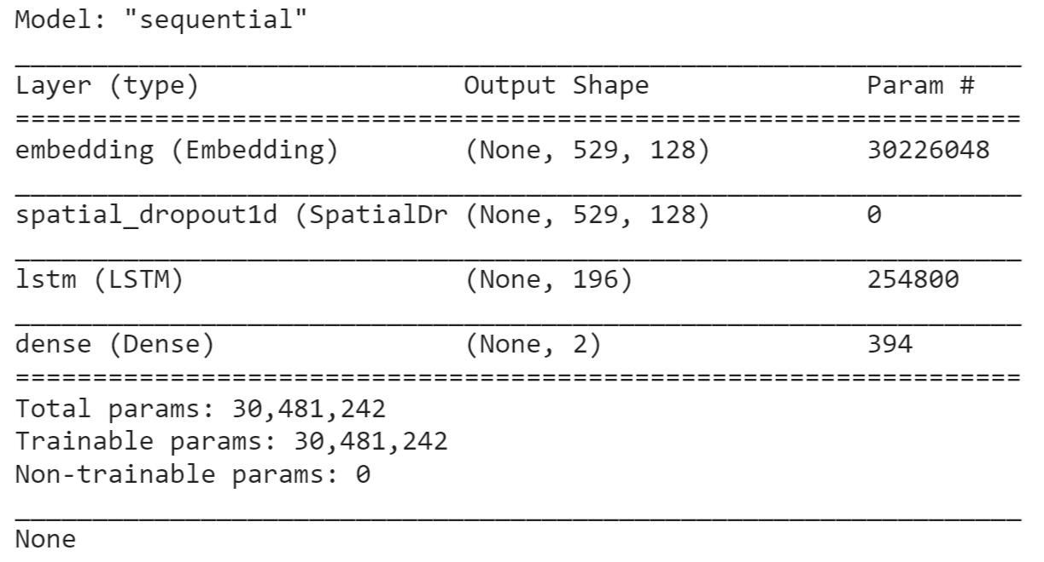
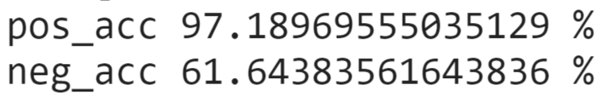
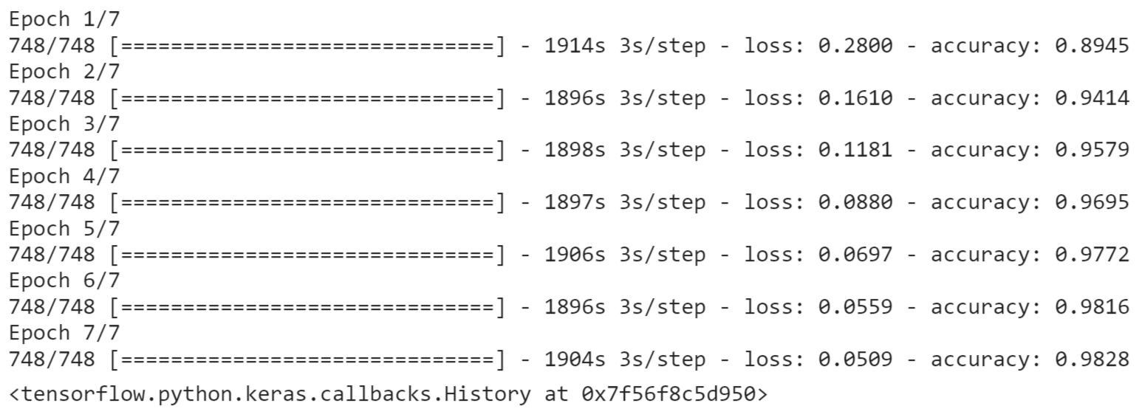
detail of model

Slide 9
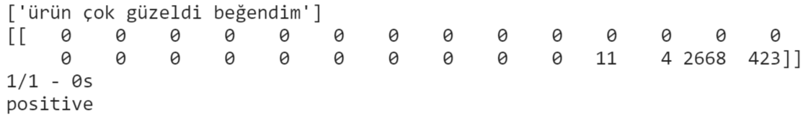
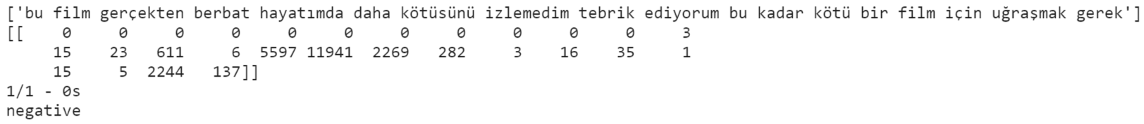
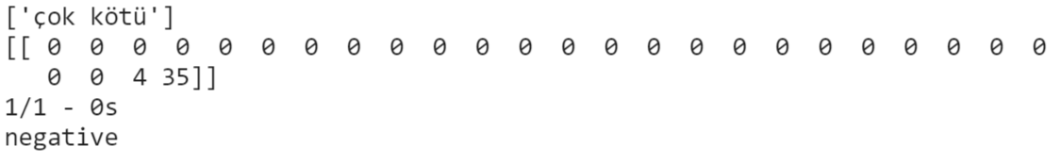
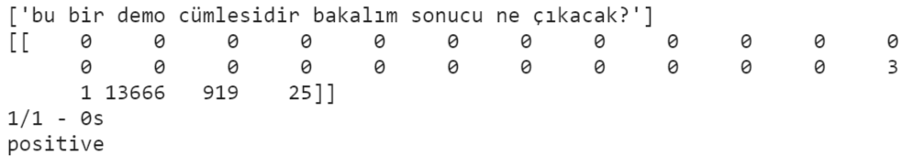
a few example

Slide 10
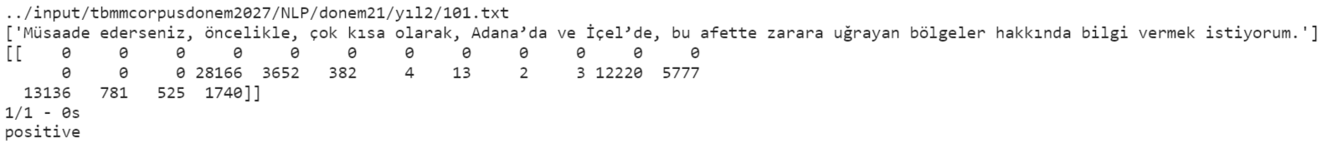
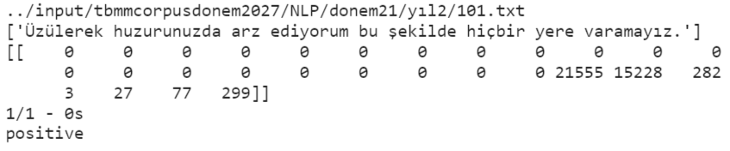
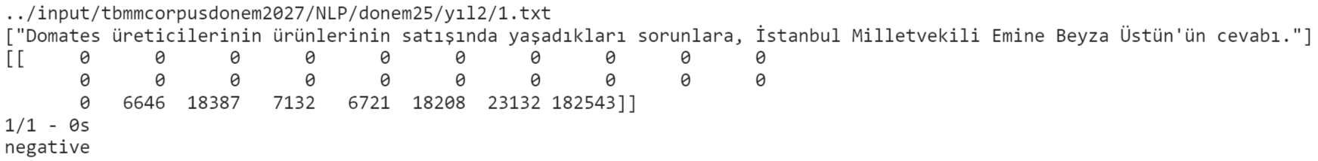
A few Observation with TBMM Corpus

Slide 11
Utilized Resources
Sentiment Analysis
Sentiment Analysis in Turkish Text with Machine Learning Algorithms
Long Short Term Memory (LSTM)

